Slide 1
Midterm Review
Xiaoli Yang

Slide 2
Short Answer
A synchronization mechanism that has two components, one that blocks if its value is 0 and continues if not, and one that increments the value, is a semaphore.
A file that contains only the name of another file that the operating system uses to locate the file is a symbolic link.
The difference between deadlock and starvation is that deadlock occurs when multiple processes block, each waiting on another, and starvation occurs when a process is waiting for a resource that occasionally becomes available but never acquires it.

Slide 3
Short Answer
Which of the following is not required for deadlock to occur:
(a) Hold and wait
(b) Mutual exclusion
(c) Unbounded wait
(d) No preemption
(e) Circular wait

Slide 4
Matching
E Context switching A. Entry points to the operating system so a process can use OS services
I Critical section B. A process that is not running but is waiting for some event
K Multiprogramming C. Unused memory space when processes that fit into the total unused memory could run
A System calls D. Scheduling algorithm that executes processes in the order of arrival
J Fence address E. Changing the executing process from one to another
C Fragmentation F. Scheduling algorithm that runs a program by a specified time or rejects the process
D First come, first serve G. The number of processes run in a given period of time
F Deadline scheduling H. Ability to remove currently running processes from CPU and start another
L Synchronous send I. Block of code only one process at a time can execute
H Pre-emptive J. Separates operating system from processes
K. Many processes run interleaved on one system
L. Process blocks until it can send a message

Slide 5
Longer answer
A distributed system using mailboxes has two IPC primitives send and receive. The latter primitive specifies a process to receive from, and blocks if no message from that process is available, even though messages may be waiting from other processes. There are no shared resources, but processes need to communicate frequently about other matters. Is deadlock possible? If so, how? If not, show why it cannot occur.
Suppose there are 3 processes A, B, and C.
Process A sends a message to process B and then does a receive on process B to obtain a reply.
Process B sends a message to process C and then does a receive on process C to obtain a reply.
Process C sends a message to process A and then does a receive on process A to obtain a reply.
This is a classic deadlock.

Slide 6
Longer answer
The semaphore operations wait and signal are defined to be atomic. Why? Give an example to show the problem if they are not atomic.
If not, they will no longer implement mutual exclusion. For example, if a process executes a wait at the same time as another process executes an signal on the same semaphore, the first may block indefinitely due to the interleaving of the decrement in the wait and the increment in the signal.
Here’s an example. Recall
signal(sem): sem := sem + 1
wait(sem): if sem = 0 then block
sem := sem - 1
Suppose process 1 executes a wait on semaphore sem, and process 2 executes a signal on sem. If wait and signal are atomic, then either process 1 executes signal, so sem becomes 2, and then process 2 enters the wait, decrements sem to 1, and continues; or process 2 enters the wait and blocks, process 1 adds 1 to sem, and then process 2 decrements sem, and continues. In either case, both processes continue and sem is 1.

Slide 7
Longer answer
The semaphore operations wait and signal are defined to be atomic. Why? Give an example to show the problem if they are not atomic.
Then consider the following order, in which sem is initially 1, as before:
Process 2 tests sem; it is not 0, so process 2 proceeds to the next line
Process 1 retrieves the value of sem (which is 1), and adds 1 to it, getting 2
Process 2 retrieves the value of sem (which is 1), and subtracts 1 from it, getting 0
Process 1 stores its computed value of sem, so sem is 2
Process 2 stores its computed value of sem, so sem is 0
So both processes continue, but sem is 0 when it should be 1. If you reverse the order of the last two lines, then
sem will be 2 when it should be 1. Either way, the value of sem is wrong.

Slide 8
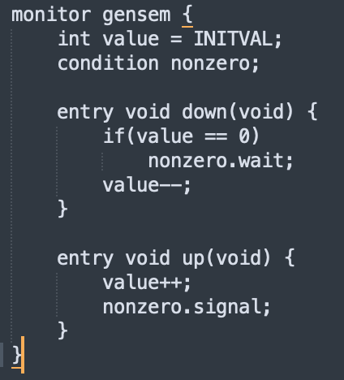
Longer answer
In class, we showed how to use semaphores to define monitors. This problem reverses this — show how to use monitors to implement general semaphores.

