Slide 1
Do fine-tuned VLM reward models give a better reward for robot RL?
We fine-tune vision-language reward models (Robometer-4B, Qwen3.5) and evaluate them as the reward signal for image-based reinforcement learning (IBRL) on a MetaWorld manipulation task.
Offline reward quality · downstream RL performance · why the two diverge

Slide 2
1 The problem: VLM rewards do not transfer to RL
SPARSE REWARD
≤ 0.13
peak task success on CoffeePush — every model, every β / threshold
DENSE REWARD
≤ 0.10
switching to a dense per-step reward does not help (Qwen3.5 diverged)
• With the same RL algorithm, task, and demonstrations, an oracle (ground-truth) reward trains the policy to 0.48–0.76 success. Every VLM reward — sparse or dense — caps near 0.1.
• The reward model, not the RL setup, is the bottleneck. The rest of this talk asks why, and whether fine-tuning helps.

Slide 3
2 Trajectory ranking — out-of-distribution
model | success AUC · success head | rank-acc (sum) · progress head | Kendall-τ · progress head
Robometer-4B (off-the-shelf) | 0.87 | 0.81 | 0.64
Robometer-FT 4B (asym + ICL) | 0.60 | 0.66 | 0.32
Robometer-FT 4B (asym) | 0.56 | 0.66 | 0.29
Robometer-FT 4B (standard loss) | 0.54 | 0.49 | -0.05
Qwen3.5-FT (asym + ICL) | 0.66 | 0.48 | -0.02
Qwen3.5-FT (asym) | 0.69 | 0.55 | 0.07
Qwen3.5-FT (standard loss) | 0.58 | 0.60 | 0.13
On held-out robots, the off-the-shelf baseline ranks trajectories best on every metric; fine-tuning on our data reduces out-of-distribution ranking. (Baseline reproduces the published Robometer numbers.)

Slide 4
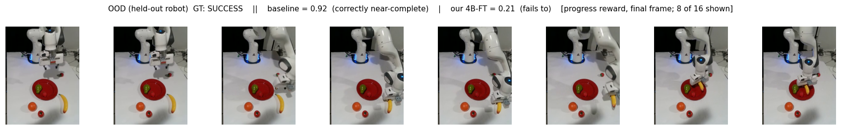
2 Out-of-distribution — a concrete failure of the fine-tuned model
• A successful trajectory on a held-out robot (unseen embodiment). The progress head reads the final frame: the baseline correctly recognises task completion (0.92); the fine-tuned model does not (0.21).
• Fine-tuning on a narrower data distribution costs generalisation to unseen embodiments.
(Progress head, scale 0–1; both models scored all 16 frames — 8 shown.)

Slide 5
3 Trajectory ranking — in-distribution
model | rank-acc (no ICL) | Kendall-τ (no ICL) | rank-acc (+ ICL) | Kendall-τ (+ ICL)
Robometer-4B (off-the-shelf) | 0.611 | 0.437 | 0.625 | 0.397
Robometer-FT 4B (asym + ICL) | 0.821 | 0.707 | 0.896 | 0.818
Robometer-FT 4B (asym) | 0.846 | 0.692 | 0.731 | 0.741
Robometer-FT 4B (std loss) | 0.771 | 0.591 | 0.747 | 0.672
Qwen3.5-FT (asym + ICL) | 0.834 | 0.669 | 0.842 | 0.676
Qwen3.5-FT (asym) | 0.743 | 0.412 | — | —
Qwen3.5-FT (std loss) | 0.813 | 0.617 | — | —
In-distribution, the fine-tuned 4B models rank best (progress head). In-context demonstrations (ICL) give a small additional gain for the models trained with them. Numbers reproduce the training-time evaluation exactly.
In-context demos help the models trained with ICL (run1, run4); for the 4B no-ICL models they are roughly neutral. (Qwen3.5 no-ICL in-context rows pending — a Qwen3.5-specific harness ICL issue is under investigation.)

Slide 6
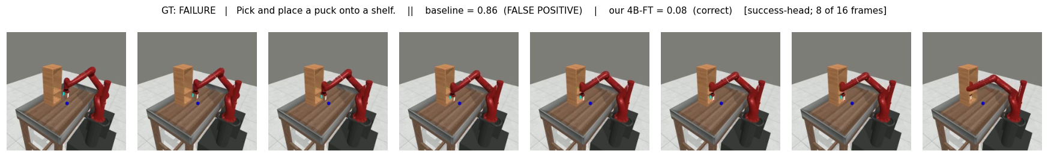
3 In-distribution — where fine-tuning wins
• A failed attempt — the puck never reaches the shelf. The baseline scores it a success (0.86) — a false positive; the fine-tuned model correctly rejects it (0.08).
• These false positives are exactly what a policy learns to exploit — the next section.
(Success head, 0–1; standard external camera, not the wrist view; 8 of 16 frames shown.)

Slide 7
4 Offline quality — success head (the reward IBRL uses)
model | AUPRC | TPR @ 5% FPR | ROC-AUC
Robometer-4B (off-the-shelf) | 0.67 | 0.24 | 0.67
Robometer-FT 4B (asym + ICL) | 0.91 | 0.55 | 0.88
Robometer-FT 4B (asym) | 0.89 | 0.54 | 0.88
Robometer-FT 4B (std loss) | 0.88 | 0.51 | 0.87
Qwen3.5-FT (asym + ICL) | 0.69 | 0.23 | 0.69
Qwen3.5-FT (asym) | 0.65 | 0.15 | 0.64
Qwen3.5-FT (std loss) | 0.64 | 0.14 | 0.65
• The success head is what the deployed reward reads. The fine-tuned 4B models clearly beat the baseline — AUPRC 0.88–0.91 vs 0.67, and at a strict 5% false-positive budget they recover 0.51–0.55 vs 0.24.
TPR @ 5% FPR is the operating point that matters for RL: catch successes without rewarding failures.

Slide 8
5 Offline quality — progress head (class separation)
model | TPR @ 5% FPR | gap (succ−fail) | pooled σ | d′ = gap / σ
Robometer-4B (off-the-shelf) | 0.22 | +0.13 | 0.31 | 0.42
Robometer-FT 4B (asym + ICL) | 0.89 | +0.48 | 0.31 | 1.54
Robometer-FT 4B (asym) | 0.91 | +0.41 | 0.31 | 1.31
Robometer-FT 4B (std loss) | 0.19 | +0.14 | 0.13 | 1.08
Qwen3.5-FT (asym + ICL) | 0.73 | +0.19 | 0.36 | 0.54
Qwen3.5-FT (asym) | 0.84 | +0.10 | 0.39 | 0.27
Qwen3.5-FT (std loss) | 0.09 | +0.04 | 0.13 | 0.32
• Separation of success vs failure by the progress head. The fine-tuned 4B models separate the classes far better than the baseline (d′ 1.3–1.5 vs 0.42). The asymmetric loss compresses the score *scale* (small gap) but keeps — even improves — *separability* (high d′).
Note d′ ≈ 1.5 means the gap is only ~1.5 standard deviations — good, not perfect. The failure distribution's upper tail still crosses any usable threshold, so a residual false-positive rate is built in (≈5% offline).

Slide 9
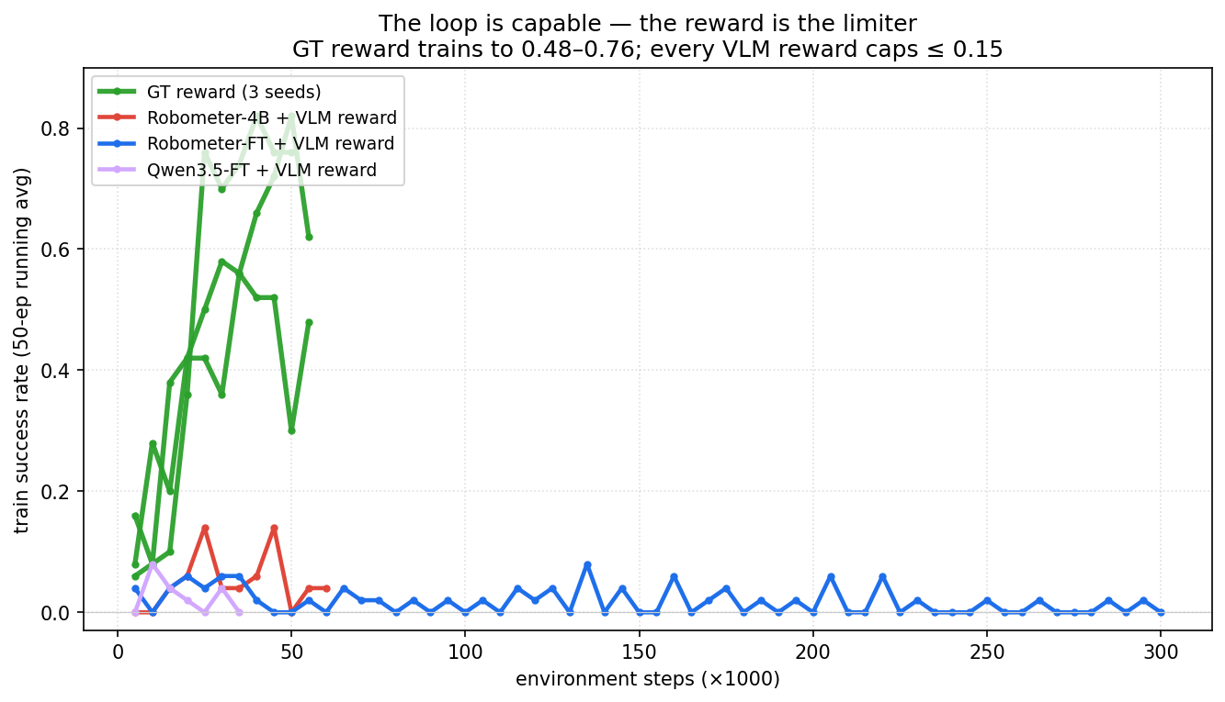
6 Downstream RL — the reward is the limiter
ORACLE REWARD
0.48–0.76
3 seeds, same RL loop
VLM REWARD
≤ 0.13
every model, every config
• Replacing the VLM reward with the simulator's ground-truth reward trains the policy to 0.48–0.76 on the identical loop, task, and demonstrations.
• So the limitation is the reward's usable signal, not the RL algorithm or the task.

Slide 10
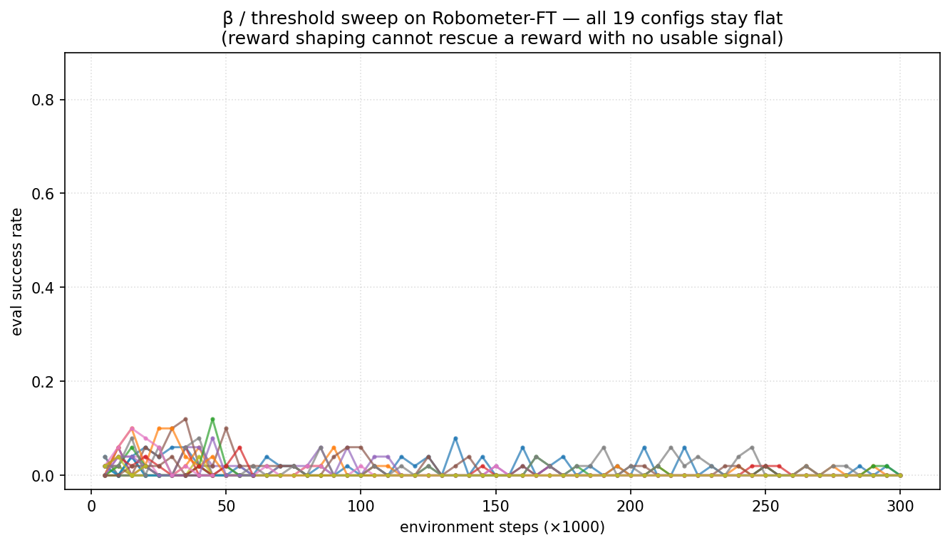
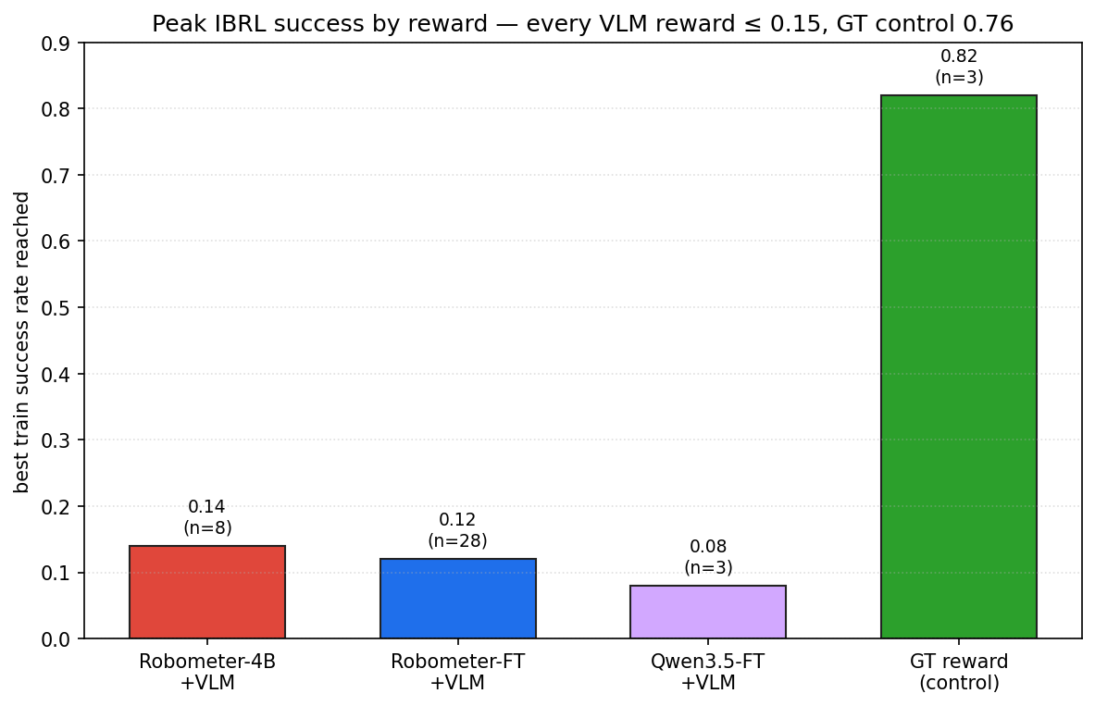
7 Reward shaping does not break the ceiling
• Left: a full reward-weighting and threshold sweep on the fine-tuned model — all flat. Right: peak success per model — every VLM reward stays ≤ 0.13, against the oracle control at 0.82.

Slide 11
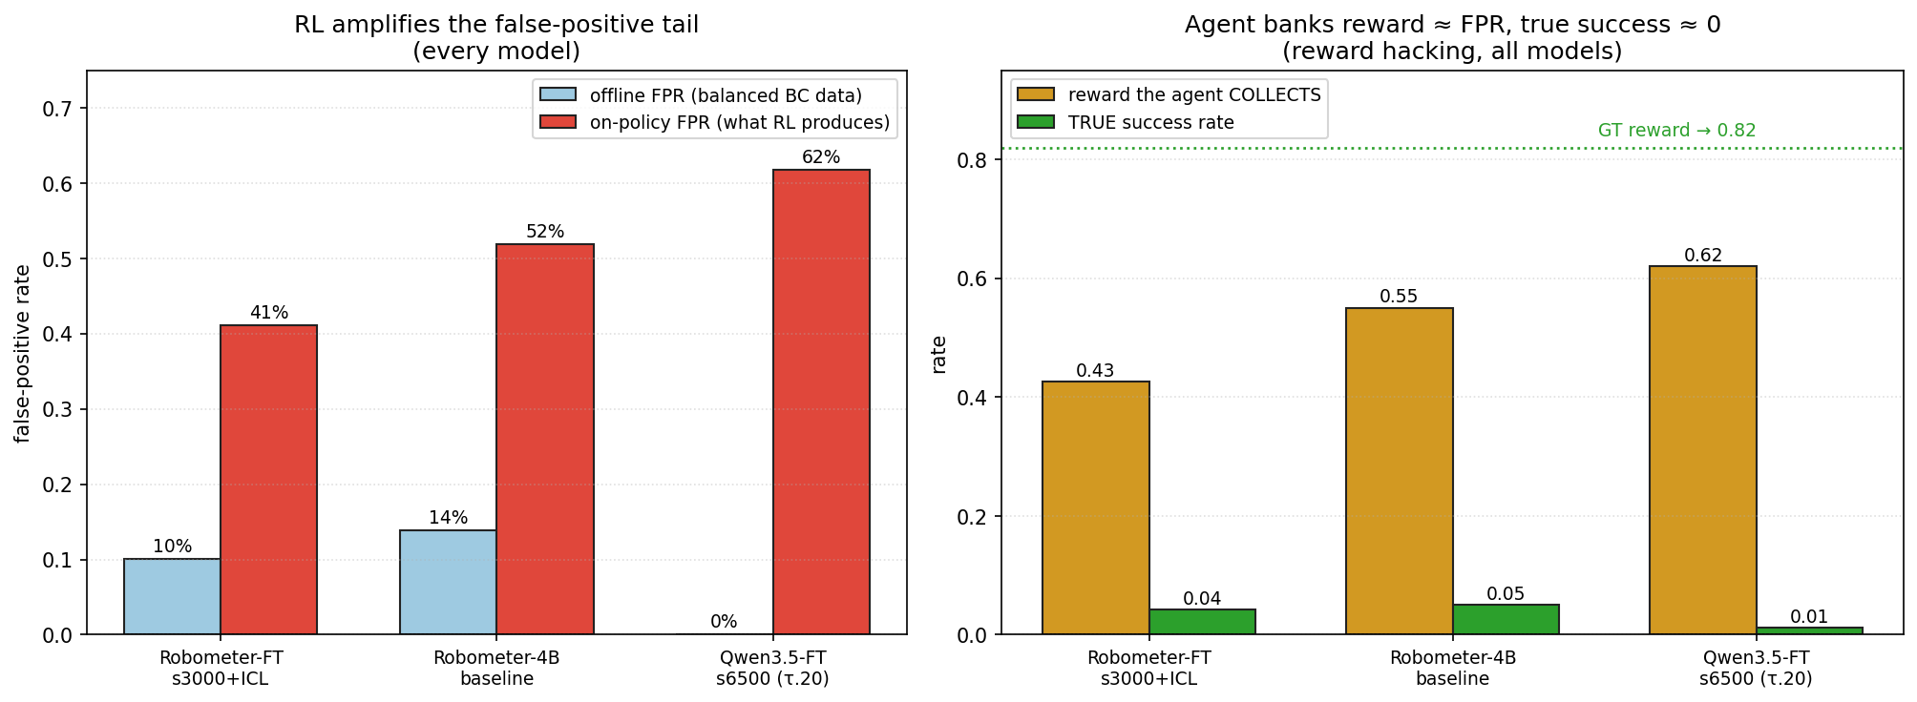
9 RL amplifies the exploitable false positives
• The reward's mistakes form a consistent, findable pattern. RL is an optimiser, so the policy learns to trigger them: the false-positive rate grows from 14–17% offline to 41–62% on-policy for every model.
• The agent banks reward ≈ its false-positive rate while true success stays near 0–5% — classic reward hacking.

Slide 12
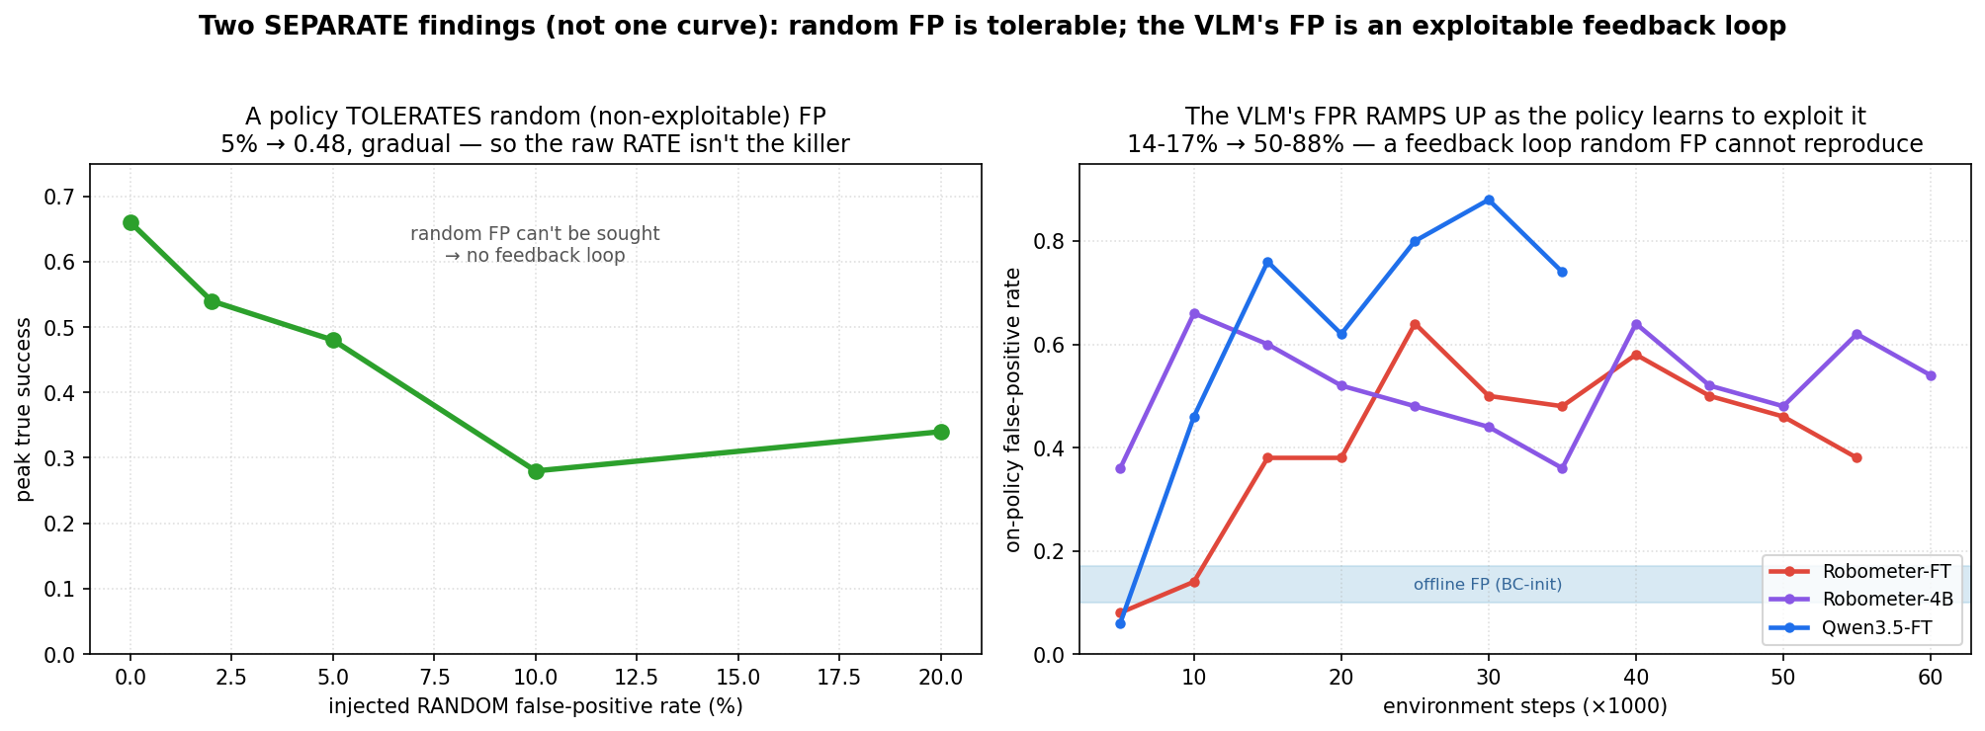
10 It is exploitability, not the raw error rate
• Controlled test: injecting *random* false positives into the oracle reward degrades performance only gradually (5% → 0.48) — a policy tolerates non-exploitable noise.
• The VLM's false positives are *structured*, so the policy locks onto them and the rate runs away — a self-reinforcing loop that random noise cannot reproduce.

Slide 13
11 A dense reward does not help either
dense per-step reward (β = 1, progress) | peak success | outcome
Robometer-4B (off-the-shelf) | 0.10 | flat — no learning
Robometer-FT 4B (ours) | 0.04 | flat — no learning
• We also tried a fully dense reward — the progress signal at every step instead of a sparse signal at the end. It caps at the same ~0.1 as the sparse reward.
• This is the key takeaway: the progress head separates classes well offline (d′ > 1), yet a dense progress reward still fails on-policy. The bottleneck is on-policy exploitation, not reward sparsity or offline quality — a dense reward simply gives the policy a smoother surface to exploit.

Slide 14
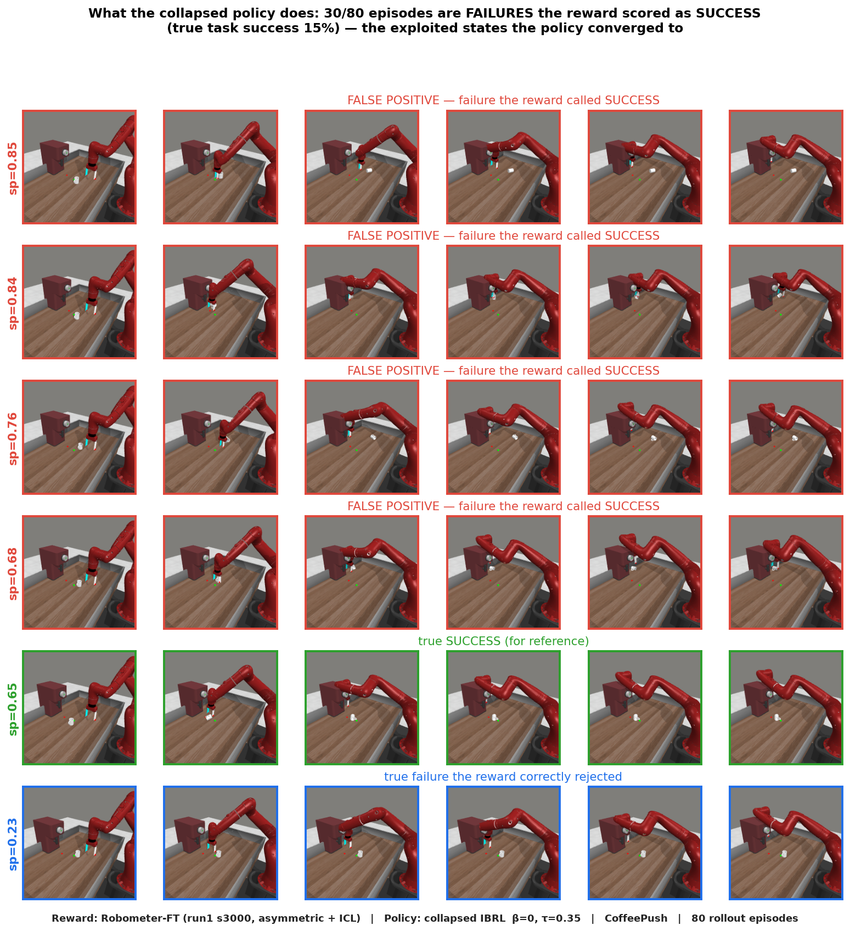
12 What the policy actually does
• We rolled out the collapsed policy (80 episodes). 44% of its failures are scored as success by the reward; true task success is 15%.
• The reward even prefers the exploited failures (score 0.68–0.85) to a genuine success (0.65) — the ranking inverts on-policy.
• The exploited states form a family — arm raised, object not delivered — that the reward over-scores. The policy parks there instead of completing the task.

Slide 15
13 Strong offline reward quality does not transfer on-policy
• The fine-tuned reward is excellent on the offline eval set, but its ability to tell success from failure decays as the data moves toward the policy's own distribution — to chance on live RL rollouts.
scoring distribution | success AUC
Offline eval set | 0.90
BC-policy rollouts | 0.66
On-policy (RL) rollouts | 0.55
same on-policy frames, re-scored as… | AUC
raw 224 (as the live env feeds them) | 0.47
h264 @ 224 (codec only) | 0.46
h264 @ 240 (full curated pipeline) | 0.56
jpeg @ 224 | 0.51
Robometer-FT, balanced set (135 successes / 65 failures from a competent GT-trained policy) — trustworthy n.
• Pushing the live frames through the exact curated-data pipeline (codec + resolution) does not recover it — every variant stays at chance.
• So the offline→online gap is a genuine content/distribution shift, not a preprocessing artifact. Offline reward metrics (AUC, ECE, d′) do not predict on-policy usefulness.

Slide 16
∑ Summary
1. Fine-tuning improves the offline reward in-distribution — higher success-head AUPRC and TPR, and better class separation (d′ 1.3–1.5 vs 0.42) than the off-the-shelf baseline.
2. It trades this for out-of-distribution generalisation — on held-out robots the baseline ranks better.
3. No VLM reward — fine-tuned or not, sparse or dense — trains the policy. All cap near 0.1; the oracle reward reaches 0.48–0.76 on the same loop.
4. The cause is on-policy reward hacking, not offline quality. The reward separates classes offline (AUC 0.89), but its structured false positives are exploitable, so RL amplifies them (14–17% → 41–62%).
5. Implication: offline reward metrics do not predict downstream RL usefulness. The next step is on-policy reward correction — relabel the false positives the policy discovers to break the exploitable loop.

