Slide 1
RoboRef
A Foundation Reward Model
MSc Artificial Intelligence · Thesis defence
Platon Karageorgis

Slide 2
Outline
01 Robometer — the current state of the art
02 Dataset — what RBM-1M is, where it falls short
03 Contribution — dense per-frame failure annotation
04 Loss functions — three candidate objectives
05 Training strategy — LoRA bake-off
06 Results — test-set comparison and calibration
07 Future steps

Slide 3
Robometer — the current state of the art for general-purpose reward modelling
Aliang et al., 2026 · 4-billion-parameter VLM reward model · trained on RBM-1M (~1.7M trajectories).
BACKBONE
THREE TASK HEADS
TRAINING SIGNAL
Qwen3-VL-4B-Instruct
progress · success · preference
Frame-level + trajectory-level
Multi-image vision–language transformer. Inputs: trajectory frames + task instruction. Outputs are pooled per frame into a per-frame hidden state.
Progress: 10-bin C51 distribution over [0,1]. Success: per-frame binary logit. Preference: pairwise ranking score for trajectory comparison.
Progress on successes via t/T heuristic. Failures supervised only by the preference head via paired comparisons. No dense per-frame failure labels.
DATASET (RBM-1M)
EVALUATION PARADIGM
OPEN QUESTION FOR DOWNSTREAM RL
~1.7M trajectories · 93 archives
Reward alignment + policy ranking
False positives → reward hacking
Humanoid, human-hand, and standard arms across diverse embodiments and tasks. Successes 8× more abundant than failures — heavy success bias.
Per-frame Spearman / Kendall on labelled progress. Ranking accuracy on held-out trajectory pairs across embodiments.
Reward overestimation on failure trajectories breaks RL fine-tuning. Robometer's preference-only failure supervision leaves this unaddressed.

Slide 4
Robometer's dataset — RBM-1M composition by embodiment family
1.69M trajectories from 93 archives — successes dominate; failures concentrate in standard arms.
AT A GLANCE
551k episodes
Humanoid
551k
8 archives
1.69M
Total episodes
1.48M
Successful trajectories
367k episodes
Human / human-hand
367k
11 archives
215.5k
Failure trajectories
774k episodes
Standard robot arms
558k
216k
93
74 archives
Archives scanned
0k
200k
400k
600k
800k
1000k
Episodes
68.9k
ICL pairs (failure → demo)
Successful trajectories
Failure trajectories

Slide 5
Contribution — dense per-frame failure annotation at scale
Two complementary annotation channels populate failures with the same ordinal scale that successes already enjoy.
SIMULATOR-DERIVED (Failsafe / MetaWorld)
VLM + LLM (DROID, Robometer Group A)
Procedural failure curriculum
Two-stage neural annotation pipeline
• Hand-crafted rubric injects 27 distinct failure modes per task.
• Stage 1 — Qwen3-VL describes each frame (objects, gripper state, sub-step status).
• Three tasks (pick / push / stack) and three viewpoints (front / side / wrist).
• Stage 2 — Qwen3-LLM scores progress on the rubric using descriptions + task prompt.
• Per-frame label derived from simulator state (gripper pose, object-to-goal distance).
• Decoupling vision from reasoning suppresses hallucinated rewards.
• Cleanest possible labels — used as the deciding evaluation split.
• Scales to ~10,500 real-world failure trajectories without human labelling.
≈ 2,900 episodes · 3 tasks · 3 cameras
≈ 5,500 DROID + ≈ 5,000 Robometer Group A
Labels: {1, 2, 3, 4, 5} — no progress → success
Labels: {1, 2, 3, 4} — failures only, paired with success demos

Slide 6
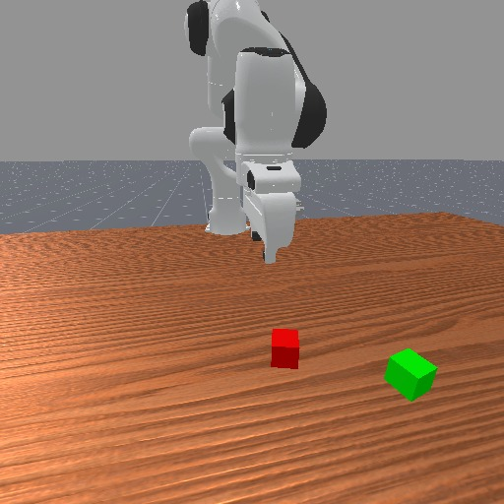
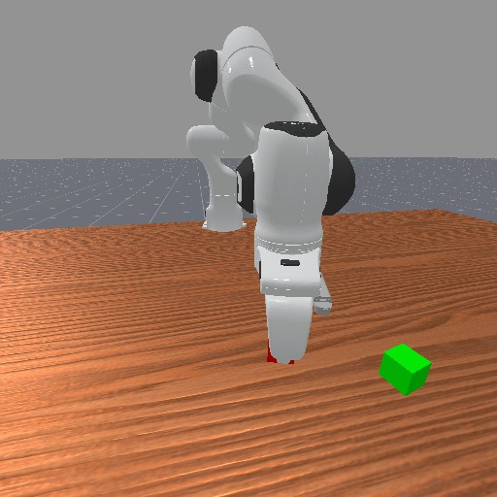
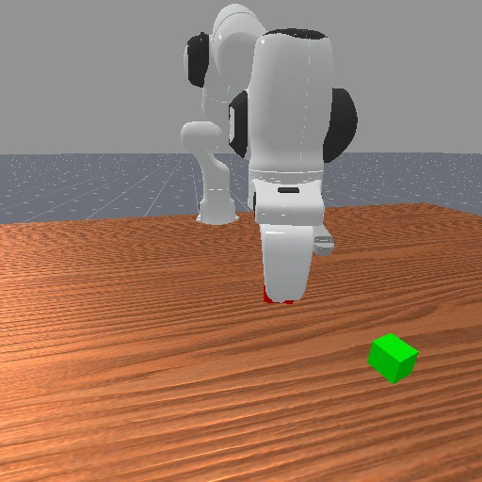
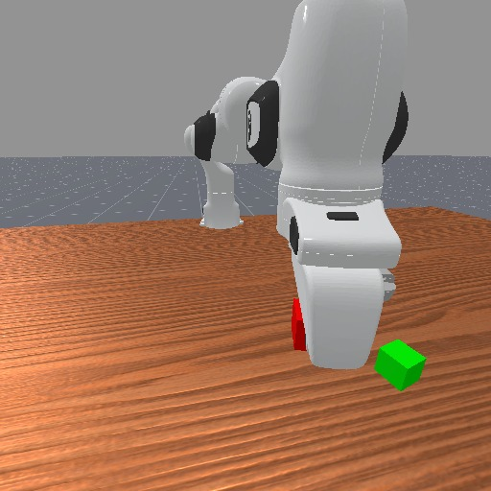











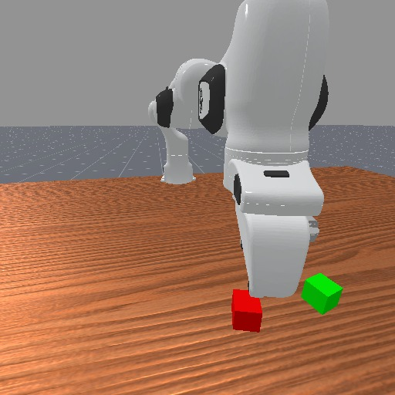
Failure annotation in simulation — Failsafe (ManiSkill, FailStackCube-v1)
Task: Pick up the red cube and stack it on top of the green cube.
Failure scenario: grasp + carry away without dropping · 16 keyframes · per-frame label from simulator state.
frame 00
frame 01
frame 02
frame 03
frame 04
frame 05
frame 06
frame 07
1
2
3
3
3
3
3
3
frame 08
frame 09
frame 10
frame 11
frame 12
frame 13
frame 14
frame 15
3
3
3
3
3
3
3
1
Per-frame ground-truth ordinal label
5
4
3
2
1
00
01
02
03
04
05
06
07
08
09
10
11
12
13
14
15
frame index

Slide 7
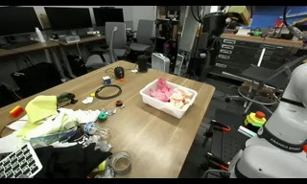
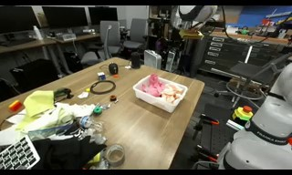
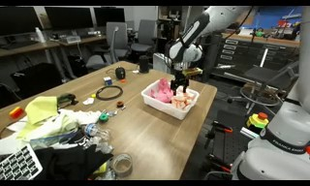
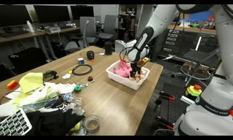
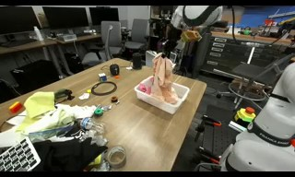
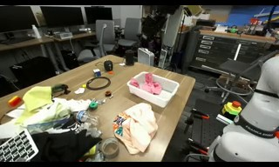
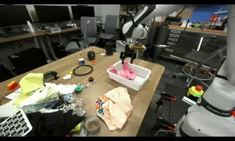
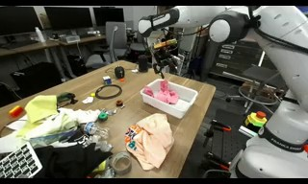
Failure annotation in the wild — DROID, two-stage VLM + LLM pipeline
Task: Take cloth pieces out of container.
Pipeline: Qwen3-VL describes each frame → Qwen3-LLM scores progress 1–4 on the rubric using description + task prompt.
frame 00
frame 02
frame 04
frame 06
frame 08
frame 10
frame 12
frame 14
1
1
2
3
3
4
4
4
LLM-assigned ordinal progress score per keyframe
4
3
2
1
00
02
04
06
08
10
12
14
Representative pipeline trace · frame 10 · score 4
VLM description: "Wooden table with pink container holding cloth pieces. Robotic arm with gripper is positioned above the container. Cloth has been grasped and lifted, with one piece now resting on the table next to the container."
LLM verdict: ANSWER: 4 because the robot has successfully removed the cloth from the container and placed it on the table, completing four of the six sub-steps.

Slide 8
Three candidate objective functions
Same backbone, same data, same LoRA setup — the only thing that varies is the loss applied to the heads.
Robometer (released baseline)
Loss 1 · Asymmetric ordinal CORN
Loss 2 · Asymmetric C51 + asymmetric BCE
Three independent heads · failures supervised only via preference learning.
Single ordinal head with cumulative thresholds · over-prediction penalised harder.
Both pretrained heads kept and trained · shared λ down-weights the under-prediction side of each loss.
progress C51 × 10
success binary
preference pairwise
CORN ordinal head 4 logits · P(y ≥ k)
progress C51 × 10 (asym. CE)
success binary (asym. BCE)
L = L_{progress} + L_{success} + L_{pref}
L = − Σ_{t,k} [ β_{k} · b_{t,k} · log σ(z_{t,k})
+ α_{k} · (1 − b_{t,k}) · log(1 − σ(z_{t,k})) ]
L_{prog} = w · CE(p, p*)
w = 𝟙[p̂ > p*] + λ · 𝟙[p̂ ≤ p*]
L_{succ} = BCE_{neg} + λ · BCE_{pos}
where
where
where
L^head — loss applied to the corresponding head
z_t,k — k-th cumulative-threshold logit at frame t (k = 2, 3, 4, 5)
p̂ — model's expected progress for the frame (continuous in [0, 1])
C51 CE — cross-entropy over the 10-bin progress distribution
σ(z_t,k) — = P(y_t ≥ k); sigmoid of the threshold logit
p* — target progress for the frame (rubric or t/T)
BCE — binary cross-entropy on the per-frame success logit
b_t,k — 1 if the true label y_t ≥ k, else 0
CE(·, ·) — Robometer's 10-bin progress CE; BCE is the per-frame success cross-entropy
rank — pairwise margin loss (Robometer's preference learning)
β_k = 1 — uniform positive-class weight
𝟙[·] — indicator function
α_k = 1 + c·(k−2) — negative weight grows with the threshold → false-success punished hardest
λ ∈ (0, 1] — shared down-weight: BCE_neg = mean BCE on y=0 frames, BCE_pos on y=1 frames; λ < 1 makes the model conservative (default 0.3)
Symmetric C51 / BCE · no supervision on failure progress · brittle as RL reward.
Single ordinal head · α_k > β_k makes it conservative · P(success) = σ(z_5).
Same λ on both heads · full penalty on over-prediction, λ on under-prediction · biases the model toward conservative success calls.

Slide 9
Training strategy
LoRA fine-tune of Robometer-4B on ~18,900 balanced (failure | success) ICL pairs.
In-context learning · per-example coin flip
Balanced batches · 50 / 50 success – failure
LoRA adapters on Robometer-4B
Each sample independently draws ICL on (prepend a success demo) or ICL off (query only) with p = 0.5. The demo defines what 'progress' means for this task.
Failure-query and success-query examples are constructed in equal numbers (~9.4k each). A stratified sampler enforces exact 50/50 within each batch after a short warmup.
rank 32, α = 64, dropout 0.05. Adapters on q/k/v/o + MLP gate/up/down. Backbone frozen, heads trained fully. bf16 forward, fp32 adapters & heads.
Optimisation schedule
Two-phase warmup
KL rehearsal anchor · planned, full fine-tune
AdamW · lr 1e-4 (adapters) · lr 5e-5 (heads) · weight decay 0.01. Linear warmup over 5% of steps → cosine decay to 10% of peak. 7,500 steps · batch 8 · grad-clip 1.0 · seed 42.
First N steps draw failure-only batches to bootstrap the ordinal head before exposing the model to successes. Loss 1: N = 2,000. Loss 2: N = 1,000.
FIFO buffer of past failure logits. On each success step sample one and add λ_KL · KL(P_old ∥ P_new) to prevent failure-prediction drift during success-heavy phases.

Slide 10
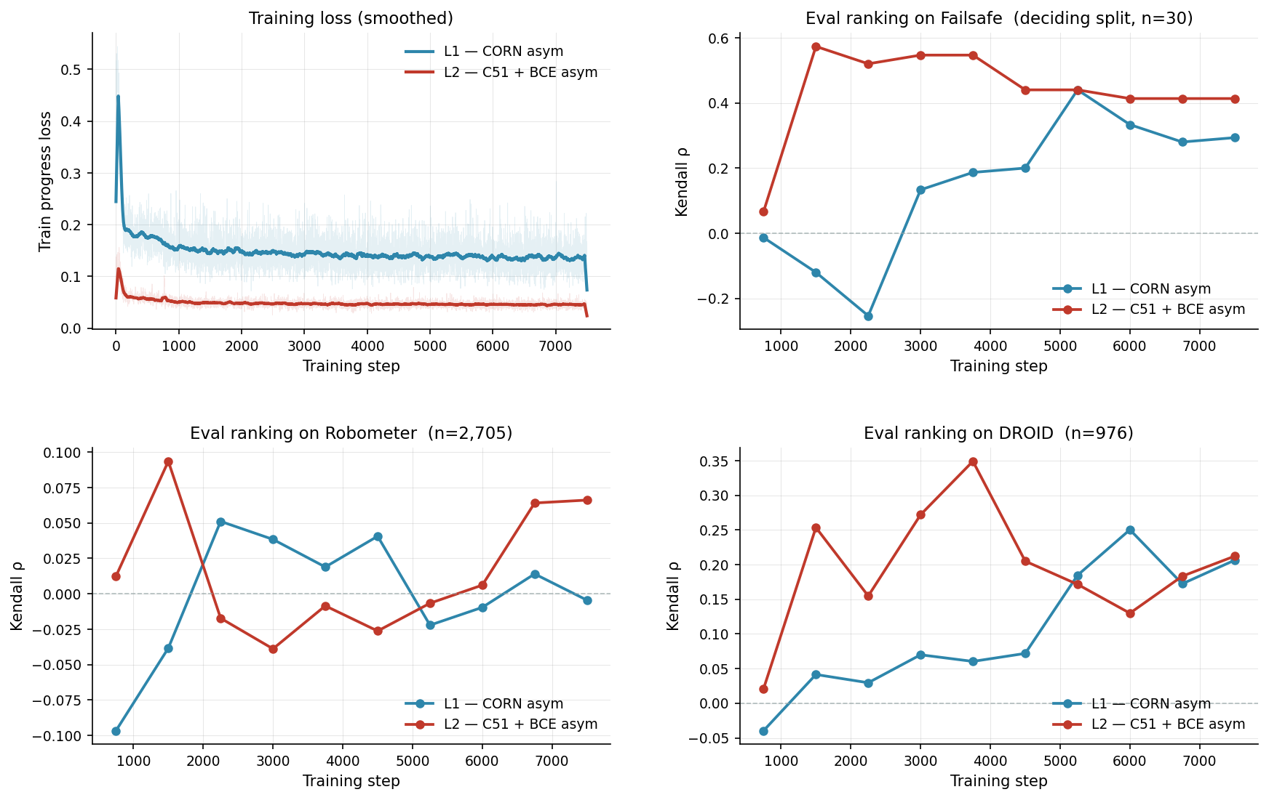
Training dynamics
Both runs converge cleanly · 10 evaluation rounds across 7,500 LoRA steps.
L2 plateaus on eval ranking by step ~1,500 · the pre-trained C51 head finds its footing fast. L1's randomly-initialised CORN head climbs more irregularly through training.

Slide 11
Test-set comparison · Baseline ranks well but is unsafe; L2 is calibrated and deployable
Each model evaluated on its trained success signal: success-head logit for Baseline and L2; σ(z_t,5) from CORN for L1.
Metric | Baseline | L1 | L2
ROC-AUC (success) | 0.855 ✓ | 0.651 | 0.783
FPR @ τ = 0.5 (lower = safer) | 0.195 ⚠ | 0.000 | 0.016 ✓
ECE (lower = better calibrated) | 0.155 | 0.026 | 0.020 ✓
Baseline · Best ranker but a 19.5% false-positive rate at the standard threshold — not deployable for RL without per-task threshold tuning.
L1 · Perfect FPR but ranks poorly (AUC 0.65) — its outputs are over-conservatised, almost never crossing 0.5 (revisited on the next slide).
L2 · The deployable winner: low FPR, calibrated probabilities, and competitive ranking.

Slide 12
How often does each model correctly identify a real success?
A reward model says 'success' when its confidence exceeds a threshold τ. Lower τ catches more successes but raises false alarms. Below: TPR (% of real successes caught) at two practical operating points.
Operating point | Baseline | L1 | L2
Safety-tuned (only 5% false alarms allowed) | catches 50% of successes | catches 6% | catches 62% ✓
Default threshold τ = 0.5 ('more likely than not') | 79% caught — but 20% false alarms ⚠ | 0% caught — model never confident enough to say 'success' | 61% caught, only 2% false alarms ✓
Baseline · Ranks well but lies confidently. At τ = 0.5 it claims 'success' on 20% of real failures — that is reward hacking. Making it safe requires hand-tuning τ per task.
L1 · Over-corrected. The asymmetric loss made it so cautious that its outputs cap below 0.5 — even on real successes, L1 says 'I'm only 30–40% sure.' Cannot separate successes from failures well.
L2 · Hit the sweet spot. At τ = 0.5 it correctly identifies 61% of successes with only 2% false alarms; at the deployment-tuned threshold it catches 62%, beating Baseline's 50%.
L2 is the only model that is both safe and useful at standard deployment settings.

Slide 13
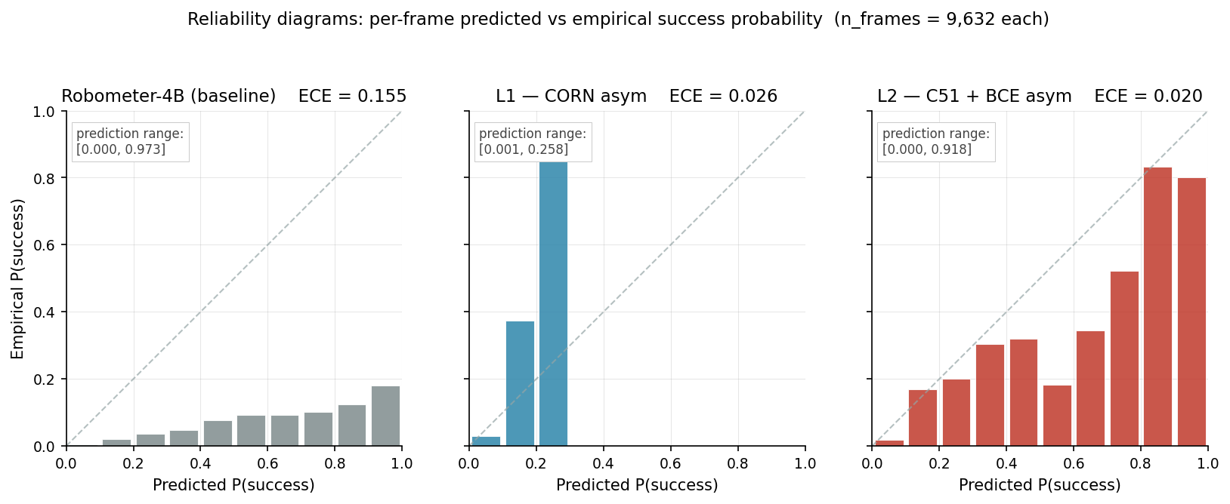
Why L2 works · its predictions actually mean what they say
A model's confidence is meaningful only if it matches reality. If the model says '70% confident' on 100 frames, ~70 of those should actually be successes. ECE measures how far off the model is.
Baseline
L1
L2
ECE = 0.155
ECE = 0.026
ECE = 0.020
off by 15.5 percentage points on average
6× better than Baseline
8× better than Baseline ✓
Baseline · Lies confidently. At '90%' the actual success rate is closer to 50%. Outputs span [0,1] but are systematically overconfident.
L1 · Honest within a narrow range. Outputs cap at ~0.43, but inside that range what L1 says is what you get. Honesty bought at the cost of expressiveness.
L2 · Honest across its full range. Predictions hug the diagonal — predicted-30% means actually-30%. This is what makes it deployable.
Each bar = a confidence bucket. Diagonal = honest. Below = overconfident. Above = underconfident.
L2's outputs are the only ones you can plug into an RL system as continuous probabilities without re-calibrating per task.

Slide 14
Future steps
01 Pick the winning loss
Lock the LoRA bake-off after the held-out evaluation finishes; commit to one objective for the rest of the work.
02 Explore further LoRA variants
Sweep rank, ICL probability, label-smoothing on failures, and the asymmetric weights c and λ on the chosen loss.
03 Pre-train rather than fine-tune
Replace the LoRA adapter on Robometer-4B with a from-scratch run on the dense-label dataset to test whether the new supervision is enough on its own.
04 GRPO with an unconstrained reward head
Drop the rubric quantisation entirely and let GRPO shape an unbounded scalar reward; benchmark against the ordinal head.
05 Submit to the RLC workshop
Target the upcoming Reinforcement Learning Conference workshop track with the bake-off + ablations.
06 Aim higher · CoRL conference (big bet)
Lift the result from a workshop note to a full CoRL submission. Requires at least two real-world robot experiments end-to-end as the reward signal, on top of the bake-off and ablations.

