Slide 1
Stabilizing the autonomous reward signal
Coffee-Push, same recipe; only the stabilization technique changes. A seed “collapses” when its success rate stays at zero.
Stabilization technique | Success rate | Collapsed seeds | Extra cost | Holds on 2nd task?
None — fixed threshold | 0.33 | 1 of 6 | — | no
Output sampling | 0.31 | 0 of 3 | none | untested
Self-ensemble (majority vote) | 0.43 | 1 of 5 | 4× scoring | weak
Gate + self-ensemble | 0.31 | 1 of 3 | 4× scoring | —
Minimum-length gate | 0.64 | 0 of 3 | none | yes (Box-Close 3/3)
The minimum-length gate gives the highest success with no collapsed seeds, adds no inference cost, and is the only technique that also holds on a second task. It simply ignores any “success” call made before the task could plausibly be finished.
Technique screening on Model A / Coffee-Push (3–6 seeds); the chosen gate is validated at 6 seeds on the next slides. Success rate = mean over seeds of each run’s last-3-evaluation average (20 episodes). No ground truth used in training.

Slide 2
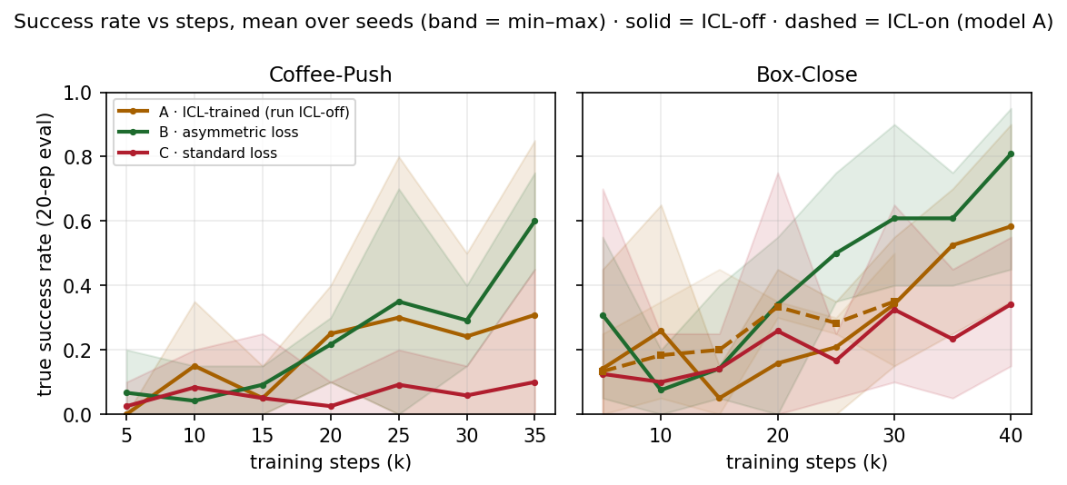
Isolating the gate, ICL, and the training loss
Success rate (seeds alive / total). Three reward models × two tasks.
Reward model · Task | ICL-off, no gate | ICL-off, gate | ICL-on, no gate | ICL-on, gate
A — ICL + asymmetric loss · Coffee-Push | 0.33 | 0.29 (3/6)
A — ICL + asymmetric loss · Box-Close | — | 0.48 (6/6)
B — asymmetric loss · Coffee-Push | 0.34 (3/3) | 0.48 (6/6) | n/a | n/a
B — asymmetric loss · Box-Close | 0.17 (3/3) | 0.68 (6/6) | n/a | n/a
C — standard loss · Coffee-Push | 0.09 (2/3) | 0.09 (2/6) | n/a | n/a
C — standard loss · Box-Close | 0.32 (2/3) | 0.30 (6/6) | n/a | n/a
Gate vs no gate isolates the gate (Box-Close 0.17 → 0.68 for B).
B vs C isolates the loss (asymmetric ≫ standard).
Trailing-mean over seeds (n = 6 gate / 3 no-gate). ICL applies to model A only.

Slide 3
Removing per-task threshold tuning: online calibration
Match the hand-tuned threshold with no per-task search.
Approach | Per-task tuning? | Needs demos? | Coffee / Box
Hand-tuned threshold (baseline) | yes | no | 0.48 / 0.68
Online demo-based (success-anchor) | no | yes | 0.51 / 0.37
Online demo-free (score-valley) | no | no | —
The demo-free method sets the bar from the live distribution of the model’s own scores, firing only when a distinct “success” cluster emerges — so it cannot be exploited the way a fixed threshold is, and needs neither labels nor demonstrations.

Slide 4
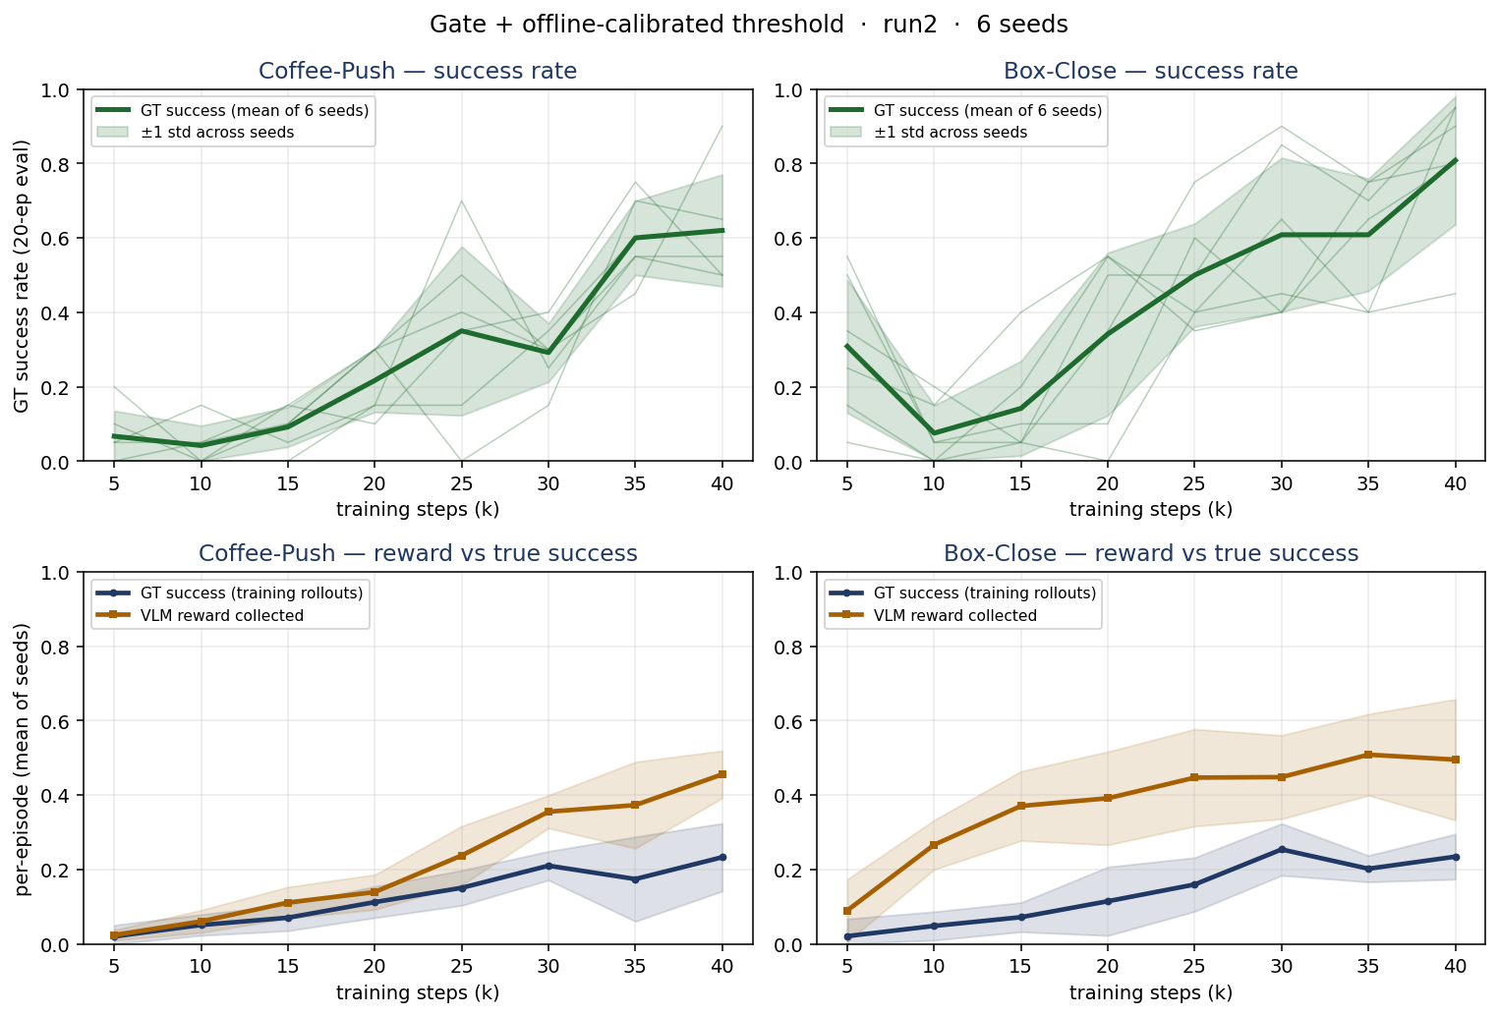
Best case — offline-calibrated threshold: does the policy truly learn?
run2 (asymmetric-loss reward model) · min-length gate · threshold from GT-labeled rollouts · 6 seeds
Top: true success (greedy eval), mean ±1 std over 6 seeds. Coffee-Push 0.48, Box-Close 0.68.
Bottom: true success and VLM reward rise together — a faithful proxy, not reward hacking.
Curves still rising at 40k (not converged); reward is graded.
Needs GT-labeled success+failure rollouts to set the threshold. Eval GT only; reward model never used at eval.

Slide 5
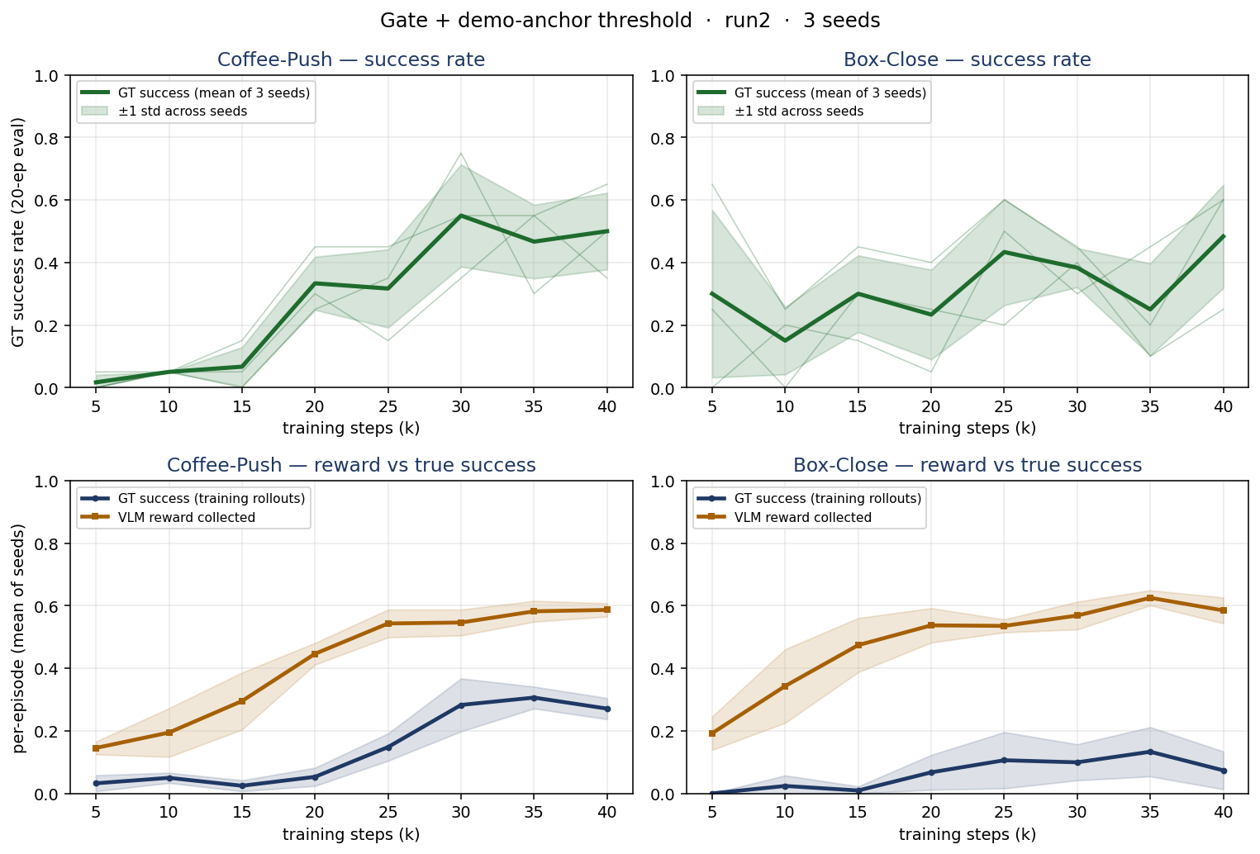
Demo-anchor (demos-only) calibration: same examination
run2 · min-length gate · threshold from a few success demos (no GT labels, no grid search) · 3 seeds
Same panels as the offline slide; only the threshold source changes.
Coffee-Push 0.51 (≈ offline 0.48), Box-Close 0.37 (vs offline 0.68): matches offline on Coffee-Push, weaker on Box-Close.
Wider reward-faithfulness gap — but needs only success demos, no GT labels.
Demos-only — no GT labels, no grid search. 3 seeds (vs 6 for offline).

Slide 6
Since last week: open items, now answered
Last week's questions — off-the-shelf baseline, transfer to harder tasks, seed stability.
Off-the-shelf reward model — dead on every task.
Mean 0.02, never reaches 0.50 (best 0.32) across 21 runs at its own calibrated thresholds (and with ICL). The fine-tuned reward model is required.
Task | Trains? | Success (run2 + gate, 6 seeds)
Coffee-Push | yes | 0.48 (6/6 seeds alive)
Box-Close | yes — 2nd working task | 0.68 (6/6 seeds alive)
Stick-Pull | no | 0.00 (0/3)
Assembly | no | 0.00 (0/4)
Stick-Pull & Assembly are characterized negatives: no usable threshold, and neither the gate nor in-context demos rescue them — an on-policy robustness limit of the reward model, not a tuning miss.
Seed stability — last week's main open problem (~1 seed in 3) — is resolved by the gate: every seed stays alive on the working tasks (slides 1–2).
FT model, winning recipe (success head, gate, sparse). Eval GT only; trailing-mean over seeds.

