Slide 1
Robometer released their LIBERO policy-learning code
Figure 5: reward models fine-tuned per benchmark, then used to train policies.
Reward models fine-tuned with LoRA on the LIBERO-10, Object, Goal, and Spatial suites.
Trained on 1,709 successful demonstrations and 1,929 generated failed trajectories.
Policies trained from scratch with reinforcement learning on the held-out LIBERO-90 suite
(close the top drawer, close the microwave).

Slide 2
run2 and the released model across the two regimes
Success rate on the held-out drawer task, reward taken from the progress head.
Reward model | Full horizon | Terminate on success
Robometer-4B (released) | 1.00 | 0.30
run2 (ours) | 0.80 | 0.30
Letting the episode run to the horizon, rather than ending it on success, drives learning in both models.

Slide 3
The policy
Reinforcement learning from scratch over a frozen perceptual representation.
Soft actor-critic trained from scratch with the reward model in the loop.
Observation: a frozen DINOv2-small encoder over the external camera image, concatenated with the proprioceptive state.
The vision encoder stays frozen, only the action policy is learned.
Because perception is fixed, the policy is easier to drive: optimization acts on the action mapping alone.

Slide 4
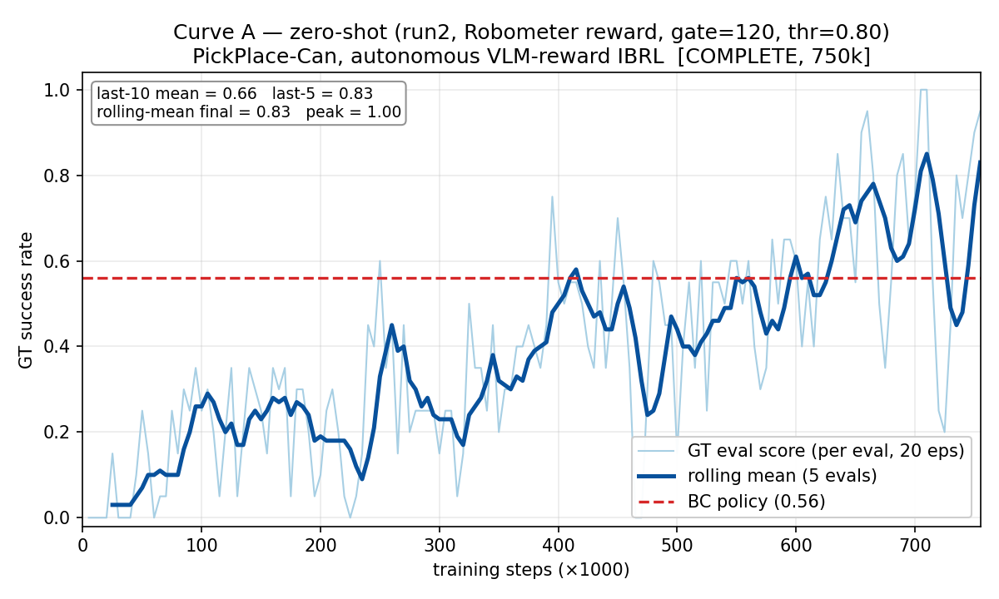
Robomimic (Can): the autonomous gate works here too
• Reward comes only from the vision-language model. The episode ends once its success head fires and the episode has passed a minimum length (the gate).
• Ground-truth success climbs to about 0.8, well above the behavior-cloning starting point (0.56, dashed).
The autonomous gate works on Robomimic too.

Slide 5
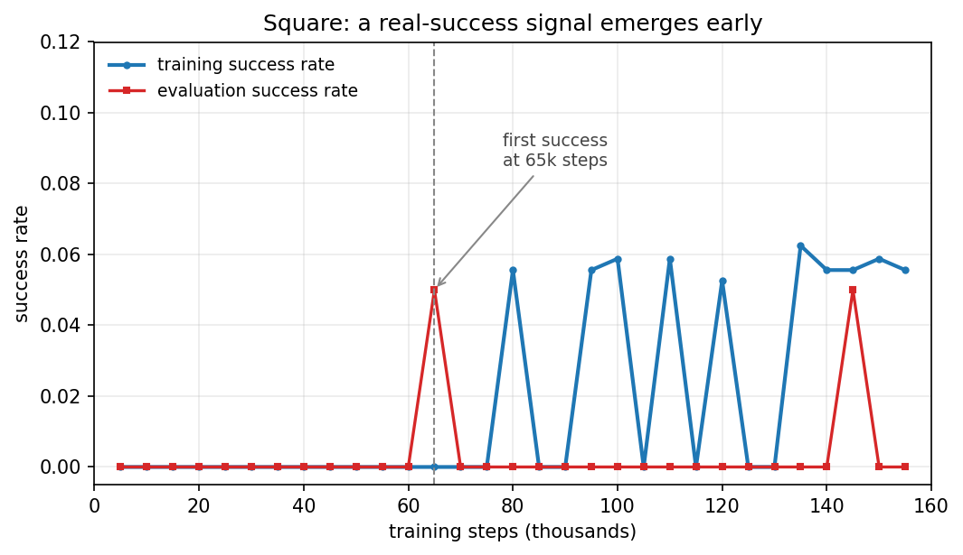
Square: slow task, with the first real-success signal appearing
• Square is a much harder, slow task. Even with the true task reward, success only rises after a few hundred thousand steps (about 0.1 at 250k, about 0.5 at 500k).
• With the vision-language reward, the success head sometimes scores failures highly, so part of the learning signal is reward hacking.
• Adding a debounce, where the success head must hold across several consecutive steps before the episode ends, produces the first real successes at about 65k steps.
Too early to judge. Because the task itself learns slowly, we expect the curve to rise later.

Slide 6
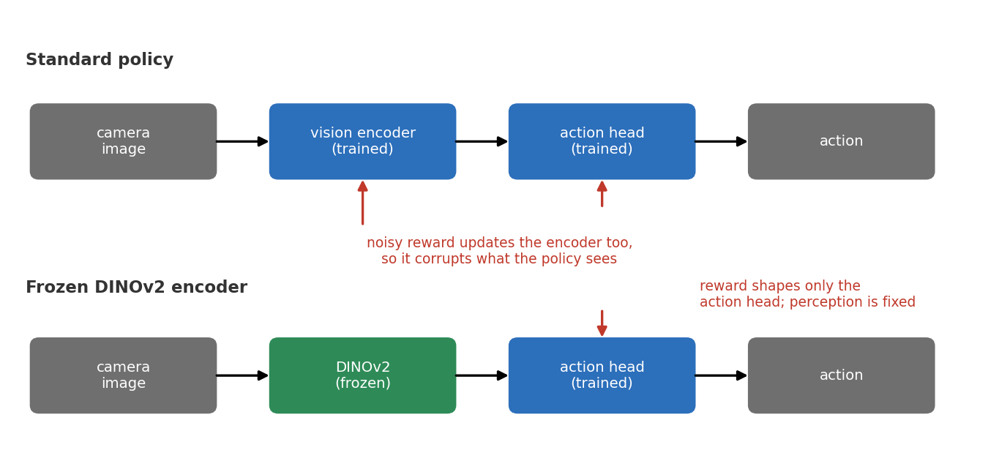
Released reward model stalls under the exact LIBERO recipe
• Released reward model, run on Robomimic with the identical recipe that reaches 100% on LIBERO (full episodes, no early termination, dense progress reward): the policy does not learn, ground-truth success stays at zero.
• New idea: freeze the policy's vision encoder and feed it DINOv2 features.
• A trainable encoder co-adapts to the reward, so a noisy reward corrupts perception itself. A frozen DINOv2 encoder fixes perception and lets the reward shape only the action head. This is also the encoder used in the LIBERO setup.

