Slide 1
Classifying 101 Food Categories with Deep Learning
ISET • Machine Learning II Capstone • Platon Epifanov

Slide 2
Motivation & Problem
Task: Predict dish category from an image (101 classes).
Applications: diet logging, menu recognition, calorie estimation.
Academic value: Food‑101 is a common research benchmark → our scores are directly comparable to published results.
Success metrics: Top‑1 / Top‑5 accuracy.

Slide 3
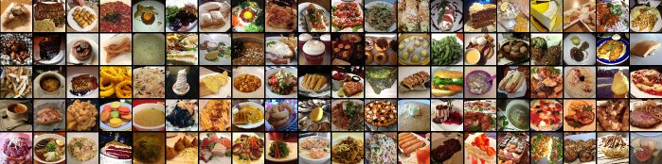
Dataset: Food-101
101 000 food photos across 101 dish categories
Official split: 80 000 training / 20 000 testing
Augmentations: RandAugment, horizontal flip, random erasing (p=0.1).

Slide 4
Reproducible Workflow
Env: Google Colab (GPU), PyTorch + timm.
Notebook pipeline: config → data → model → train → eval → interpret.
Seeds fixed for torch / numpy / random.
requirements.txt & README.md; Kaggle API for data download.
Saved checkpoint: best_food101.pth.

Slide 5
Model Choice & Justification
Backbone: EfficientNet‑B3 (pretrained on ImageNet) via timm.
Efficient width/depth/resolution scaling → good accuracy/params.
Head: Linear(in_features, 101).
Loss: CrossEntropy + label smoothing (0.1).
Optimizer: AdamW (lr=3e‑4, weight_decay=1e‑4); Cosine LR schedule.

Slide 6
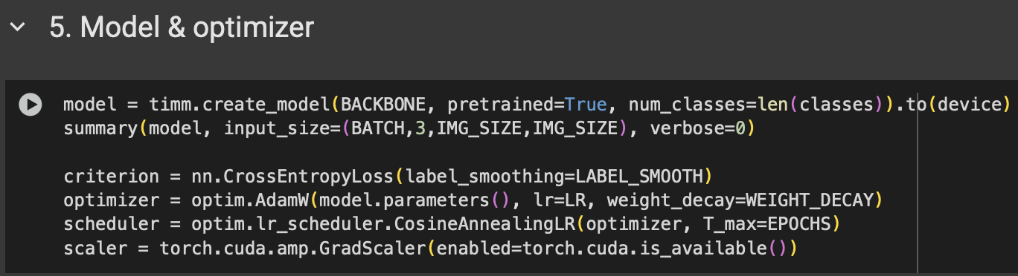
Pretrained EfficientNet-B3 model loaded via timm, fine-tuned for 101 food classes.
Cross-Entropy Loss with label smoothing to reduce overconfidence.
AdamW optimizer with weight decay for better generalization.
Cosine learning rate scheduler for smoother convergence across epochs.
Mixed-precision training (AMP) enabled for faster and more efficient GPU training.

Slide 7
Training Setup
EPOCHS = 12 • BATCH = 64 • IMG_SIZE = 224.
Mixed precision (AMP) for speed/memory.
Validate each epoch; keep best Top‑1 acc model.
Logged loss/acc curves for analysis.

Slide 8
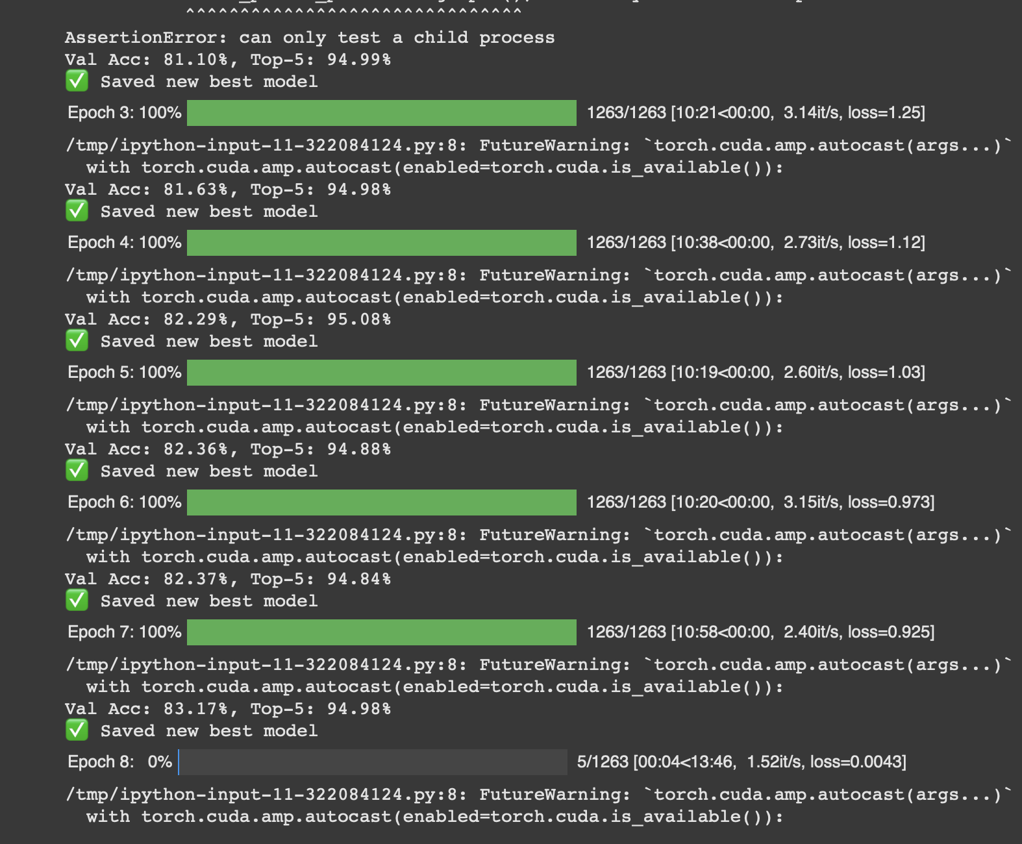
Key Code Snippet (Epoch Loop)

Slide 9
Results
Top‑1 Accuracy: 83.17 %
Top‑5 Accuracy: 94.98 %

Slide 10
Limitations & Future Work
Dataset bias (cuisine coverage).
Single-label assumption for mixed dishes.
Future: ViT/ConvNeXt, self‑supervised pretraining, domain adaptation.
Deploy as web demo (Streamlit/Gradio).

Slide 11
Takeaways & Reproducibility
Transfer learning + solid augments → strong performance.
Followed universal ML workflow (problem→data→model→eval).
Full reproducibility: notebook, requirements, seeds, download script.

Slide 12
Thank you!

