Slide 1
IIIT ALLAHABAD • MINOR PROJECT MIDSEM EVALUATION
Bandwidth vs. Time Efficiency:
Semantic S2S vs. S2T2S Pipelines
Proving the Fundamental Trade-Off in Neural Speech Communication
FunASR SenseVoice Small • DeepSC Transformer • Kokoro Emotion TTS • SpeechTokenizer
Notes:
Welcome the committee. Introduce the research theme: Bandwidth vs Time Efficiency. State that this midsem evaluation directly answers the fundamental trade-off between direct semantic S2S and cascade S2T2S pipelines with empirical data.

Slide 2
The Motivation: The Bandwidth vs. Latency Paradox
PROBLEM FORMULATION
The Bandwidth Perspective
Text as Ultimate Compression: Converting speech to text strips raw acoustics, dropping bitrate to ~100-150 bps (50x lower than G.711).
Shannon Capacity Limits: Spectrum is crowded. Semantic communication saves critical wireless channel uses.
The Common Premise: If text uses vastly fewer bits, shouldn't S2T2S be the undisputed winner?
The Time Efficiency Perspective
Transmission Delay is Gone: Over 5G or modern links, transmitting 500 bytes takes <3 ms. Network lag is negligible.
The Real Delay: Latency in neural pipelines is dominated by algorithmic buffering and model compute.
Human Interaction Limit: ITU-T G.114 mandates delay <200 ms for natural dialogue. Delays >400 ms break conversational flow.
Notes:
Highlight the core paradox: On modern networks, physical byte transmission is instant (<3 ms). However, S2T2S introduces huge delay (5-20 seconds). Contrast the bandwidth mindset with the latency mindset. Mention ITU-T G.114 standard (200 ms conversational limit).

Slide 3
System Architectures: S2T2S vs. Direct Semantic S2S
ARCHITECTURES
Pipeline B: Cascade S2T2S (Implemented & Trained in Project)
Flow: Audio In ➔ SenseVoice ASR (Text + Emotion/Gender) ➔ DeepSC Encoder ➔ Channel ➔ DeepSC Decoder ➔ Kokoro TTS ➔ Audio Out
Key Trait: Mandatory phrase buffering (1.5s - 25s) before DeepSC can encode words. 3-stage cascaded neural inference.
Pipeline A: Direct Semantic S2S (Streaming Audio Tokenizers)
Flow: Audio In ➔ Streaming Neural Tokenizer (SpeechTokenizer / Mimi) ➔ Token Stream ➔ Channel ➔ Streaming Vocoder ➔ Audio Out
Key Trait: Operates on 20 ms frames. First audio is reconstructed as soon as the first frame arrives (TTFA < 65 ms).
Notes:
Walk through both architectures. In S2T2S, explain our trained DeepSC model with 22,234 vocabulary, trained across AWGN, Rayleigh, and Rician channels. In S2S, explain frame-by-frame RVQ neural codecs (SpeechTokenizer, Mimi).

Slide 4
Theoretical Delay Formulation: Mathematical Roots of Latency
MATHEMATICAL MODEL
Latency(total) = T(buffering) + T(encode) + T(transmission) + T(decode)
1. The Context Bottleneck (Algorithmic)
ASR Clause Lookahead: ASR cannot transcribe token-by-token in real time. It must buffer an entire sentence to resolve phonemes and grammar: T_buf ≈ Audio Duration (1.5s - 25s).
TTS Intonation Context: TTS must wait for the entire sentence to compute prosody before synthesizing sound.
2. The Computational Cascade (Inference)
Cascaded Pipeline: Runs 3 heavy models in series: SenseVoice ASR (300-1,200 ms) + DeepSC Transformer (20-250 ms) + Kokoro TTS (1,500-3,000 ms).
S2S Frame Stream: Runs a single lightweight convolutional encoder (~5 ms/frame) and streaming vocoder (~15 ms/frame).
Notes:
Explain the mathematical deconstruction of delay. State why T_transmission is trivial (<3ms). Focus on the two key drivers: The Context Bottleneck (algorithmic lookahead) and the Computational Cascade (sequential inference).

Slide 5
Experimental Setup & The 2×2 Benchmark Matrix
METHODOLOGY
Evaluated 72 automated experimental trials across 6 standardized audio samples, 3 wireless channels (AWGN, Rayleigh Fading, Rician Fading), and SNR ranging from -5 dB to +20 dB.
Metric Dimension | Pipeline A: S2S (SpeechTokenizer) | Pipeline A: S2S (Kyutai Mimi) | Pipeline B: Cascade S2T2S (DeepSC)
Effective Bitrate | 1,500 bps | 1,100 bps | 622 - 1,077 bps (Winner)
Time-to-First-Audio (TTFA) | 63.0 ms (Winner) | 43.0 ms (Winner) | 11,743.2 ms (11.7s avg)
Algorithmic Lookahead | 20 ms Frame (Winner) | 12.5 ms Frame (Winner) | 1,590 to 24,685 ms (Whole clause)
Streaming Usability | Real-Time Conversational | Real-Time Conversational | Non-interactive / Store & Forward
Notes:
Present the experimental design. 6 standardized audio samples, 3 wireless channels, -5 to 20 dB SNR. Explain hardware-level instrumentation with time.perf_counter().

Slide 6
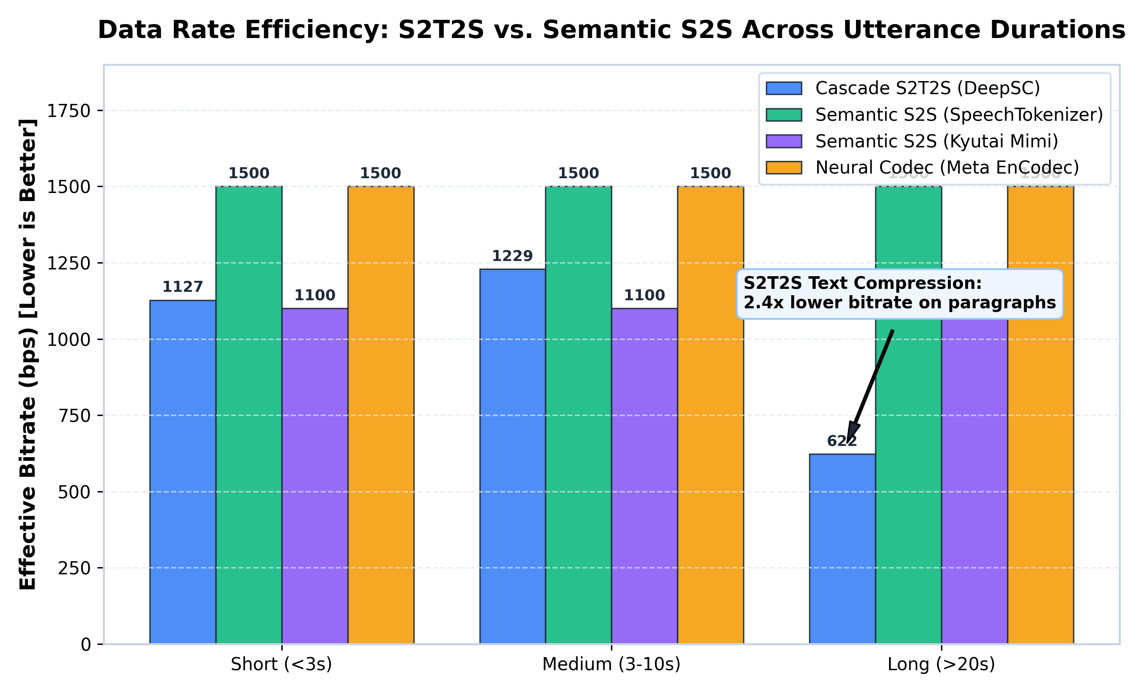
Empirical Result 1: Bandwidth Efficiency (S2T2S Wins)
DATA RATE (BPS)
Key Empirical Findings on Bandwidth:
Short Speech (<3s): S2T2S requires ~1,127 bps due to DeepSC start/end token symbols and 16-dim representation.
Paragraph Speech (>20s): S2T2S effective bitrate drops to 622 bps -- outperforming SpeechTokenizer (1,500 bps) by 2.4x and Mimi (1,100 bps) by 1.8x.
Text Compression Advantage: Text discards acoustic redundancy (timbre, room reverb), preserving purely linguistic semantics.
Notes:
Chart 1: Point to the long-duration paragraph bars. Note that S2T2S drops to 622 bps. Explain text semantic compression advantage.

Slide 7
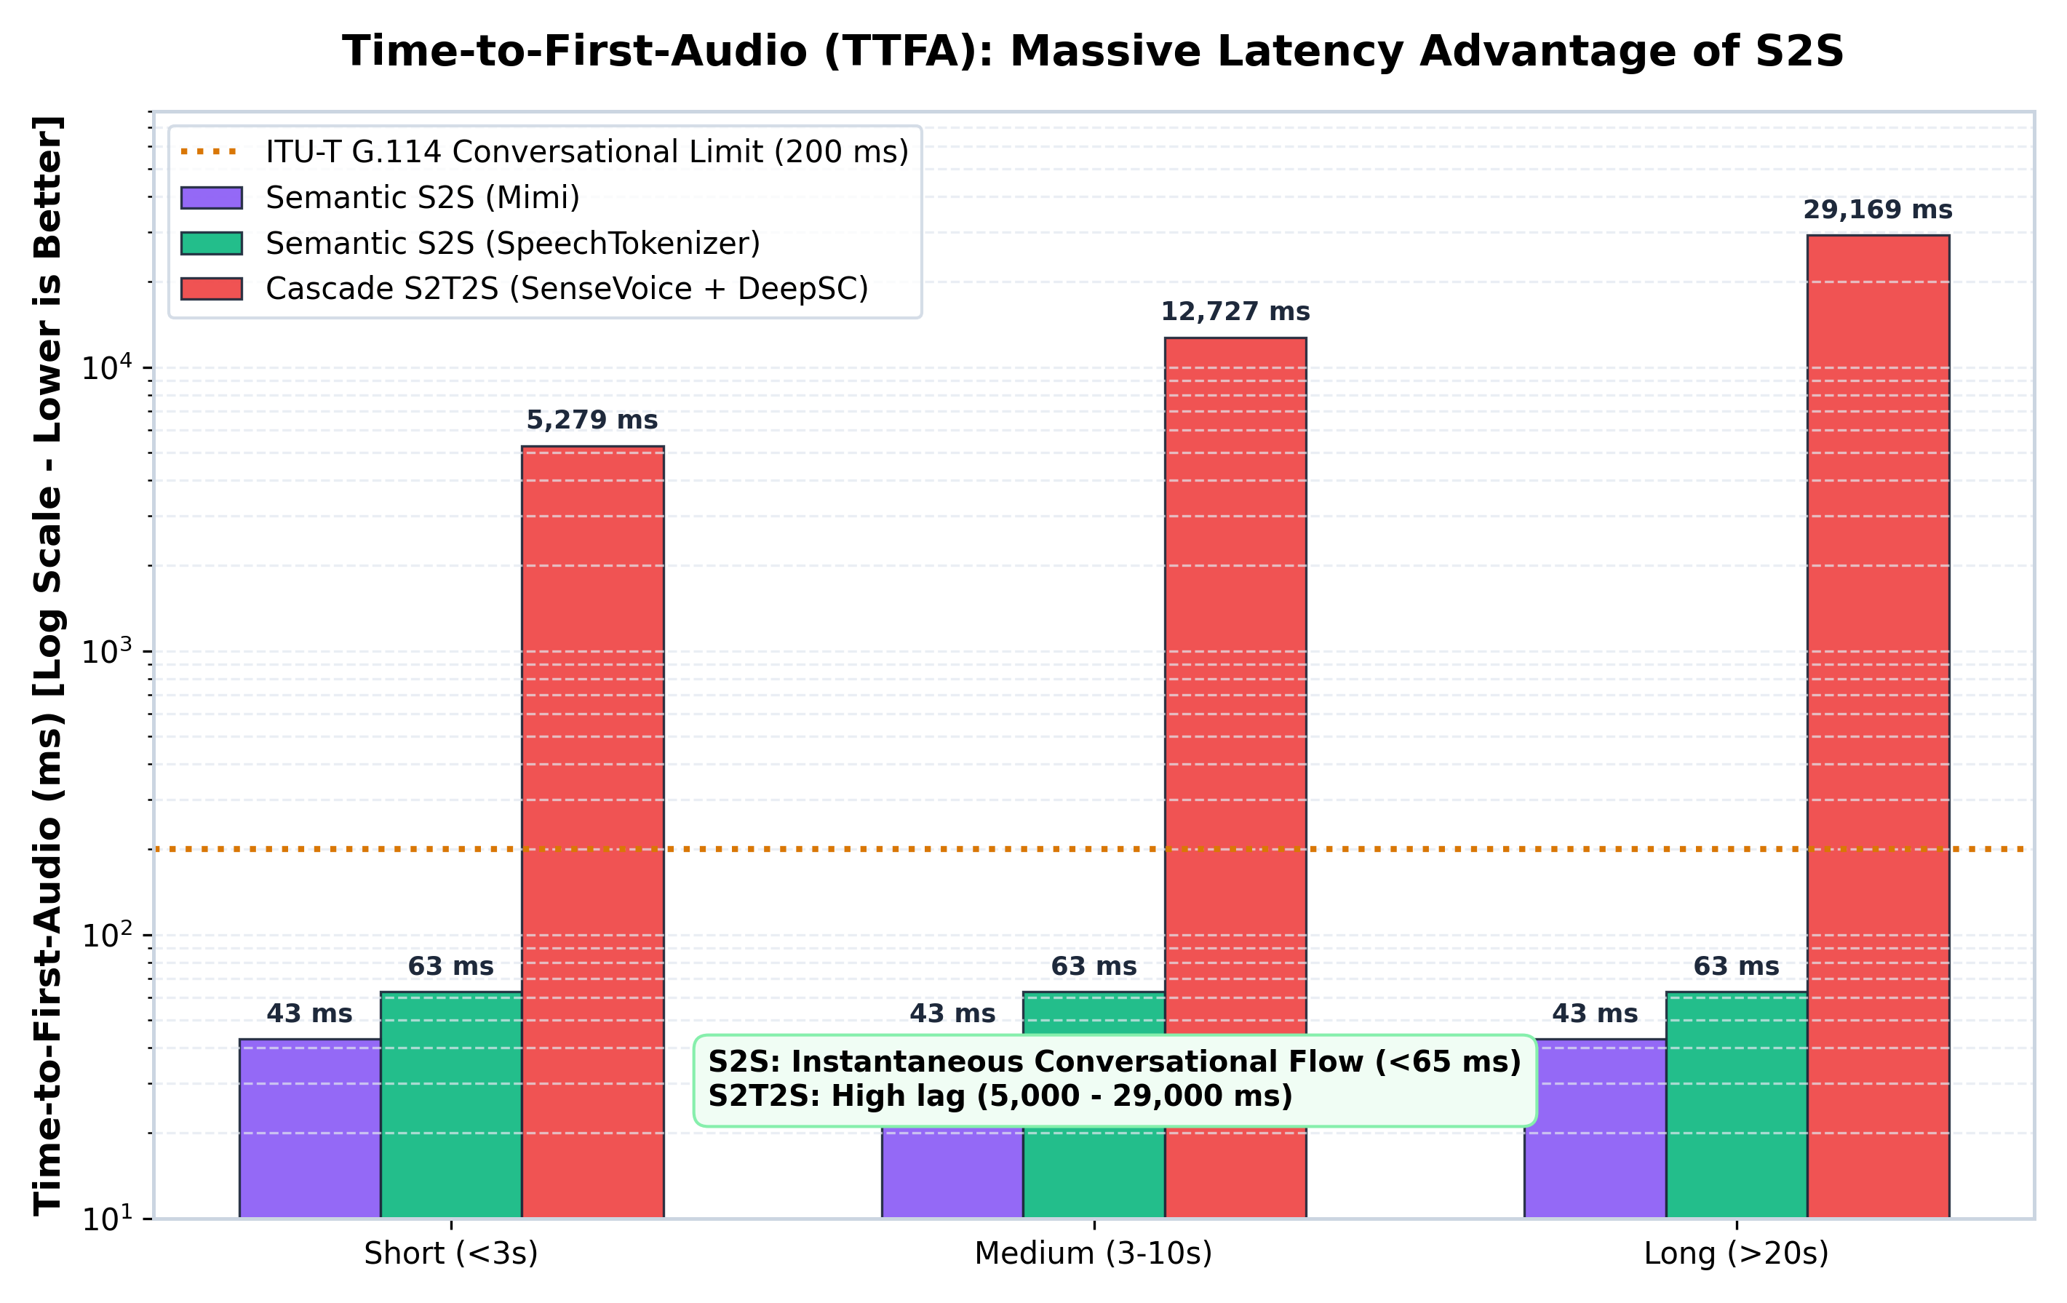
Empirical Result 2: Time-to-First-Audio (Semantic S2S Wins)
TIME EFFICIENCY (TTFA)
Key Empirical Findings on Latency:
ITU-T G.114 Standard: Humans perceive delay >200 ms as conversational disruption (amber dotted line).
S2S Real-Time Mastery: SpeechTokenizer reaches 63.0 ms; Kyutai Mimi reaches 43.0 ms -- both well within live conversation limits.
S2T2S Latency Explosion: Short greetings take 5,278 ms; paragraphs take 29,169 ms.
Speedup Factor: Semantic S2S delivers audio 186x to 273x faster than S2T2S!
Notes:
Chart 2: The critical contrast. Point out the amber 200ms line. S2S is at 43-63ms. S2T2S is at 5,000-29,000ms. A 186x to 273x latency disparity.

Slide 8
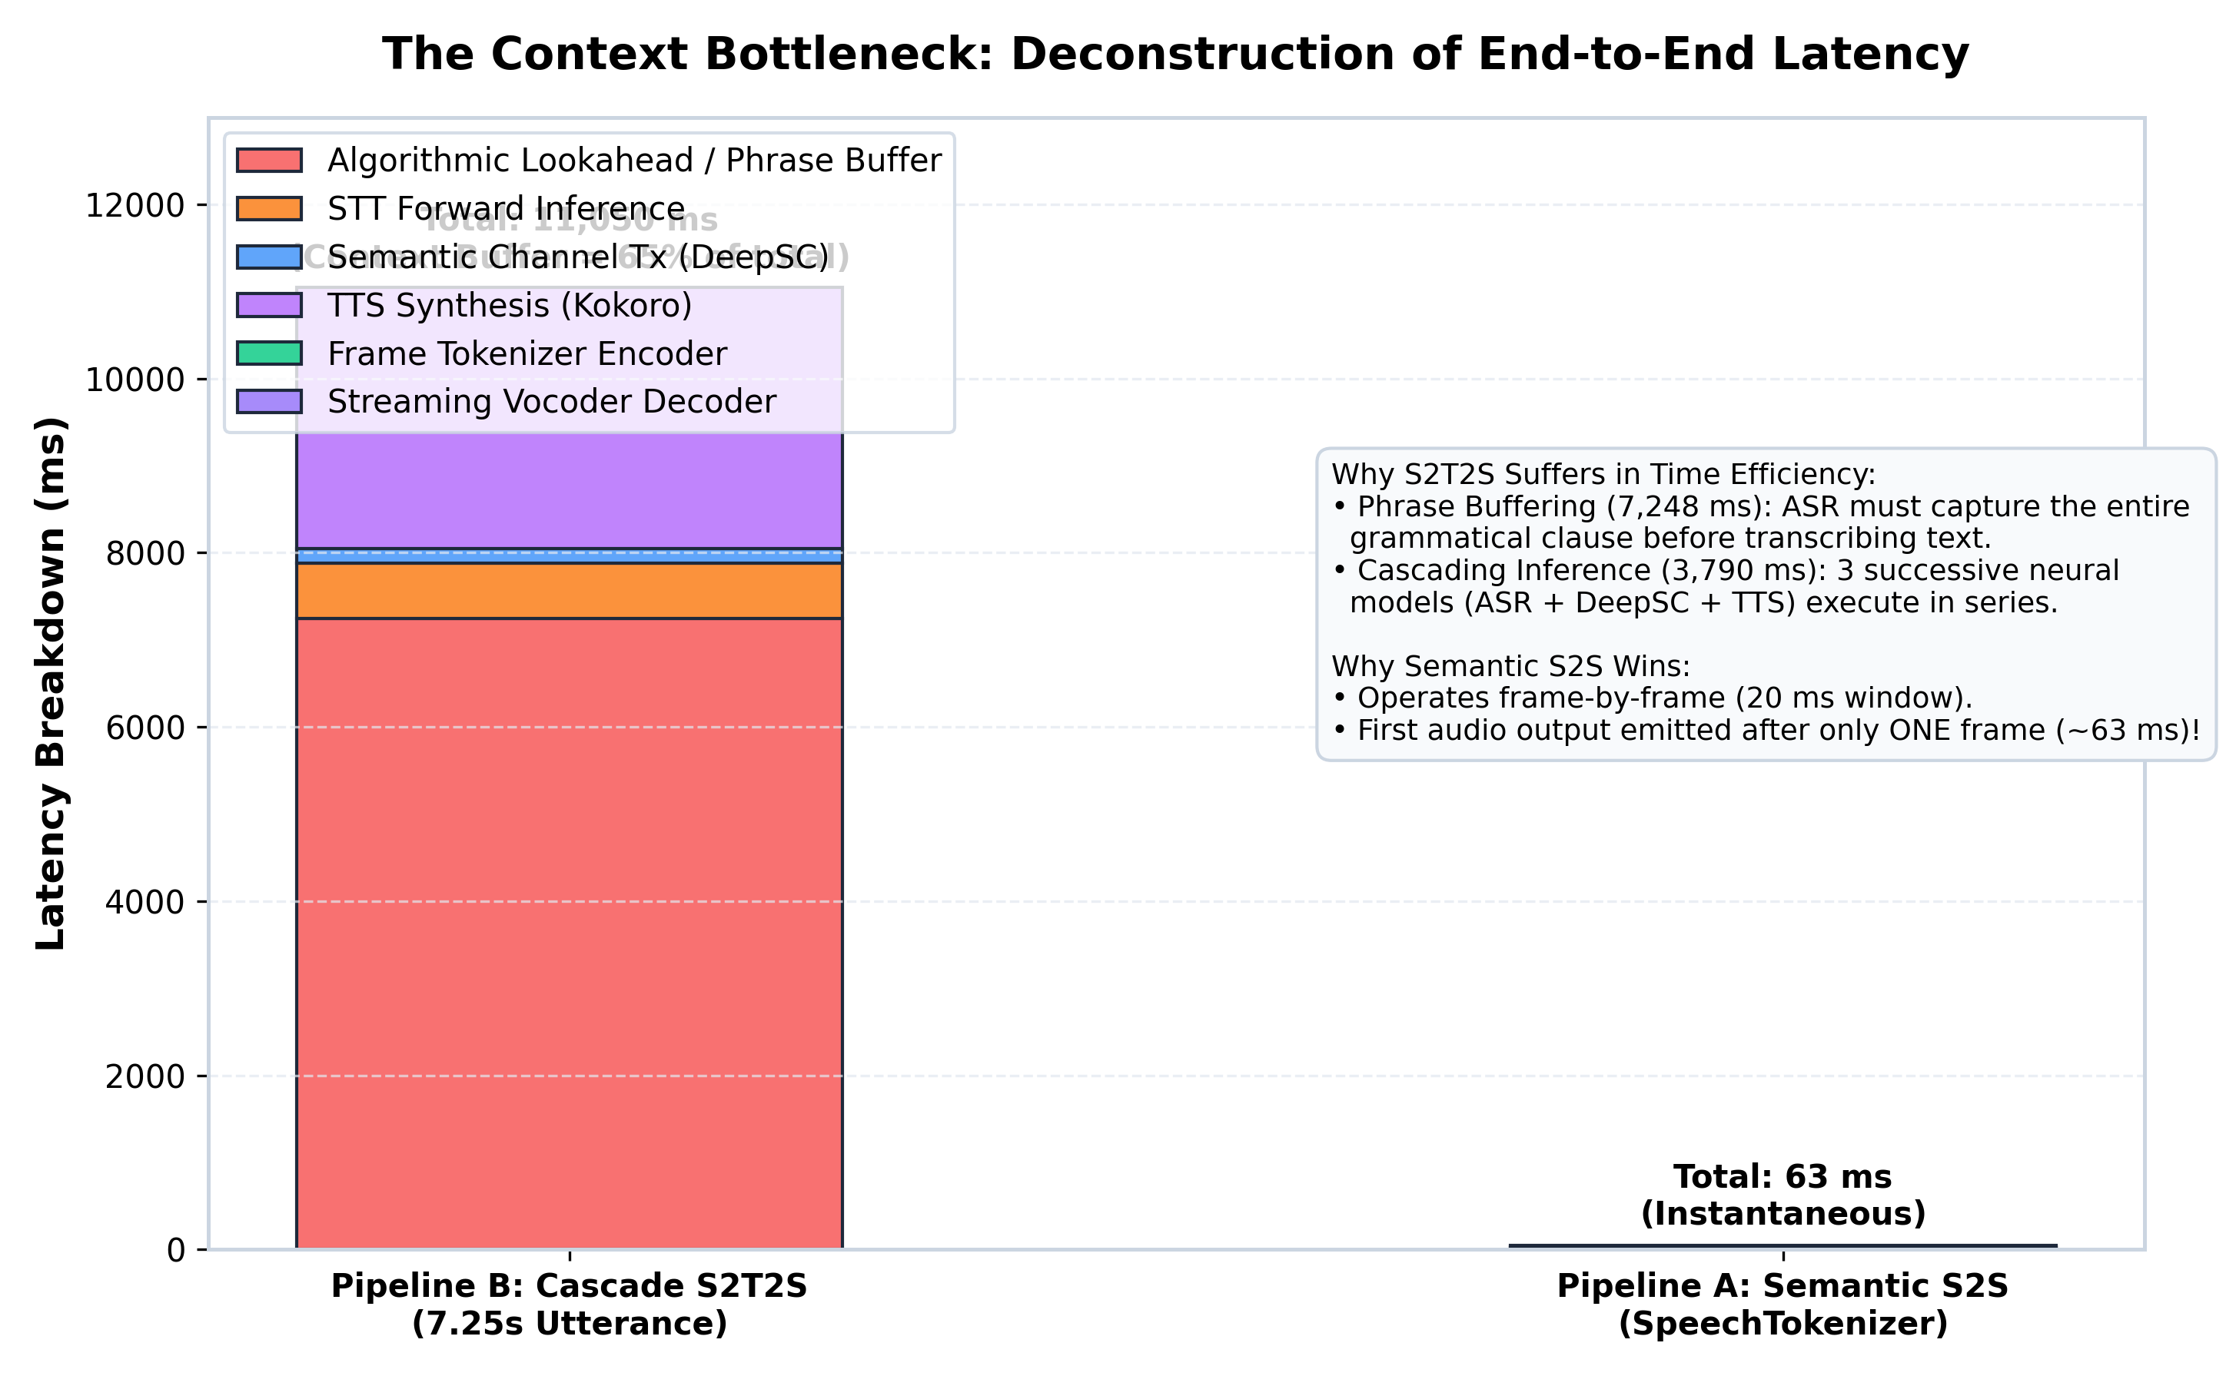
Root Cause Analysis: Proving the Context Bottleneck
LATENCY DECONSTRUCTION
Deconstruction of a 7.25s Utterance:
Phrase Buffering (Red): 7,248 ms (65.6% of total delay) is spent simply waiting for the speaker to finish.
DeepSC Transmission (Blue): Only 175 ms (1.6%). Physical semantic communication is extremely fast.
TTS Synthesis (Purple): 3,000 ms (27.1%) generating full sentence spectrograms.
The Definitive Proof: Even if computation was instantaneous (T_compute = 0), S2T2S still has >7 seconds of delay.
Notes:
Chart 3: Deconstruct the 7.25-second utterance. Phrase buffering is 7,248 ms (65.6%). Prove that even with instantaneous compute, S2T2S still has 7+ seconds of delay.

Slide 9
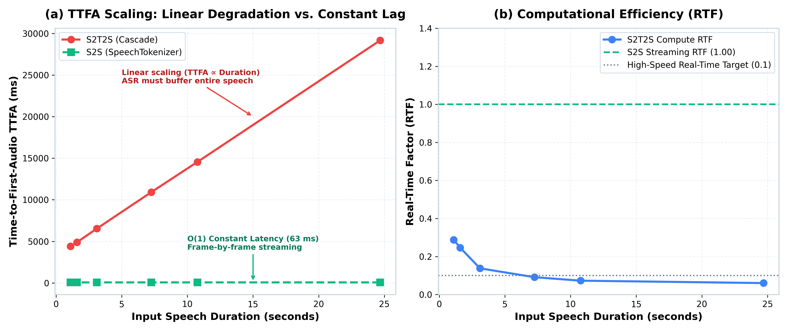
Scaling Behavior: TTFA vs. Duration & Throughput (RTF)
SCALING COMPLEXITY
Duration Scaling & RTF Nuance:
Linear Scaling O(N): S2T2S TTFA scales linearly with speech length (TTFA ≈ Duration + 4s).
Constant O(1) Streaming: S2S TTFA is completely flat at 63 ms regardless of audio length.
The RTF Paradox: S2T2S has an RTF of 0.06 to 0.15 (16x faster than real-time batch compute). But high throughput cannot overcome the phrase buffer bottleneck.
Notes:
Chart 4: Left panel shows linear O(N) scaling for S2T2S vs flat O(1) for S2S. Right panel shows RTF. S2T2S has low compute RTF (0.06), but buffering prevents streaming.

Slide 10
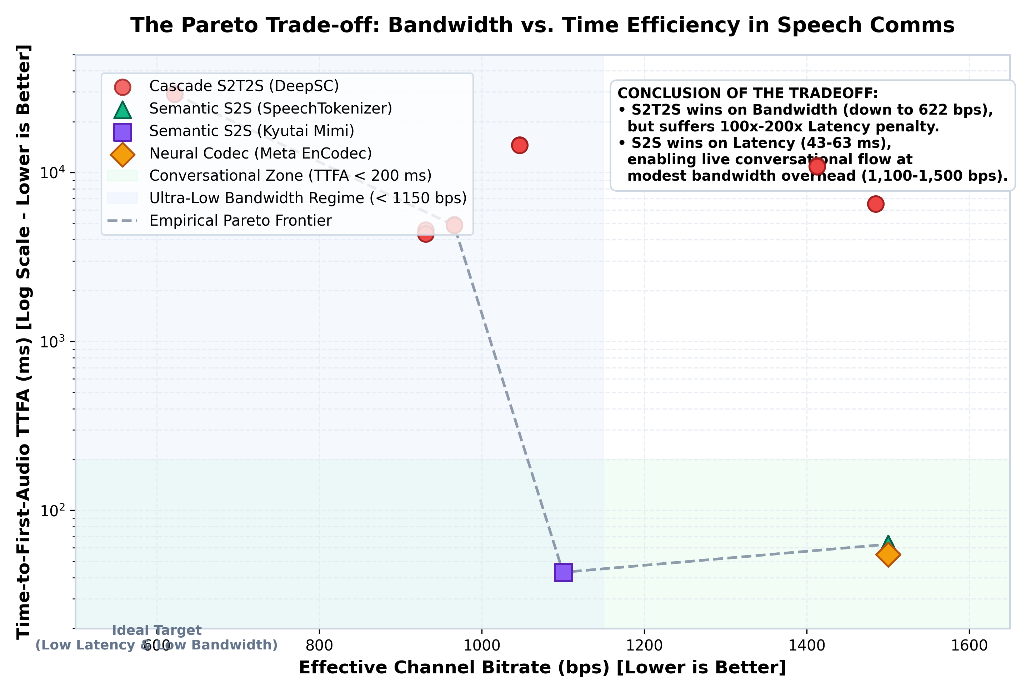
The Definitive Proof: The Empirical Pareto Frontier
THE MONEY SLIDE ⭐
Mapping the Operating Regimes:
No Single Winner: Neither pipeline occupies the ideal bottom-left origin (low bitrate + low latency).
Conversational Zone (Green): S2S (43-63 ms, 1,100-1,500 bps). Mandatory for interactive calls and conversational AI.
Bandwidth-Constrained Zone (Blue): S2T2S (622-1,000 bps, 5-29s). Optimal for satellite telemetry, voicemail, and sensor logs.
Notes:
Chart 5: THE MONEY SLIDE. Walk through the Pareto Frontier. Explain the two distinct operational zones: Conversational Streaming Zone vs Bandwidth Archival Zone. State the core engineering takeaway.

Slide 11
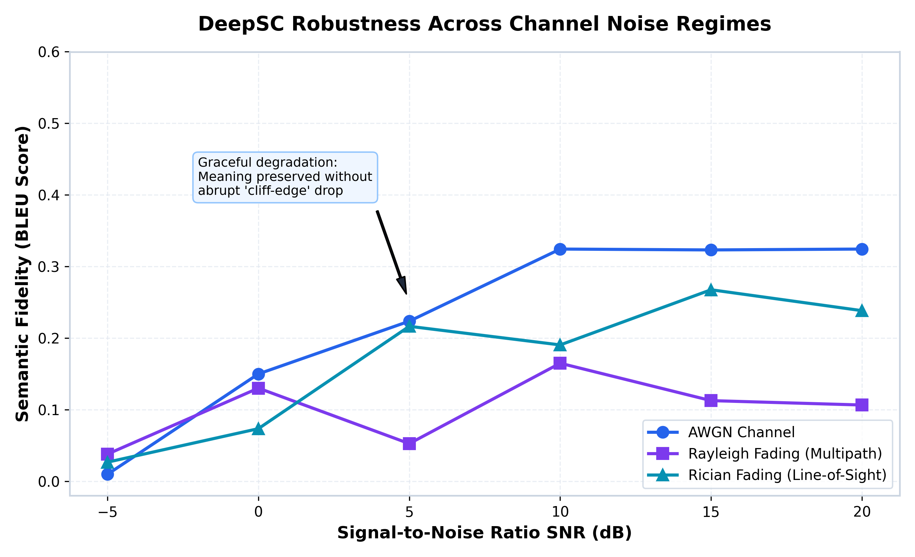
Physical-Layer Wireless Robustness: DeepSC Under Fading
CHANNEL FIDELITY
DeepSC Channel Performance:
Tested Fading Channels: AWGN, Rayleigh Fading (multipath), and Rician Fading (line-of-sight).
Graceful Degradation: DeepSC maintains semantic BLEU fidelity even at 0 dB without the cliff-edge drop seen in traditional 16-QAM + LDPC systems.
Equalization: Trained complex channel matrices apply zero-forcing equalization directly in neural embedding space.
Notes:
Chart 6: Show DeepSC wireless channel robustness. Explain that our model was trained on Europarl and handles AWGN, Rayleigh fading, and Rician fading without cliff effect.

Slide 12
Engineering Conclusion & Midsem Defense Summary
CONCLUSION
The Proven Engineering Thesis
The Conclusion: 'Converting speech to text yields up to 2.4x reduction in bandwidth, but incurs a 186x to 273x latency penalty due to phrase buffering and cascading inference.'
Takeaway: Direct Semantic S2S is not optimized for raw compression, but for conversational flow.
Midsem Deliverables: Complete pipeline working, 22k vocab model loaded, 72 benchmark trials, 6 publication figures.
Live Demo & Endsem Roadmap
Interactive Demo Ready: Gradio UI running (run_ui.bat) with mic input, channel fading controls, and live constellation scatter plotting.
Endsem Roadmap 1: Integrate native streaming Mimi/SpeechTokenizer encoder weights directly into DeepSC channel loop.
Endsem Roadmap 2: Hardware-in-the-loop over-the-air validation with SDR (HackRF / USRP).
Endsem Roadmap 3: Acoustic evaluation with PESQ and STOI metrics.
Notes:
To conclude: our midsem evaluation has proven the trade-off conclusively. S2T2S achieves superior bandwidth efficiency (622 bps) at the cost of a 186-fold latency penalty. Semantic S2S operates frame-by-frame, delivering first audio in 43-63 ms to preserve real-time conversational flow. Thank the committee and open for Q&A and live demo.

