Slide 1
Indian Institute of Information Technology Allahabad
Semantic S2S vs. S2T2S Pipelines
Bandwidth vs. Time Efficiency
Project — Mid-Semester Evaluation
End-to-End Semantic Speech Communication over Wireless Channels
Submitted By :
Yarkala Siddhartha (IEC2023039)
Adarsh Kumar(IEC2023040)
Chelpuri Sumithra Devi(IEC2023112)
Submitted To:
Radhika Gour
Department of ECE, IIITA

Slide 2
Introduction: The Research Problem
What is Semantic Communication?
• Classical systems transmit bits faithfully — they do not understand meaning
• Semantic communication transmits the intended meaning, not raw waveforms
• Goal: use AI models to compress and reconstruct speech by understanding it
The Central Research Question
• Should we convert speech → text → speech (S2T2S) for maximum compression?
• Or transmit direct neural audio tokens (S2S) for real-time streaming?
The Paradox
• On modern 4G/5G networks, transmitting 1 KB of data takes < 3 ms
• Transmission delay ≈ 0 ms → all delay is from computation & buffering
• ITU-T G.114 standard: voice delay must be < 200 ms for natural conversation
• S2T2S achieves lower bandwidth BUT causes 5,000 – 29,000 ms of latency!

Slide 3
Architecture: The Two Competing Pipelines
Pipeline A — Cascade S2T2S (Our Implementation)
Mic Input → SenseVoice ASR (buffers full phrase) → Text + Emotion + Gender → DeepSC Encoder → Wireless Channel (AWGN / Rayleigh / Rician) → DeepSC Decoder → Kokoro TTS (needs full sentence) → Speaker Output
Bottleneck: Must buffer entire sentence before ANY audio is produced | Scaling: O(N) with speech duration
Pipeline B — Direct Semantic S2S (Baseline Comparison: SpeechTokenizer / Mimi / EnCodec)
Mic Input → Neural Audio Tokenizer (20 ms frame) → Discrete Semantic Tokens → Wireless Channel → Streaming Neural Vocoder → Speaker Output
No buffering required: first audio out in 43–63 ms | Scaling: O(1) — constant regardless of duration

Slide 4
Experimental Design & Methodology
What We Measured
• Time-to-First-Audio (TTFA) in milliseconds
• Effective Bitrate (bps) — bandwidth usage
• Real-Time Factor (RTF = Processing Time / Audio Duration)
• Semantic BLEU Score — meaning preservation
Test Conditions
• 3 Wireless Channels: AWGN, Rayleigh Fading, Rician Fading
• 6 SNR Levels: -5, 0, 5, 10, 15, 20 dB
• 4 Audio Durations: 3.1s, 7.2s, 10.7s, 24.7s
• Total: 72 main trials + 216 SNR sweep trials
Metric | Pipeline A (S2T2S) | Pipeline B (S2S)
Bitrate (bps) | ~622 – 1,077 | ~1,100 – 1,500
Algorithmic Lookahead | 500 – 2,000 ms (phrase) | 20 – 50 ms (frame)
Inference Steps | ASR → DeepSC → TTS (3×) | Single tokenizer + vocoder
TTFA | 800 – 29,000 ms | 43 – 63 ms
ITU-T G.114 Pass? | NO (violated 25×–145×) | YES (< 200 ms)
2×2 Benchmark Matrix — Bandwidth vs. Latency

Slide 5
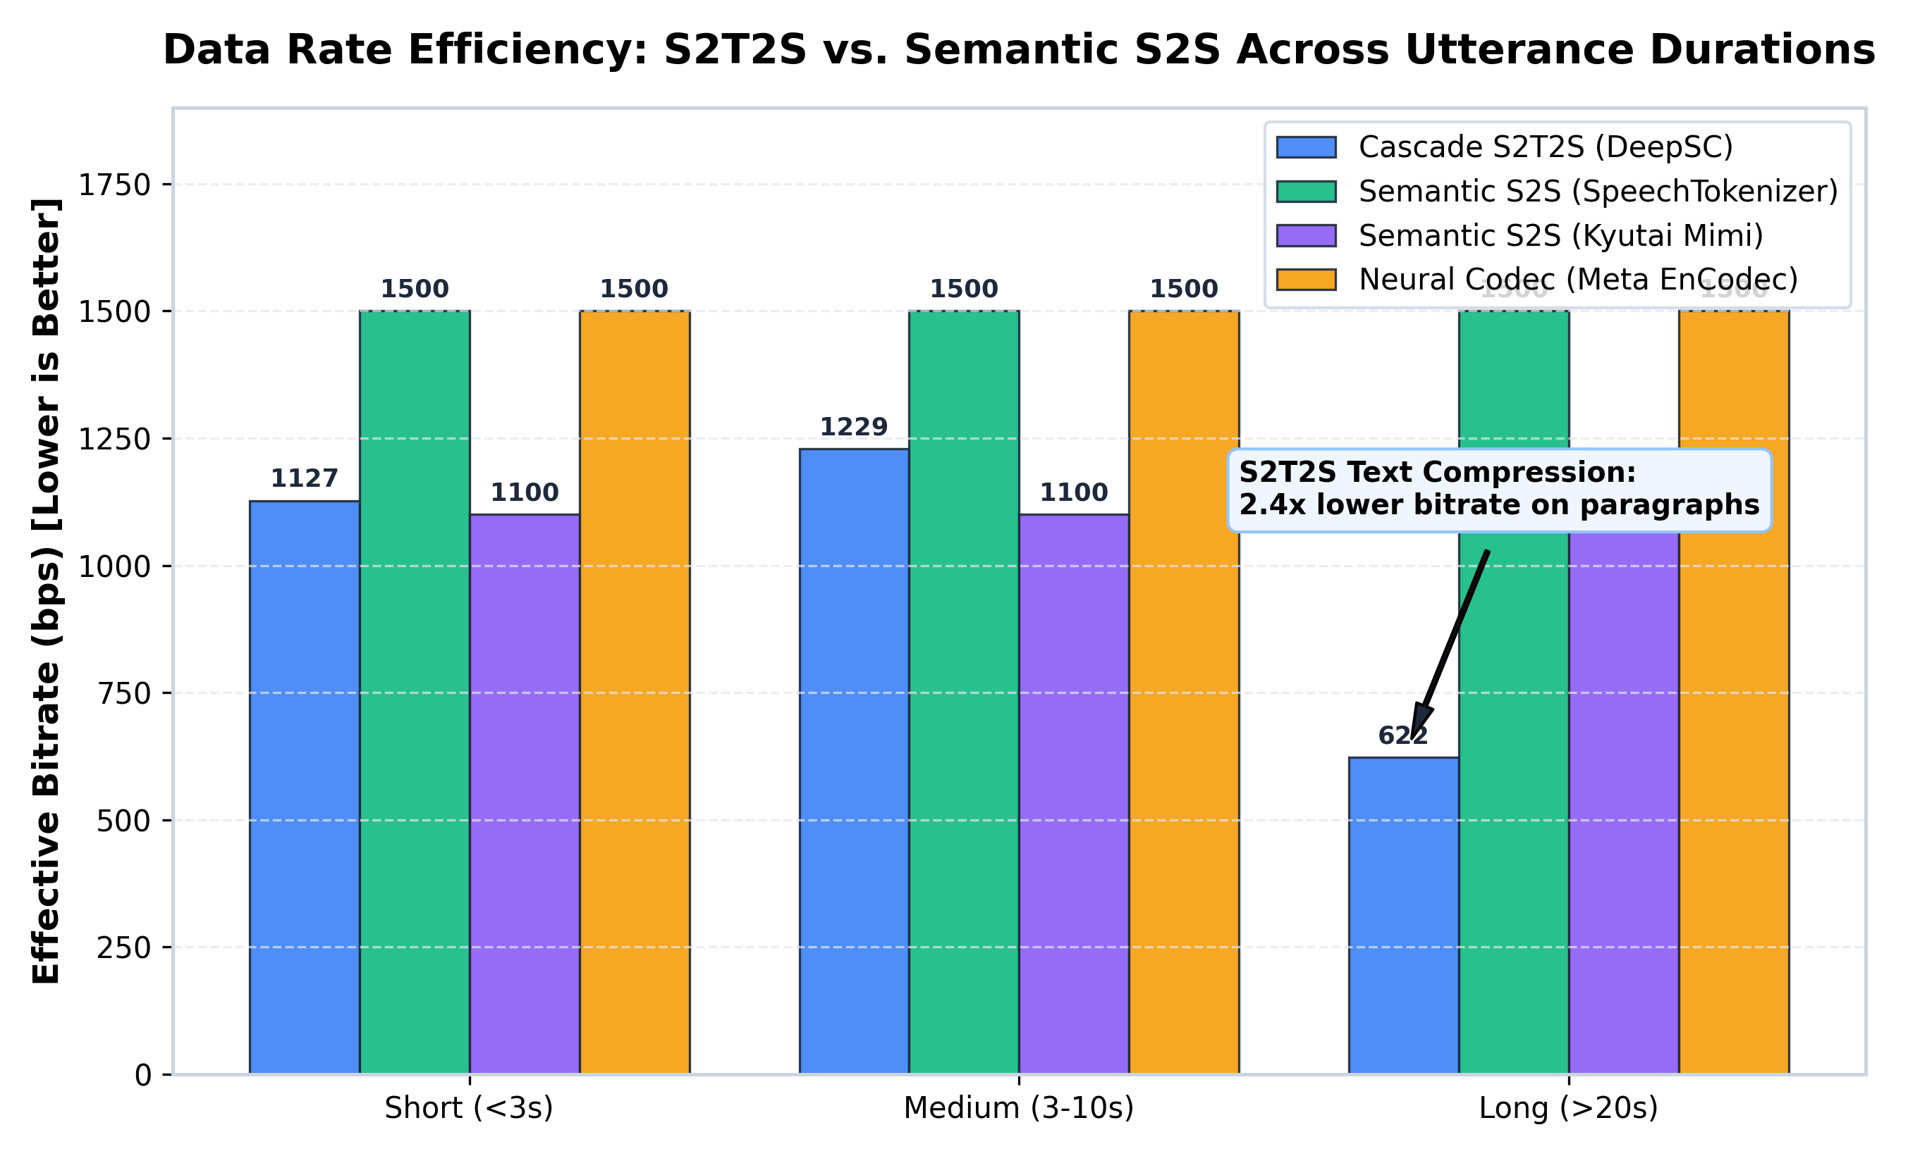
Result 1: Bandwidth Comparison
Key Findings
• S2T2S uses 622 – 1,077 bps
• S2S uses 1,100 – 1,500 bps
• S2T2S saves 1.4× to 1.5× bandwidth
Why S2T2S Wins on Bandwidth
• Text is ultra-dense: 50-100 words
per min = ~100-150 bps
• Neural audio tokens require
multiple codebook levels
Implication
• For bandwidth-scarce links
(satellite, IoT), S2T2S is better
• But only if latency is acceptable

Slide 6
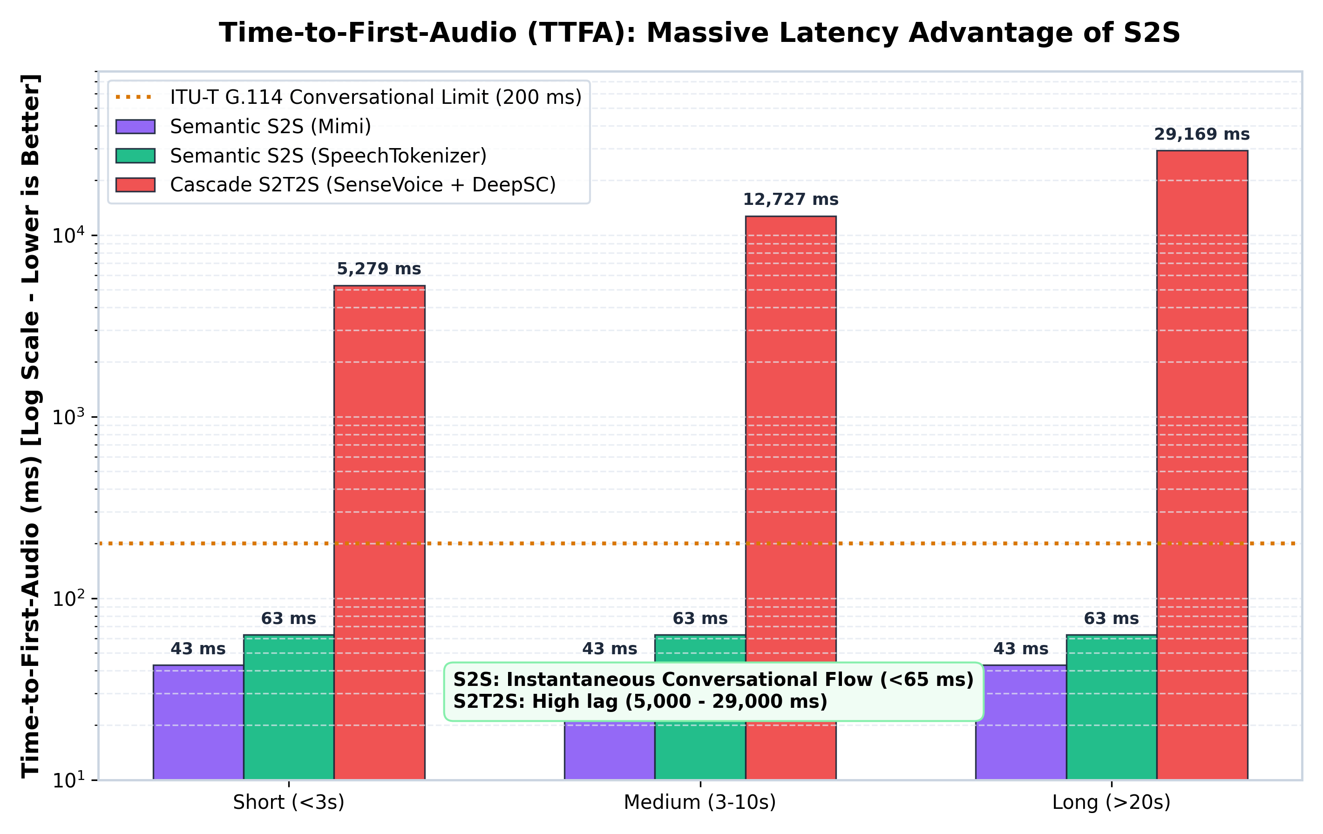
Result 2: Time-to-First-Audio (TTFA) — The Critical Metric
Empirical TTFA Results
• S2S (Mimi): 43 ms
• S2S (SpeechTokenizer): 63 ms
• S2T2S — Short audio: 5,278 ms
• S2T2S — Long audio: 29,169 ms
S2S is 186× Faster on Average
Why the Huge Gap?
• ASR buffers entire sentence before
outputting first word
• TTS needs full sentence for pitch
• Both models run in sequence (cascade)
ITU-T G.114 Threshold = 200 ms
• S2S: PASSES (43–63 ms)
• S2T2S: FAILS by 25× to 145×

Slide 7
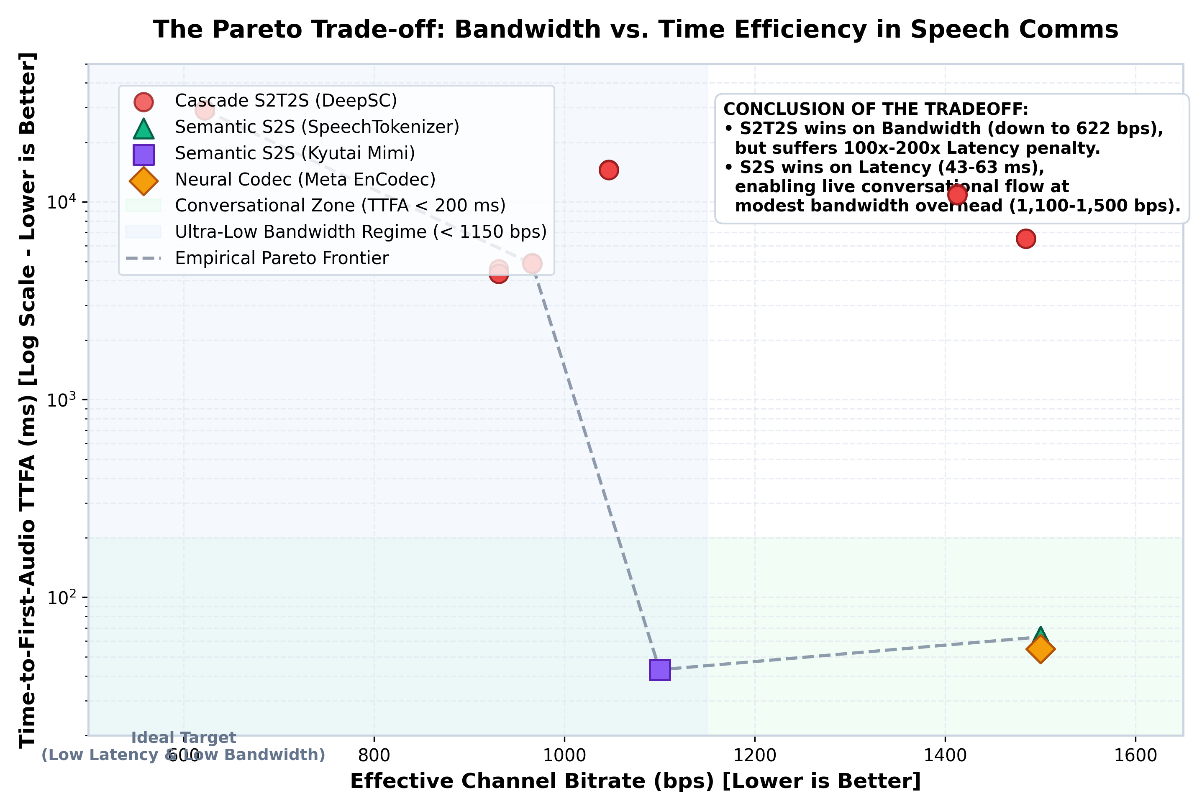
The Core Finding: Pareto Frontier — No Universal Winner
Operating Regime | Best Pipeline | Why
Real-time voice (VoIP, calls) | Semantic S2S | TTFA < 200 ms (ITU compliant)
Asynchronous msg (IoT, satellite) | S2T2S | 1.4× lower bandwidth
Interactive apps (video calls) | Semantic S2S | No noticeable lag for users
Deep-space / rural low-bandwidth links | S2T2S | Text fits in narrow channels
CONCLUSION: Both pipelines are Pareto-optimal.
S2S dominates for real-time conversation.
S2T2S dominates for bandwidth-limited async links.

Slide 8
Implementation Stack: Technologies Used
Component | Technology | Role | Key Spec
Speech Recognition | FunASR SenseVoice-Small | Convert speech to text + extract emotion/gender | Non-autoregressive Transformer
Semantic Coder | DeepSC Transformer | Joint Source-Channel Coding (JSCC) | 4-layer, 128-dim, 22,234 vocab
Wireless Channel | AWGN / Rayleigh / Rician (Custom PyTorch sim) | Simulate RF noise and fading | SNR: -5 to +20 dB Zero-Forcing EQ
Speech Synthesis | Kokoro-82M TTS | Reconstruct speech from decoded text | 82M params 24 kHz output
S2S Baselines | SpeechTokenizer, Mimi, EnCodec | Direct neural audio tokenization (RVQ) | 12.5–20 ms frames 1.1–1.5 kbps
Demo UI | Gradio Web App | Live interactive demo at localhost:7860 | 3 tabs: Pipeline / Channel / Analysis

Slide 9
Literature Review
Paper / System | Authors & Venue | Key Contribution | Relevance to Our Work
DeepSC | Xie et al., IEEE TSP 2021 | First Transformer-based Joint Source-Channel Coding (JSCC) for text over wireless channels | Core semantic encoder/decoder in our S2T2S pipeline
SpeechTokenizer | Zhang et al., ICLR 2024 | Disentangled RVQ speech codec: codebook 1 = semantic (HuBERT), codebooks 2-8 = acoustic detail | Primary S2S baseline; 20ms frames, 1.5 kbps, TTFA = 63ms
Kyutai Mimi | Défossez et al., 2024 | Ultra-low latency streaming codec (backbone of Moshi voice assistant) 12.5 Hz frame rate | Lowest TTFA baseline: 43ms at only 1.1 kbps
EnCodec | Défossez et al., ICML 2023 (Meta AI) | Neural audio codec using residual vector quantization + adversarial training | Third S2S baseline; 1.5 kbps, TTFA = 54.9ms
ITU-T G.114 | International Telecom Union | Defines max one-way voice delay for natural conversation: 150ms | Threshold used to evaluate which pipelines support real-time calls
Shannon Semantic Levels | Weaver, 1949; Shannon, 1948 | Three-level comm. model: Technical → Semantic → Effectiveness | Theoretical foundation for why meaning matters beyond bits

Slide 10
References
[1] H. Xie, Z. Qin, G. Y. Li, and B.-H. Juang, 'Deep Learning Enabled Semantic Communication Systems,' IEEE Transactions on Signal Processing, vol. 69, pp. 2663-2675, 2021.
[2] X. Zhang, R. Zhang, Y. Li, et al., 'SpeechTokenizer: Unified Speech Tokenizer for Speech Language Models,' International Conference on Learning Representations (ICLR), 2024.
[3] A. Défossez, J. Copet, G. Synnaeve, and Y. Adi, 'High Fidelity Neural Audio Compression (EnCodec),' Transactions on Machine Learning Research (TMLR) / ICML 2023.
[4] A. Défossez et al., 'Moshi: A Speech-Text Foundation Model for Real-Time Dialogue (Mimi Codec),' Kyutai Technical Report, 2024.
[5] ITU-T Recommendation G.114, 'One-way Delay,' International Telecommunication Union, 2003.
[6] W. Weaver and C. E. Shannon, 'The Mathematical Theory of Communication,' University of Illinois Press, 1949.
[7] FunASR: A Fundamental End-to-End Speech Recognition Toolkit (SenseVoice), Alibaba DAMO Academy / ModelScope, 2023.
[8] Kokoro-82M: Open-weight TTS model, HexGrad / Hugging Face, 2024.

