Slide 1
Benchmark Examples for Data-driven Site Characterization
June 7th 2021

Slide 2
Outline
The two basic goals of data-driven site characterization (DDSC) are: (1) map the 3D stratigraphic profile below a project site and (2) assign properties to each spatial point based on site-specific data. To compare the performance of different DDSC methods, benchmark examples are proposed using cone penetration test data (CPT). CPT-based soil profiling is arguably the most common approach in geotechnical engineering. There is potential to improve DDSC results by combining site-specific data with Big Indirect Data (BID) from similar sites (“site recognition” challenge). This aspect will be considered in future benchmark examples. The current 12 benchmark examples are defined by the Table below. The virtual ground represents the complete state of “reality”. Everything is known within this virtual ground, because it is generated by assuming a stratigraphy and populating the properties in each layer using a random field generator. However, the rule of the game is to assume that only the training sets (various CPT layouts) are available. The purpose of a DDSC method after it has been suitably trained is to predict the soil profile and the properties at a set of prescribed validation soundings that are distinct from the training set.
Virtual ground | Training set
 | T1 | T2 | T3
G1 | G1-T1 | G1-T2 | G1-T3
G2 | G2-T1 | G2-T2 | G2-T3
G3 | G3-T1 | G3-T2 | G3-T3
G4 | G4-T1 | G4-T2 | G4-T3

Slide 3
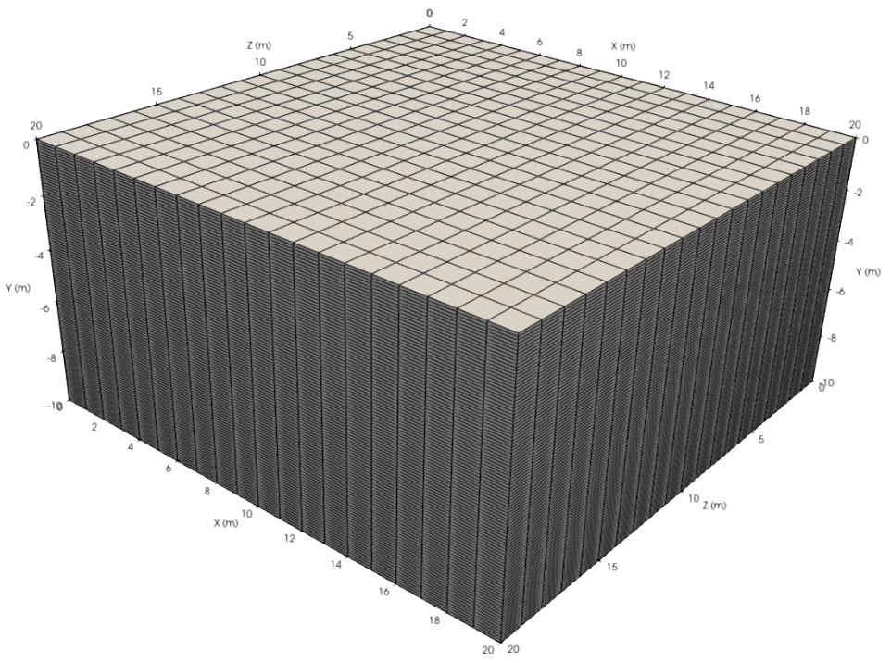
Virtual Ground
20m
20m
Mid-point
1.0m
10m
1.0m
0.1m
Cell size
Parameter values are assumed to be constant in each cell
Geometry
Degree of Freedom (DoF) = 20×100×20 = 40,000

Slide 4
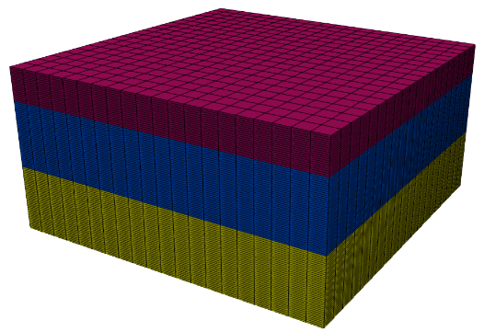
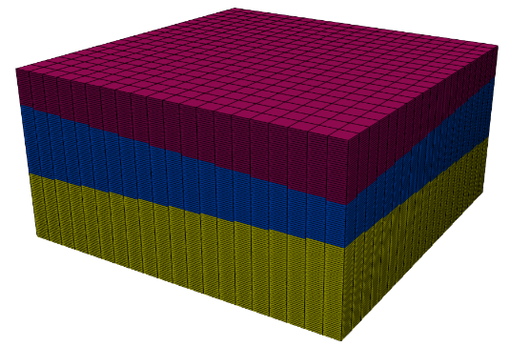
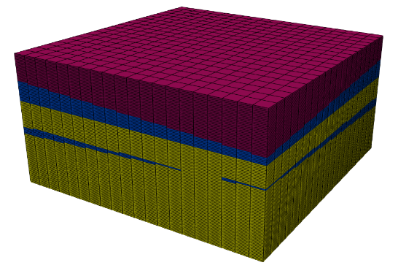
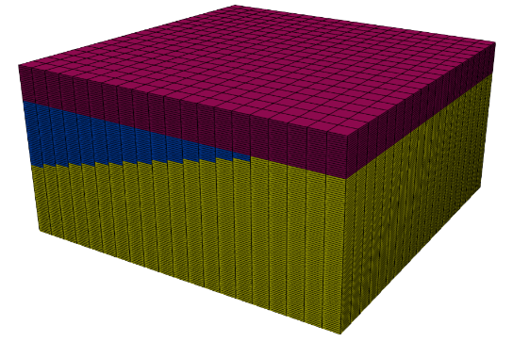
Four Examples
G1: Horizontal layers with constant property trend in each layer
G2: Inclined layers with constant property trend in each layer
G3: Inclined layers with linear property trend in each layer
G4: Mixture of continuous and discontinuous layers with constant trend in each layer

Slide 5
Boundary Surface
X
Z
Layer Boundary 1
Y
*Note that Z is NOT depth
Layer Boundary 2
XYZ coordinates in meters
Parameters in the table
Virtual Ground | Layer Boundary | a | b | c | d
G1 | 1 (top) | 0.00 | 1.00 | 0.00 | -2.00
 | 2 (bottom) | 0.00 | 1.00 | 0.00 | -6.00
G2 | 1 (top) | 0.05 | 1.00 | -0.05 | -2.00
 | 2 (bottom) | -0.05 | 1.00 | 0.05 | -6.00
G3 | 1 (top) | 0.05 | 1.00 | -0.05 | -2.00
 | 2 (bottom) | -0.05 | 1.00 | 0.05 | -6.00
G4 | 1 (top) | 0.00 | 1.00 | 0.00 | -2.00
 | 2 (bottom) | 0.25 | 1.00 | 0.25 | -6.00

Slide 6
Trend model & Stochastic Characteristics
Constant trend (G1, G2, G4)
Linear trend (G3)
y_{i,j}: trend model of q_{t} and f_{s}
Y_{j}: depth in meters
μ: mean (different mean for different soil and property type)
α: parameter for linear trend
ε_{i,j}:a zero-mean 3D random field described by the COV and SoF
Layer | Mean μ |  | Parameter for linear trend α |  | Coefficient of variation (COV) |  | Scale of fluctuation (SoF) |  | Pearson’s r between q_{t} and f_{s}
 | q_{t} (MPa) | f_{s} (kPa) | q_{t} | f_{s} | q_{t} | f_{s} | θ_{h}* (m) | θ_{v} (m)
1: Sand | 9.0 | 110 | -1.0 | -10.0 | 0.24 | 0.24 | 10.0 | 1.0 | 0.7
2: Clay | 2.0 | 75 | 0.2 | 4.0 | 0.20 | 0.20 | 15.0 | 1.2 | 0.7
3: Silt | 5.5 | 85 | 0.2 | 2.0 | 0.24 | 0.24 | 10.0 | 1.0 | 0.7
* Horizontal spatial variability is isotropic

Slide 7
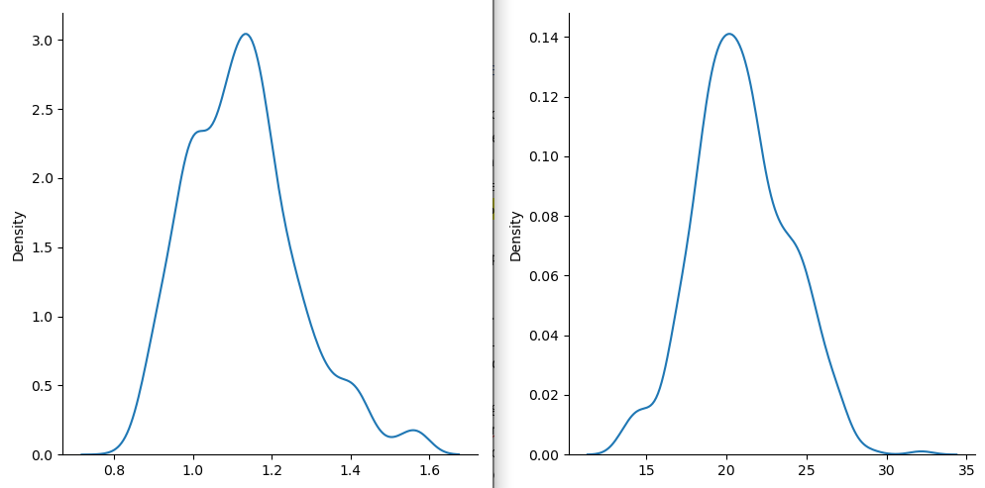
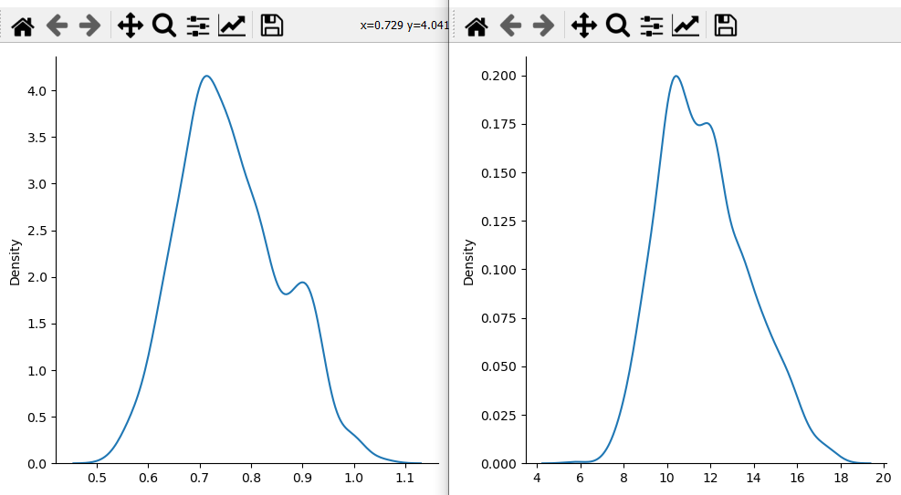
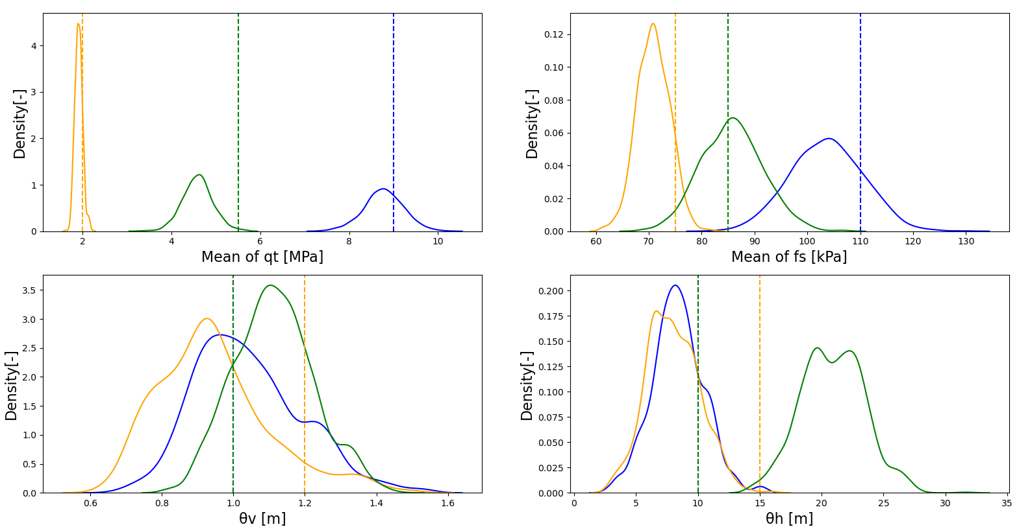
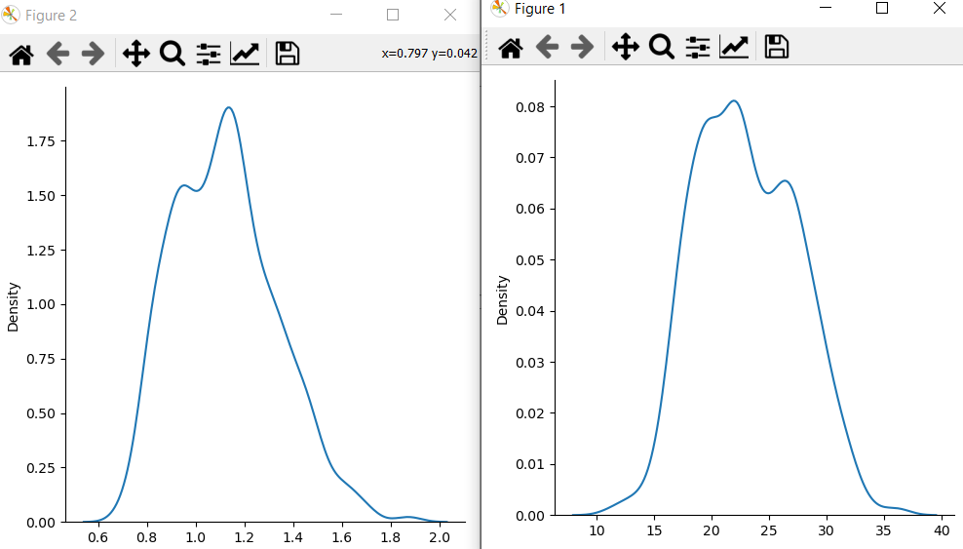
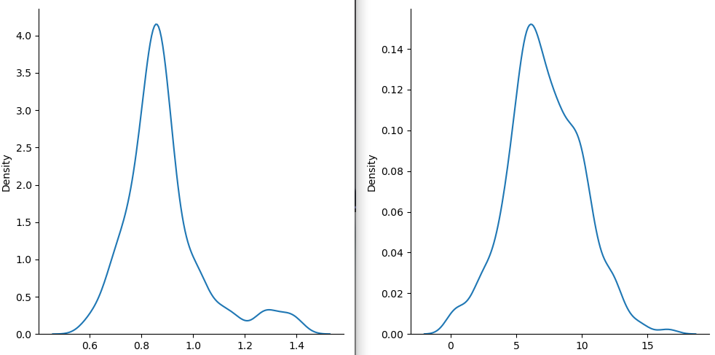
Silt split with SBT
Silt split with geological formation
Clay split with SBT
Clay split with geological formation

Slide 8
Available Data
Cone Penetration Test (CPT) data
Cone tip resistance, q_{t} (MPa)
Sleeve friction, f_{s} (kPa)
Soil behavior type index, I_{c}
z_{i}: depth (m)
[Reference]
Robertson, P. K. and Wride, C. E. (1998). Evaluating cyclic liquefaction potential using the cone penetration test. Canadian Geotechnical Journal, 35, 442-459. https://doi.org/10.1139/t98-017.
Robertson, P. K. and Cabal, K.L. (2010). Estimating soil unit weight from CPT, 2nd International Symposium on Cone Penetration Testing, Huntingon Beach, CA, USA, Volume 2&3: Technical Papers, Session 2: Interpretation, Paper No. 40.
Robertson, P. K. (2016). Cone penetration test (CPT)-based soil behaviour type (SBT) classification system - an update. Canadian Geotechnical Journal, 53(12), 1910-1927. https://doi.org/10.1139/cgj-2016-0044.

Slide 9
Training Set & Validation Set
Location of No.51 CPT data:
(X, Z) = (10.5m, 2.5m)
(X, Z) = (0.0m, 0.0m)
No. 20
No. 51
No. 51
No. 123
No. 119
X
No. 211
No. 304
No. 304
Z
No. 357
No. 357
No.381
Training set 1
No.400
Training set 2
Training set
No. 22
No. 18
No. 51
No. 172
No. 119
No. 108
No. 95
No. 123
No. 211
No. 202
No. 208
No. 196
No. 274
No. 260
No. 304
No. 289
No. 357
No. 371
Training set 3
No. 381
Validation set

Slide 10
Example of Training Set (q_{t})
Layout
: data
: true trend
G1
G2
G3
G4

Slide 11
Benchmark Tasks
Estimating 3D spatial distribution of q_{t} (MPa) using only training data (Assign q_{t} values to all the cells)
3D CPT-based soil stratification (you may use only Ic or all the available data)
Performance Evaluation (See the next slide and the performance summary table that shown later)
Soil Behaviour Type (SBT) Index by Robertson and Wride (1998)
Soil behaviour type index, I_{c} | Zone | Soil behaviour type
I_{c} < 1.31 | 7 | Gravelly sand to dense sand
1.31 < I_{c} < 2.05 | 6 | Sands: clean sand to silty sand
2.05 < I_{c} < 2.60 | 5 | Sand mixtures: silty sand to sandy silt
2.60 < I_{c} < 2.95 | 4 | Silt mixtures: clayey silt to silty clay
2.95 < I_{c} < 3.60 | 3 | Clays: silty clay to clay
I_{c} > 3.60 | 2 | Organic soils: peats

Slide 12
Performance Evaluation Measure
Root-mean-square error:
y_{i}: q_{t} or I_{c} of validation data at the i^{th} depth
x_{i}: Estimated q_{t} or I_{c} value at the i^{th} depth
Identification rate:
SBT(y_{i}), SBT(x_{i}): Soil behavior type that corresponds to y_{i} and x_{i}
*Monte Carlo-based (probabilistic) methods usually do not directly produce a point estimate, and sample mean, median, or mode may be used as x_{i} in those methods.

Slide 13
Yardsticks: Geotechnical Lasso (Shuku and Phoon 2021)
Results of 3D site characterization by Glasso are shown as a yardstick for the benchmarking.
In Glasso, n-dimensional unknown parameter vector x (n = 40,000) is obtained by minimizing the following objective function:
Observation vector
Unknown parameter vector
Linear operator
Linear operator that impose structural sparsity in x
Regularization parameter
In this PPT, only the results for G2-T1, T2, T3 are presented
[Reference]
Shuku, T. and Phoon, K.K. (2021). Three-dimensional subsurface modelling using Geotechnical Lasso, Computers and Geotechnics, 133, 1034068. https://doi.org/10.1016/j.compgeo.2021.104068.

Slide 14
Results: G2-T1
:Best
:Worst

Slide 15
Results: G2-T2
:Best
:Worst

Slide 16
Results: G2-T3
:Best
:Worst

Slide 17
Performance Evaluation
Result of q_{t}
RMSE of I_{c}
Layout 1 = T1
Layout 2 = T2
Layout 3 = T3
Layout 1 = T1
Layout 2 = T2
Layout 3 = T3

Slide 18
Performance Summary
Example No. Type of Virtual Ground | G2
Training set | T1 | T2 | T3
Average RMSE of q_{t} | 3.831 | 2.654 | 2.626
Best RMSE of q_{t} | 1.108 | 1.055 | 1.064
Worst RMSE of q_{t} | 8.670 | 8.450 | 8.357
Average identification rate | 0.61 | 0.79 | 0.80
Best Identification rate | 0.89 | 0.91 | 0.90
Worst identification rate | 0.19 | 0.68 | 0.66
PC Specs | Intel Core i7-8700 CPU at 3.2GHz with 32GB RAM
Execution Time (Training*) [sec] | 32348.764 | 16873.617 | 16811.986
Execution Time [sec] | 6418.469 | 2473.984 | 2482.891
* ”Training” means determining hyper parameter λ

