Slide 1

AI-Driven Sentiment Analysis of Social Media for Mental Health Indicators
Mason Conkel and Sudman Sakib

Slide 2

AI-Driven Sentiment Analysis of Social Media for Mental Health Indicators
Problem
Data
Models
Metrics
Results
Mason Conkel and Sudman Sakib 1

Slide 3

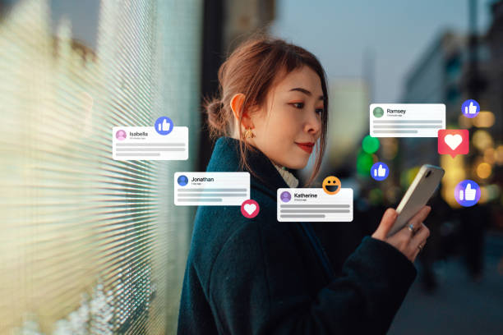
Problem
Social Media declines mental health.
Sentiment Analysis (SA) can predict this decline in users.
Model assurance is key to deploying helpful AI models with explainable and reliable SA.
Mason Conkel and Sudman Sakib 2

Slide 4
AI-Driven Sentiment Analysis of Social Media for Mental Health Indicators
Problem
Data
Models
Metrics
Results
Mason Conkel and Sudman Sakib 3

Slide 5
Datasets
emotion-dataset-raw
Labels for Anger, Disgust, Fear, Joy, Neutral, Sadness, Shame and Surprise for text examples.
sentiment-analysis-for-mental-health
Labels for Anxiety, Bipolar, Depression, Normal, Personality Disorder, Stress and Suicidal for text examples
mental-health-corpus
Binary label for Normal or Mental Health Issue for text.
Mason Conkel and Sudman Sakib 4

Slide 6
AI-Driven Sentiment Analysis of Social Media for Mental Health Indicators
Problem
Data
Models
Metrics
Results
Mason Conkel and Sudman Sakib 5

Slide 7

Model Roles
Emotional Sentiment Model:
Trained on emotion-dataset-raw
Higher weight of two deployed models
Mental Health Model:
Trained on sentiment-analysis-for-mental-health
More difficult to explain than emotions
Pure Test Data:
Mental-health-corpus
Provides unseen data for dual model analysis.
Mason Conkel and Sudman Sakib 6

Slide 8


Model Architectures
GPT2
Decoder-Only Transformer
~110+ million parameters
BERT
Encoder-Only Transformer
~100+ million parameters
Encoder-Only Custom
Smaller transformer built on BERT principles
~9 million parameter (light-weight)
Mason Conkel and Sudman Sakib 7

Slide 9
AI-Driven Sentiment Analysis of Social Media for Mental Health Indicators
Problem
Data
Models
Metrics
Results
Mason Conkel and Sudman Sakib 8

Slide 10
Standard
Accuracy
Training Standard
Correct Predictions of Total Predictions
F1 Score
Typical Analysis Tool
Correct Predictions vs Predictions Concerning Class
Confidence
Typical Measure of Model Assurance
Value at argmax position after a softmax
$F1=\frac{2×TP}{2×TP+FP+FN}=\frac{2×Precision×Recall}{Precision+Recall}$
Mason Conkel and Sudman Sakib 9

Slide 11
Cross-Tabular Probability
Emotion Model Predicts on Mental Health
Intersects Provide Probability Relations
I.E. P(Depression | Sadness) = 41.43%
Mental State | Anxiety | Bipolar | Depression | Normal | Personality Disorder | Stress | Suicidal
Predicted Emotion
Anger | 400 | 502 | 2258 | 1824 | 257 | 610 | 1592
Fear | 1500 | 380 | 1822 | 2501 | 206 | 477 | 1408
Joy | 1329 | 1252 | 4463 | 5007 | 351 | 1027 | 2436
Neutral | 22 | 6 | 102 | 844 | 5 | 13 | 77
Sadness | 551 | 594 | 6382 | 3762 | 244 | 429 | 4888
Surprise | 39 | 43 | 377 | 2405 | 14 | 31 | 179
Mason Conkel and Sudman Sakib 10

Slide 12
Sentiment Awareness
Combination of Metrics
Confidence and Probability.
Explains the assurance of the dual model system.
$SAware=\frac{1}{\sqrt{2}}×P\left(State\text{ | }Emotion\right)×RSS\left({Conf}_{Emotion},{Conf}_{State}\right)$
Mason Conkel and Sudman Sakib 11

Slide 13
AI-Driven Sentiment Analysis of Social Media for Mental Health Indicators
Problem
Data
Models
Metrics
Results
Mason Conkel and Sudman Sakib 12

Slide 14
Sentiment Awareness
“nothing look forward lifei dont many reasons keep going feel like nothing keeps going next day makes want hang myself”
Label: Has Mental Health Issues
GPT2: Sadness, Suicidal (99.98%, 68.22%); SAware (39.54%)
BERT: Sadness, Suicidal (88.76%, 74.04%); SAware (55.38%)
Custom: Joy, Suicidal (59.65%, 44.14%); SAware (3.07%)
Mason Conkel and Sudman Sakib 13

Slide 15
Sentiment Awareness
“finally upgarded grandma bought new phone beneath using s yearsd”
Label: Normal
GPT2: Neutral, Normal (96.06%, 81.21%); SAware (4.59%)
BERT: Sadness, Normal (55.48%, 99,98%); SAware (26.96%)
Custom: Neutral, Normal (97.16%, 91.39%); SAware (6.19%)
Mason Conkel and Sudman Sakib 14

Slide 16
Sentiment Awareness
“rabbit died rabbit named thumper died fell garden pot broke neck really nice bunny fearless scared anyone add insult injury happened right birthday idk posting sad”
Label: Normal
GPT2: Sadness, Suicidal (99.98%, 78.45%); SAware (41.52%)
BERT: Sadness, Normal (99.29%, 99.96%); SAware (32.89%)
Custom: Anger, Suicidal (99.99%, 86.67%); SAware (5.96%)
Mason Conkel and Sudman Sakib 15

Slide 17
Discussion
SAware allows the adjustment of thresholds to compensate for small values.
Threshold of 3.0% for the custom model will solve drift for low probability labels.
Expert can adjust thresholds and use to automate tasks even with small models.
Mason Conkel and Sudman Sakib 16

Slide 18
AI-Driven Sentiment Analysis of Social Media for Mental Health Indicators
Problem
Data
Models
Metrics
Results
Mason Conkel and Sudman Sakib 17

Slide 19
AI-Driven Sentiment Analysis of Social Media for Mental Health Indicators
Problem & Data:
Sentiment Analysis for Mental Health using Labeled Social Media
Models
Dual, Distinct Models using GPT2, BERT and Encode-Transformer
Metrics and Results
Accuracy, F1 Score, Confidence, Probability of Cross-Tabular Intersection and Sentiment Awareness
Sentiment Awareness provides actionable and tunable metric for to explain and assure decision making.
Mason Conkel and Sudman Sakib 18

Slide 20

utsa.edu
Notes:
Add icons for each department.

