Slide 1
Project CASA: Status update – week 11
Supporting Document for first SteerCo Meeting
May 2, 2017
Yevgeniya Chekh, Jan Kohout, David Löffler, Miroslav Rudišin, Kryštof Sýkora, Marek Szeles, Ho Minh Thanh

Slide 2
Goals for this Meeting
Present overview of project status
Review code translating progress
Review code testing progress
Define next steps

Slide 3
Project team assesment

Slide 4
Project Team Update
Team Role | Name | Contact
Project Lead | Marek Szeles | szelemar@fel.cvut.cz
Analyst | Ho Minh Thanh | homintha@fel.cvut.cz
Head of Development | David Löffler | loffldav@fel.cvut.cz
Head of Testing | Kryštof Sýkora | sykorkry@fel.cvut.cz
Developer | Miroslav Rudišin | rudismi1@fel.cvut.cz
Developer | Jan Kohout | kohouj13@fel.cvut.cz
Tester | Yevgeniya Chekh | chekhyev@fel.cvut.cz

Slide 5
Project status overview

Slide 6
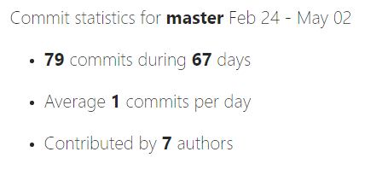
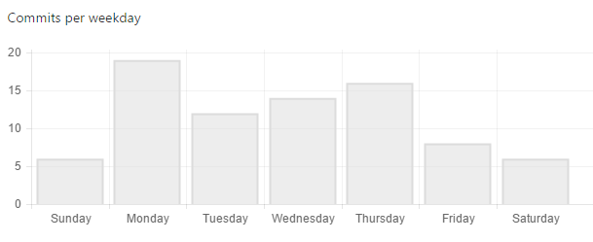
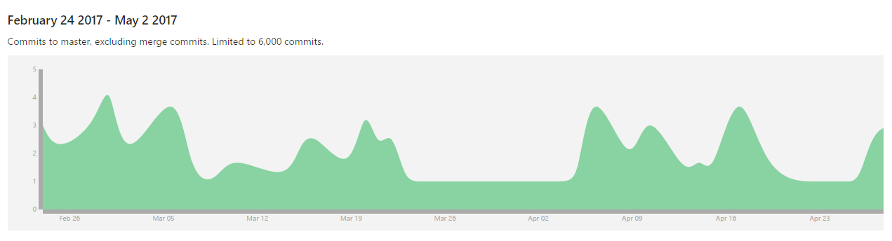
Project is being steadily updated…

Slide 7
…and we are still within planned schedule
Feb
Mar
Apr
May
Activity
08
09
10
11
12
13
14
15
16
17
18
19
20
21
Project Scope Analysis
CASA Architecture Mapping
Documentation Creation
Development in Java
Testing
SteerCo Meetings
Milestones
23. Feb 2017
Team Assembly
02. Mar 2017
Proposal Agreement
16. Mar 2017
Start of
Development
27. Apr 2017
Testing Phase
25. May 2017
Final outcome
hand-in
We are
here
Rector day off

Slide 8
Development update

Slide 9
Development progress
CASA
1
2
3
casa
common
minisat
1.1
1.5
2.1
3.1
algorithms
io
posix
solver
1.2
1.6
2.2
3.2
annealing
sat
utility
include
1.3
1.7
covering
search
1.4
events
Main.C

Slide 10
Full Project View: Last meeting (20.4.2017)
1
2.1
2
1.1
1.2
2.2
1.3
1.5
1.4
Legend
1.7
Not started
1.6
In progress
3
Finished
3.1
3.2
Change request

Slide 11
Full Project View: Current status (2.5.2017)
1
2.1
2
1.1
1.2
2.2
1.3
1.5
1.4
Legend
1.7
Not started
1.6
In progress
3
Finished
3.1
3.2
Change request

Slide 12
Testing update

Slide 13
High-level View
CASA
1
2
3
casa
common
minisat
1.1
1.5
2.1
3.1
algorithms
io
posix
solver
1.2
1.6
2.2
3.2
annealing
sat
utility
include
1.3
1.7
covering
search
1.4
events
Main.C

Slide 14


Unit testing overview
1
2.1
2
1.1
1.2
2.2
1.3
1.5
1.4
Legend
1.7
Header file
1.6
C file
3
Dependency
3.1
3.2

