Slide 1
Project CASA: Final Project Presentation
May 25, 2017
Yevgeniya Chekh, Jan Kohout, David Löffler, Miroslav Rudišin, Kryštof Sýkora, Marek Szeles, Ho Minh Thanh

Slide 2
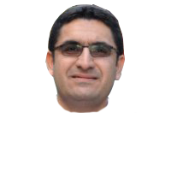
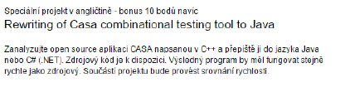
What is CASA?

Slide 3
So… Is CASA a success?

Slide 4
Why?
Docs stats here

Slide 5
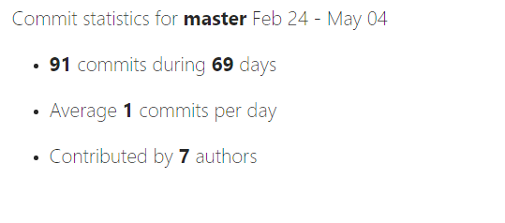
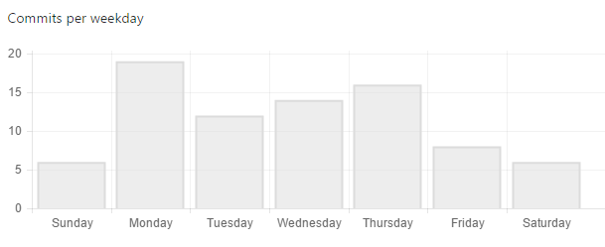
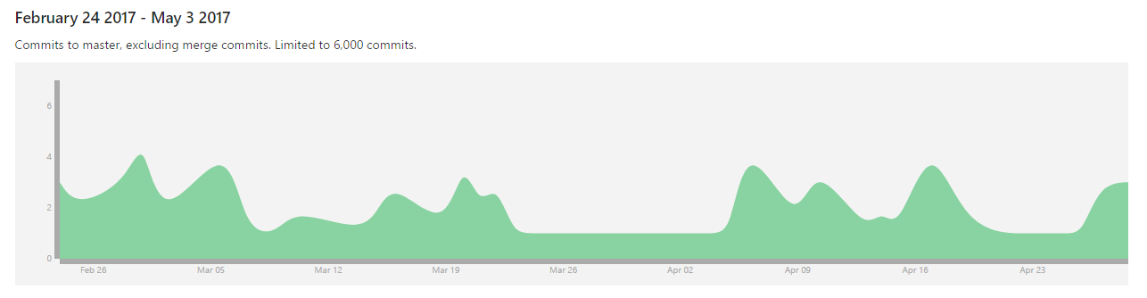
Also why?

Slide 6
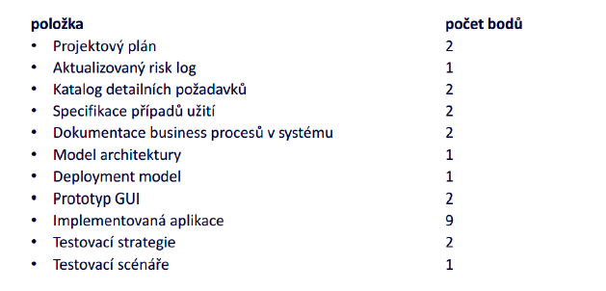
Let‘s take a look at the official rules though:

Slide 7
Let‘s take a look at the official rules though:

Slide 8
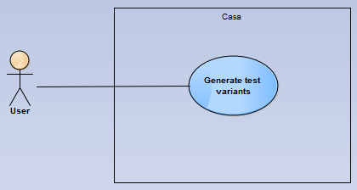
Use case

Slide 9
Old slides

Slide 10
CASA is a success!
Present overview of project status
Review code translating progress
Review code testing progress
Define next steps

Slide 11
Project team assesment

Slide 12
Project Team Update
Team Role | Name | Contact
Project Lead | Marek Szeles | szelemar@fel.cvut.cz
Analyst | Ho Minh Thanh | homintha@fel.cvut.cz
Head of Development | David Löffler | loffldav@fel.cvut.cz
Head of Testing | Kryštof Sýkora | sykorkry@fel.cvut.cz
Developer | Miroslav Rudišin | rudismi1@fel.cvut.cz
Developer | Jan Kohout | kohouj13@fel.cvut.cz
Tester | Yevgeniya Chekh | chekhyev@fel.cvut.cz

Slide 13
Project status overview

Slide 14
Project is being steadily updated…

Slide 15
…and we are still within planned schedule
Feb
Mar
Apr
May
Activity
08
09
10
11
12
13
14
15
16
17
18
19
20
21
Project Scope Analysis
CASA Architecture Mapping
Documentation Creation
Development in Java
Testing
SteerCo Meetings
Milestones
23. Feb 2017
Team Assembly
02. Mar 2017
Proposal Agreement
16. Mar 2017
Start of
Development
27. Apr 2017
Testing Phase
25. May 2017
Final outcome
hand-in
We are
here
Rector day off

Slide 16
Today we need to:
Resolve change requests
Discuss translation problems
Revise testing strategy
We would like to implement some changes to the original code in the two parsing modules
See attachment (ChR: Parsing Analysis)
Some problems have arisen during code translation
In some modules, test stubs are already in place -

Slide 17
Development update

Slide 18
Development progress
CASA
1
2
3
casa
common
minisat
1.1
1.5
2.1
3.1
algorithms
io
posix
solver
1.2
1.6
2.2
3.2
annealing
sat
utility
include
1.3
1.7
covering
search
1.4
events
Main.C

Slide 19
Full Project View: Last meeting (20.4.2017)
1
2.1
2
1.1
1.2
2.2
1.3
1.5
1.4
Legend
Not started
1.7
1.6
In progress
3
Finished
3.1
3.2
Change request

Slide 20
Full Project View: Current status (4.5.2017)
1
2.1
2
1.1
1.2
2.2
1.3
1.5
1.4
Legend
Not started
1.7
1.6
In progress
3
Finished
3.1
3.2
Change request

Slide 21
Testing update

Slide 22
High-level View
CASA
1
2
3
casa
common
minisat
1.1
1.5
2.1
3.1
algorithms
io
posix
solver
1.2
1.6
2.2
3.2
annealing
sat
utility
include
1.3
1.7
covering
search
1.4
events
Main.C

Slide 23
Unit testing overview
1
2.1
2
1.1
1.2
2.2
1.3
1.5
1.4
Legend
Not started
1.7
1.6
In progress
3
Finished
3.1
3.2
Change request

