Slide 1
Project Staffr: Status report v1
October 5, 2017
Kryštof Sýkora, Marek Szeles

Slide 2
What is Staffr?
Staff managemenet system
Allows for administration of staff, projects, offices, etc.
Helps search for relevant employees for a project

Slide 3
Original Schedule
Jul
Aug
Sep
Oct
Activity
26
27
28
29
30
31
32
33
34
35
36
37
38
39
40
Document creation
Learning
Development
Meetings
1.7.
16.7.
28.7.
25.8.
17.9.
Milestones
CP0
3.7.
CP1
20.8.
CP2
22.9.
Start of new semester
1.10.
FS Hungary
19.7. - 23.7.
FS Czech + UK
2.8. - 20.8.
Boat trip
24.7. - 27.7.

Slide 4

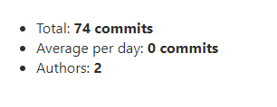
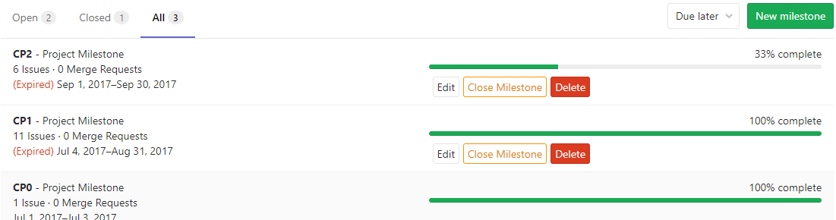
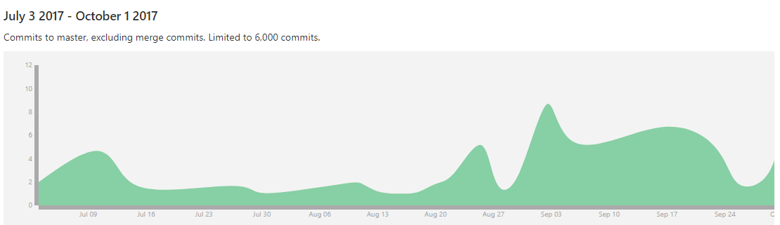
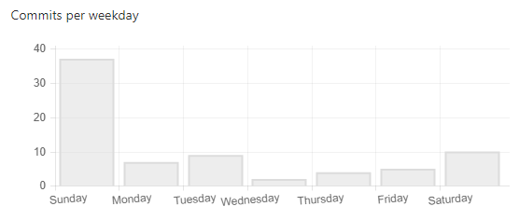
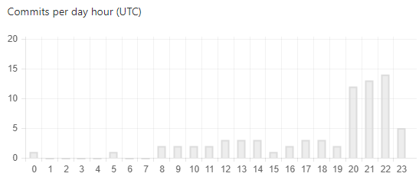
Current status

Slide 5
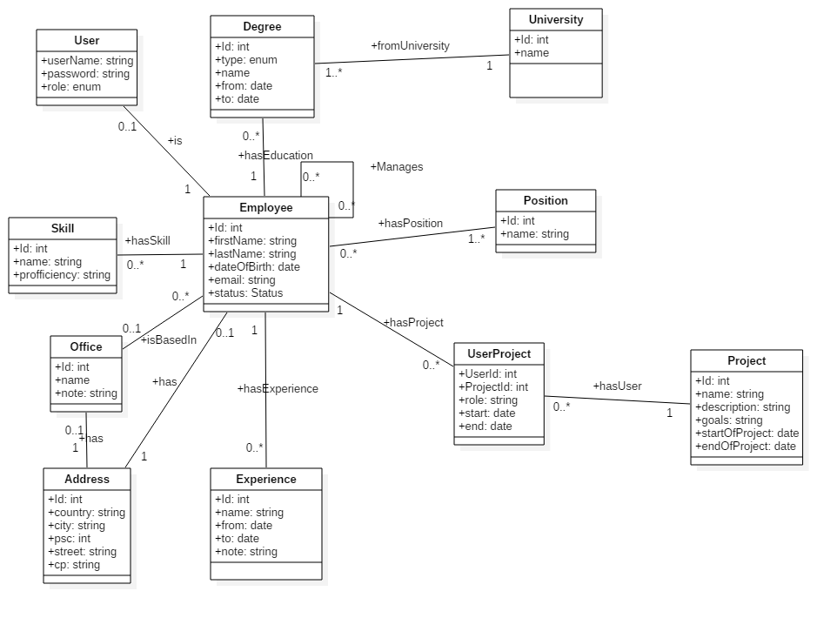
Domain model

