Slide 1













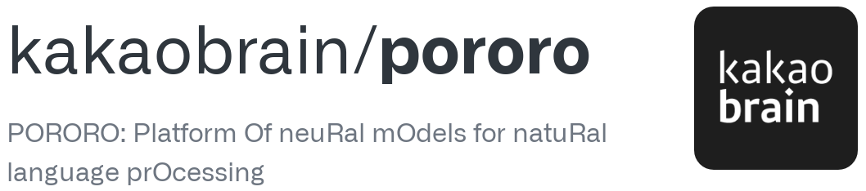
AWS Cloud
Web Crawling
Sentiment & Topic Analysis Results
Users
MUSINSA
Website Crawling

