Slide 1


Research Proposal
Intelligent Management of Campus Water Supply System
topic：
Water Supply System

Slide 2
https://www.ypppt.com/
CONTENT
Background and Significance
PART 1
PART 2
Research Methodology
PART 3
Relevant Literature
PART 4
Research Questions
PART 5
References

Slide 3
01
Background and Significance

Slide 4


Background
No.1
The campus water supply system is an important part of the campus public facilities, and the school needs to invest a lot of man power, material and financial resources in order to ensure the normal operation of the campus water supply system.
No.2
With the development of science and technology, smart water meters have been widely used on campus, so that a large amount of real-time water supply system operation data can be obtained.

Slide 5
Signifiancere
Meaning
Effectively improve the level of campus services and management about the water supply system.

Slide 6
02
Research Methodology

Slide 7
Research Methodology
No.1
From a statistical point of view, analyze the statistical characteristics of the data.
No.2
method
Establish a multivariate linear regression model, and find the optimal model through least squares method and error analysis.
No.3
Establish 2σ standard deviation extraction exception data model.

Slide 8
03
Relevant Literature

Slide 9
Relevant Literature
Litreature review
[1]朱乃富.基于数据驱动的供水管网独立计量分区漏损检测和定位方法研究.2019.浙江大学,MA thesis.
[2]卓严报.基于支持向量机的城市给水管网故障诊断研究.2013.重庆大学,MA thesis.
[3]王凌.维修决策模型和方法的理论与应用研究.2007.浙江大学,PhD dissertation.

Slide 10
04
Research Questions

Slide 11
Research Question
1
Statistics and analysis of the changes in the data of each water meter, and give the water use characteristics of different functional areas (dormitories, teaching buildings, office buildings, canteens, etc.) on campus.
Combine the hierarchical relationship of water meters in the campus, establish a relationship model of water meter data, and use the existing data analysis model errors.
question
2

Slide 12
05
Reference

Slide 13
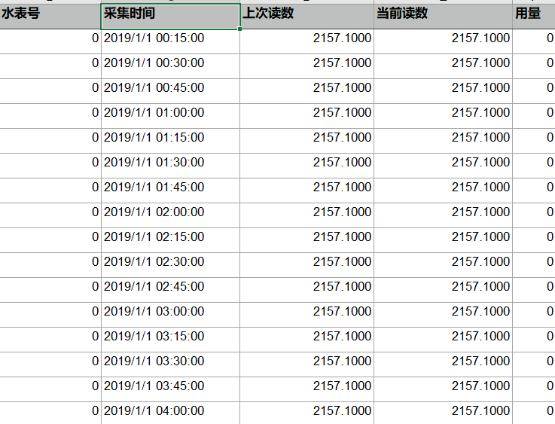
Reference
Data Set(partial)
The hierarchical relationship of water meters on a campus and the readings of all water meters for four quarters (at intervals of time, such as 15 minutes) and the corresponding water use data.

Slide 14
Thanks For Watching

