Slide 1
Portfolio
Sean Vasey
f5093049
Link to GitHub Repo

Slide 2
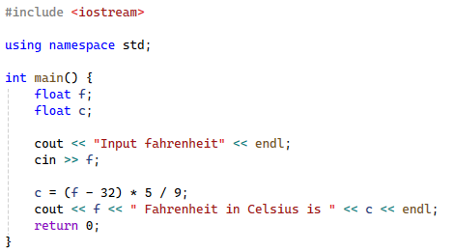

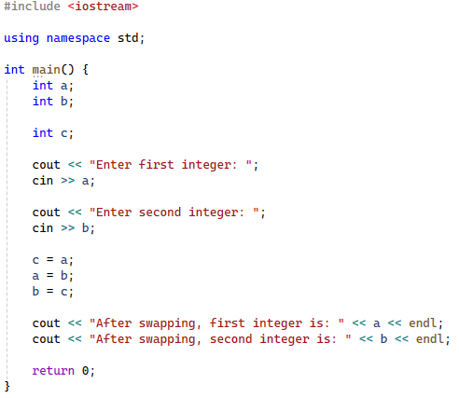
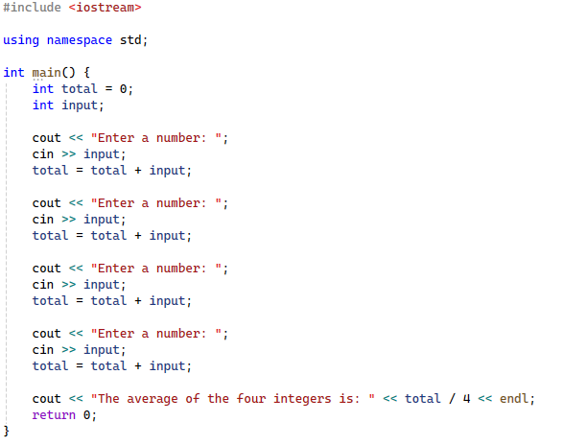
Week 1: Types and Variables
This week, we learned how to use basic types, variables and arithmetic operators.
Fahrenheit Calculator
Average Calculator
Integer Swap

Slide 3
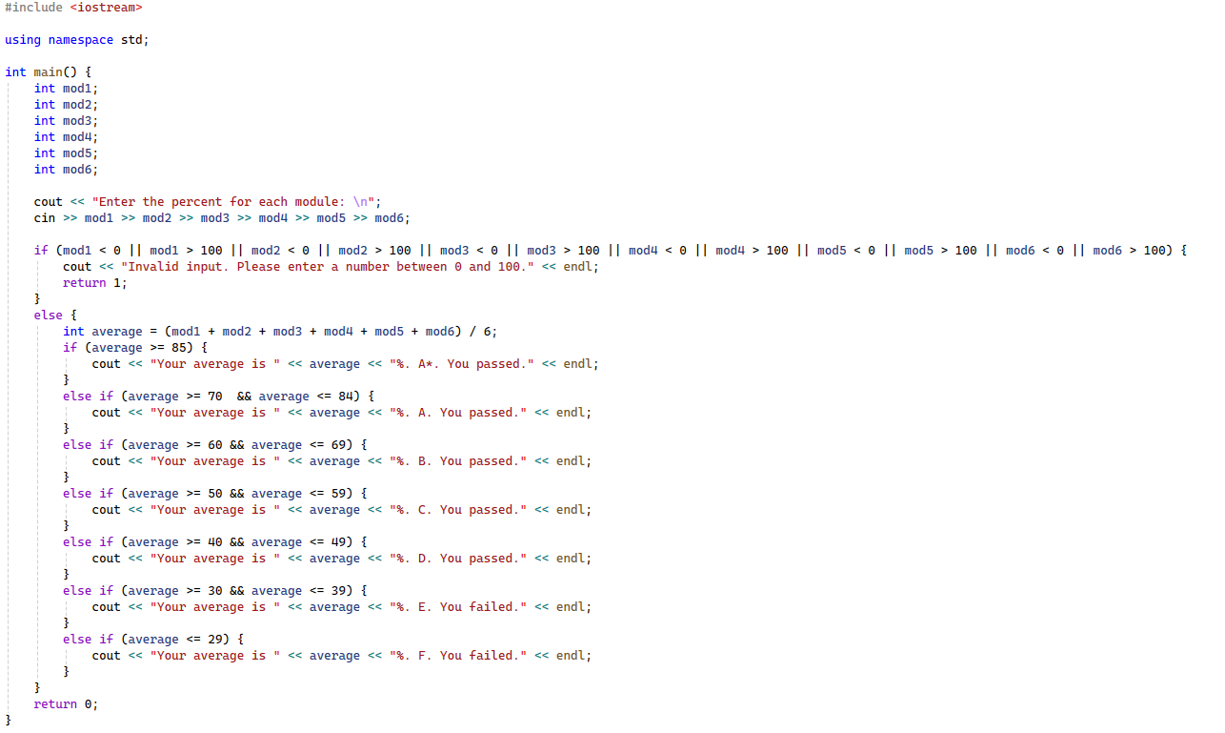
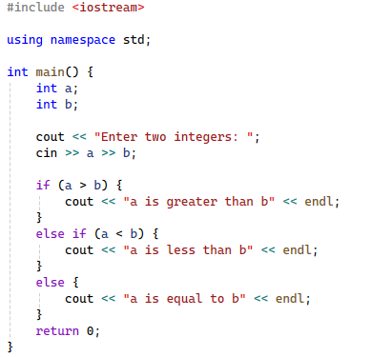
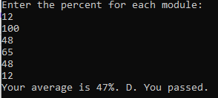
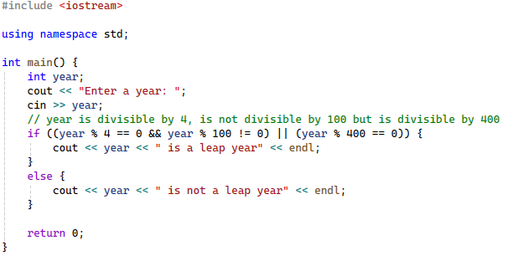
Week 2: Boolean logic and Conditionals
This week, we learned how to use Booleans and conditional logic such as if/else statements
Grade Calculator
Leap year calculator
More/Less

Slide 4
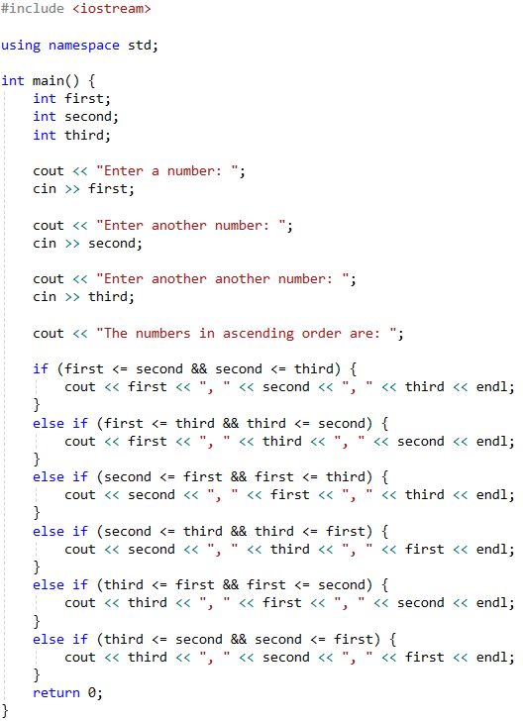
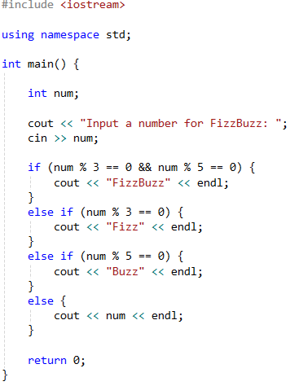
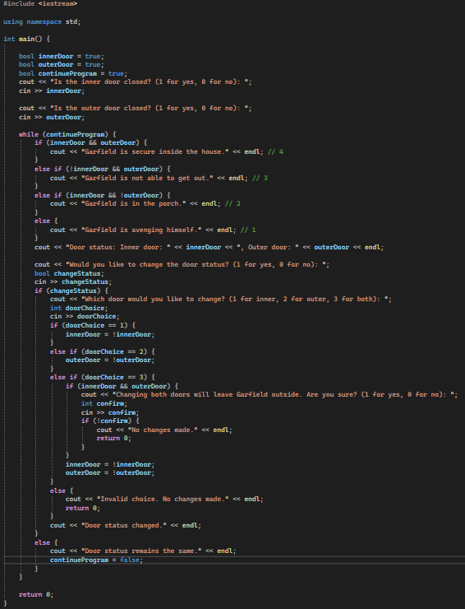

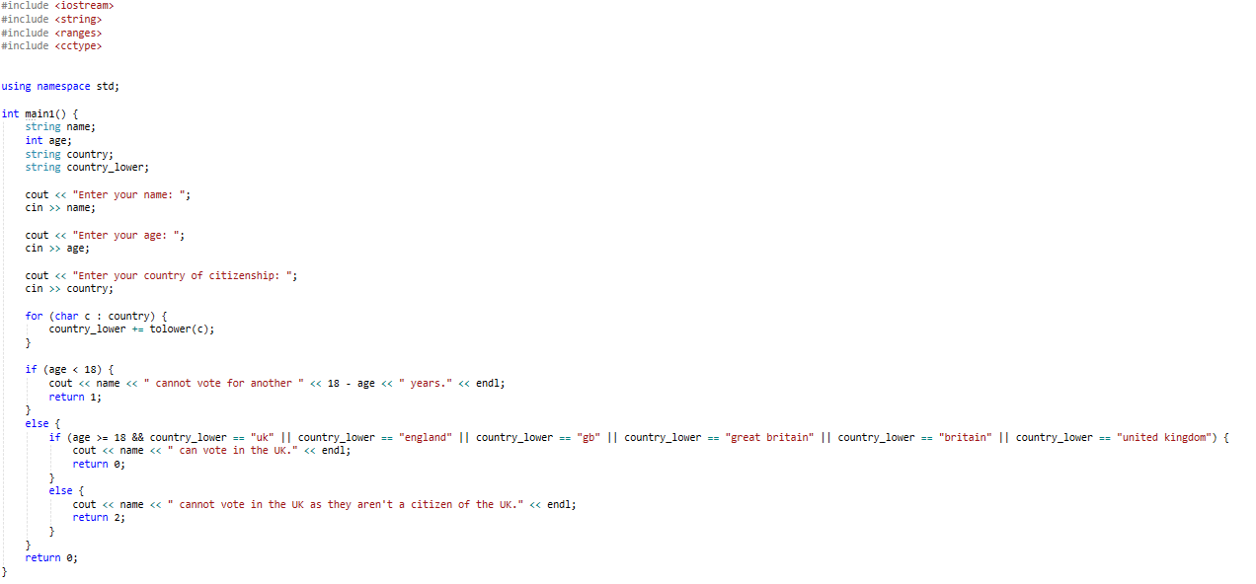

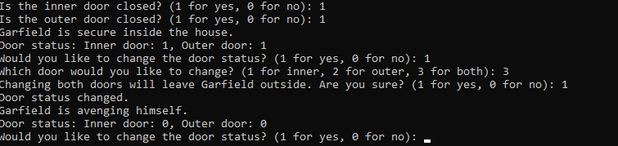
Simplified FizzBuzz
Week 2: Boolean logic and Conditionals
Garfield and his cat doors
Sorting using ifs
Voting

Slide 5
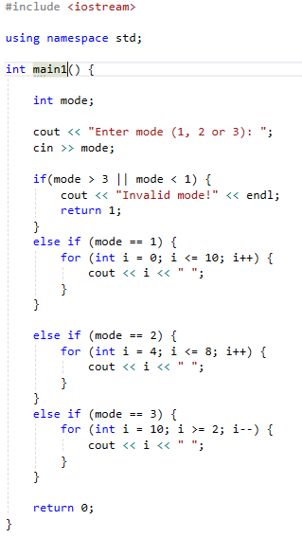
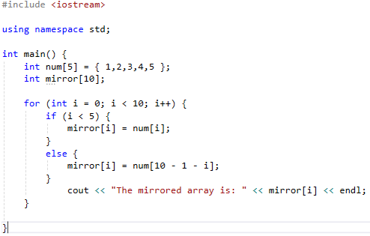
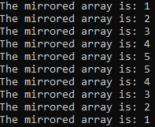
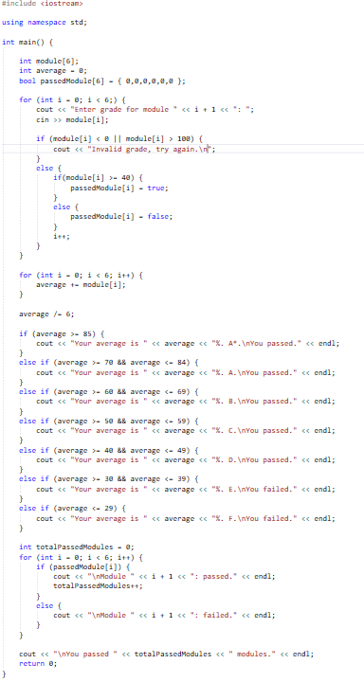
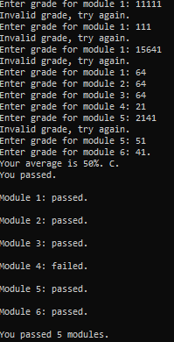
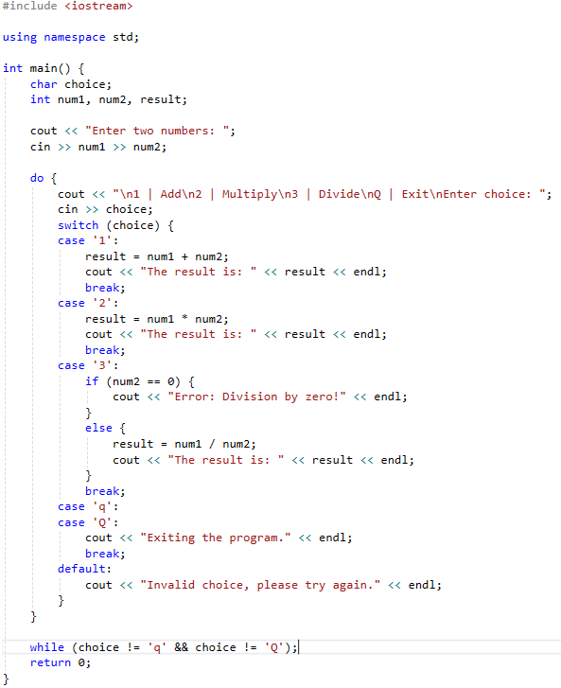
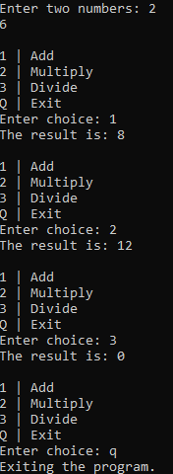
For Loop practice
Week 3: Arrays and Loops
Mirror array
This week, we learned how to use arrays and loops efficiently.
Grade Calculator
Revisited
More/Less

Slide 6
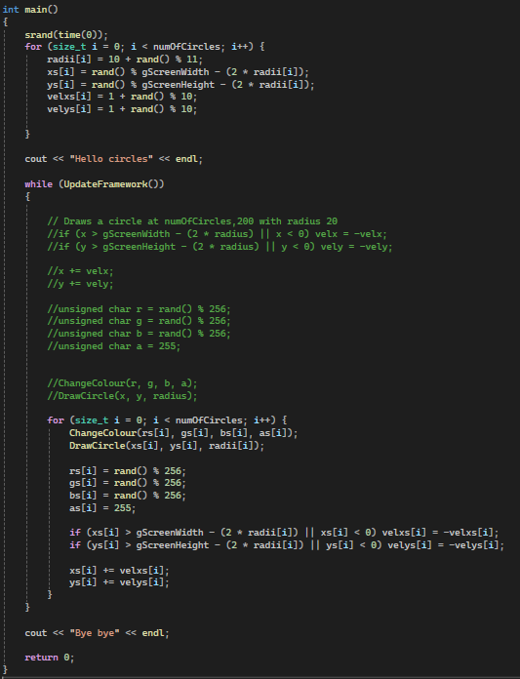
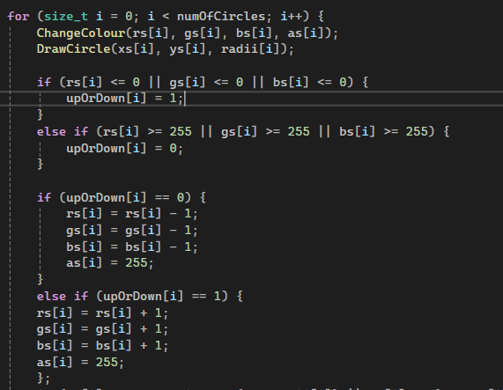
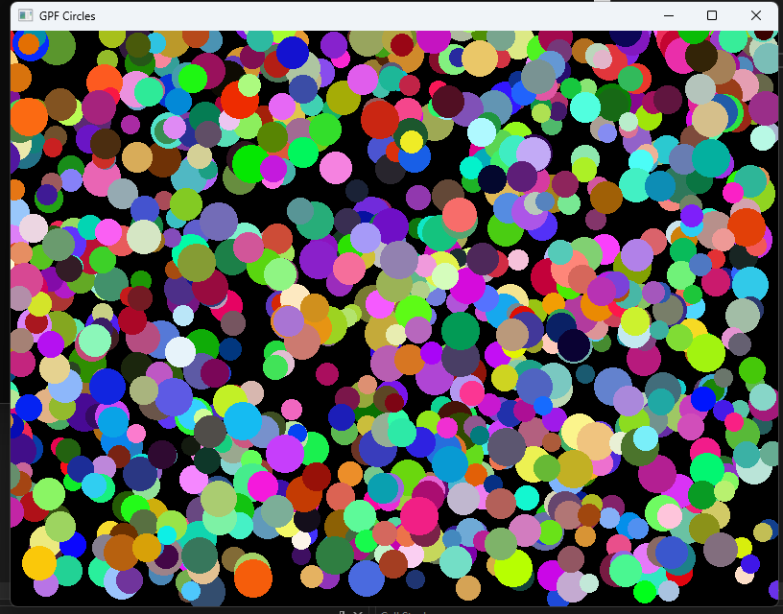
Week 4: Containers
Circles bounce off of edge with random speed
This week, we learned how to use containers by creating a circle example.
Change colour smoothly
Support for ‘infinite’ multicoloured circles

Slide 7
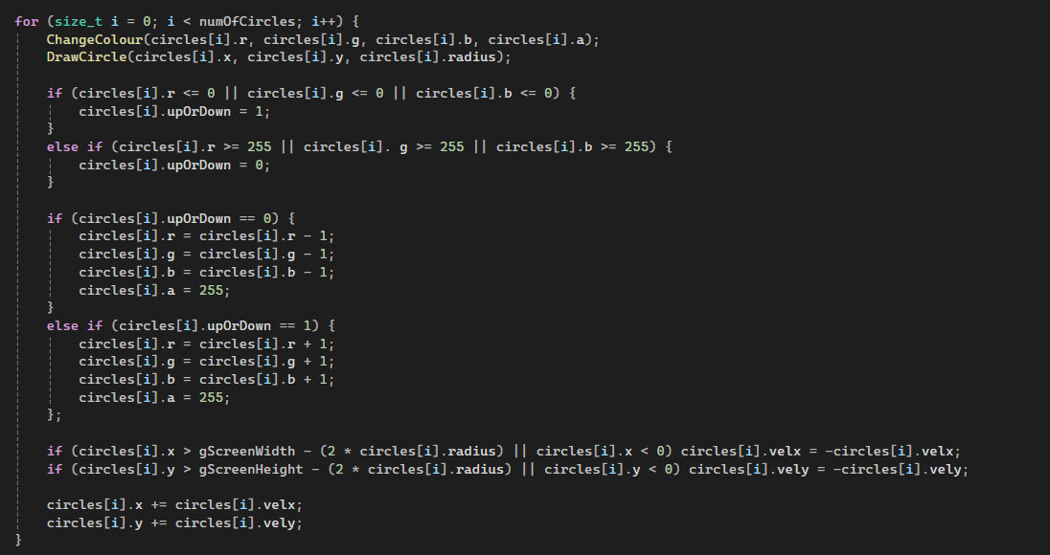
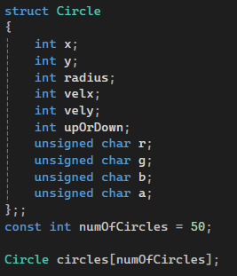
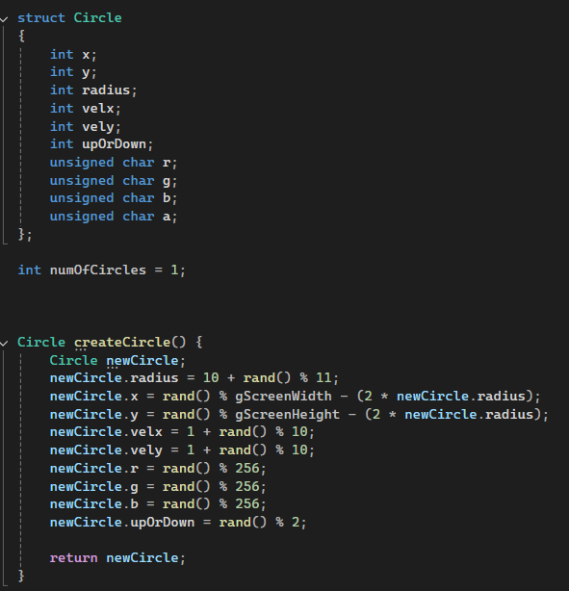
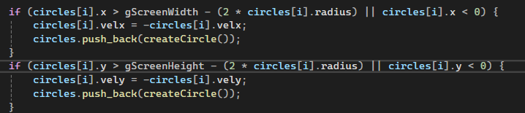
Week 5: Structures
This week, we learned how to use structures.
Using Vectors
Hydra-style Circle Gen

Slide 8
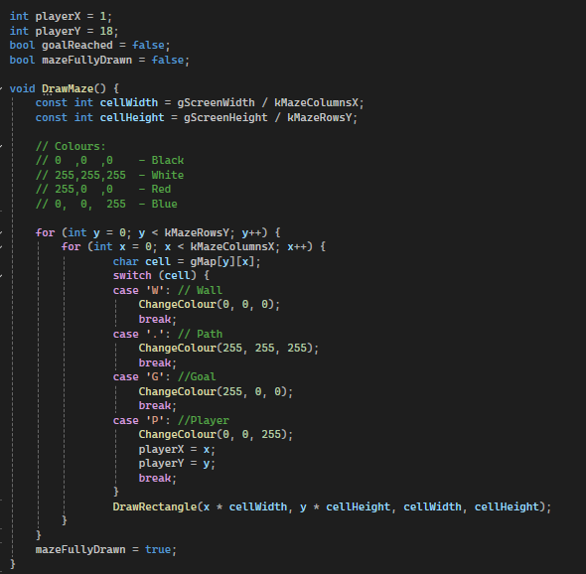
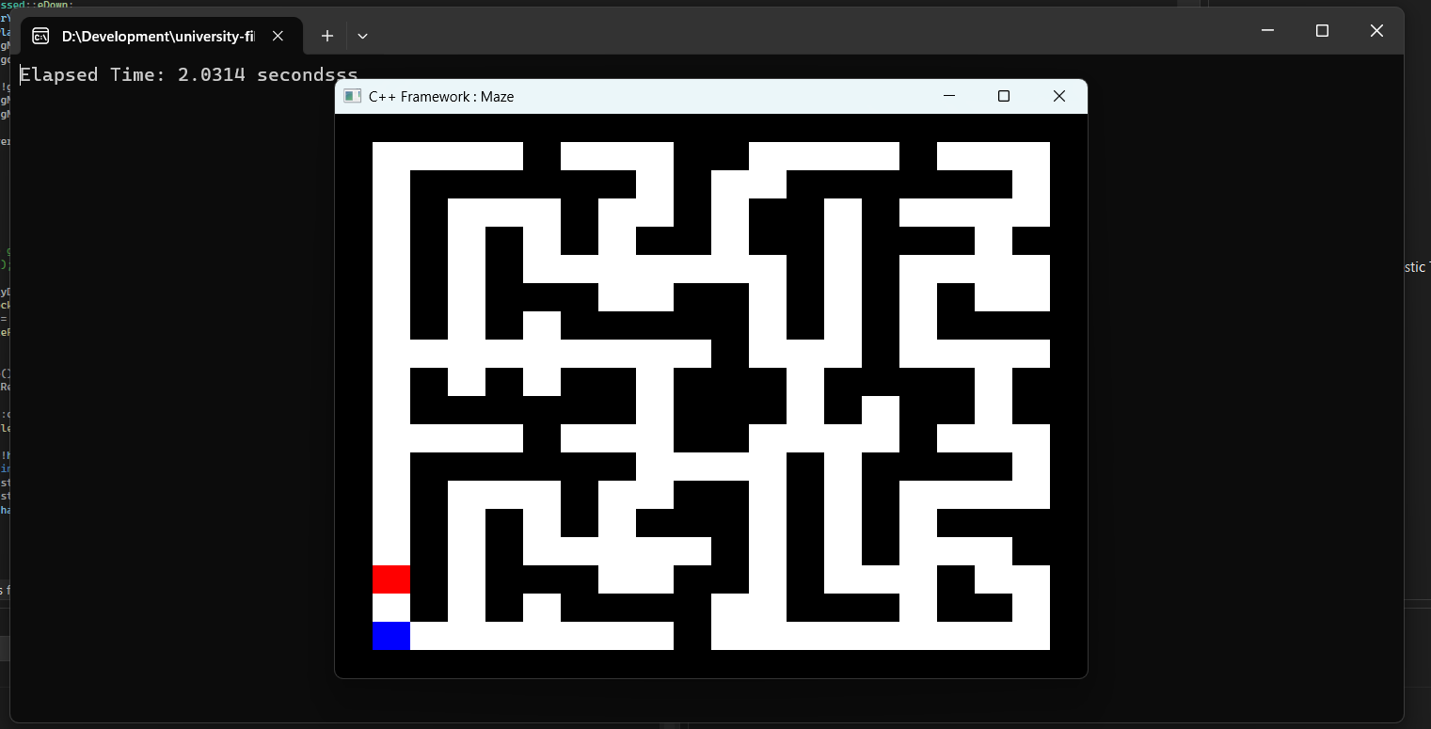
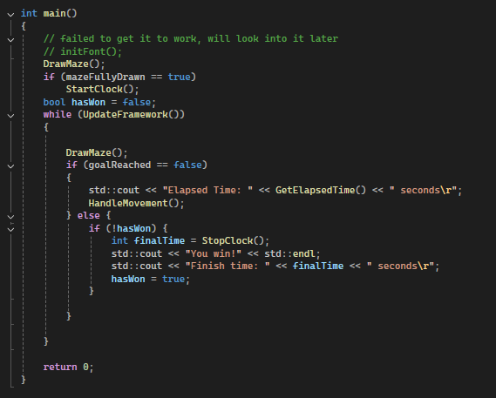
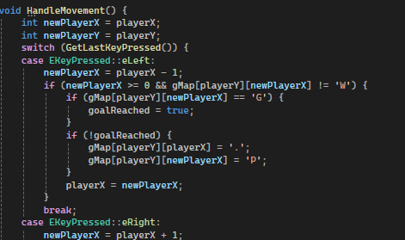
Drawing Maze logic
Week 6-7: Maze
This week, we learned how to make a maze game
Player Movement
Maze running
Main loop

Slide 9
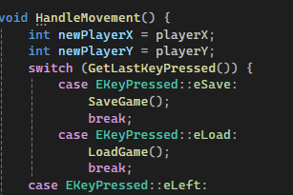
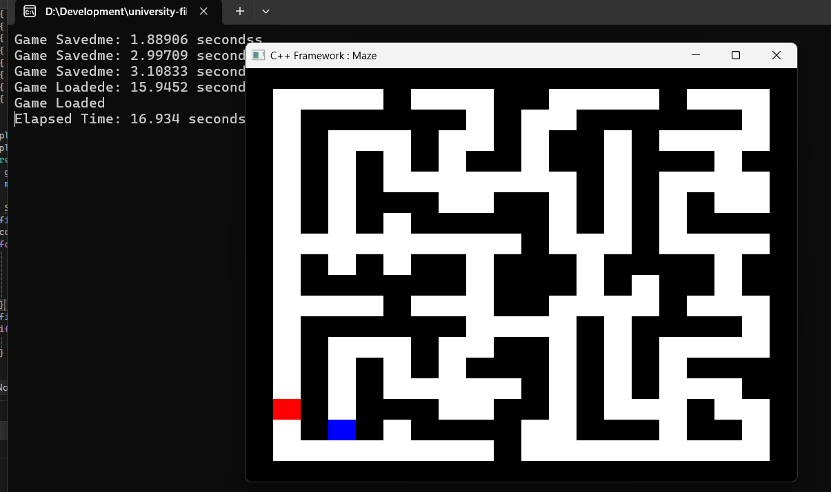
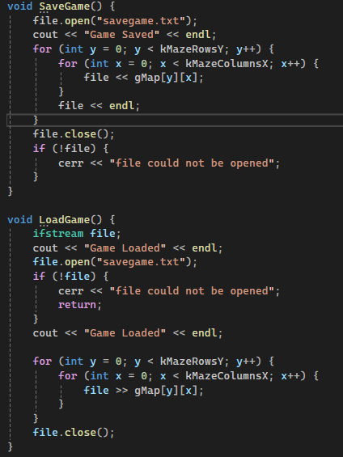
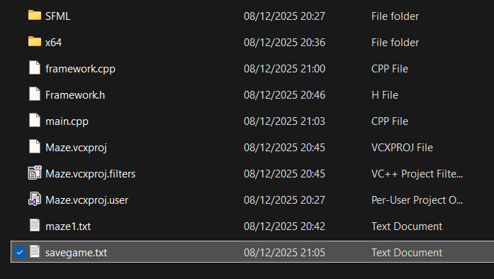
Save/Load
Week 8: File Saving
This week, we learned how to save the players position in the maze.
File Location
Proof of Work
SaveGame
/
LoadGame
functions

Slide 10
Break week!
Week 9 was Animex week.

Slide 11
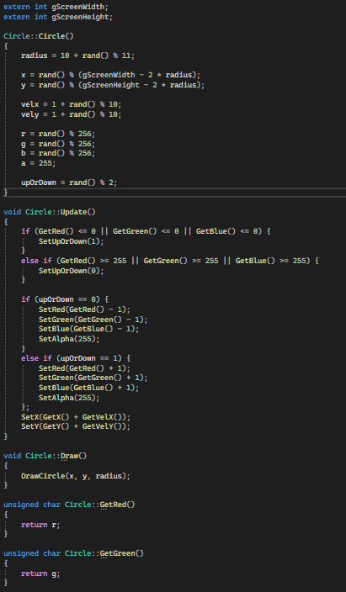
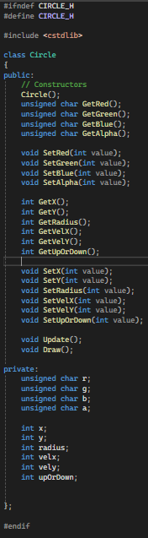
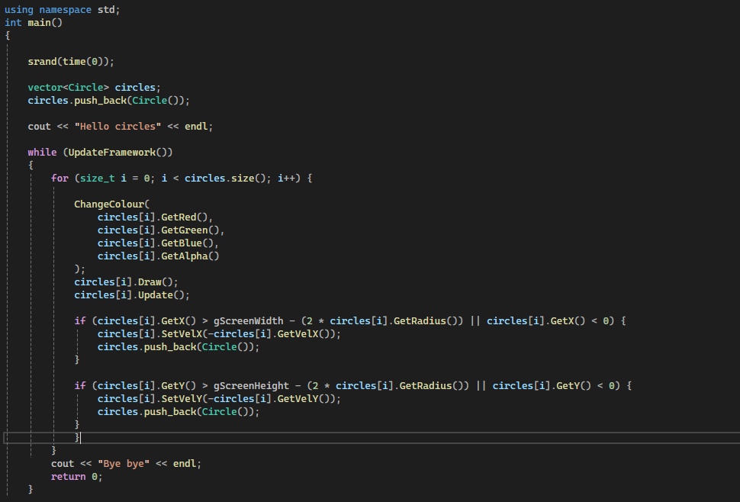
Week 10: Classes
This week, we learned how to use classes in relation to the week 4/5 Circle worksheet.
Main.cpp after using classes
Circle.cpp and Circle.h

Slide 12
Reflection
I went into this module with little to no knowledge of C++, but relatively good knowledge of Python and general programming concepts. This made learning the language and syntax a lot easier than if I knew nothing at all. The hardest thing I found was figuring out how header files worked and how to use multiple .cpp files to handle code but I got there in the end and could confidently create header files more efficiently.
From this module, I have learned how to properly use C++ and how to apply proper technique to specific programming fundamentals. I still believe there is room to improve on some things such as file handling and pointers, but I don’t doubt I could learn it with enough time and effort. In the future, I wish to work on C++ more and improve my skills as it is one of the more sought-after languages.

