Slide 1


FantaManager
Large-Scale and Multi-Structured Databases
Emmanuel Piazza, Edoardo Focacci, Matteo Razzai

Slide 2
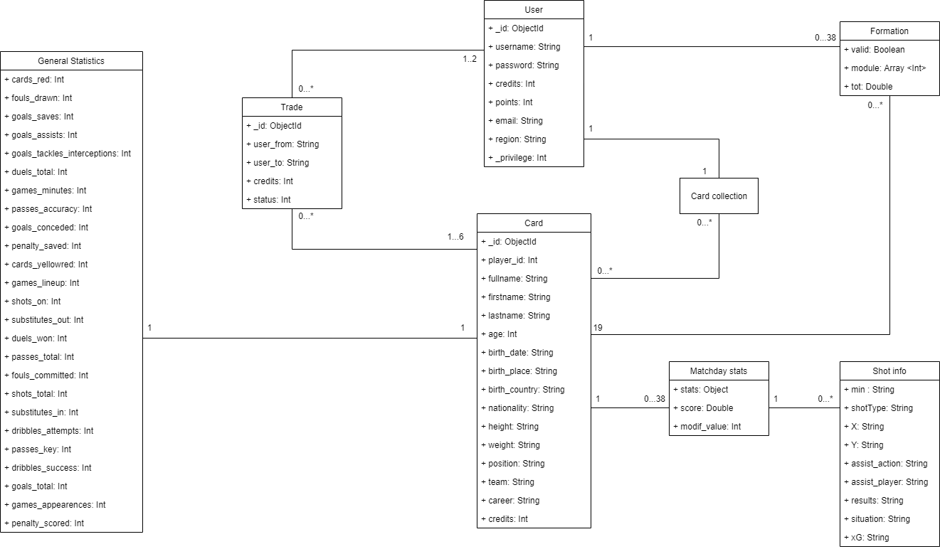
UML Class Diagram

Slide 3
Dataset Description
Source: Wikipedia – Understats – Kickest - APIFootball
Description: Information about players retrieved by scraping. Users’ information and trade offers are randomly generated.
Volume: At the beginning, the database is filled up only with players and users' information. Every week the admin will add the rating of the week for every player.
Variety: Statistics and rating of players retrieved from different sites. Wikipedia page of players used for retrieve a brief description of him.
Velocity/Variability: Stats and rate of every player is retrieved at the end of every matchday. The statistics of the past weeks stays in the database and from them the value of the players is calculated

Slide 4
Non-Functional Requirements
The application needs to be consistent regarding the application’s economy (trade and credits) to provide fair information among users.
The transactions must be monotonic: every user must see the last version of the data and every trade request must be managed in the same order they are accepted.
The password must be protected and stored encrypted for privacy issues.
The system will be available 24 * 7.
A Graphical User Interface is crucial for an involving game experience.
The statistics regarding cards are not needed to be real-time, they are updated periodically, and they will be eventually consistent.

Slide 5
Non-Functional Requirements and CAP Theorem
According to Non-Functional Requirements, our system must guarantee a high consistency and stability.
Consistency and Partitioning are the edges chosen from the CAP Triangle (Users and Trades collection)
It is important that all users see the same version of the data, especially for the Trades entity. Only the primary server can accept writes, whereas the secondary in some cases can make the workload of the primary lighter by accepting some read (only from Cards entity).
The partition tolerance is guarantee thanks to MongoDB replica set feature design. If one server is down, we can continue to offer out service by searching contents from replicas.

Slide 6
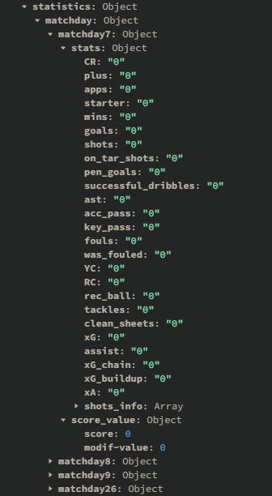
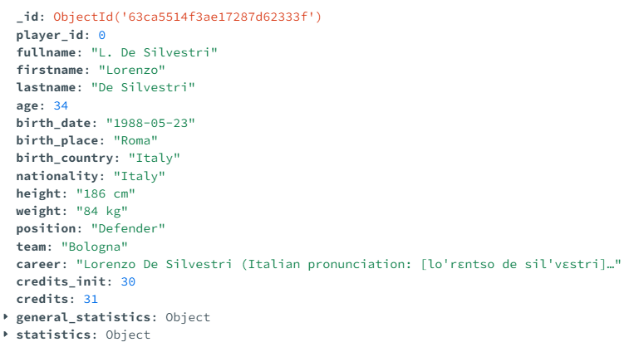
Database design MongoDB (1)
Stored entities:
Users – Trades – Cards
Statistics attribute from Cards entity
Cards entity

Slide 7
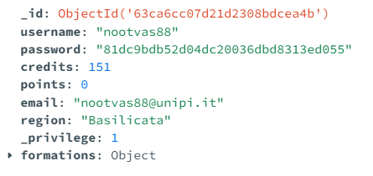
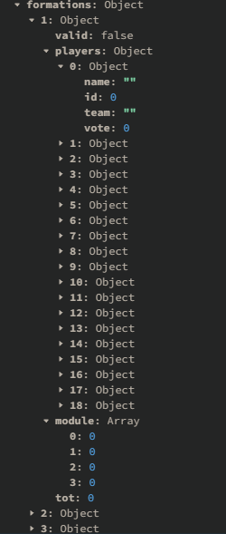
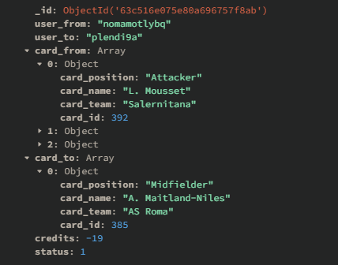
Database design MongoDB (2)
Users entity
Trades entity
Formations attribute from
Users entity

Slide 8
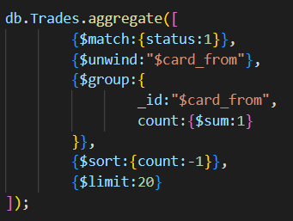
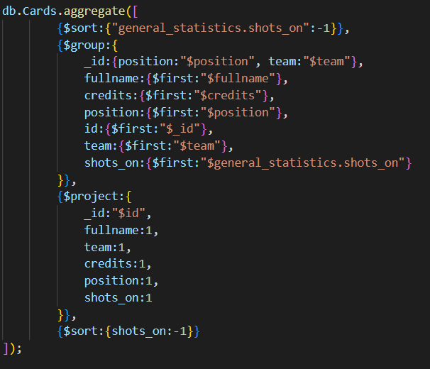
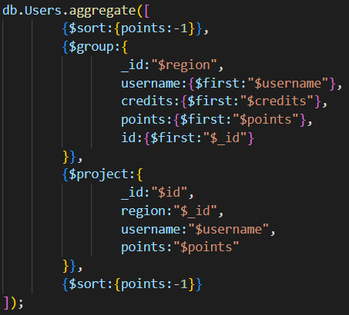
Main Queries on MongoDB (1)
Most offered/wanted footballer’s card in Trades
Best Cards by skill (general statistics field)
Best User for each region

Slide 9
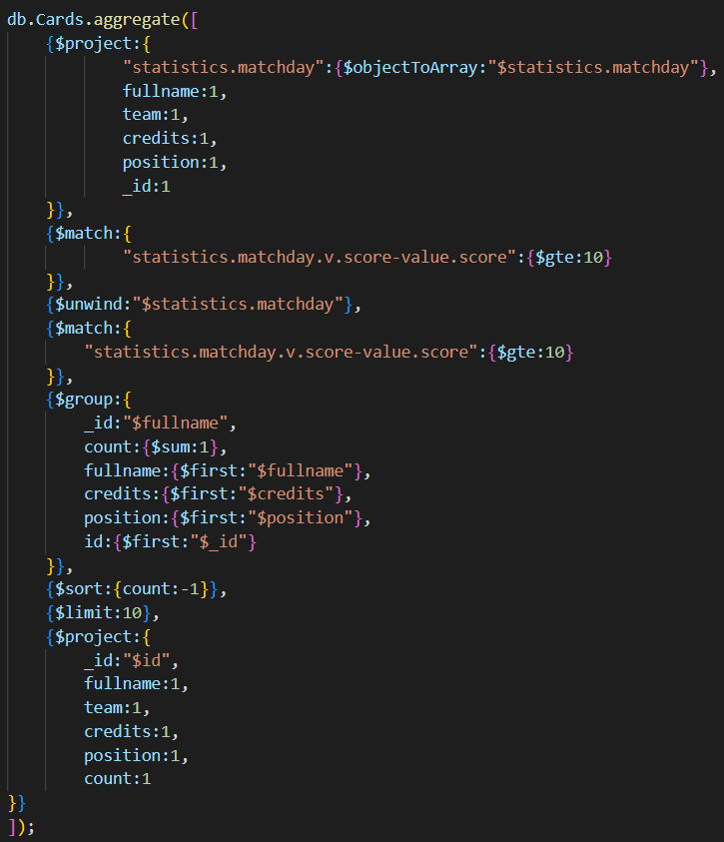
Main Queries on MongoDB (2)
Best Cards for matchday’s score

Slide 10
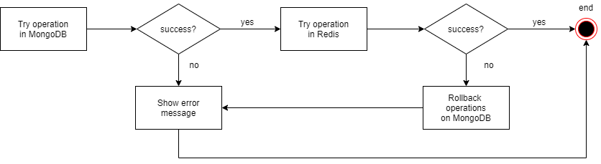
Consistency
We must consider the problem of consistency between the two databases in the following cases:
Create, accept, delete a Trade → Mongo operations are made first; if successful, Redis operations are done next, if fails, all documents are restored to their previous state.
Delete a user → Redis operation are made first; if successful, Mongo operations are done next, if fails, all values are restored. In this case, is simplier reinsert the user’s card collection into Redis instead of restore the deleted trades.

Slide 11
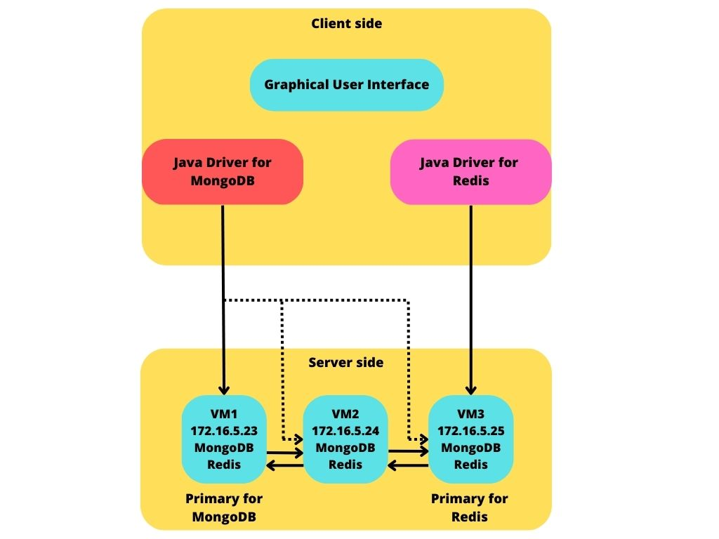
Software and Hardware architecture
Programming Language:
JavaFX
Java
Python
DBMSs:
MongoDB
Redis
Frameworks:
Maven

Slide 12
Sharding, a possible implementation
For the users collection we can consider the region field as a shard key and a partitioning method based on list. In this way user’s information are segmented by country on the cluster and each server, locally deployed, would serve the incoming requests for the users’ region. For regions that produce a critical amount of requests we should consider a higher number of servers and add some more replicas.
For the trades collection we can consider the _id as a shard key and a partitioning method based on Hashing. Trades information are not easily divisible by other means, but a Hashing algorithm on the _id field makes it possible.
For the cards collection we thought that a sharding method is not that useful, as its size is limited and known. However, considering for example the role as a shard key, a partitioning method based on list is possible.

Slide 13

Final considerations
Altro testo
MongoDB collection | Attribute
Users | username
Users | region
Trades | user_from
Trades | Status
Cards | fullname
We choose to add some Indexes to improve the performance of the queries

Slide 14

THANKS FOR YOUR ATTENTION

