Slide 1
A-RAS : Augmented RSA
Abdallah Karakra and Ahmad Alsadeh, SAI Computing Conference,1016 - 1023, 2016
National Tsing Hua University
106062615 Alvin
Date : 11/6

Slide 2
Table of Contents
Introduction
RSA Cryptosystem
Rabin Cryptosystem
Huffman Coding
A-RSA Cryptosystem
Performance
Reference

Slide 3
Introduction
Q1: Encrypting the same message by RSA more than once gives the same ciphertext.
A1: Randomization component r.
Q2: RSA is known to be slower than the standards symmetric key encryption.
A2: Huffman coding.

Slide 4
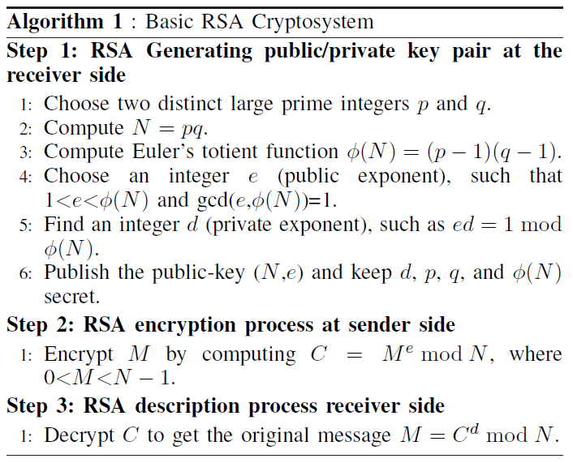
RSA Cryptosystem

Slide 5
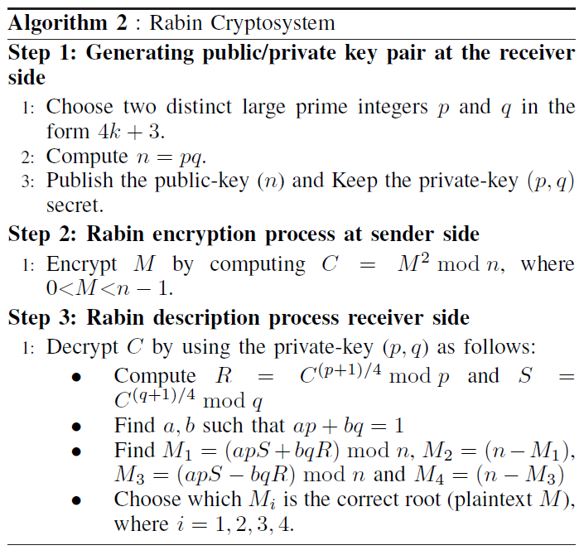
Rabin Cryptosystem

Slide 6
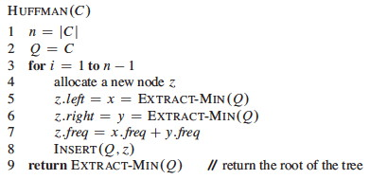
Huffman Coding

Slide 7
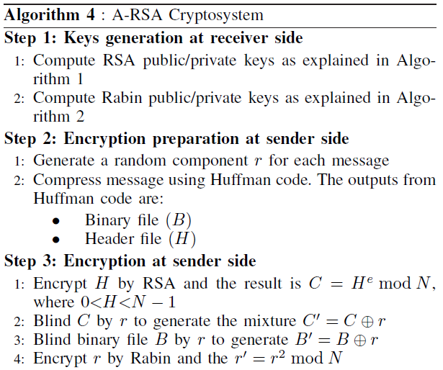
A-RSA Cryptosystem

Slide 8
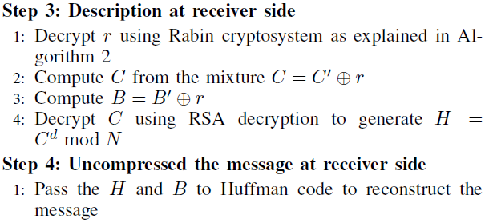
A-RSA Cryptosystem (Cont’d)

Slide 9
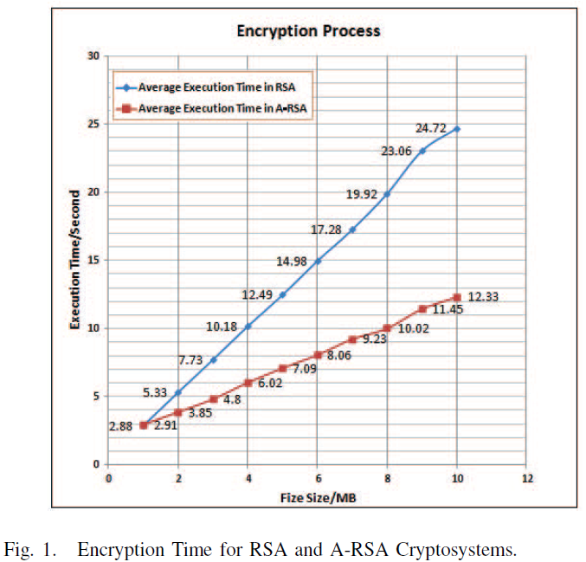
Performance

Slide 10
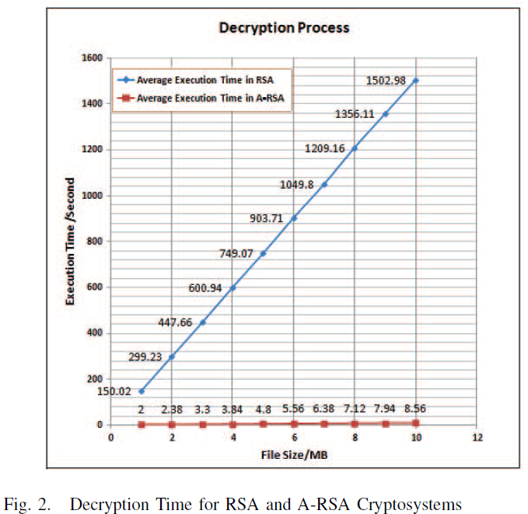
Performance (Cont’d)

Slide 11
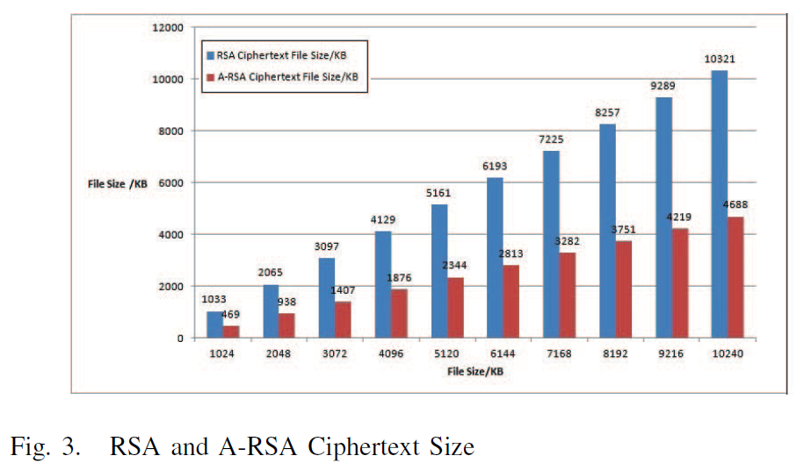
Performance (Cont’d)

Slide 12
Reference
Abdallah Karakra and Ahmad Alsadeh, SAI Computing Conference,1016 - 1023, 2016
R. L. Rivest, A. Shamir, and L. Adleman, ‘A Method for Obtaining Digital Signatures and Public-Key Cryptosystems’, Communications of the ACM, Vol. 21, No. 2, 120-126, 1978
[web1]https://en.wikipedia.org/wiki/RSA_(cryptosystem)#Proof_using_Fermat's_little_theorem
[web2] https://en.wikipedia.org/wiki/Rabin_cryptosystem

