Slide 1
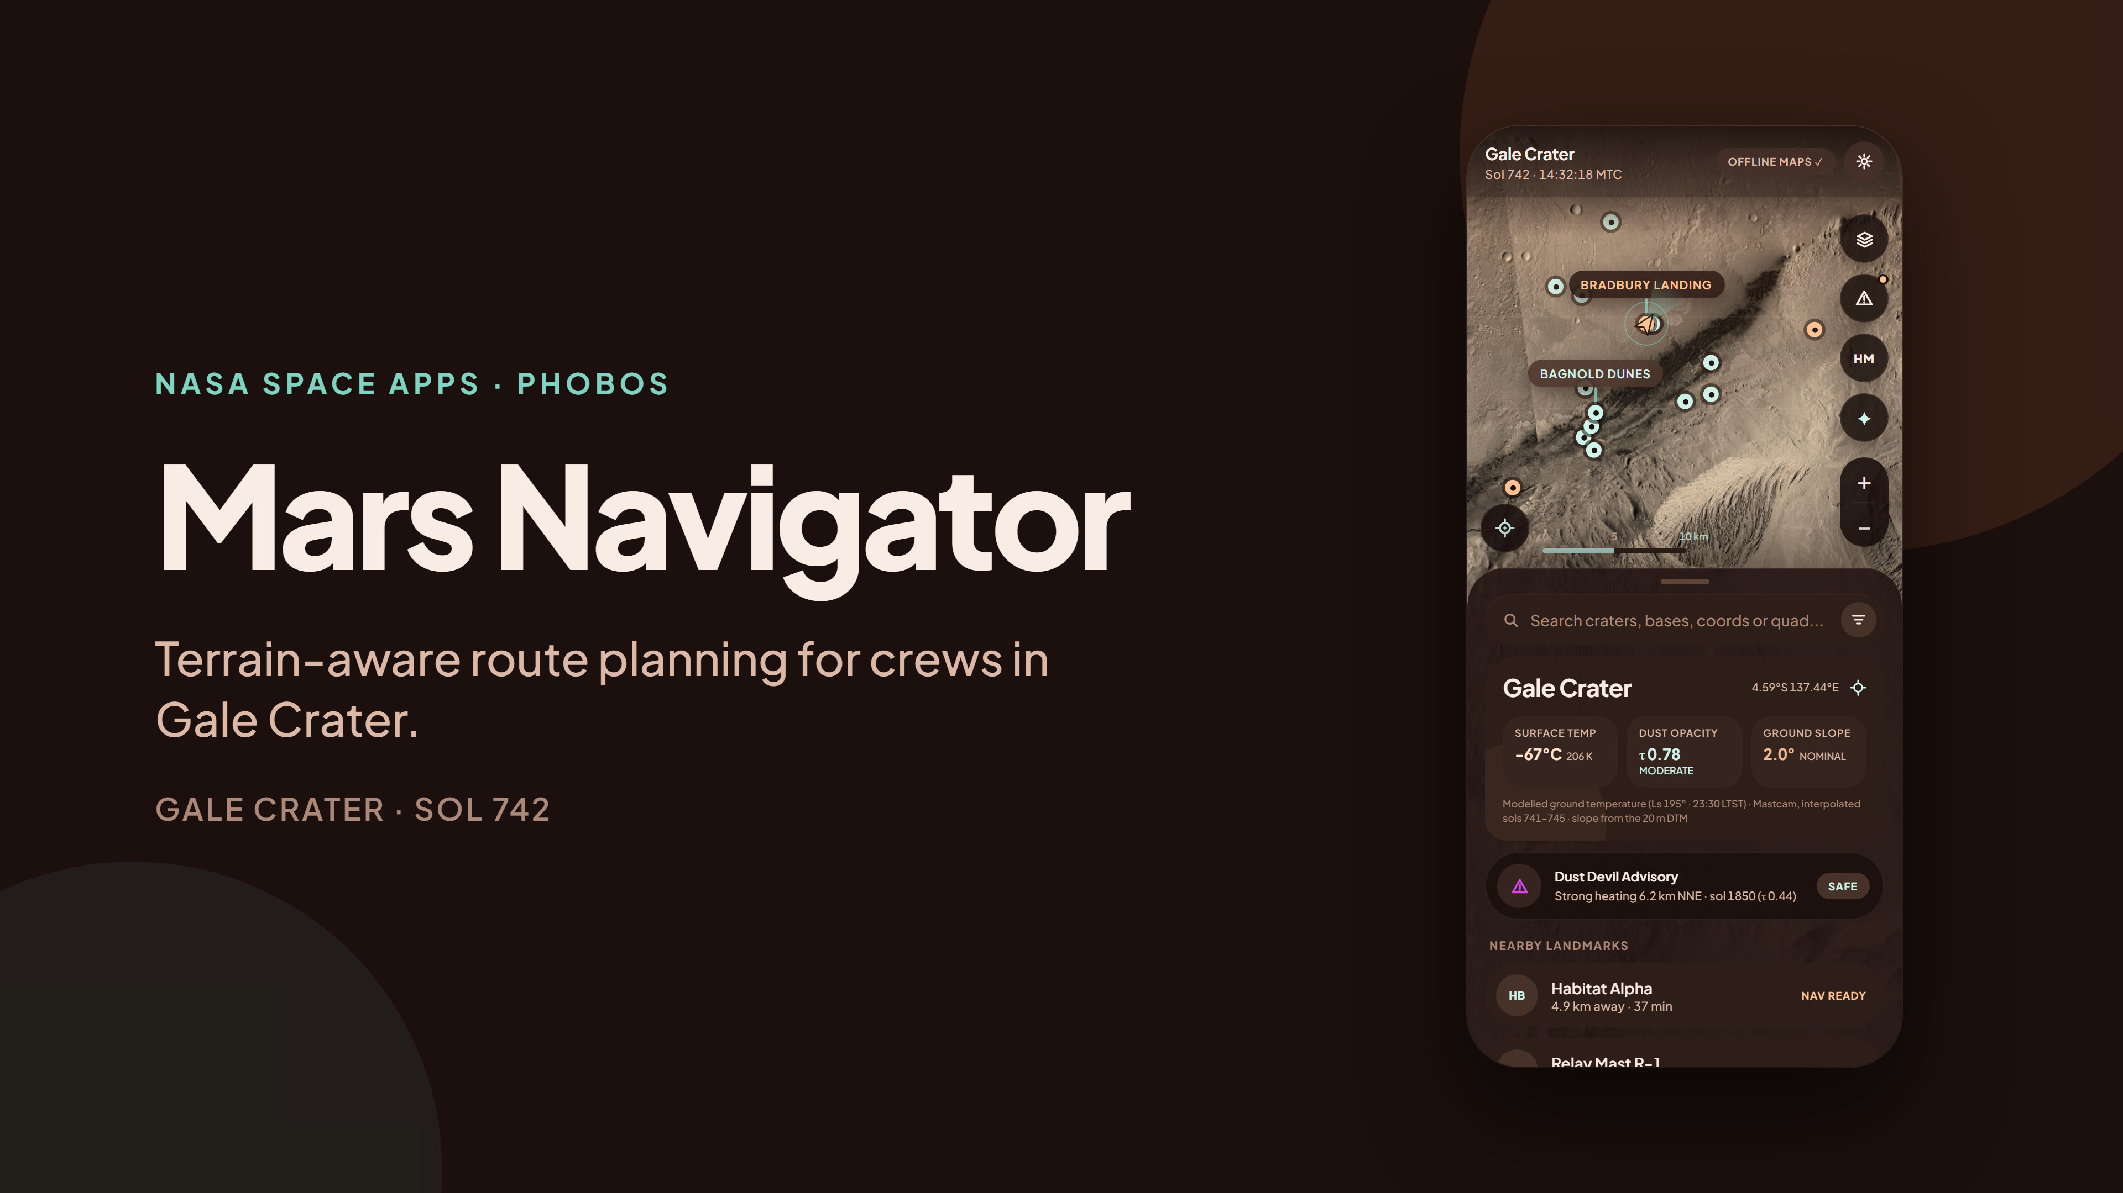
Notes:
Mars Navigator is a surface navigation app for crews in Gale Crater, built on real NASA orbital and rover data. The phone on the right is a screenshot of the working app (React Native and Expo, running on phones and in the browser).

Slide 2
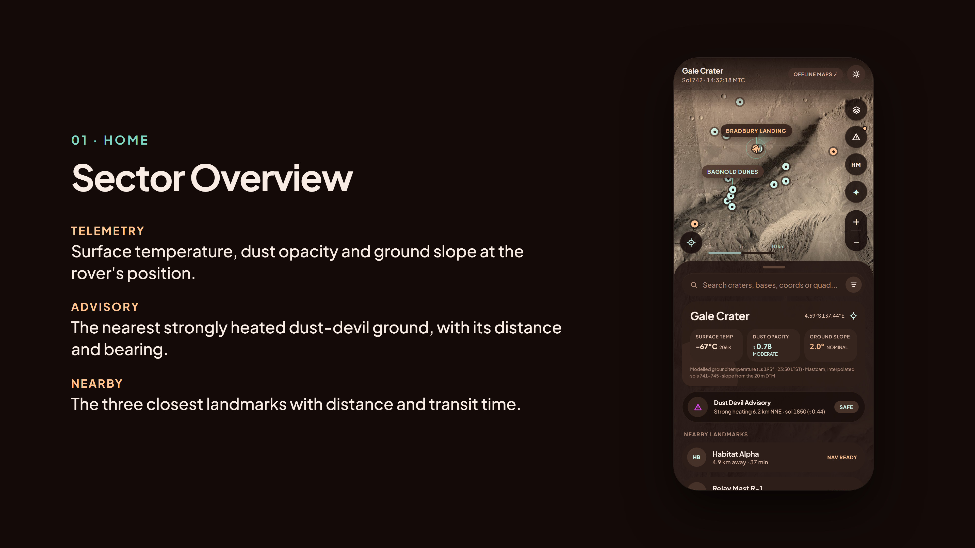
Notes:
The home sheet: modelled surface temperature, measured dust opacity (Mastcam tau) and DEM slope at the rover, the dust-devil advisory from the real heating-index map, and the closest landmarks. Drag the map, pinch or scroll to zoom, tap any marker.

Slide 3
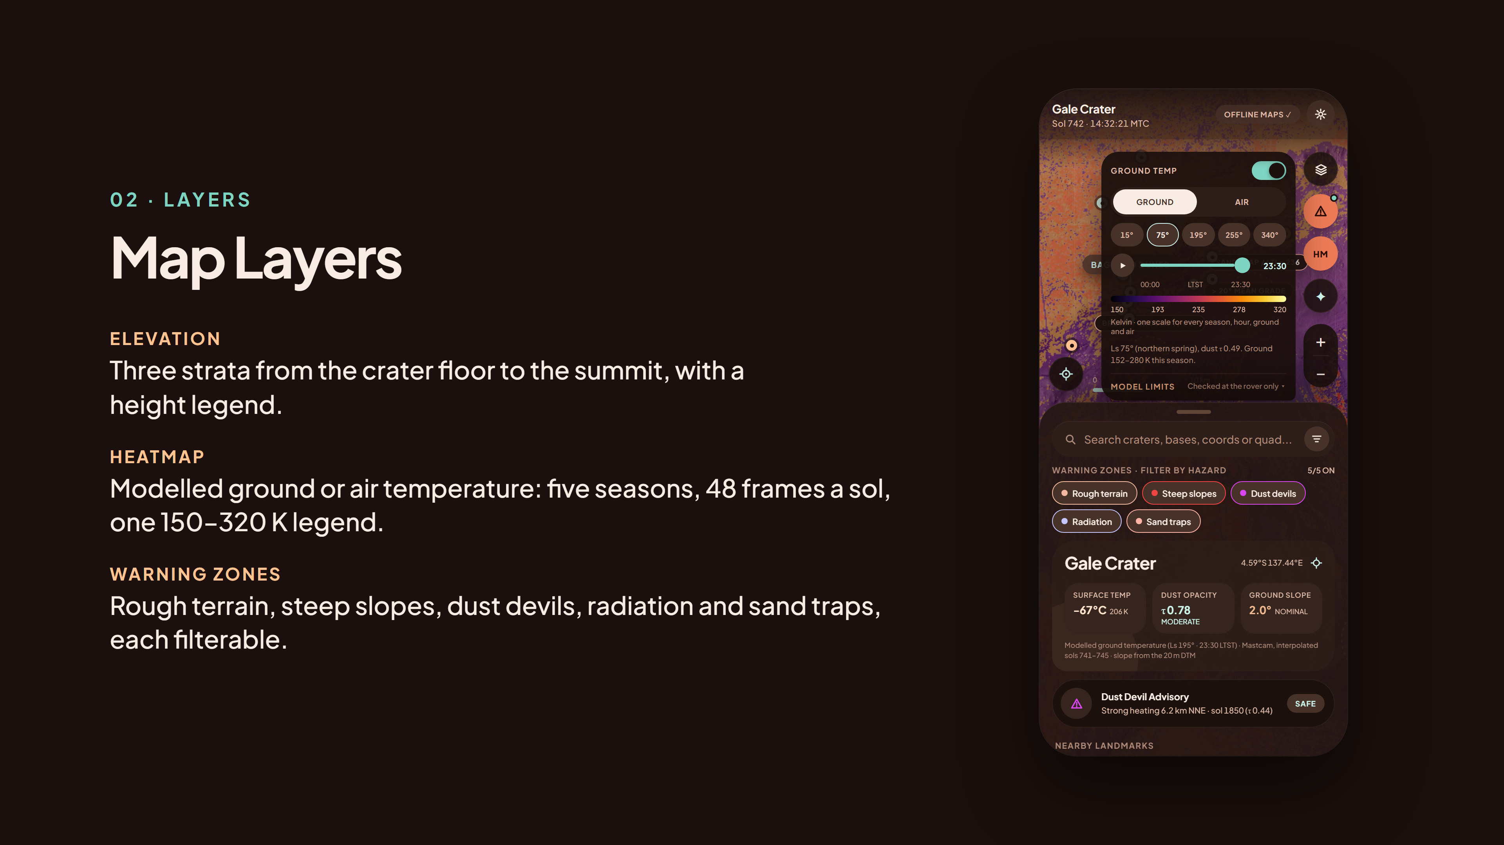
Notes:
Layers live in a floating dock: elevation strata from the stereo DTM, modelled ground or air temperature for five seasons with a time slider and timelapse, five filterable warning zones, and a dust-devil heating index built from real thermal data. The heat legend says where the model was checked: at the rover only.

Slide 4
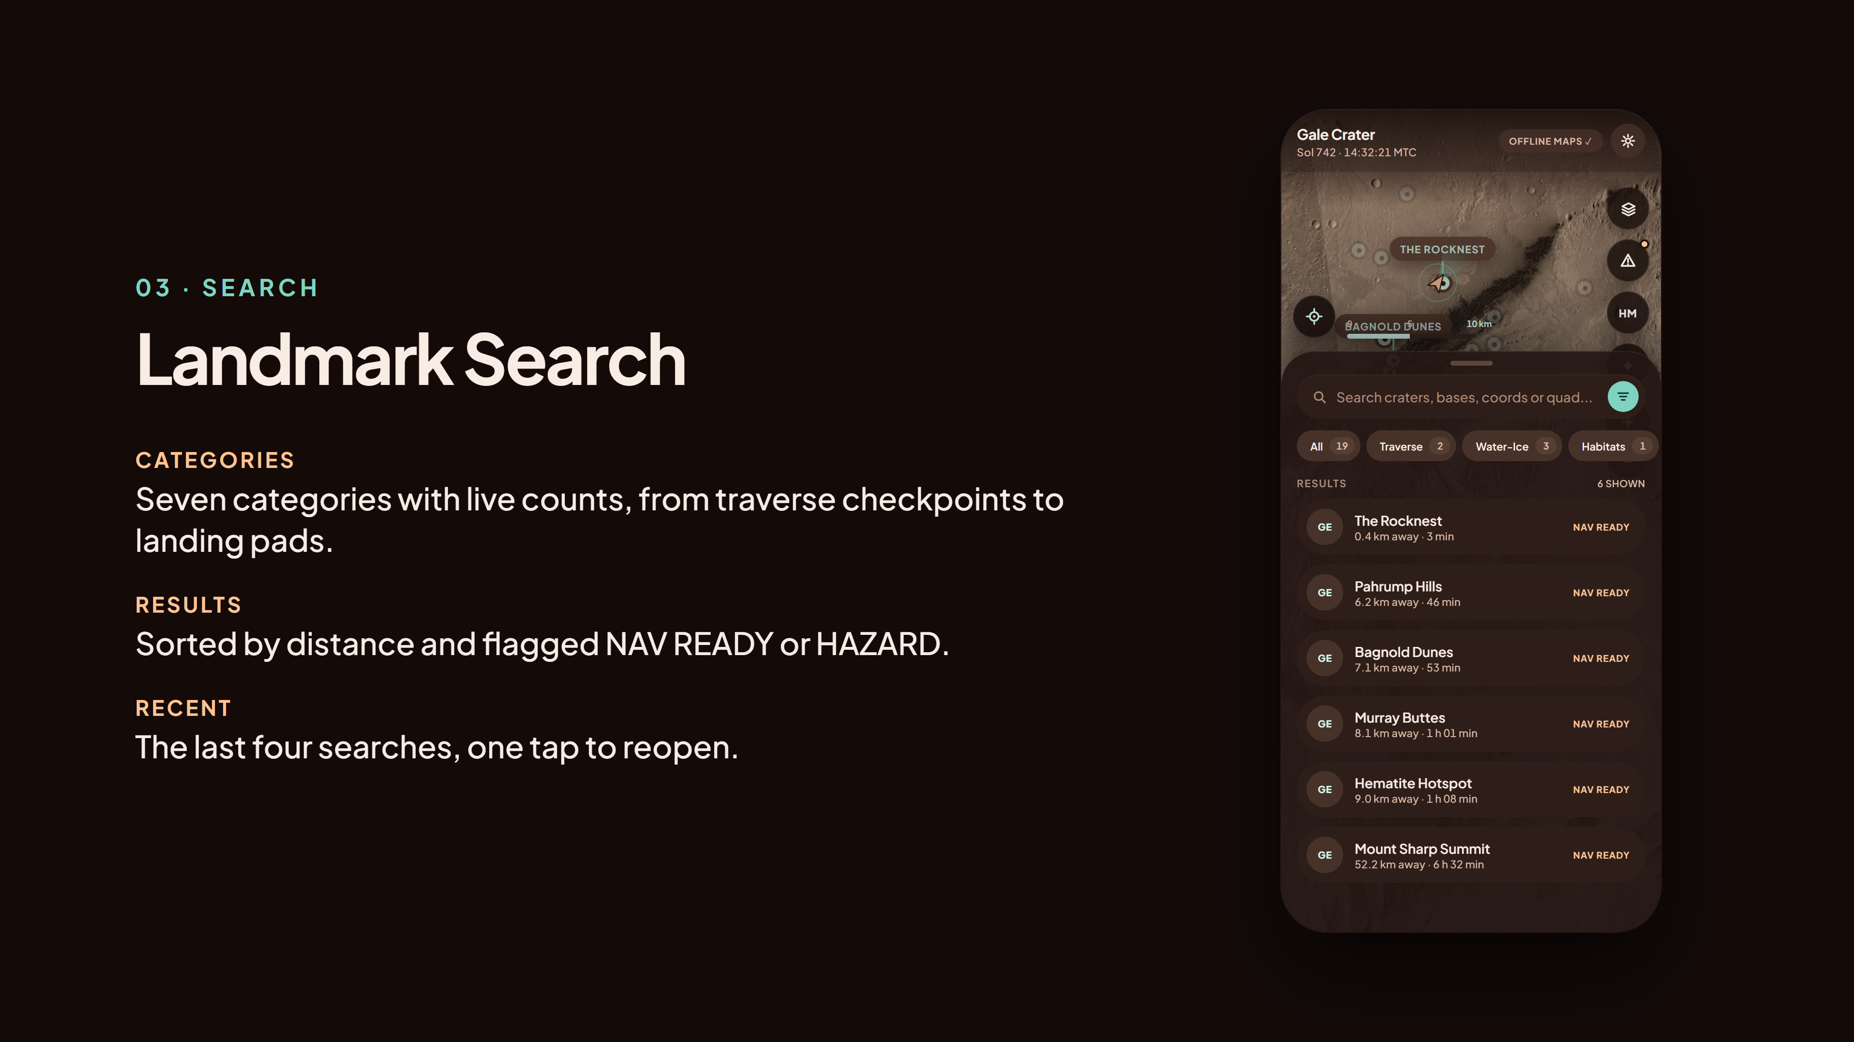
Notes:
Search covers 19 landmarks in seven categories, and coordinates like 4.6S 137.4E jump the map there. Results sort by distance and are flagged when they sit inside a hazard zone.

Slide 5

Notes:
Opening a waypoint plans two slope-aware routes with A* on the real DEM. The profile marks every section over 12 degrees. Blocked targets get a safe-approach point or an explicit override. The eye button opens Street Level, a real Curiosity panorama, when one is nearby.

Slide 6
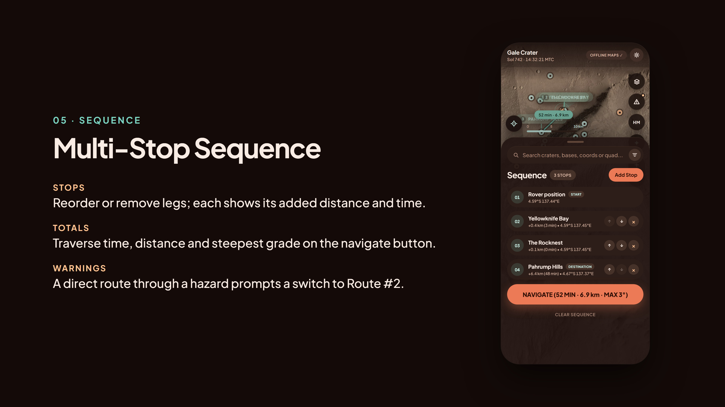
Notes:
Stops chain into a sequence. Each leg shows its added distance and time; the navigate button carries the totals.

Slide 7
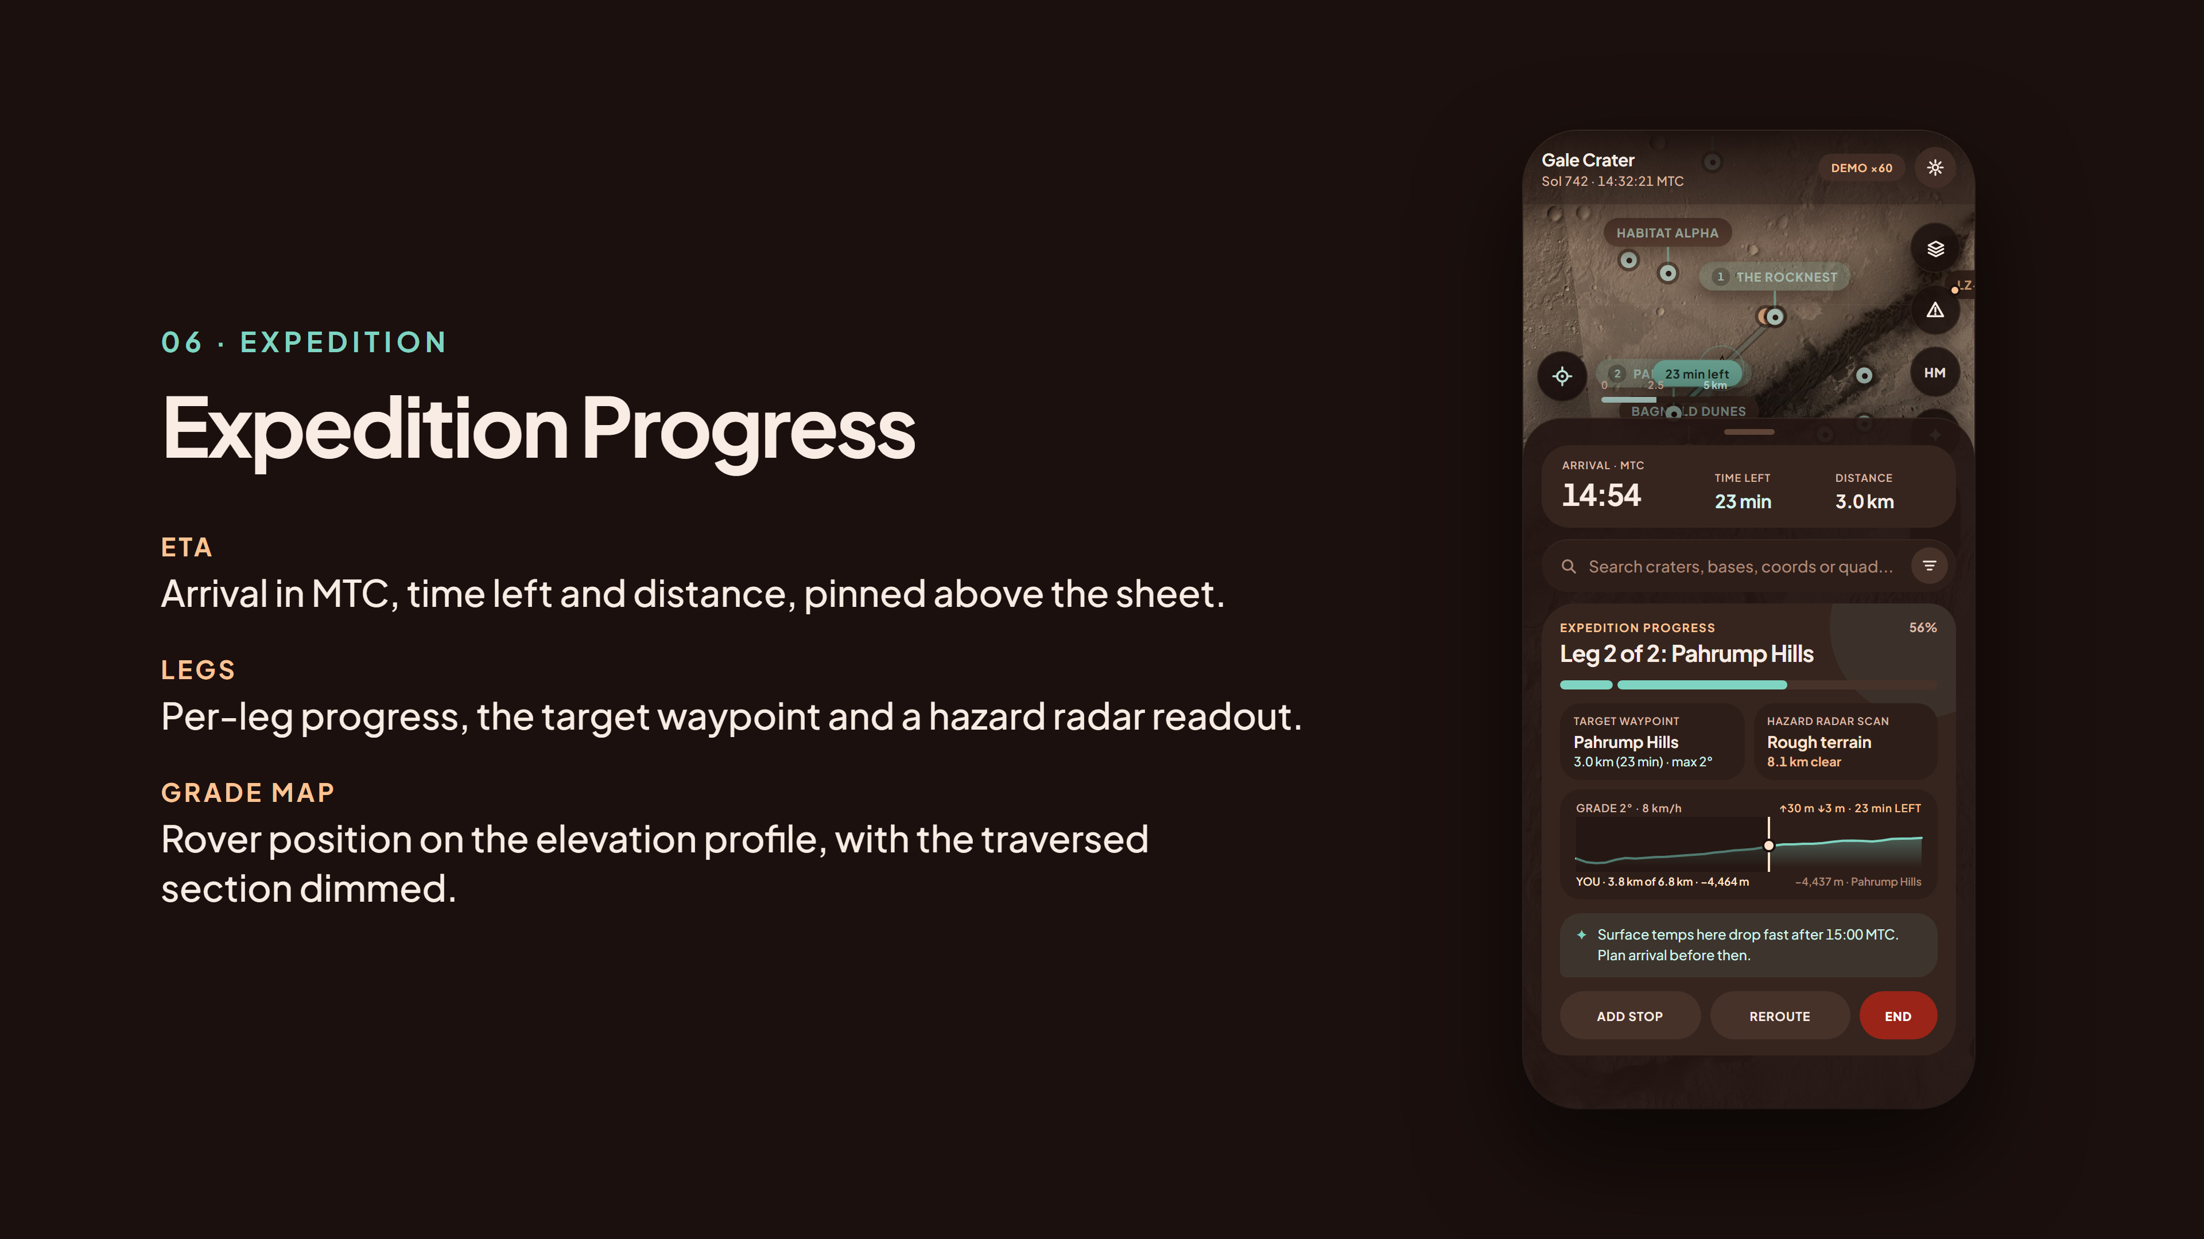
Notes:
During an expedition the rover drives the route in simulation. ETA stays pinned; the grade map shows where the rover is on the profile. Reroute by hand or automatically.

Slide 8
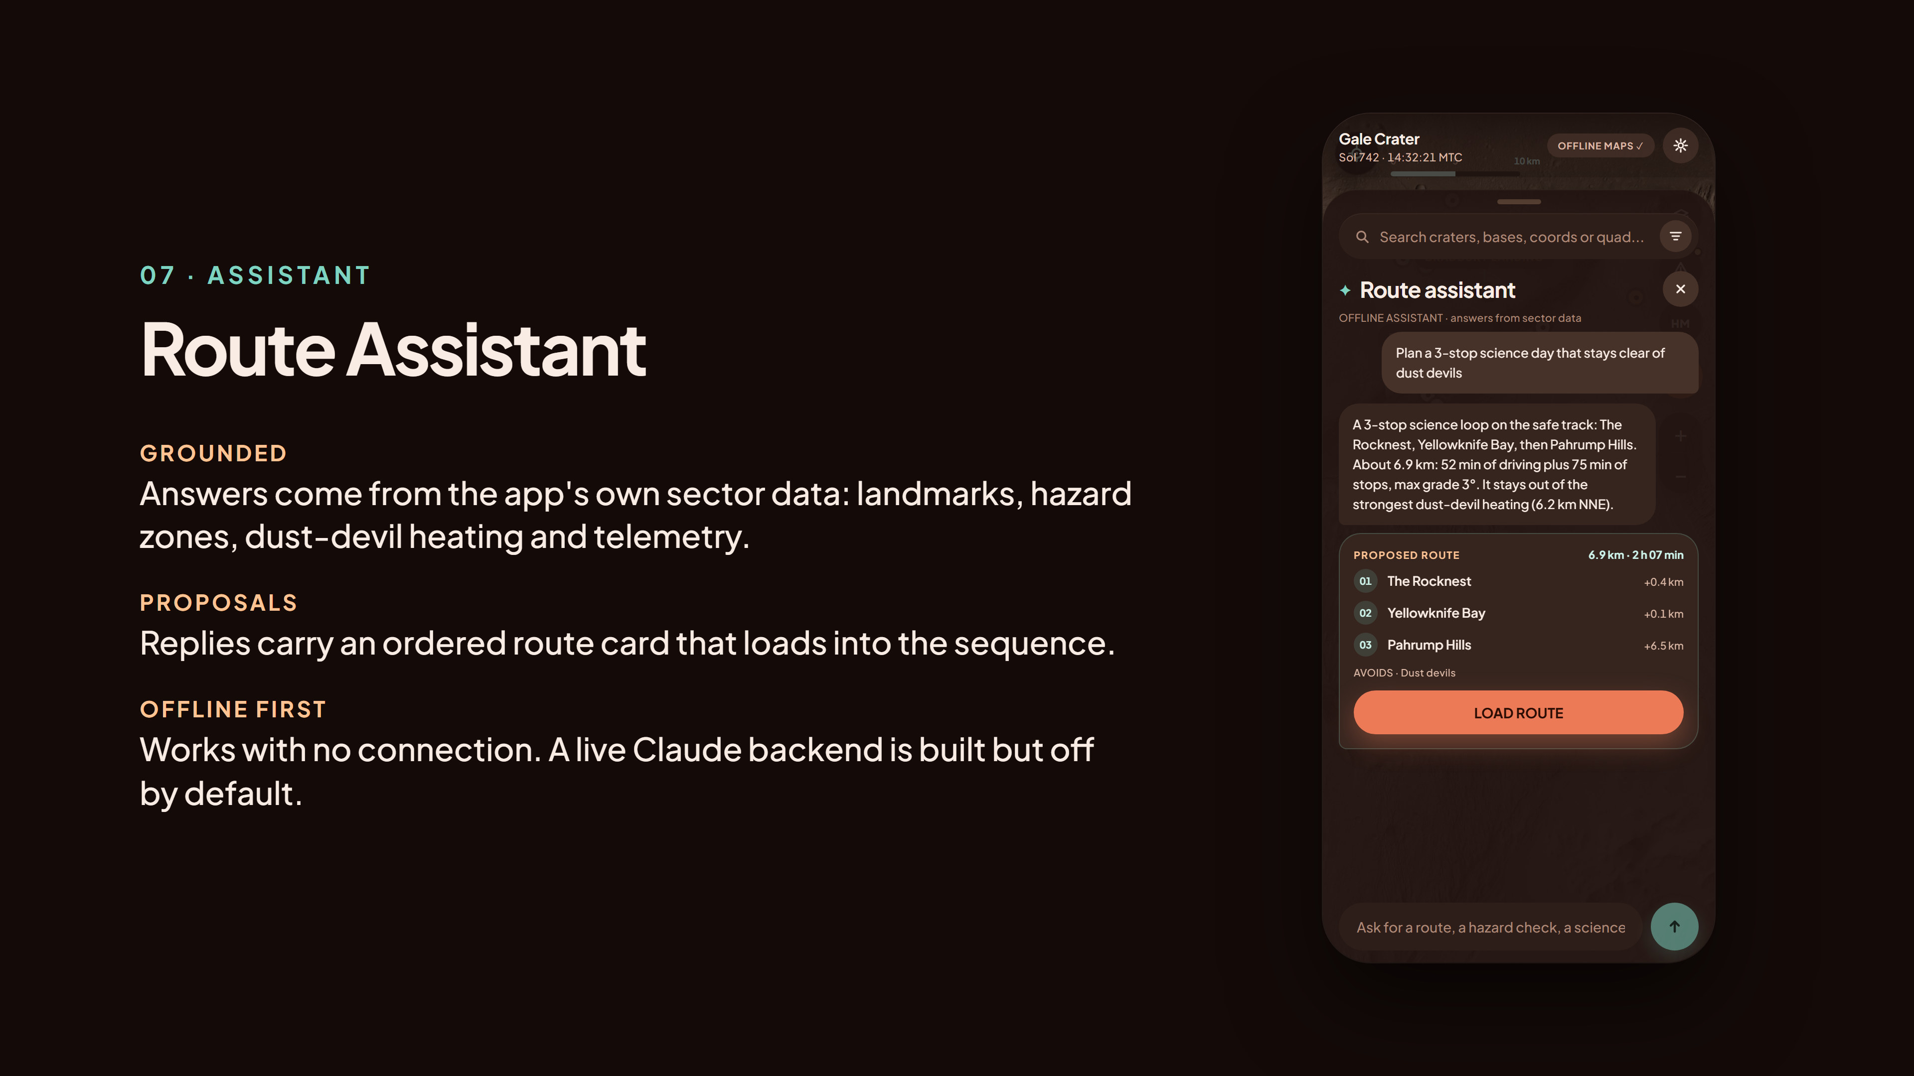
Notes:
The route assistant answers from the app's own sector data: the planned routes, hazard zones, dust-devil heating and telemetry. Replies carry a route card that loads straight into the sequence on the safe route. It runs offline by default; a server-side Claude backend is in place but switched off, and the API key would stay on the server.

Slide 9
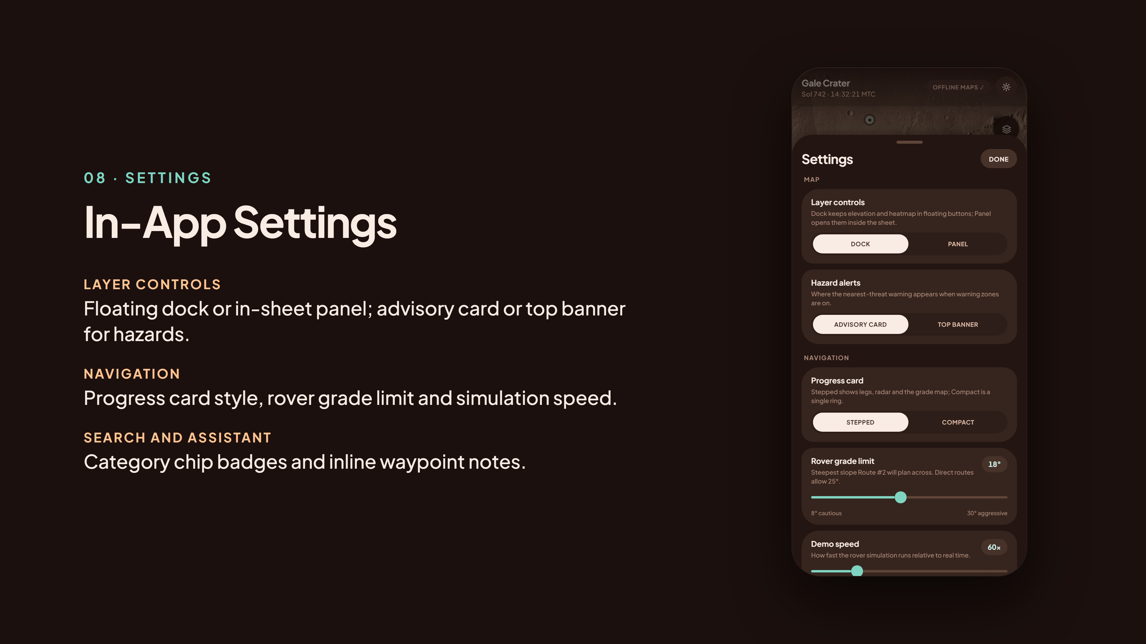
Notes:
Settings expose the demo controls inside the app: layer controls, hazard alert style, progress card, grade limit, simulation speed, chip badges and inline notes. The last row opens About and credits.

Slide 10
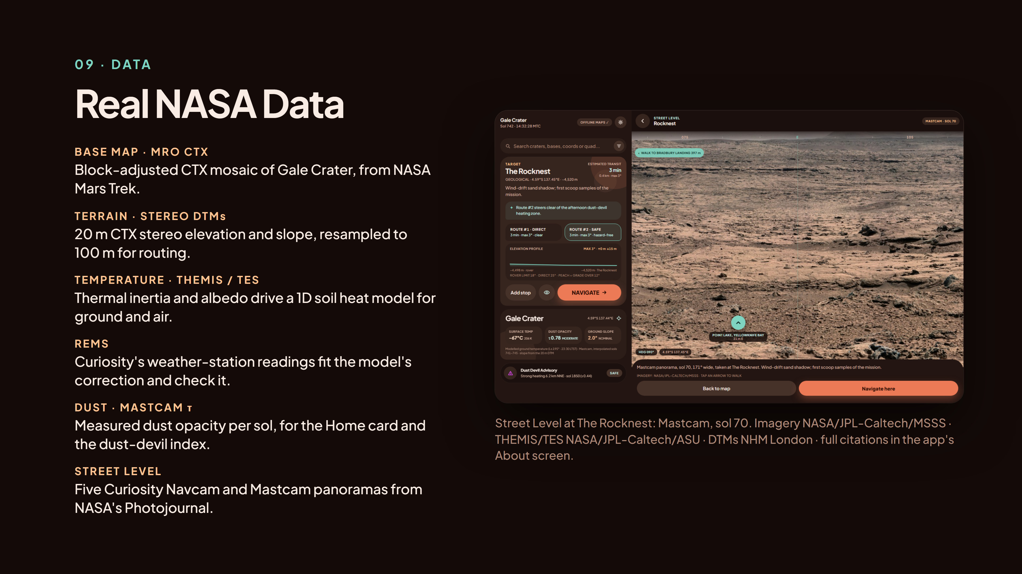
Notes:
Every layer comes from real data. The base map is the MRO CTX mosaic from NASA Mars Trek. Elevation and slope come from 20 metre CTX stereo DTMs processed at the Natural History Museum, London. Ground and air temperature come from our own model, driven by THEMIS thermal inertia and TES albedo and fitted to Curiosity's REMS readings. Dust opacity is Curiosity's Mastcam tau record. Street Level shows five real Curiosity panoramas. Full citations are in the app's About screen and in MarsDataPipline/raw_data/Citations.

Slide 11
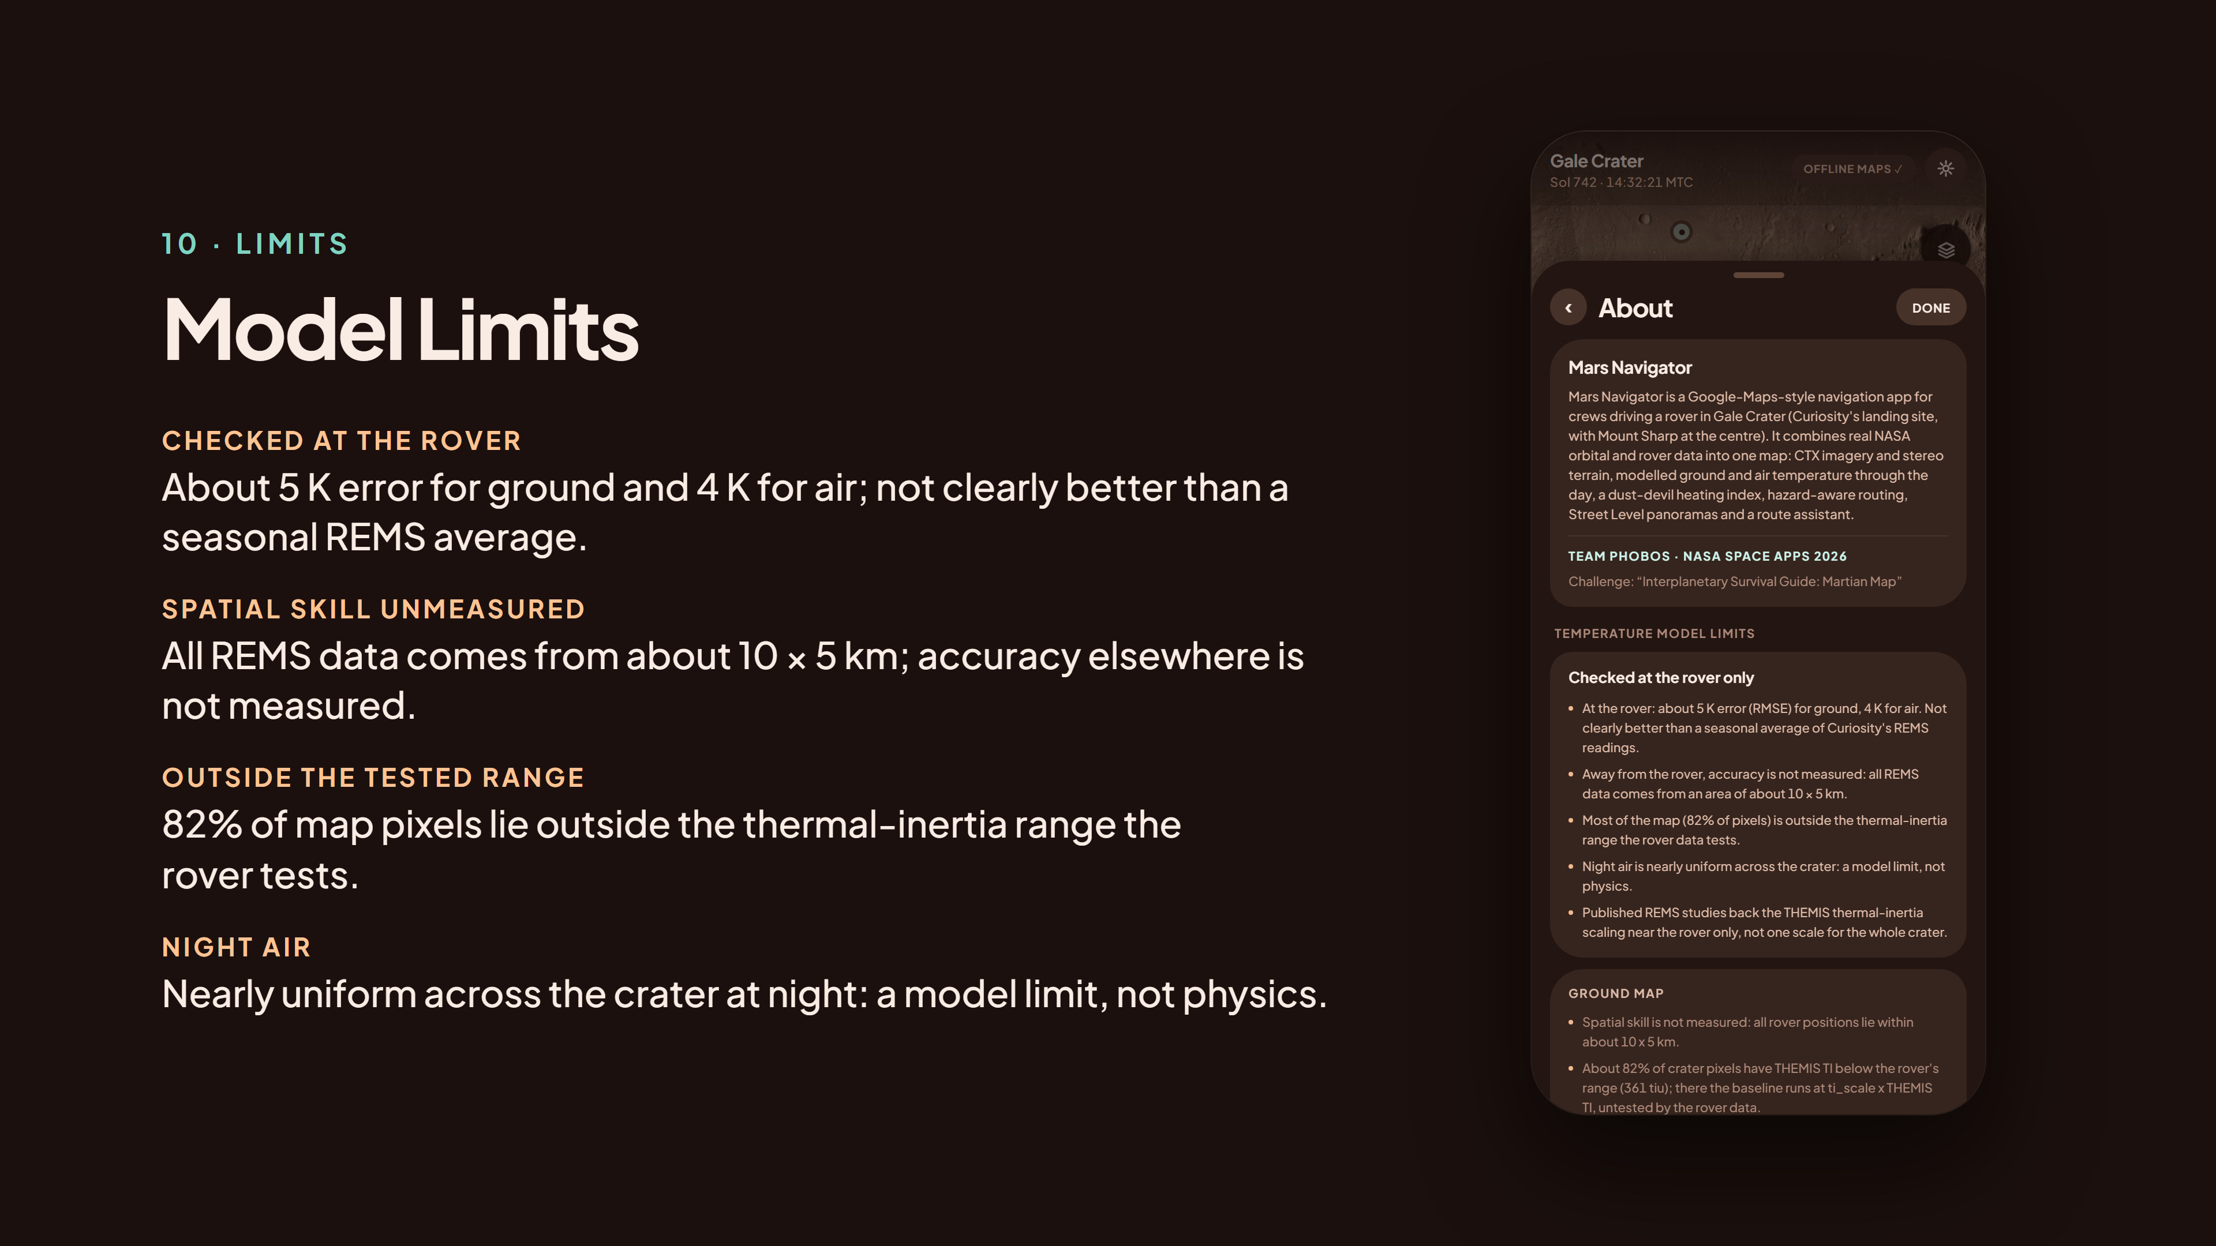
Notes:
We say what the temperature maps can't tell you, in the app itself: the heat legend reads 'Checked at the rover only', the heat popover lists the key limits, and About gives the full caveats. At the rover the error is about 5 K for ground and 4 K for air, not clearly better than a seasonal average of REMS. All REMS data comes from about 10 by 5 km, so accuracy elsewhere is not measured, and 82 percent of the map lies outside the thermal-inertia range the rover tests. Also: the dust-devil heating index is a heuristic, not a probability, and the habitats, relays and landing pads are invented sites placed on real ground.

