Slide 1

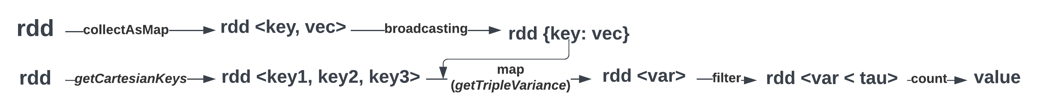

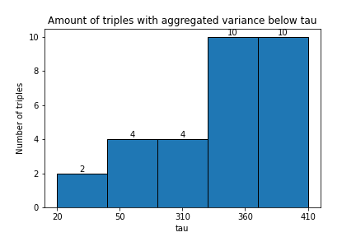
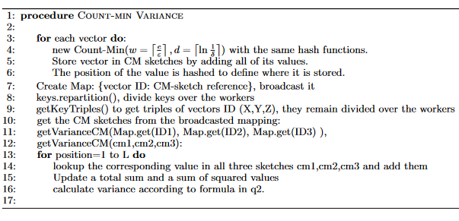
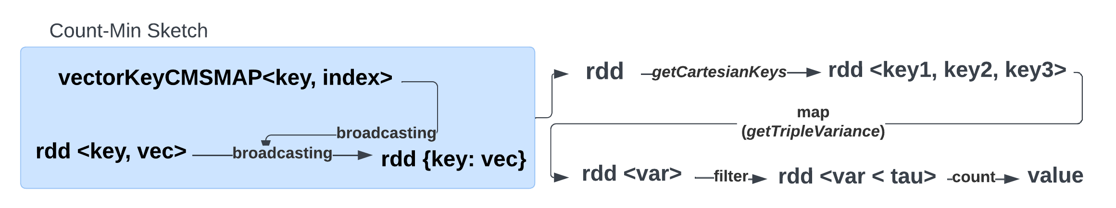
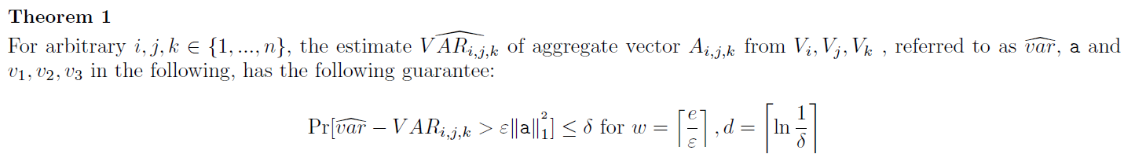
Big Data Management
Discovering combinations of vectors with low aggregate variance
Group 23 - Thomas de Lange (2648586) & Dalton Harmsen (1293885) & Roëlle Bänffer (1523198) & Lieke van den Biggelaar (1479652) & Rik Litjens (1317059) & Marco Pleket (1295713)
Creating a data frame/dataset and RDD
Without SparkSQL
Architecture
The architecture uses two paths; one creates a broadcast variable that stores the vectors for each key, and the other finds the triples of the keys. Combining the paths, it is possible to compute the aggregated variance of the triples. Finally, only the triples that are at most tau remain and are counted. Optimization is performed by switching from python to java. Together with swapping the cartesian() methods with flatmap() and broadcasting, which improved by 60%. Then we also added repartitions(20) and performed a cache() throughout. This improved by another 5s per tau. Resulting in an execution time of 20s per tau on 250x10000. The results are tau 410 = count 10, tau 20 = count 2. This is the same as the results from Q2, but much quicker computed.
C_0 | C_1
T7RO | 55;12;5,52…
BJ4X | 12;97;44;25…
CW9L | 68;45;93;35…
key | vec
T7RO | [55,12,5…
BJ4X | [12,97,44
CW9L | [68,45,98,…
vectors.csv
SparkSQL
UDF: Only one pass over the data needed
Join conditions, only unique pairs
Repartitions, divide the workload
Explain method: shows smaller broadcast joins
Caching for multiple tau values
‘Posexplode’, dividing the values over the columns
Results show worse performance for explode
Converting the codebase to java
Execution time: 543 seconds
Count-min sketch
A Count-min sketch is a list that we update for each vector. For each vector, we store all values in the CM sketch and hash them based on their position within the vector. Because the actual values are compressed into this w by d matrix, estimating the results is less computationally expensive and requires less storage. A Hashmap is created to map the ID of a vector to the corresponding count-min sketch. The broadcast function is used to send this variable to all workers from the driver which reduces communication costs between nodes. The execution time is 82.62 seconds for epsilon = 0.01, delta = 0.1 and tau = 200000.
Function tripleVariance(a1,a2,a3){ for i from 0 to vectorDimensions-1{ currentSum = a1[i] + a2[i] + a3[i] mu += currentSum / vectorDimensions totalSumSquared += currentSum * currentSum } return (1/vectorDimensions * totalSumSquared) - mu^2
} SELECT * FROM (SELECT v1INNER.key, v2.key, v3.key,
tripleVariance(v1INNER.vec, v2.vec,v3.vec) AS variance FROM TEMP AS v1 INNER JOIN TEMP AS v2 ON v1INNER.key < v2.key INNER JOIN TEMP AS v3 ON v2.key < v3.key) WHERE variance < tauParameter
Ethical and other aspects
To compute variances for a large dataset, there are various options:
Relational databases can quickly compute results using query optimization but do not utilize distributed computing.
Multi-threaded programs on powerful servers are fast but may have communication issues between threads.
Company-owned clusters provide control and privacy, but require initial investment, while cloud resources offer scalability at higher cost.
Approximation techniques are suitable when error bounds are acceptable, while Spark can precisely calculate results.
Data Science & Artificial Intelligence

