Slide 1
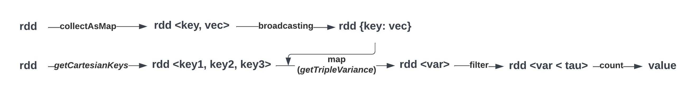
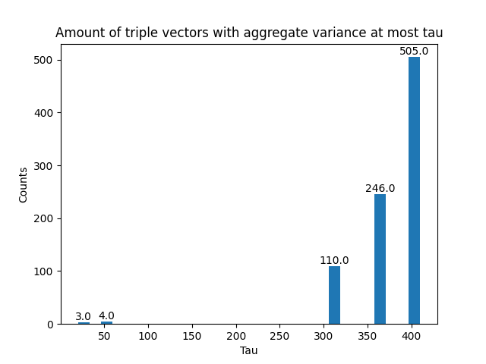
Big Data Management
Discovery of combinations of vectors with low aggregate variance
Group 23 - Thomas de Lange (2648586) & Dalton Harmsen (1293885) & Roëlle Bänffer (1523198) & Lieke van den Biggelaar (1479652) & Rik Litjens (1317059) & Marco Pleket (1295713)
Creating a data frame/dataset and RDD
The data frame/ dataset is created by Spark by first reading the csv which gives us the data frame. The c0 column is used as a key for the vector. The original c1 column values are split and the posexplode() function is used to create a row for each position of the vector. For the RDD, we split the key and values. The RDD is a tuple with first the key followed by the values of the vector.
Without SparkSQL: find all triples of vectors <X,Y,Z> with aggregate variance at most tau
Architecture
Figure 1, Figure description
C_0 | C_1
T7RO | 55,12,5,52…
BJ4X | 12,97,44,25…
CW9L | 68,45,93,35…
key | pos | value
T7RO | 0 | 55
T7RO | 1 | 12
T7RO | 2 | 5
SparkSQL: find all triples of vectors <X,Y,Z> with aggregate variance at most tau
Bold
The first version of Q2 consists of a different Q1a where the data would be split into a data frame with key, position, and value (using the built-in posexplode function). The full computation of aggregated variance is calculated in the SQL query where the value would be added based on the position for each different key. The version with the position in the data frame is more efficient than the udf function since Spark can not optimize the udf function. Our previous algorithms were written in Python which was slower than Java. We decide to switch to the second version and to use Java to speed up the algorithm. Different optimization techniques have been applied to the Python version like indexing, repartition and storing in temporary view.
SELECT triple_id, VAR_POP(col) FROM (
SELECT CONCAT(v1.key, ',', v2.key, ',', v3.key) AS triple_id, v1.pos, v1.col + v2.col + v3.col as col
FROM vectors as v1
INNER JOIN vectors as v2 ON (v1.key < v2.key AND v1.pos = v2.pos)
INNER JOIN vectors as v3 ON (v2.key < v3.key AND v2.pos = v3.pos))
GROUP BY triple_id
HAVING VAR_POP(col) < {TAU_PARAMETER};)
Figure 1, Figure description
Count-min sketch
Bold
The sketch is created by storing each vector with an hash function. Different functions are applied on the sketch to get the aggregated variance. Dyadic intervals are used to get the triples which are below a certain tau threshold. We give the sketch the width and the depth which are calculated with the following formula. The update cms function add the vector to the hash table. The add function in the sketch adds the vector values based on position.
Pseudo code Count-min sketch:
Store variables width and depth based on epsilon and delta
Create empty dictionary which is CMS
Store hashed data in CMS
Add values of hashed data together in CMS based on position
Calculate variance for aggregated triple variance
Get triples keys which are below threshold tau
Return triples of vector ids <X,Y,Z>
Figure 1, Figure description
Ethical and other aspects
Bold
To compute variances for a large dataset, there are various options:
Relational databases can quickly compute results using query optimization but do not utilize distributed computing.
Multi-threaded programs on powerful servers are fast but may have communication issues between threads.
Company-owned clusters provide control and privacy, but require initial investment, while cloud resources offer scalability at higher cost.
Approximation techniques are suitable when error bounds are acceptable, while Spark can precisely calculate results.
Figure 1, Figure description
Data Science & Artificial Intelligence

