Slide 1
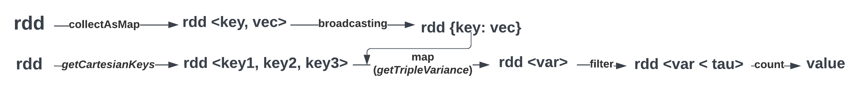
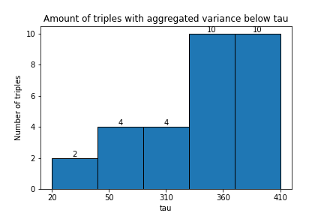
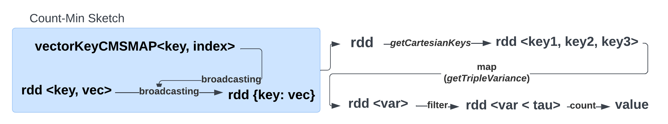
Big Data Management
Discovery of combinations of vectors with low aggregate variance
Group 23 - Thomas de Lange (2648586) & Dalton Harmsen (1293885) & Roëlle Bänffer (1523198) & Lieke van den Biggelaar (1479652) & Rik Litjens (1317059) & Marco Pleket (1295713)
Creating a data frame/dataset and RDD
The data frame is created by reading the. The c0 column is used as a key for the vector. The original c1 column values are split and the posexplode() function is used to create a row for each position of the vector. For the RDD, we split the key and values. The RDD is a tuple with the key followed by the values of the vector.
Without SparkSQL
Architecture
The architecture uses two paths; one creates a broadcast variable that stores the vectors for each key, and the other finds the triples of the keys. Combining the paths, it is possible to compute the aggregated variance of the triples. Finally, only the triples that are at most tau remain and are counted. Optimization is performed by switching from python to java. Together with swapping the cartesian() methods with flatmap() and broadcasting, which improved by 60%. Then we also added repartitions(20) and performed a cache() throughout. This improved by another 5s per tau. Resulting in an execution time of 20s per tau on 250x10000. The results are tau 410 = count 10, tau 20 = count 2. This is the same as the results from Q2, but much quicker computed.
C_0 | C_1
T7RO | 55,12,5,52…
BJ4X | 12,97,44,25…
CW9L | 68,45,93,35…
key | pos | value
T7RO | 0 | 55
T7RO | 1 | 12
T7RO | 2 | 5
SparkSQL
The first version consists of a different data frame where the data would be split into a data frame with key, position, and value (using the built-in posexplode function). The full computation of aggregated variance is calculated in the SQL query where the value would be added based on the position for each different key. The version with the position in the data frame is more efficient than the UDF since Spark can not optimize the UDF. Our previous algorithms were written in Python which was slower than Java. We decide to switch to the second version and to use Java to speed up the algorithm. Different optimization techniques have been applied to the Python version like indexing, repartition and storing in temporary view. The execution time for the cluster is 1766 seconds.
Count-min sketch
A Count-min sketch is a list that we update for each vector. For each vector, we store the key, position, and value. Each vector list is hashed to create the sketch. Because the actual values are compressed into this w by d matrix, estimating the results is less computationally expensive. A Hashmap is used to match the index of a count-min sketch to the key to the vector. The broadcast function is used to keep a variable cached on each machine which reduces communication costs between nodes. We get the aggregated variance by applying a cartesian and getting the value based on the position for the sketch. A filter function is used to get the triples that are below a certain threshold.
Pseudo code Count-min sketch:
Store variables width and depth based on epsilon and delta
Create empty dictionary which is CMS
Store hashed data in CMS
Add values of hashed data together in CMS based on position
Calculate variance for aggregated triple variance
Get triples keys which are below threshold tau
Return triples of vector ids <X,Y,Z>
SELECT triple_id, VAR_POP(col) FROM (
SELECT CONCAT(v1.key, ',', v2.key, ',', v3.key)
AS triple_id, v1.pos, v1.col + v2.col + v3.col as col
FROM vectors as v1
INNER JOIN vectors as v2 ON (v1.key < v2.key
AND v1.pos = v2.pos)
INNER JOIN vectors as v3 ON (v2.key < v3.key
AND v2.pos = v3.pos))
GROUP BY triple_id
HAVING VAR_POP(col) < {TAU_PARAMETER};)
Ethical and other aspects
To compute variances for a large dataset, there are various options:
Relational databases can quickly compute results using query optimization but do not utilize distributed computing.
Multi-threaded programs on powerful servers are fast but may have communication issues between threads.
Company-owned clusters provide control and privacy, but require initial investment, while cloud resources offer scalability at higher cost.
Approximation techniques are suitable when error bounds are acceptable, while Spark can precisely calculate results.
Data Science & Artificial Intelligence

