Slide 1
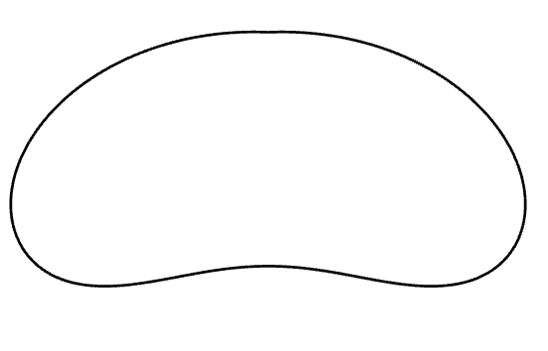
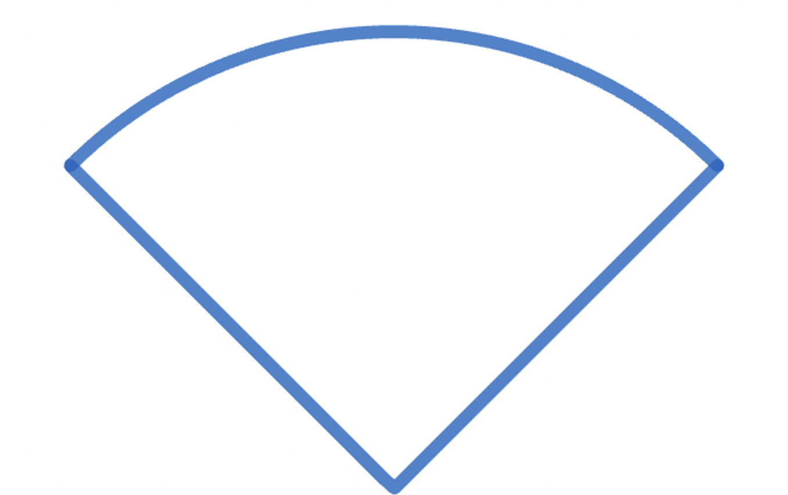
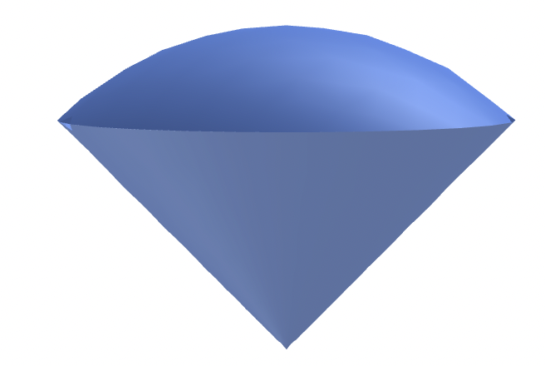

$$f$$

Slide 2
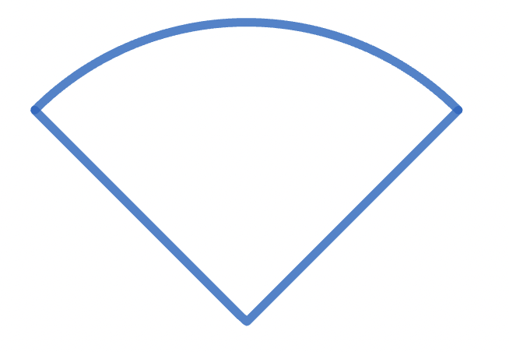
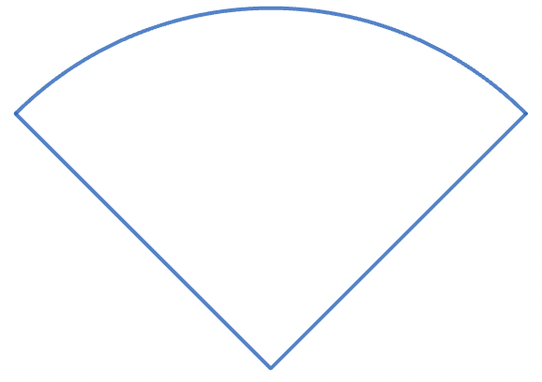



$$γ$$
$$arccos⁡(α)$$
$$O$$
Notes:
§

Slide 3










$$1$$
$$2$$
$$3$$
$$4$$
$$5$$
$$6$$
$$7$$
$$8$$
$$9$$
$$10$$
Notes:
§

