Slide 1



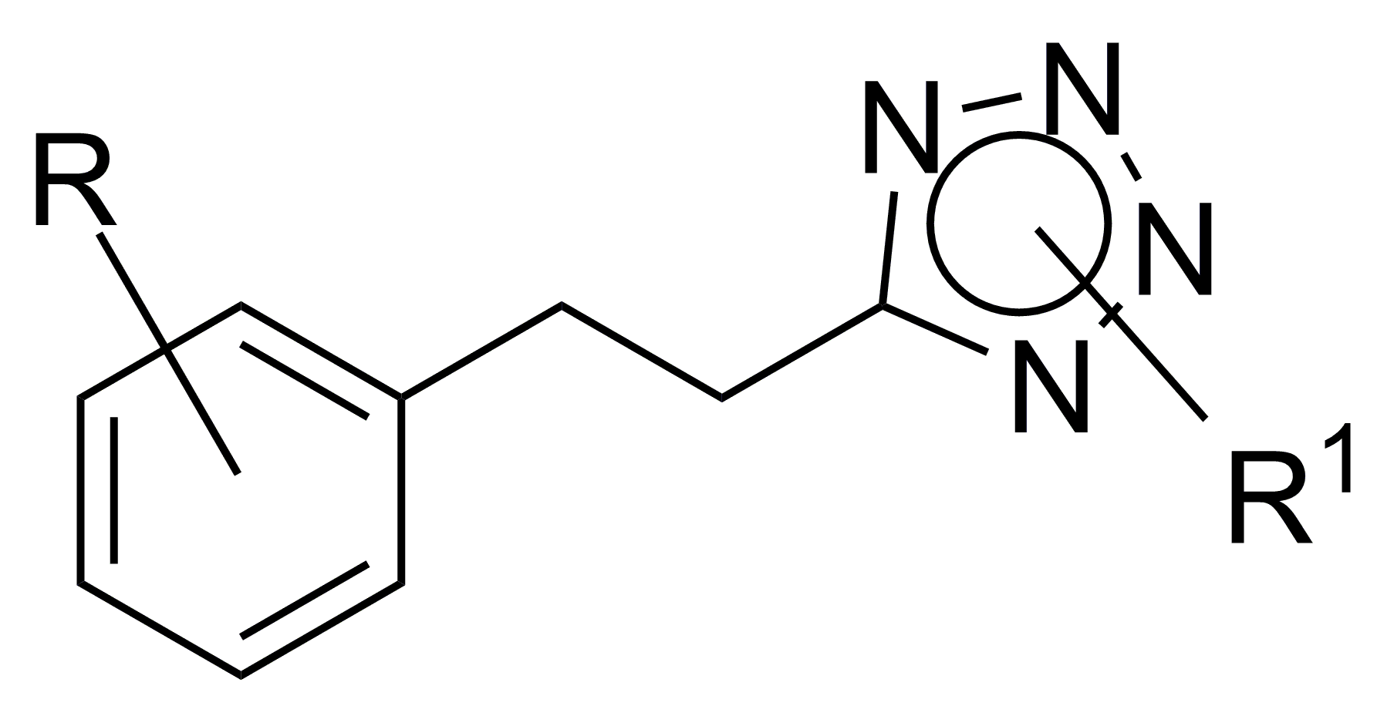
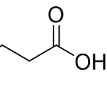

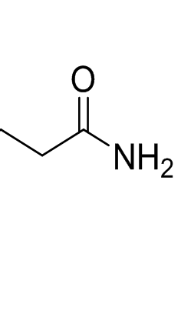
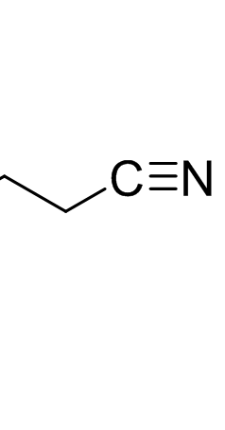
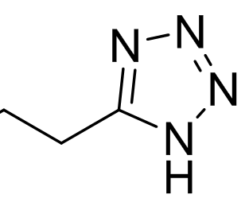
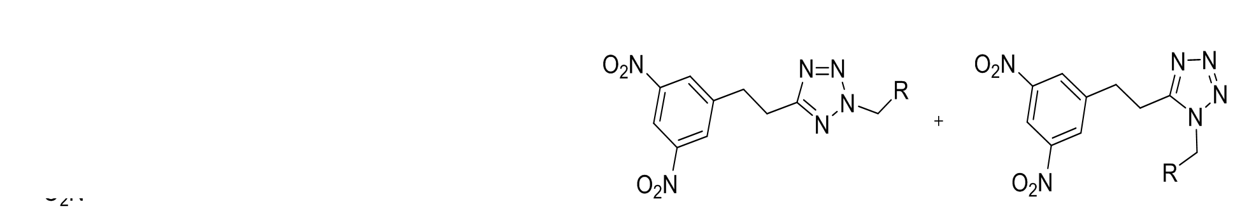

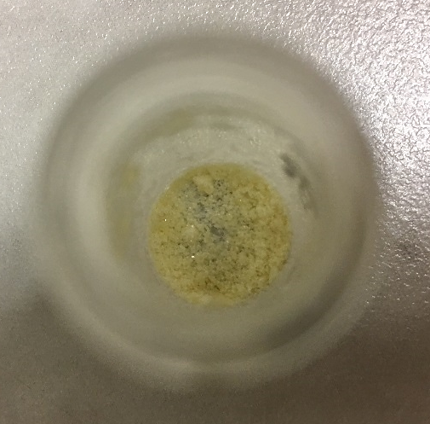

The 26th International Conference of Young Scientists, Kuala Lumpur 2019
Synthesis of Potential Anti-tuberculosis Drugs
Author: Nikola Eva Mádlová Supervisor: Ing. Galina Karabanovich, Ph.D.
First Private Language Grammar School in Hradec Králové, Czech Republic; madlova.nikola@psjg-hk.cz Charles University, Faculty of Pharmacy in Hradec Králové
A. Introduction
Tuberculosis (TB) is a serious global problem, which causes milions of deaths every year.
The pathogenic agent of TB is the mycobacteria from the group Mycobacterium tuberculosis komplex (M.tb).
The World Health Organisation (WHO) estimated that TB caused only in the year 2017 about 1,6 milion deaths (range 1,5- 1,7 milion).
This work deals with the synthesis of substances for which the activity against M.tb and its strains resisitant to commonly used anti-tuberculosis drugs is expected.
C. Research methods
NM5a
NM6a
NM1a
Alkylation of the tetrazole
B. Aim of research work
Synthesis of novel tetrazole derivatives where the benzylsulfanyl group was replaced with the phenethyl group.
Synthesis of a series of new compounds: substituted 1-alkyl a 2-alkyl-5-(phenethyl)-1H-tetrazoles
Study the effect of the linker between the phenyl fragment and the tetrazole cycle on the antimycobacterial activity
Study how the position of substituent on the tetrazole cycle affects the antimycobacterial activity of the final compounds.
→ The goal is to preserve high antimycobacterial activity and enhance the metabolic stability of the final products
NM2a, NM3a, NM4a
NM2b, NM3b, NM4b
Scheme 2: Synthesis of final compounds
D. Results
The abbreviation of the product |  | The yield | The melting point
Amide (NM5a) |  | 60 % | 107-108 °C
Nitrile (NM6a) |  | 76 % | 106-107 °C
Tetrazole (NM1a) |  | 33 % | 174-175 °C
NM2a | R¹ = PhCH₂ | 24 % | 76 - 77 °C
NM2b |  | 10 % | 132 - 133 °C
NM3a | R¹ = 4-CH₃OPhCH₂ | 28 % | 135 - 136 °C
NM3b |  | 25 % | 119 - 120 °C
NM4a | R¹ = 4-ClPhCH₂ | 36 % | 123 - 124 °C
NM4b |  | 25 % | 107 - 108 °C
Scheme 3: General formula of synthetised compounds
S
C
NM3b
Pic.1: The NM3b substance
Scheme 1: Substitution of the benzylsulfanyl group with the phenethyl group
Tab. 1: Synthesized substances with indicated yields and melting points
E. Conclusion and Recommendation
F. References
This work deals with the problematics of tuberculosis and development of new anti-TB active substances: 1-alkyl- a 2-alkyl-5-(phenethyl)-1H-tetrazoles.
The studies crucial for this work were:
Karabanovich (2014) a study exploring the relationship between the structure of benzylsulfanyltetrazoles and their antimycobacterial activity [1]
Karabanovich (2015) a study comparing the activity of 1,5- and 2,5-disubstituted tetrazoles [2]
The evaluation of antimycobacterial activity shows that:
the replacement of sulfur for carbon in linker led to decrease of antimycobacterial activity of the prepared compounds.
the substituent bound to N¹ or N² –tetrazole has almost no influence on the effect of the obtained compounds.
the position of the substituent on the tetrazole cycle does not affect the activity of the compounds.
If you are interested in citations of the mentioned studies, they are listed here.
Please use the QR-code reader on your mobile device to read it.

