Slide 1



Hold My Coffee: Drinks Stabilization Platform
Valentin Pletea-Marinescu & Sebastian-Alexandru Matei
Faculty of Automatic Control and Computer Science / Engineering in Foreign Languages
Active stabilization system preventing beverage spillage during motion.

Slide 2
Motivation
Spilling drinks while walking or carrying trays is a common issue.
Goal: Keep beverage level even when base moves or tilts.
Applications: Restaurants, hospitals, mobile robots, drones.

Slide 3
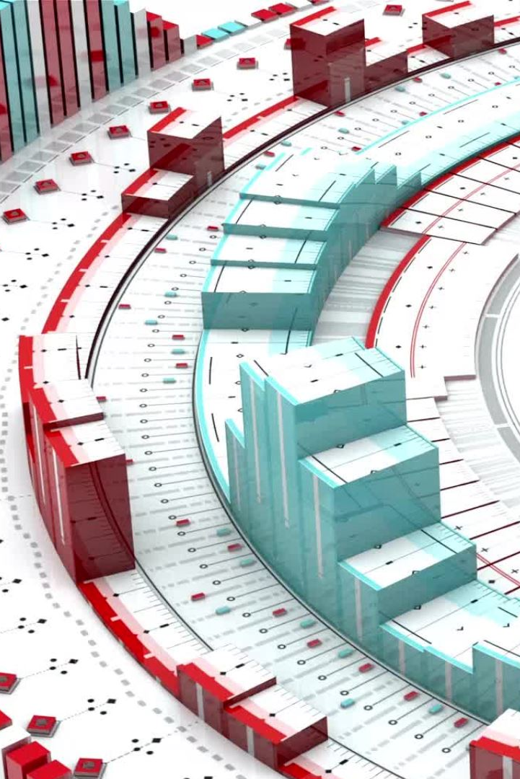
Introduction / Objective
Design an active mechatronic stabilization platform that maintains level surface.
3 Degrees of Freedom: Pitch, Roll, Vertical height.
Dual-microcontroller architecture for real-time control (Teensy 4.1 & Arduino UNO).

Slide 4
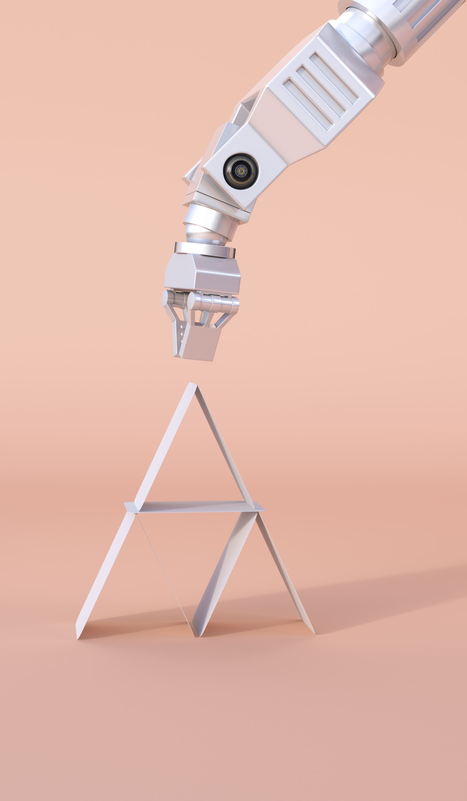
Current State of the Field
Camera gimbals: high-precision stabilization (DJI, Zhiyun).
Tank & ship systems: large loads, slower response.
Robot stabilization: self-balancing & predictive control.
Gap: No small, affordable beverage stabilizer exists.

Slide 5
Features / Innovations
Dual-microcontroller real-time architecture.
Cascaded PID control for pitch, roll, and height.
Vertical stabilization (unique among gimbals).
Modular 3D-printed design for easy maintenance.

Slide 6
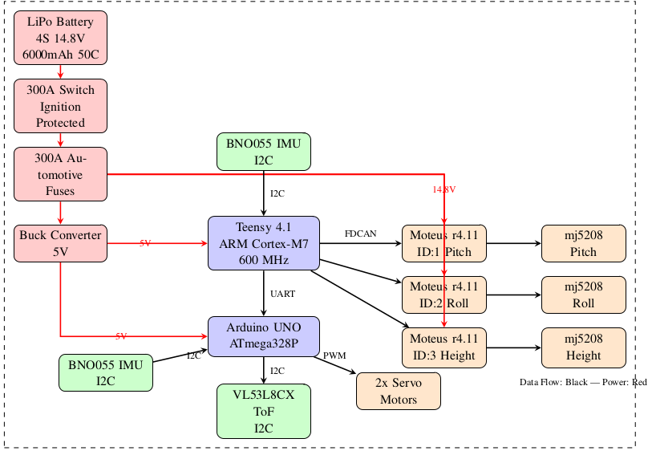
Hardware Overview
Main controller: Teensy 4.1 (600 MHz ARM Cortex-M7).
Secondary controller: Arduino UNO for height & servo control.
Actuators: 3x mj5208 brushless motors + Moteus r4.11 controllers.
Sensors: BNO055 IMU & VL53L8CX Time-of-Flight sensor.
Power: LiPo 14.8V, 300A switch & fuse protection.

Slide 7
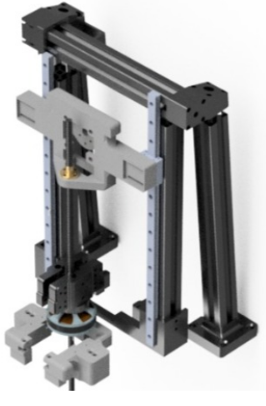
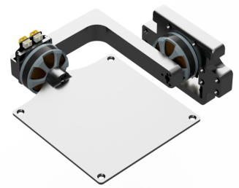
Mechanical Design
3D printed ABS/PETG parts + aluminum extrusions.
Vertical motion via ACME T8 lead screw + MGN linear rails.
Modular, replaceable structure for flexibility and repairability.

Slide 8
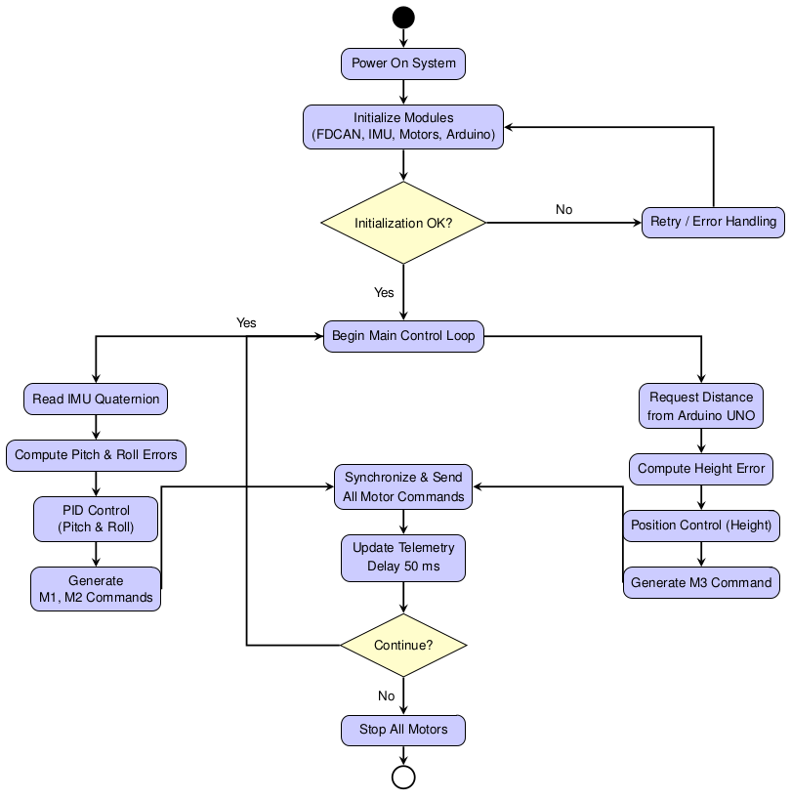
Control & Software
Cascaded PID loops: Teensy high-level control, Moteus low-level loops.
20 Hz control rate, low-latency FDCAN communication.
Quaternion to Euler conversion for orientation control.
Sensor fusion via complementary filter.

Slide 9
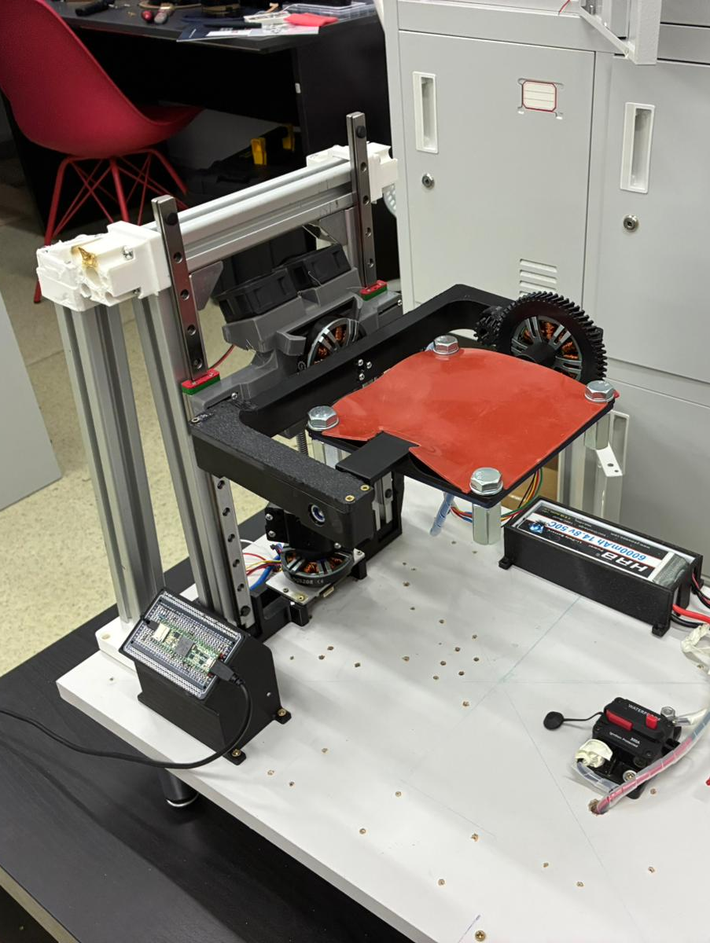
Performance & Demonstration
Stable within ±1° tilt, recovery < 0.2 seconds.
No spillage for base tilt up to 90°.
Battery runtime: 3 hours continuous operation.
Smooth and fast control response observed.

Slide 10
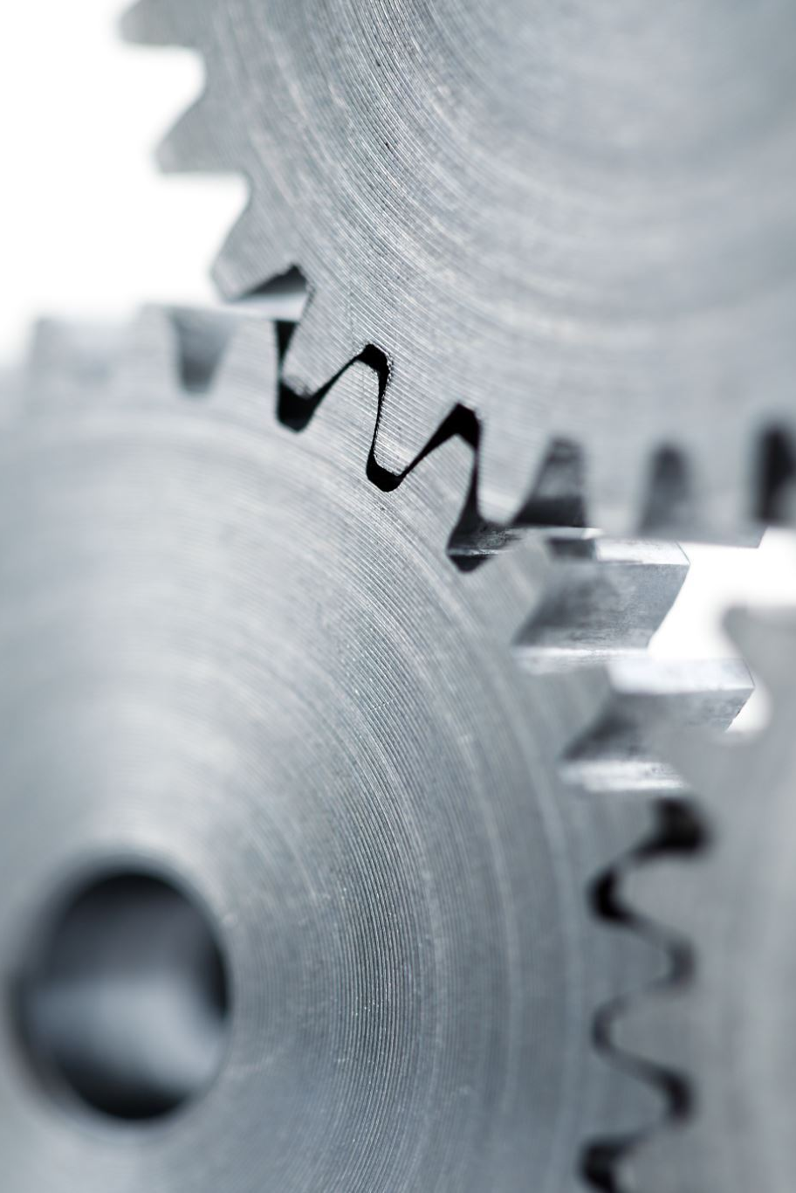
Challenges & Improvements
PID tuning for changing center of mass (varying liquid levels).
Mechanical alignment and backlash issues.
Future: adaptive or ADRC control, faster sensors, wireless monitoring.

Slide 11
Conclusions
Fully functional multi-axis active stabilization platform.
Demonstrates real-time mechatronic control and integration.
Achieves low-cost alternative to professional stabilizers.

Slide 12
Summary of Contributions
Valentin: Software design (PID control, sensor fusion, communication).
Sebastian: Hardware & mechanical system design, integration.
Joint: Testing, safety systems, documentation, final demonstration.
Main takeaway: Engineering precision applied to daily-life stability.

