Slide 1
作品集结构
Fact + Problem framing + tags（角色）
Overview(product)
Features
Design Process(Agile UX, build-measure-learn loop)
Brainstorming > Lean canvas
Market research
Wireframes

Slide 2
Fact
All-cause death was the most frequent major event in more than 17,000 newly diagnosed AF patients, far exceeding the rate of stroke or major bleeding.
Notes:
https://www.escardio.org/Congresses-&-Events/ESC-Congress/Congress-resources/Congress-news/2020-esc-clinical-practice-guidelines-for-the-diagnosis-and-management-of-atrial-fibrillation

Slide 3
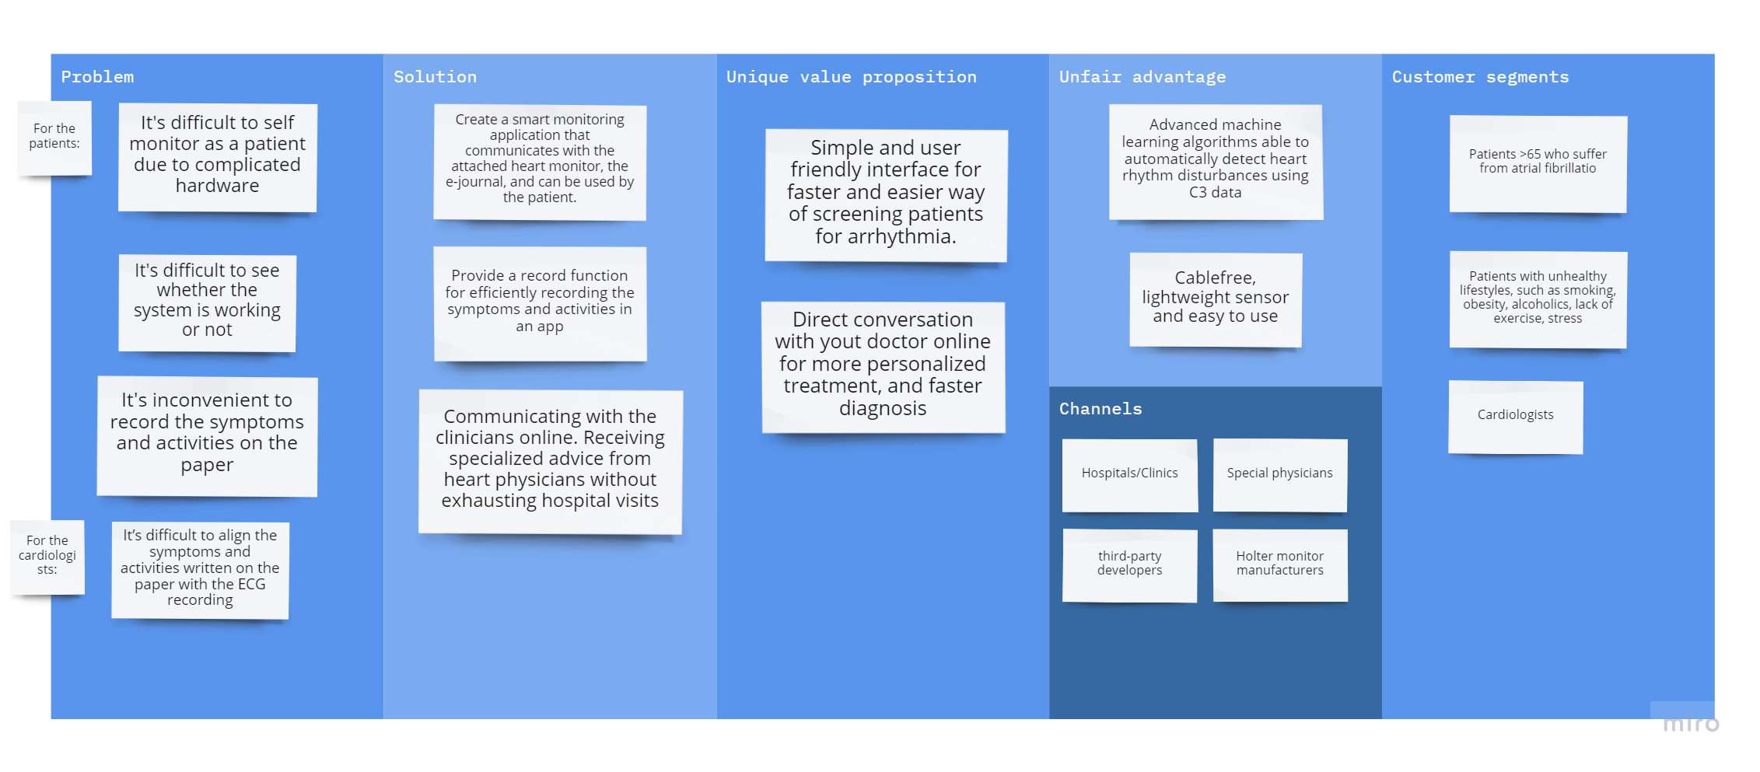

Slide 4
Data Insights™ offers an automated analysis method to accurately and consistently find, classify, and report on the arrhythmias within the ECG signal. The following table outlines the arrhythmia types, classifications, and quantification parameters available with Data Insights.
Notes:
ECG监测

