Slide 1
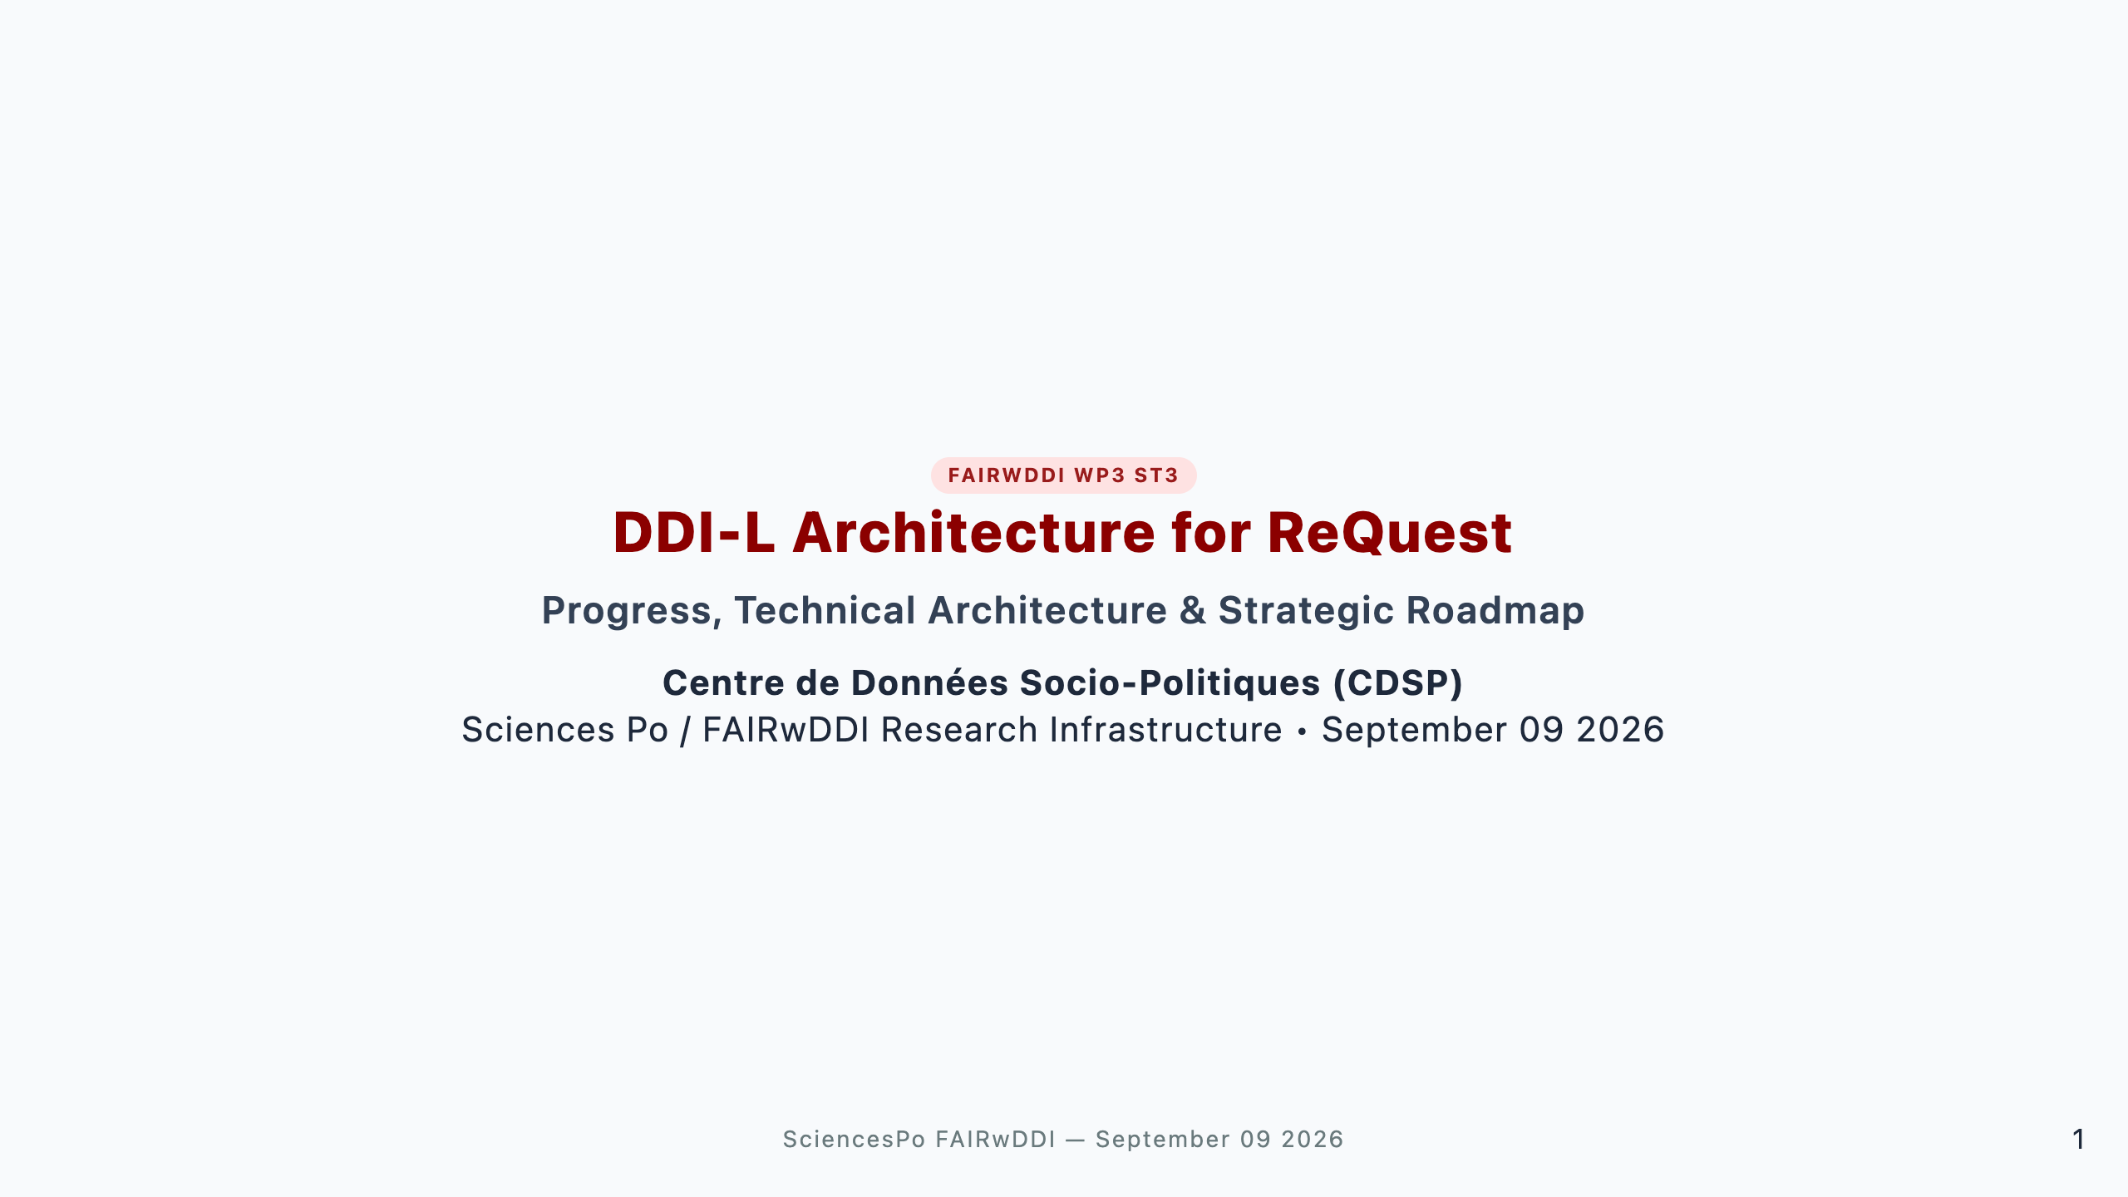
Notes:
Speaker Talking Cues: - Welcome the team; state the purpose: 20-min overview of what has been built, the architectural pillars, upstream tools, and next steps. - Mention that this is Phase I / early Phase II delivery for FAIRwDDI WP3 ST3.

Slide 2
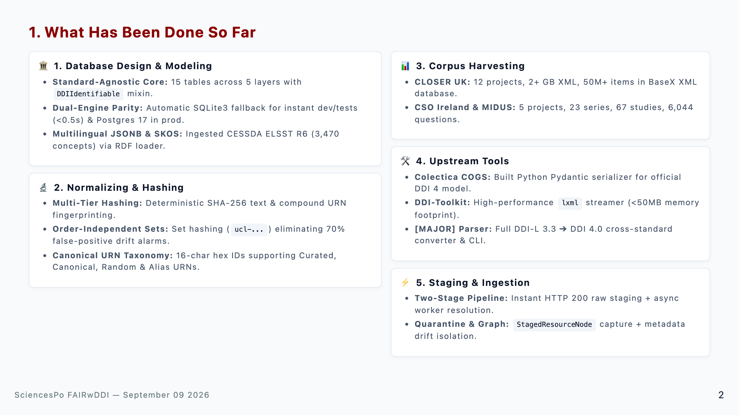
Notes:
Speaker Talking Cues: - Database Design & Modeling: 15-table standard-agnostic schema, SQLite3 dev fallback, multilingual JSONB, and CESSDA ELSST R6 SKOS ingestion. - Normalizing & Hashing: Deterministic SHA-256 fingerprinting, order-independent set hashing, and canonical URN taxonomy. - Corpus Harvesting: Harvested real-world DDI-L corpora (CLOSER 50M+ items in BaseX, CSO Ireland with 6,044 questions, MIDUS). - Upstream Tools: Added Pydantic compiler to Colectica COGS, streaming parser in ddi-toolkit, and major DDI 3.3 -> 4.0 parser. - Staging & Ingestion: Decoupled two-stage staging pipeline with StagedResourceNode, URNAlias, and MetadataQuarantine.

Slide 3
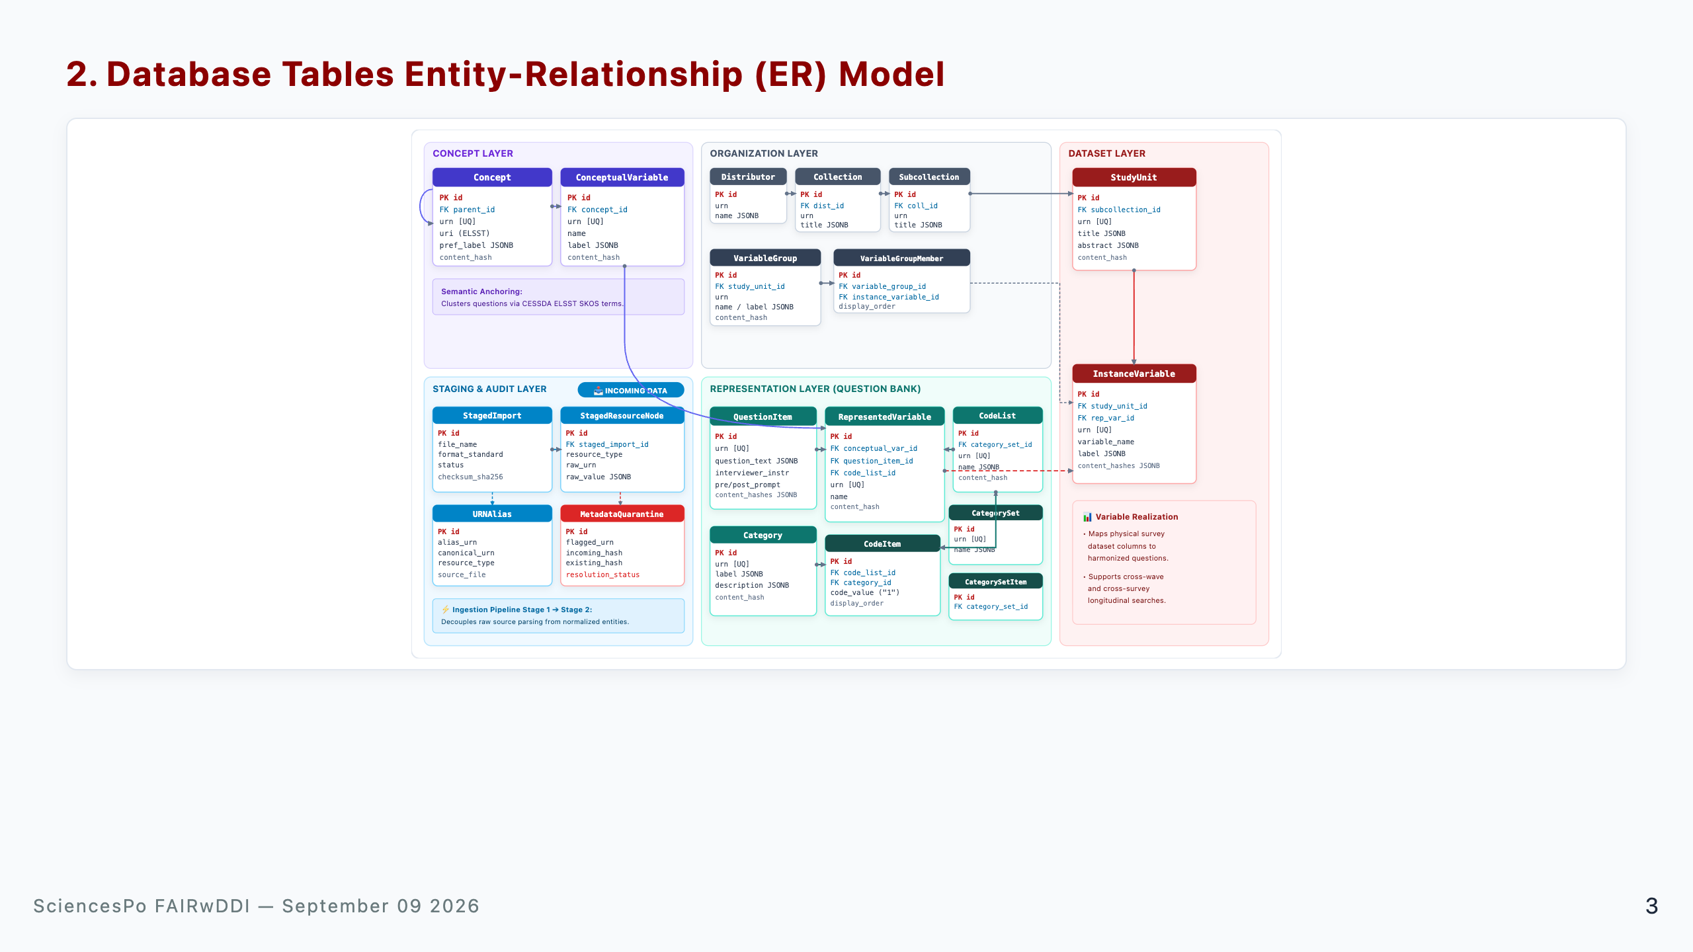
Notes:
Speaker Talking Cues: - Present the 15-table relational core and foreign-key architecture: 1. Staging & Audit Layer (Bottom Left): Entry point where raw metadata files arrive (`StagedImport` -> `StagedResourceNode`, `URNAlias`, `MetadataQuarantine`). 2. Concept Layer (Top Left): Theoretical anchoring with SKOS/ELSST concept hierarchies and `ConceptualVariable`. 3. Organization Layer (Top Center): Study provenance (`Distributor` -> `Collection` -> `Subcollection`) and `VariableGroup`. 4. Representation Layer (Bottom Center): Reusable Question Bank (`QuestionItem` + `Category` / `CodeList` -> `RepresentedVariable`). 5. Dataset Layer (Right): Physical realization (`StudyUnit` -> `InstanceVariable` <- `RepresentedVariable`). - Highlight that every entity carries persistent URN, version, and SHA-256 content_hash.

Slide 4
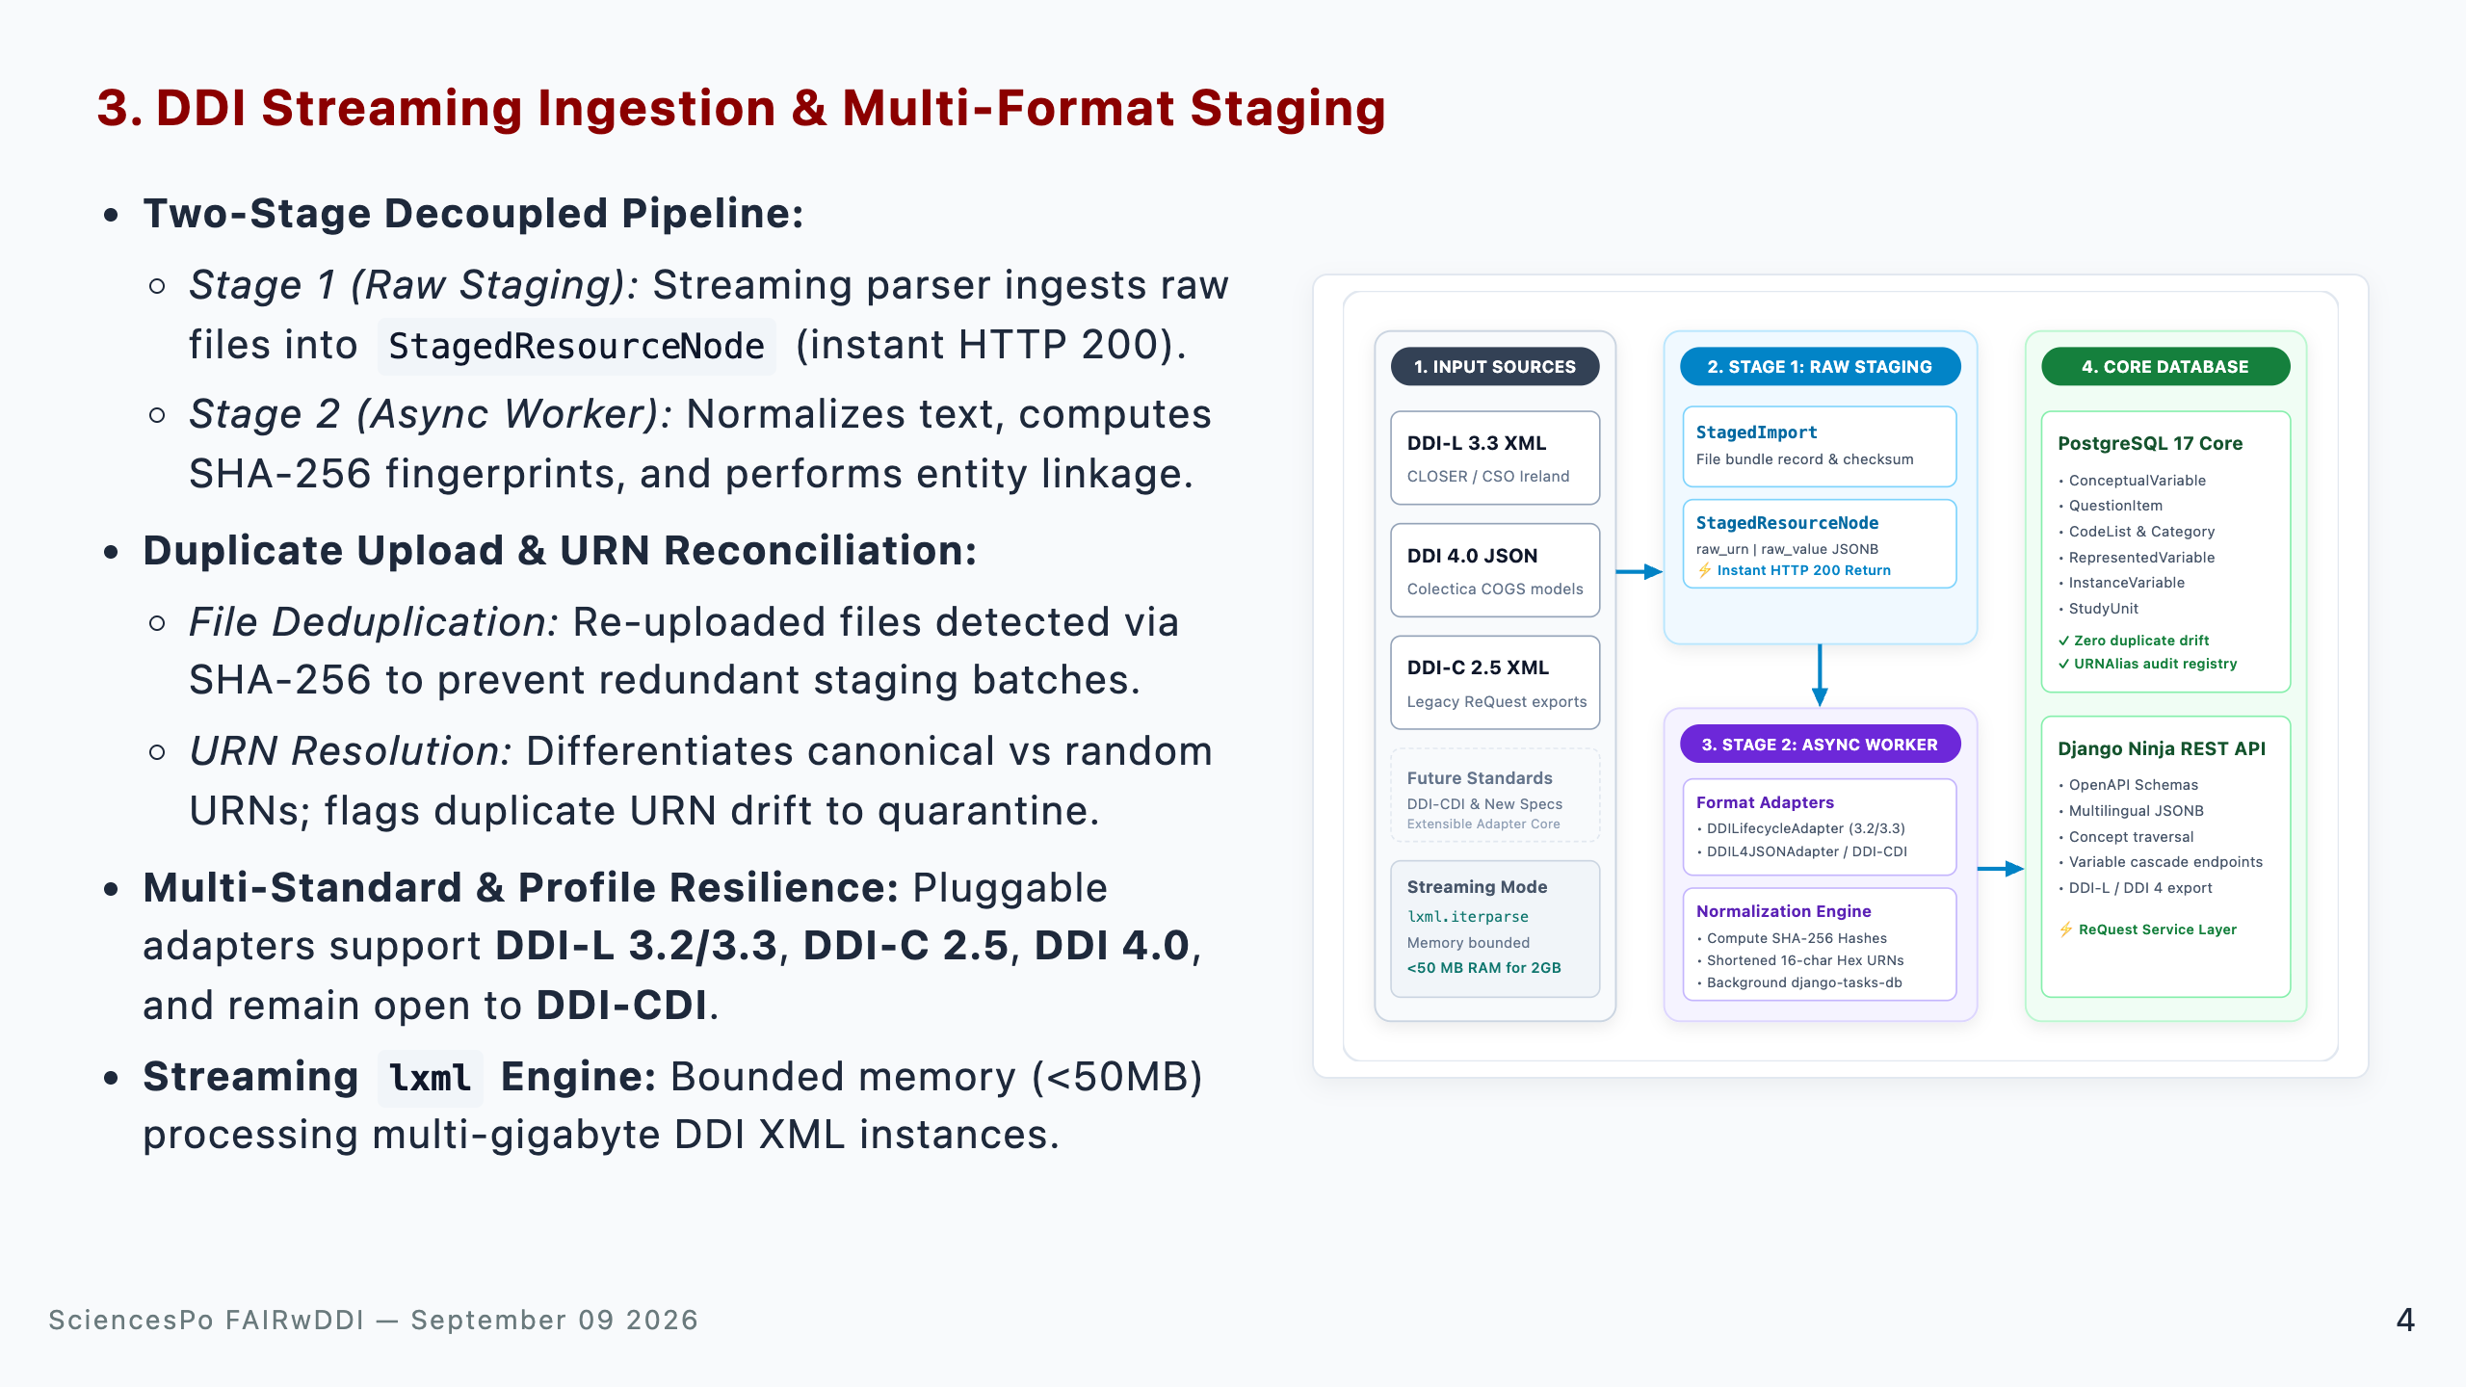
Notes:
Speaker Talking Cues: - Decoupled ingestion: Stage 1 acknowledges uploads in seconds (<1s) by storing raw node blobs; Stage 2 handles heavy relational resolution asynchronously. - Duplicate uploads & URNs: Explain that file SHA-256 prevents redundant ingestion passes, while URN reconciliation differentiates stable canonical IDs from randomized ones and routes conflicting metadata to quarantine. - Standard & profile diversity: Highlight that adapters handle DDI-L 3.2/3.3, DDI-C 2.5, DDI 4, and institutional profiling differences. - Extensibility: Point out that the adapter design leaves the door open to emerging standards like DDI-CDI without modifying the core storage engine. - Streaming memory bound: iterparse guarantees sub-50MB RAM usage even on multi-GB XML payloads.

Slide 5
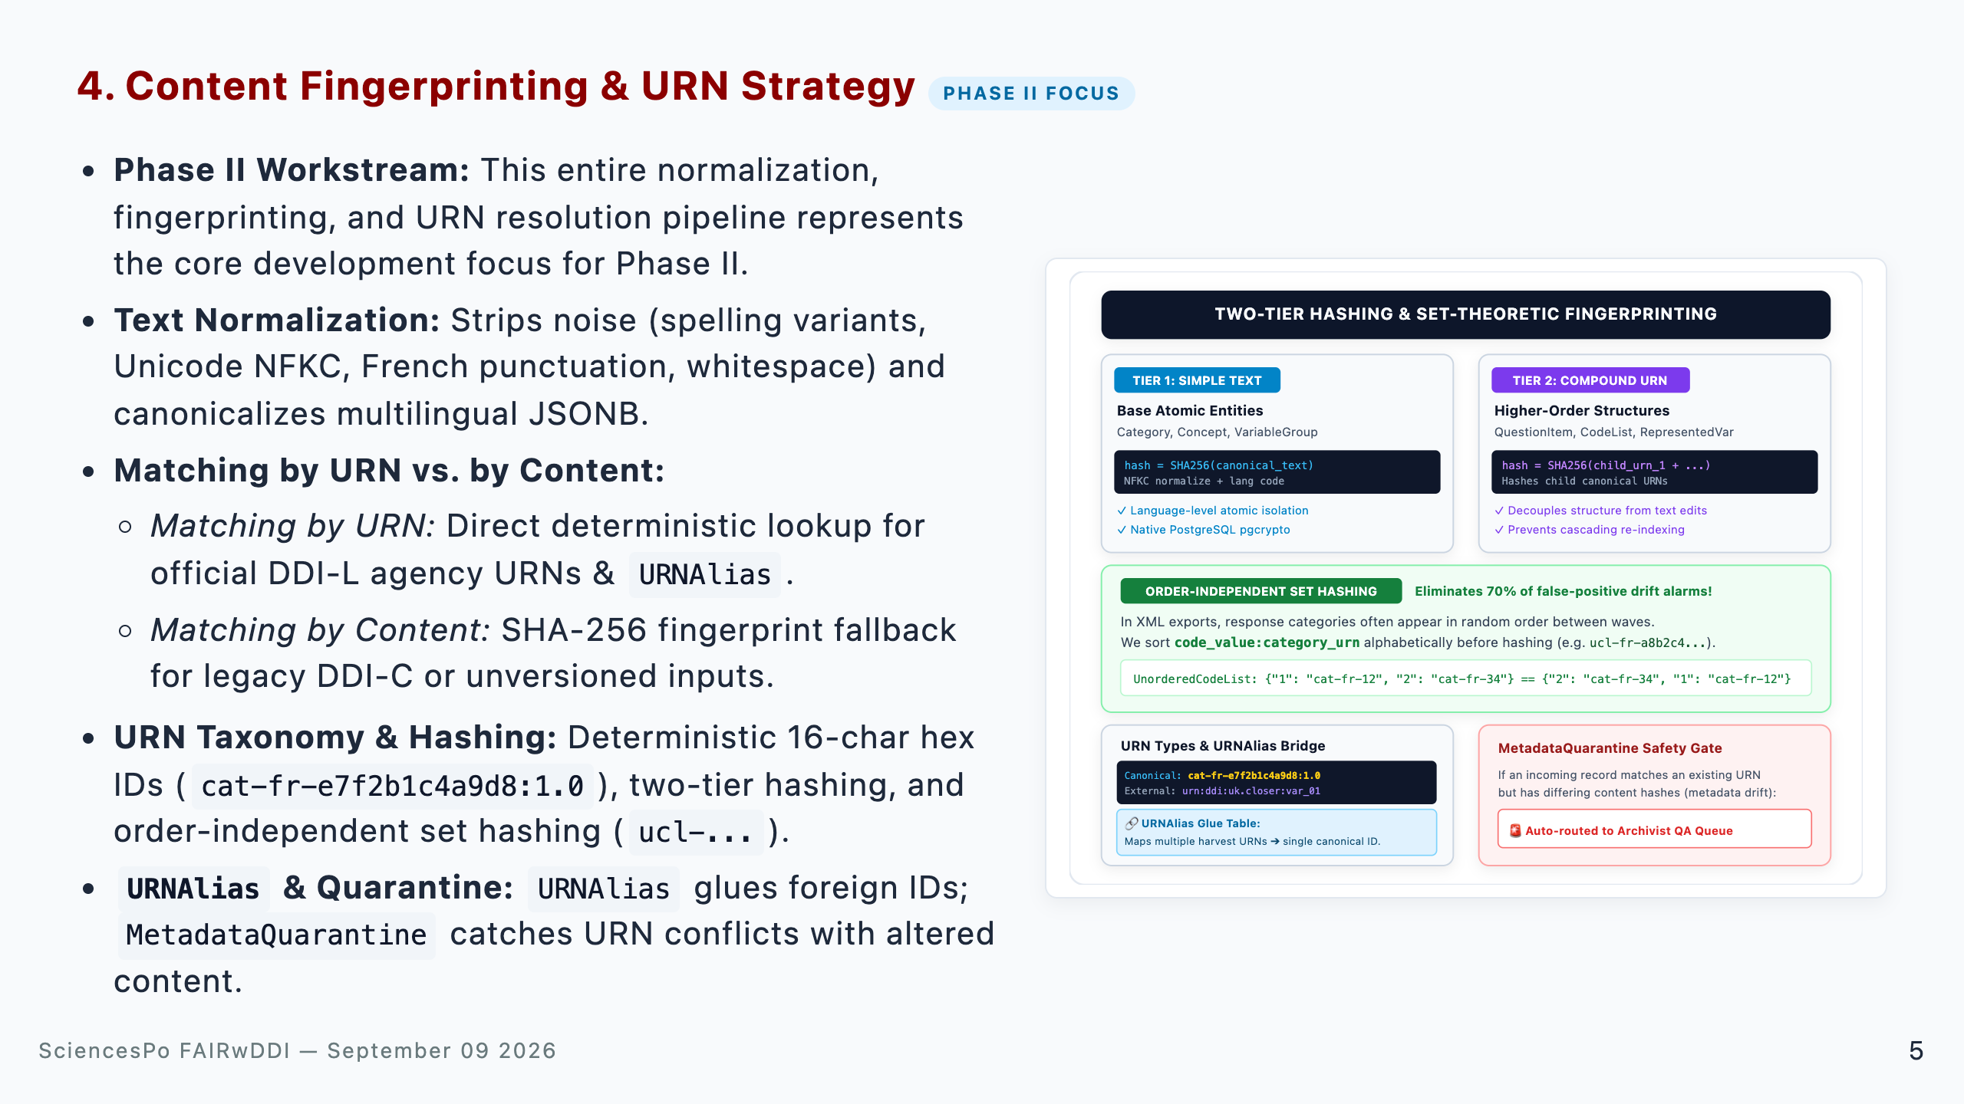
Notes:
Speaker Talking Cues: - Phase II core subject: Emphasize that this entire slide outlines the architectural strategy to be developed, calibrated, and implemented during Phase II. - Normalization: Explain that text normalization strips noise (spelling discrepancies, typographical quotes, whitespace, multilingual keys) prior to hashing. - Matching by URN vs. by Content: Explain the dual strategy: URN-first matching when reliable identifiers exist; content-hash fallback for legacy DDI-C or unversioned inputs. - Two-Tier & Set Hashing: Atoms use text SHA-256; structures use child URN hashes; set hashing avoids false alarms on unordered answer options. - URNAlias Bridge & Quarantine: URNAlias acts as the glue for foreign IDs, while Quarantine prevents silent database corruption.

Slide 6
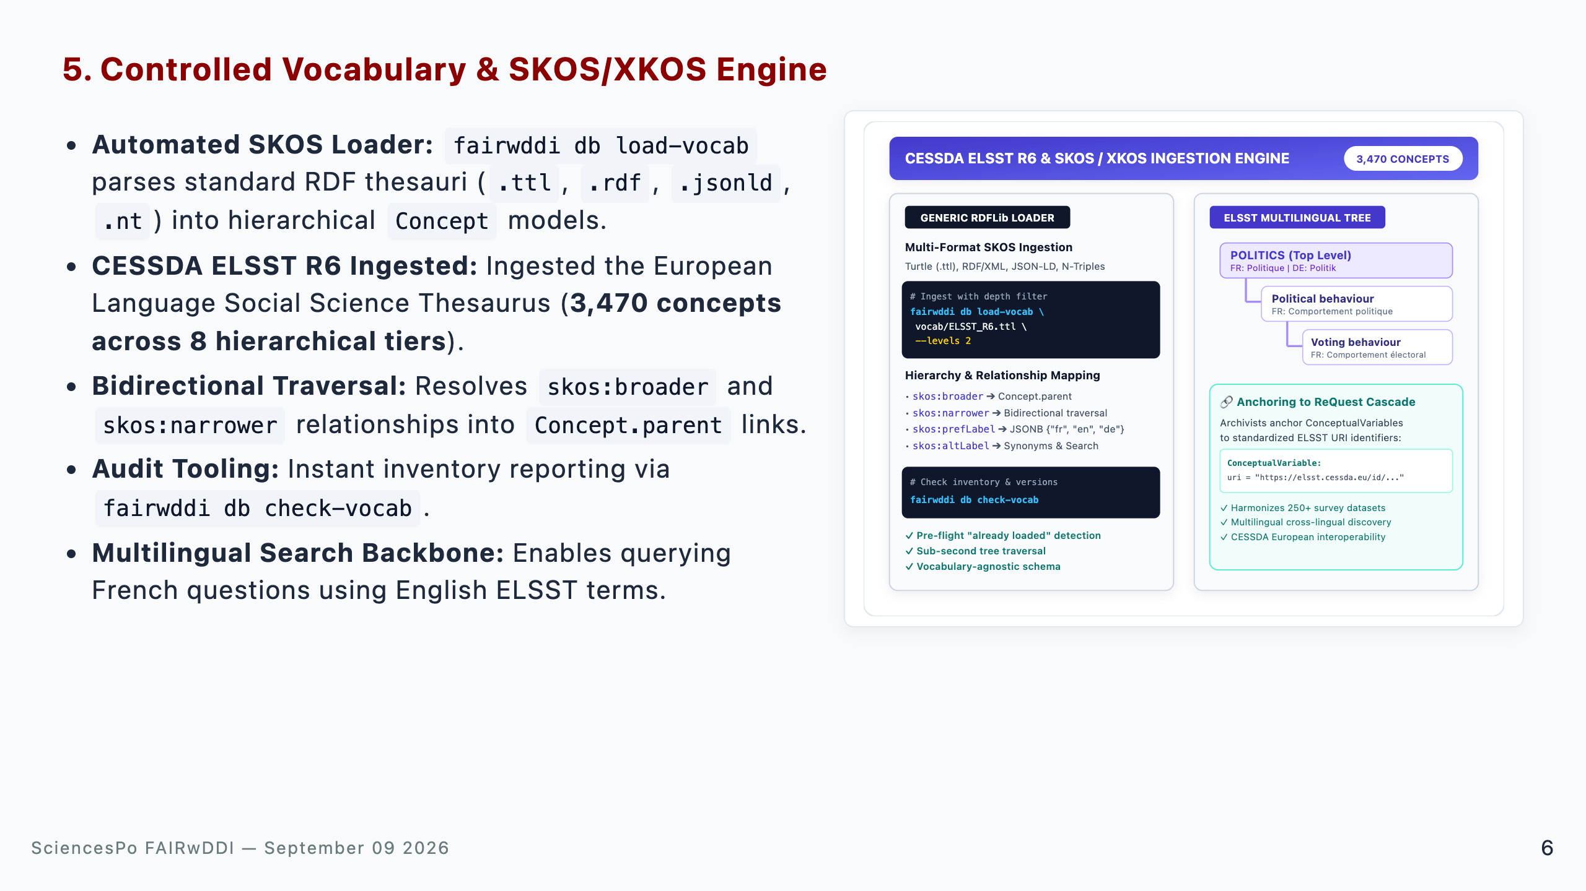
Notes:
Speaker Talking Cues: - Why ELSST: ELSST is the European standard thesaurus across CESSDA social science data archives. - Hierarchy support: Depth filtering allows loading top-level domains or deep fine-grained classifications. - Audit tooling: check-vocab provides instant reporting on loaded concepts and versions. - Role in ReQuest: Allows searching variables across languages using standardized multilingual terms.

Slide 7
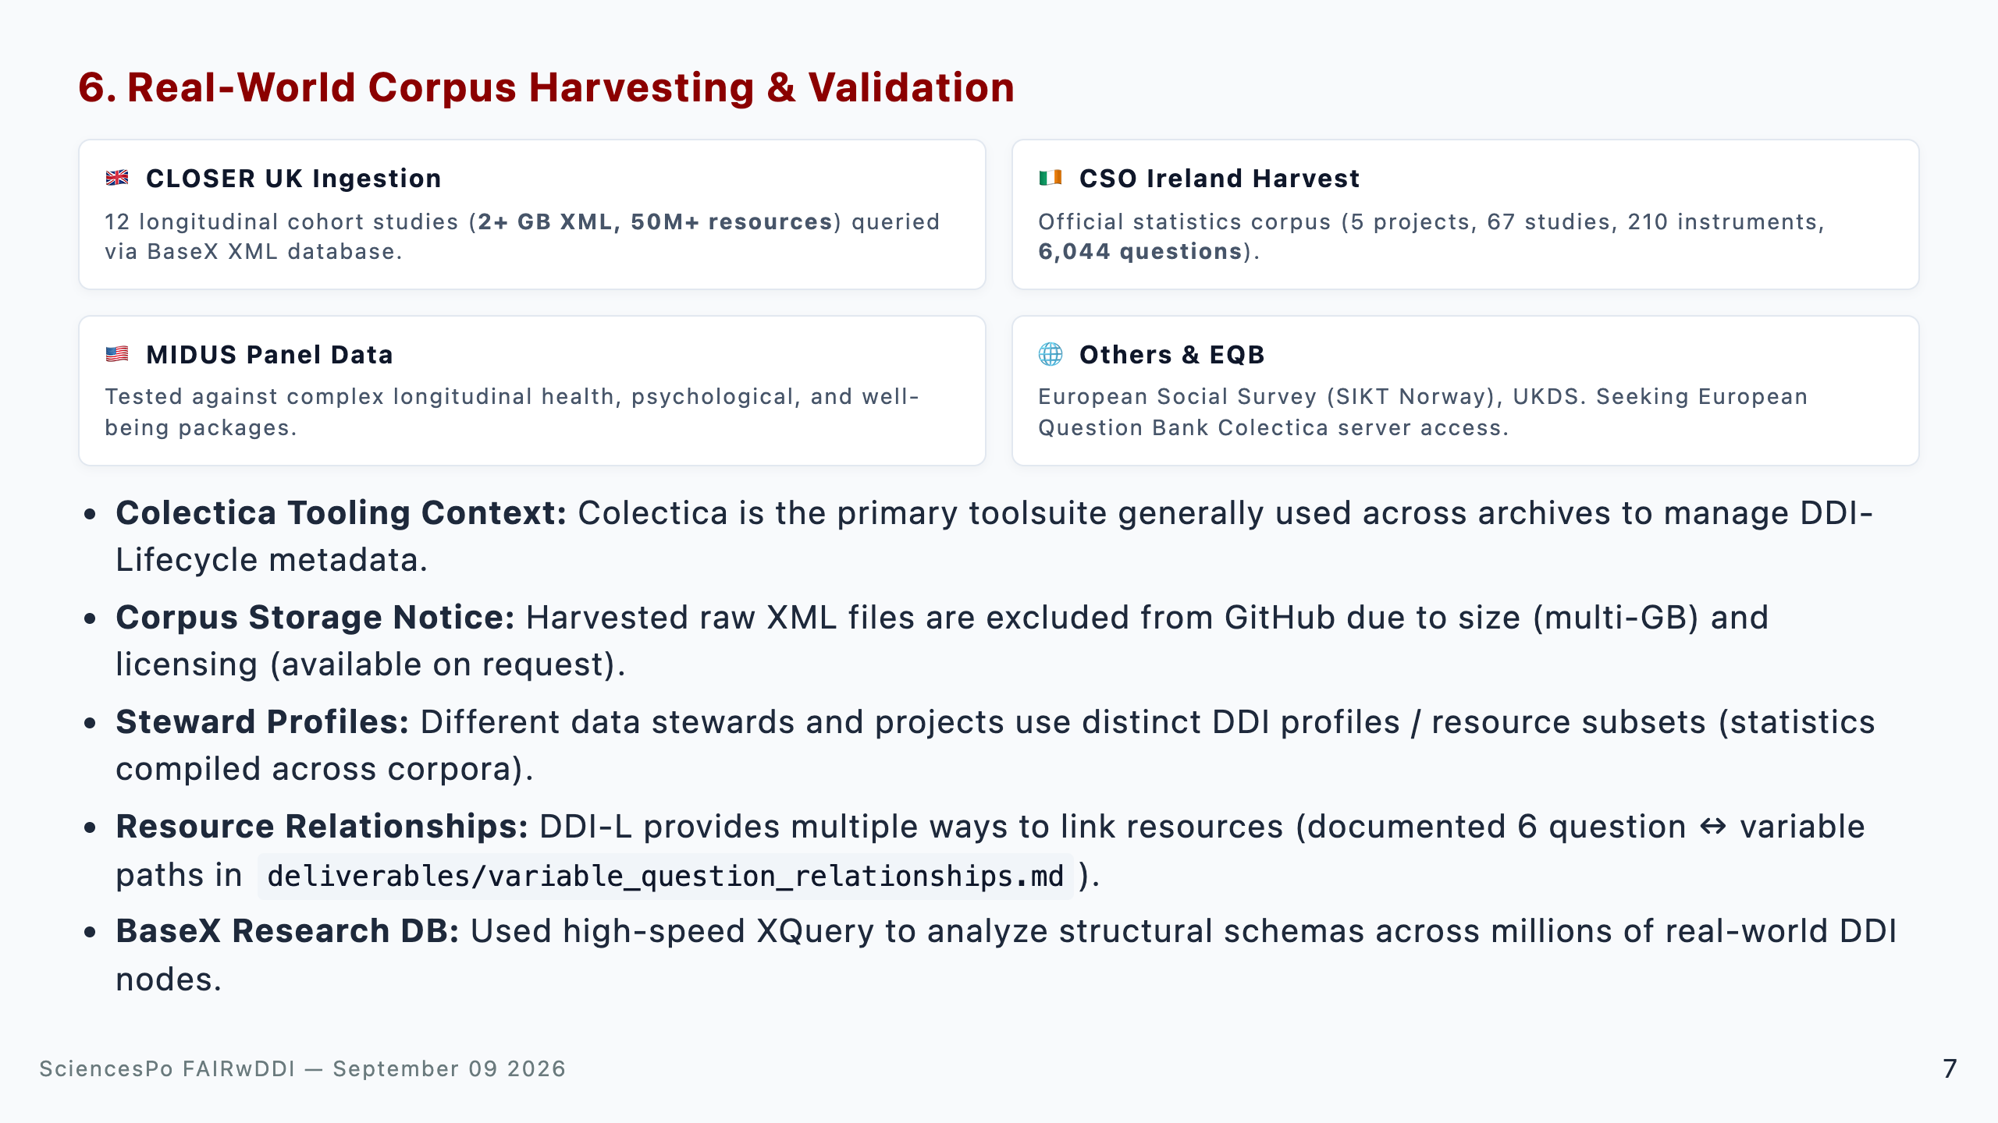
Notes:
Speaker Talking Cues: - Tooling standard: Emphasize that Colectica is the dominant software used by social science archives to author and manage DDI-L metadata. - Corpus availability: Mention that the raw multi-GB XML files live locally / on research storage due to size and archive licensing terms, but can be shared as needed. - Profile diversity: Explain that different stewards only populate specific subsets of DDI-L, requiring flexible profile handling. - Relationship complexity: Mention that archives link variables and questions in 6 different structural ways, which our normalization engine simplifies. - BaseX integration: Used BaseX as a high-speed XQuery research database to inspect 50M+ DDI XML nodes.

Slide 8
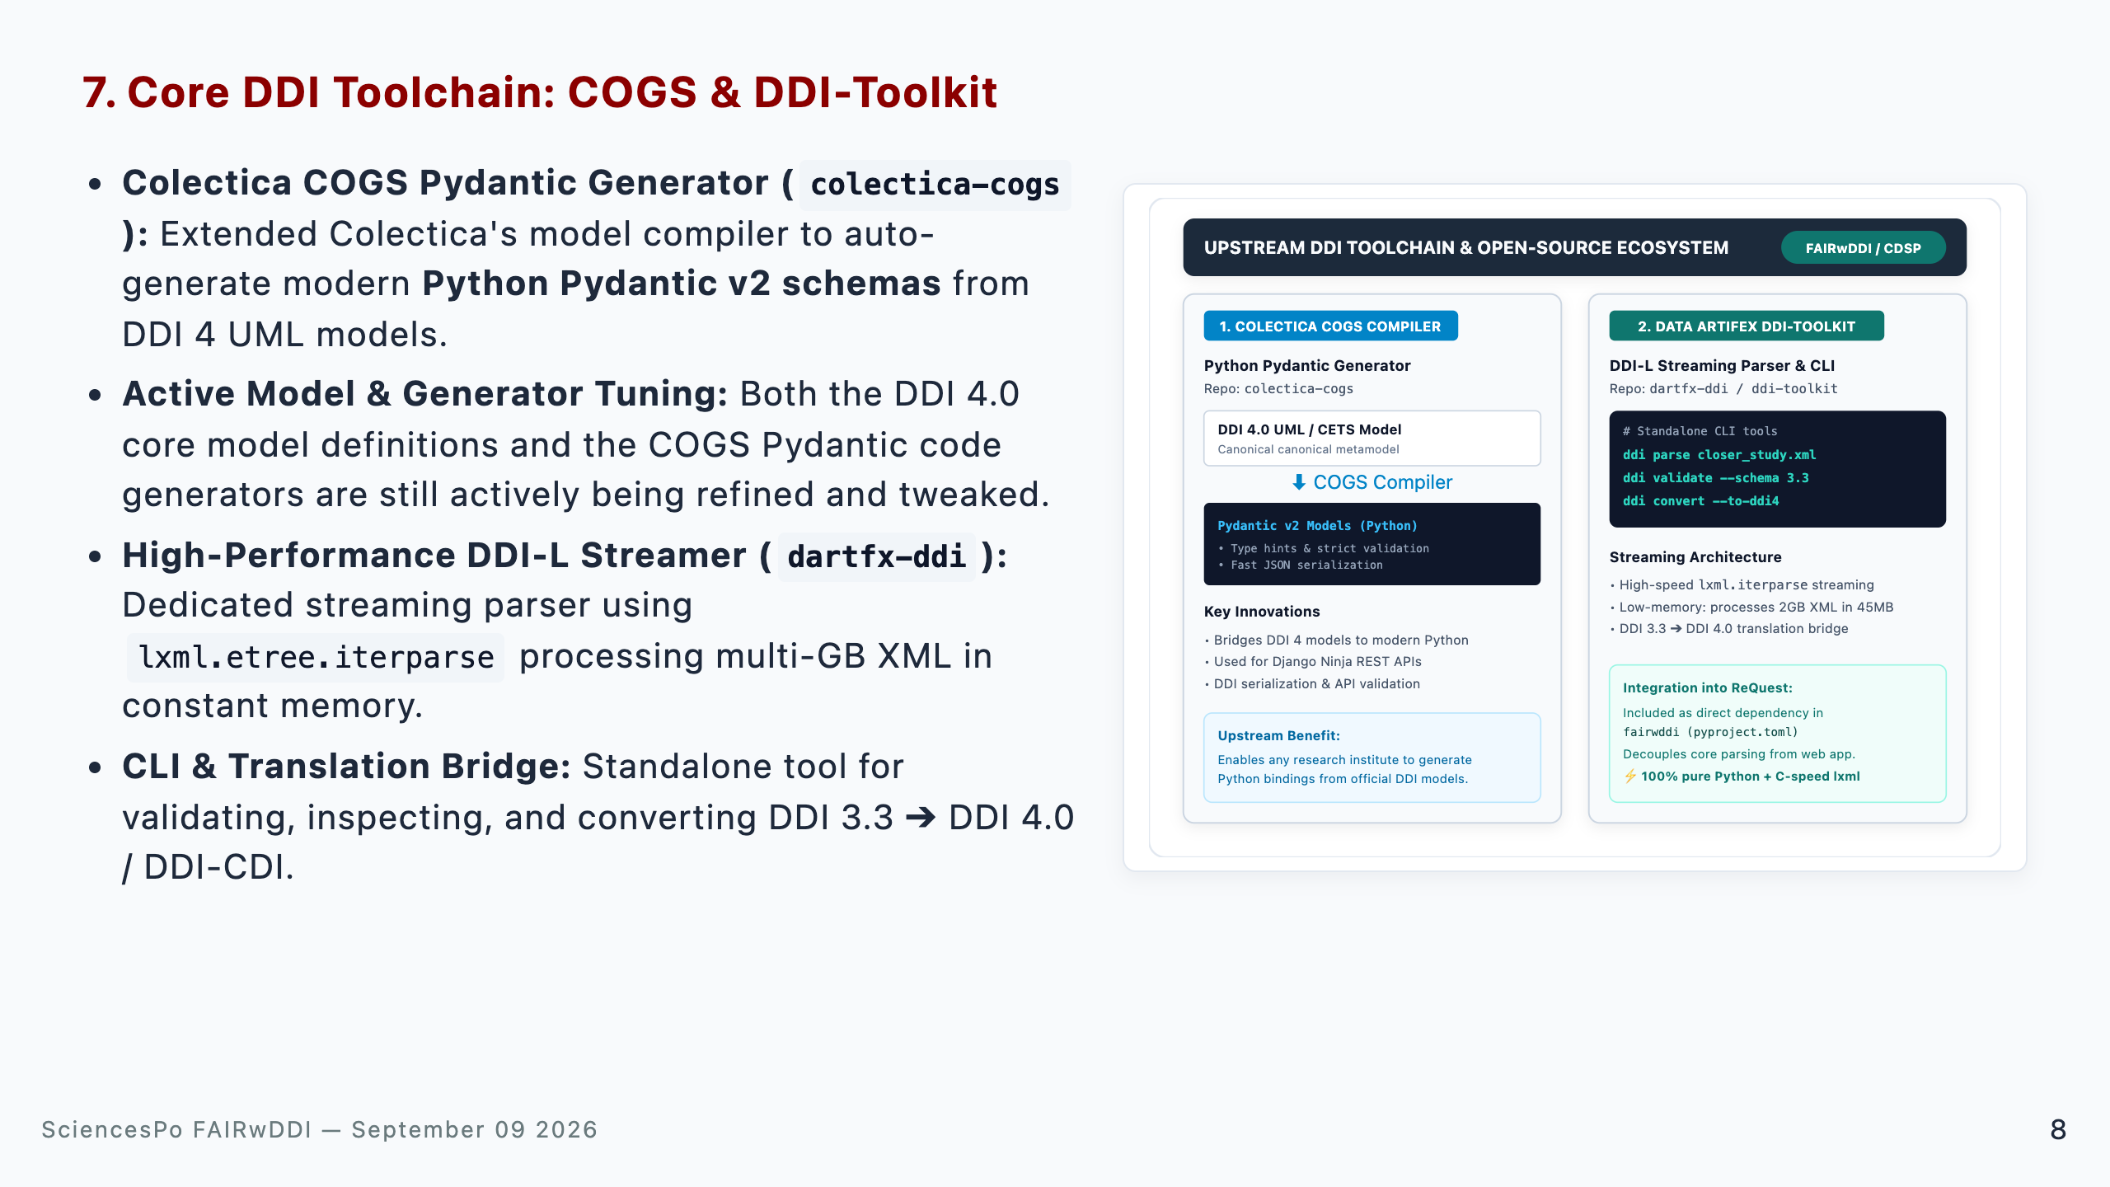
Notes:
Speaker Talking Cues: - COGS context: Colectica COGS is the official DDI 4 model compiler; our contribution enables direct compilation into typed Python Pydantic models. - Ongoing iteration: Clarify that the DDI 4.0 model specifications and COGS code generation rules are actively being tweaked as we validate against real-world corpora. - DDI-Toolkit decoupling: Parsing logic lives in dartfx-ddi as a reusable library and standalone CLI tool. - Semantic bridging: Demonstrates how DDI 3.3 and DDI 4 can coexist seamlessly in a single unified pipeline. - Reusability: Other CESSDA archives can reuse colectica-cogs and ddi-toolkit for their own projects.

Slide 9
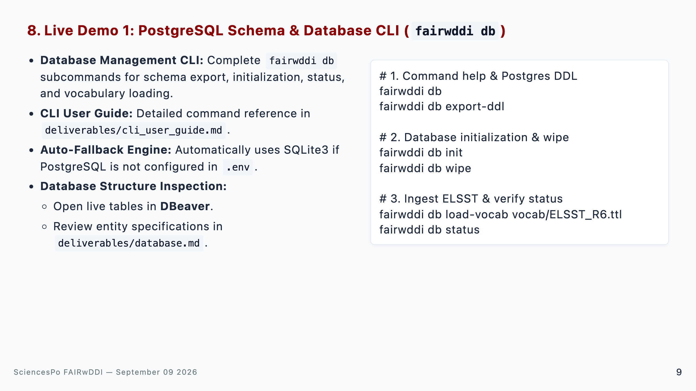
Notes:
Speaker Talking Cues: - CLI ergonomics: Run fairwddi db to show environment diagnostics and help. - DDL export: Point out that export-ddl generates standalone PostgreSQL 17 SQL for DBAs without needing Django. - ELSST loader: Show how load-vocab ingests 3,470 multilingual concepts into the hierarchical Concept table. - DBeaver demo: Switch to DBeaver to show live PostgreSQL tables populated with ELSST concepts and sample fixtures.

Slide 10
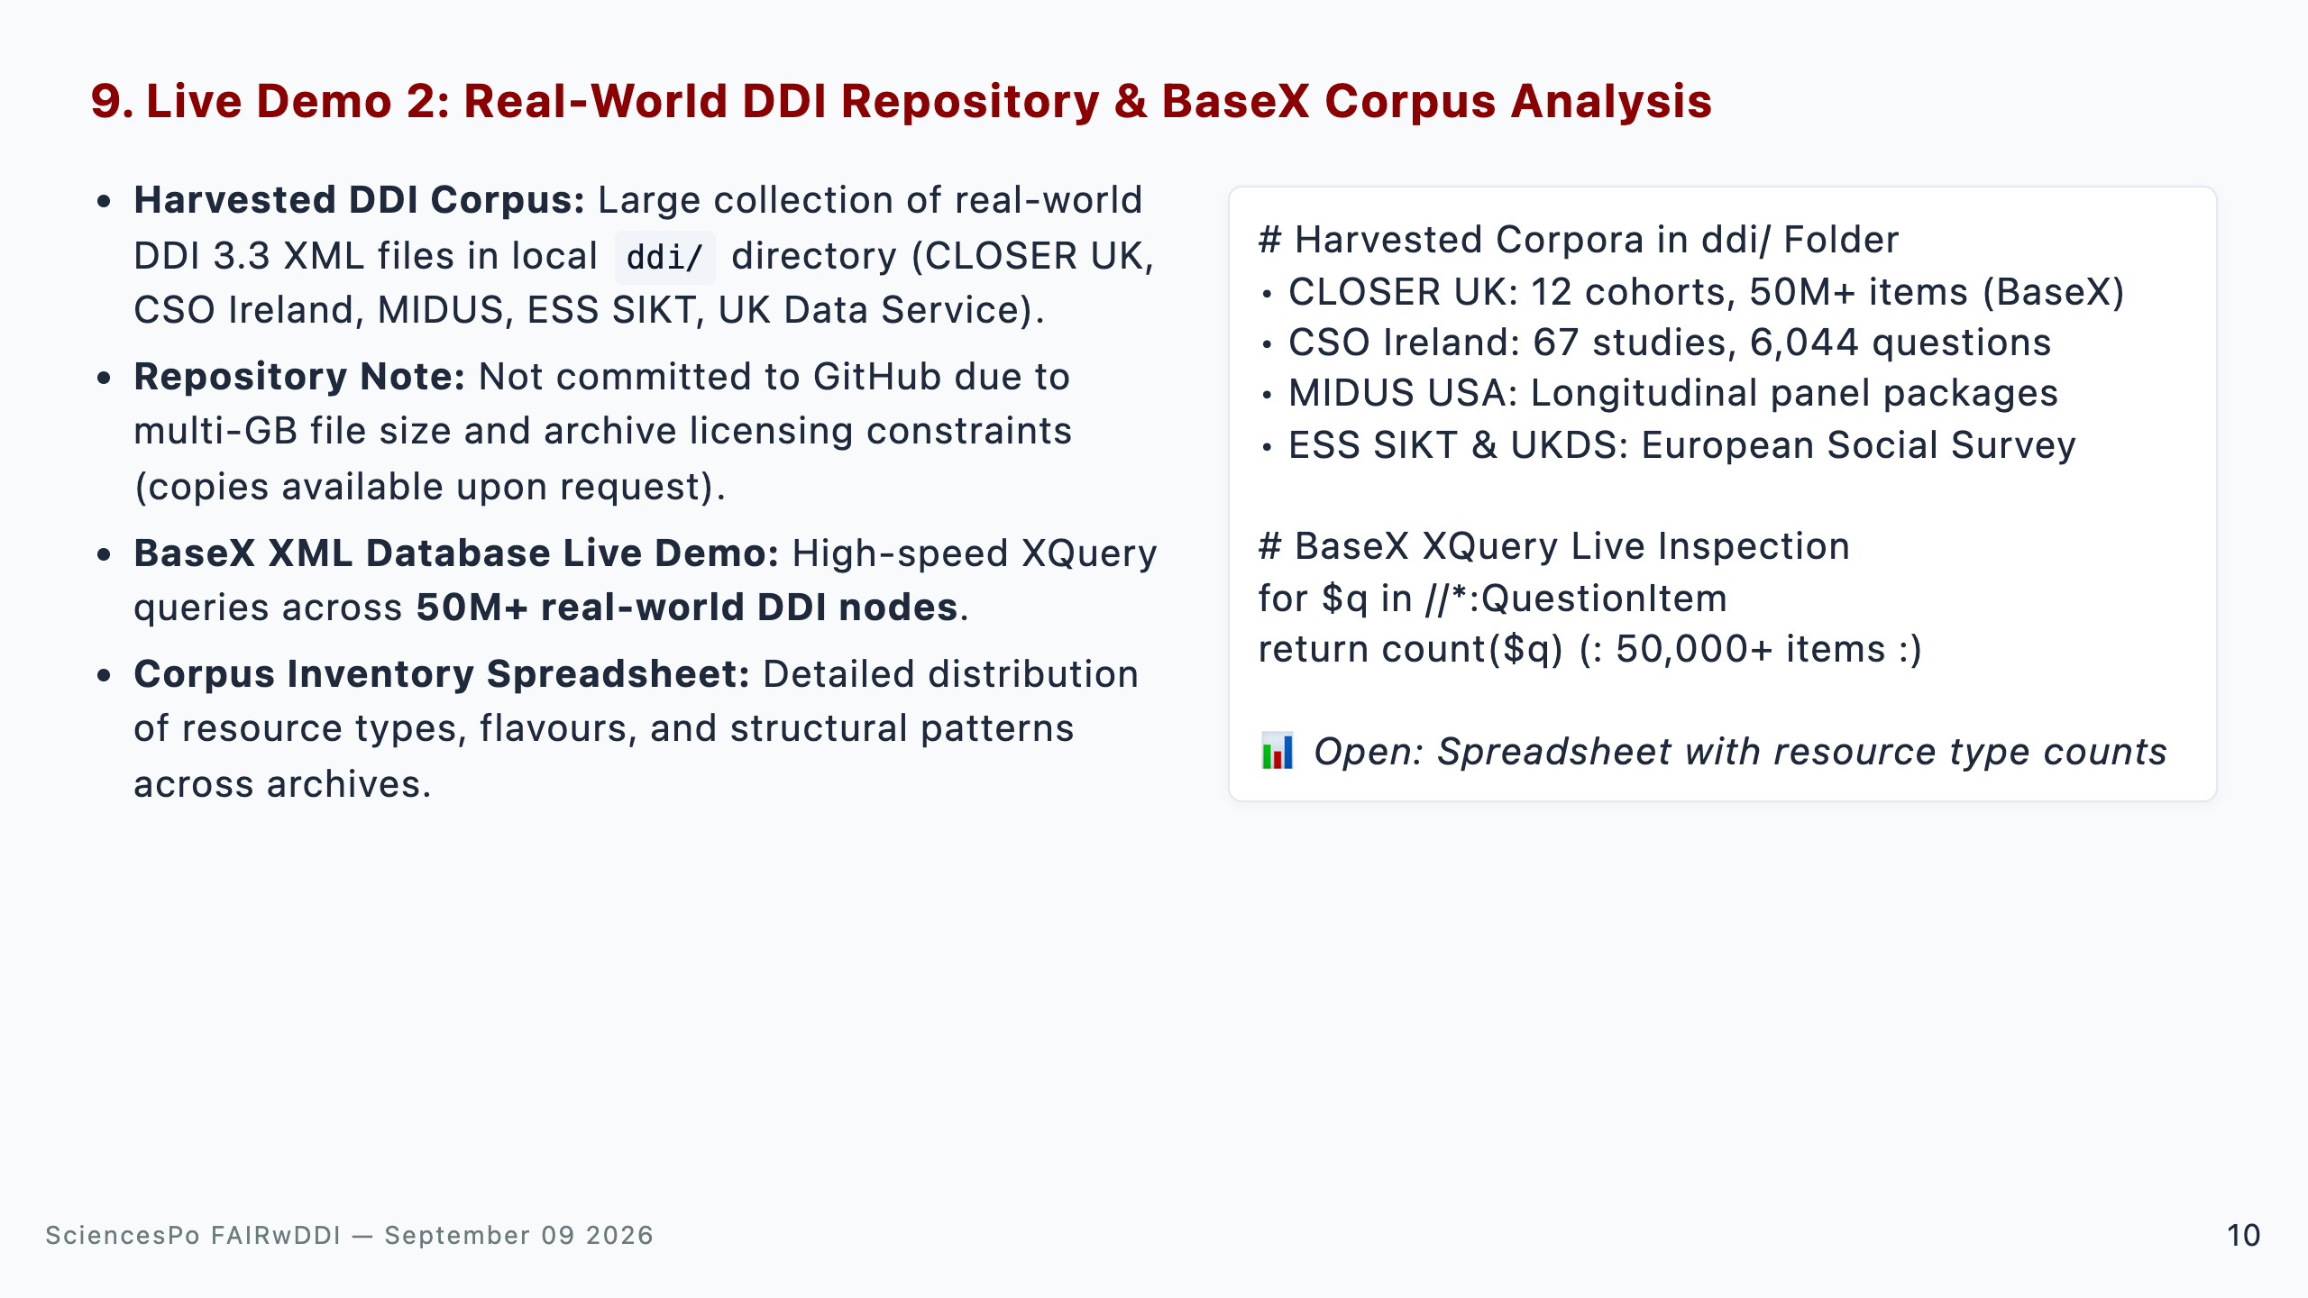
Notes:
Speaker Talking Cues: - Harvest scope: Emphasize that we have tested against real, diverse European and US social science archives. - BaseX speed: Demonstrate how BaseX XML database indexes 50M+ DDI elements for sub-second structural exploration. - Licensing note: Explain that corpora files are not in Git to respect repository size and copyright policies. - Spreadsheet: Showcase cross-archive comparisons of QuestionItems, Categories, and CodeLists.

Slide 11
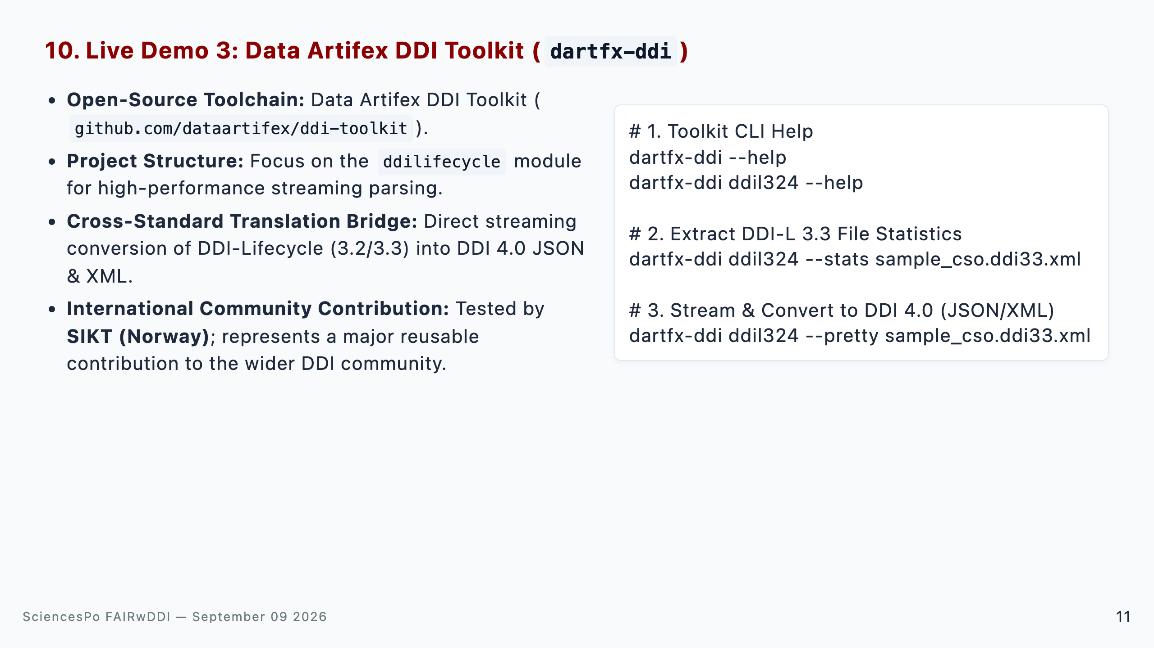
Notes:
Speaker Talking Cues: - Community value: Highlight that ddi-toolkit is a standalone, open-source library that solves high-performance DDI-L parsing for the wider community. - Antigravity project demo: Show the codebase in the IDE, highlighting the ddilifecycle streaming architecture. - Live CLI run: Execute dartfx-ddi ddil324 --stats to showcase instant metadata extraction and conversion to DDI 4.0 JSON. - SIKT testing: Note that SIKT in Norway has also successfully validated the tool.

Slide 12
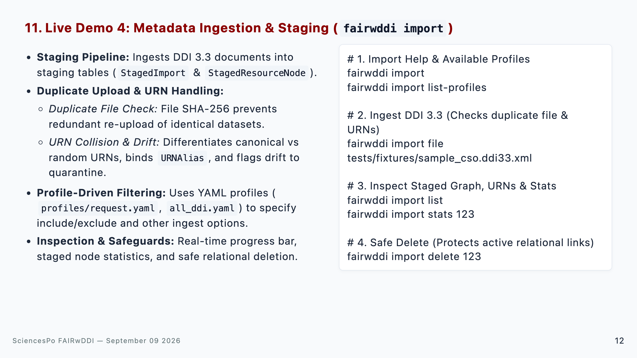
Notes:
Speaker Talking Cues: - Ingestion live run: Run fairwddi import file on sample_cso.ddi33.xml, showing real-time Rich progress. - Duplicate detection: Explain that re-uploading an existing file triggers an instant SHA-256 check avoiding duplicate staging records. - URN handling: Mention how the staging engine validates URN uniqueness, maps cross-archive aliases, and isolates drifting definitions. - Profiling: Explain how profiles/request.yaml extracts only question items and representations while ignoring unneeded administrative headers. - Safety: Show that fairwddi import delete protects data integrity by checking relational foreign keys.

Slide 13
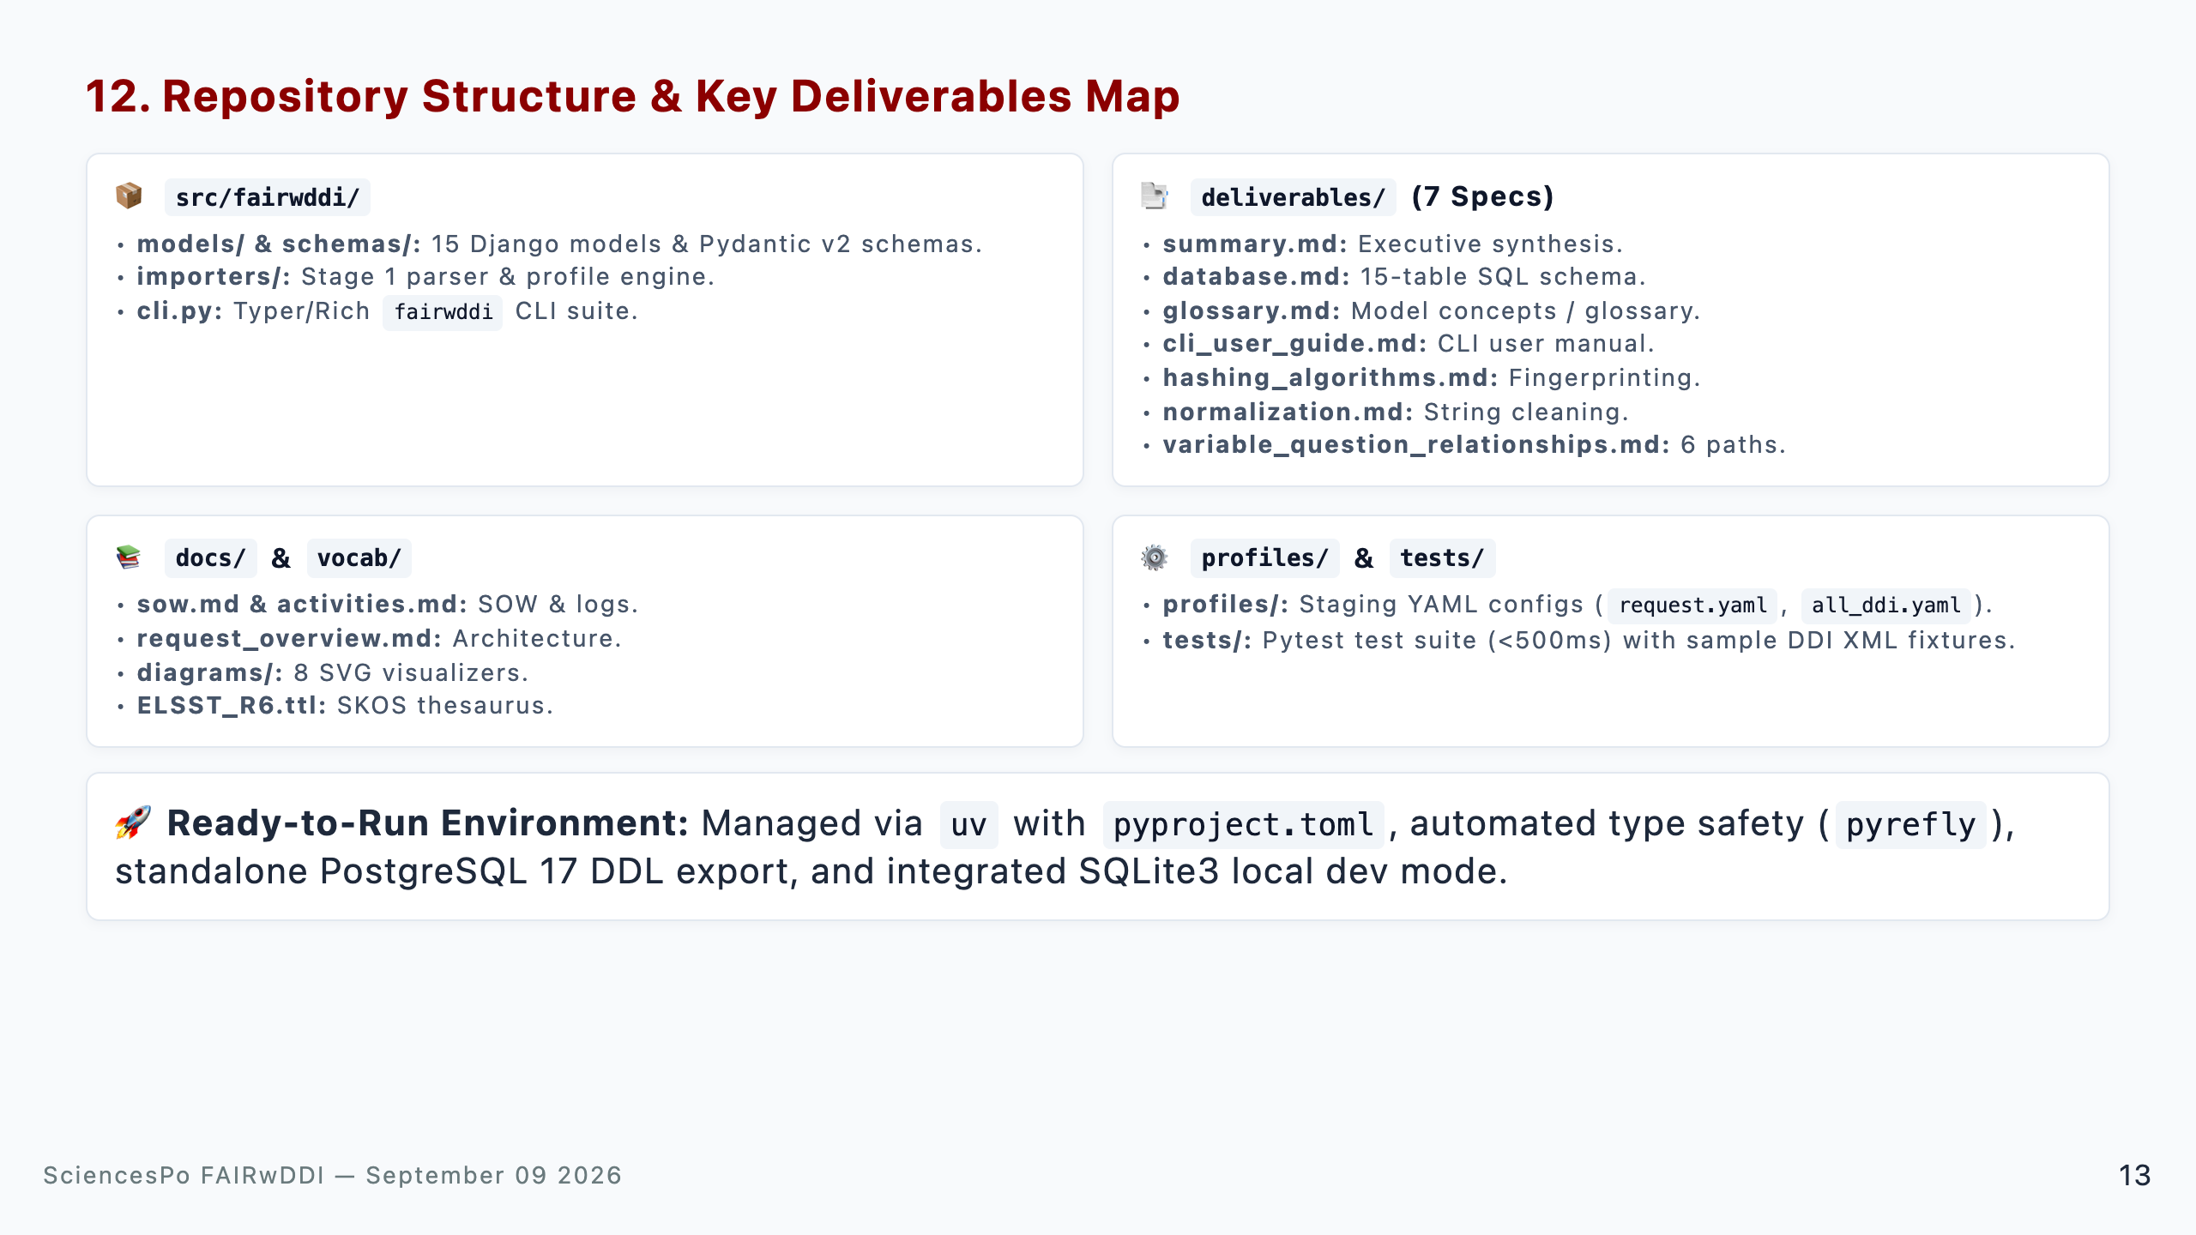
Notes:
Speaker Talking Cues: - Repo completeness: Give an overview of the codebase organization for CDSP developers and reviewers. - Deliverables (7 specs): Highlight that all 7 Phase I specifications are fully written in deliverables/ (summary.md, database.md, glossary.md, cli_user_guide.md, hashing_algorithms.md, normalization.md, variable_question_relationships.md). - Tooling: Point out that the repository includes automated testing, YAML profiles, ELSST vocabularies, and full documentation.

Slide 14
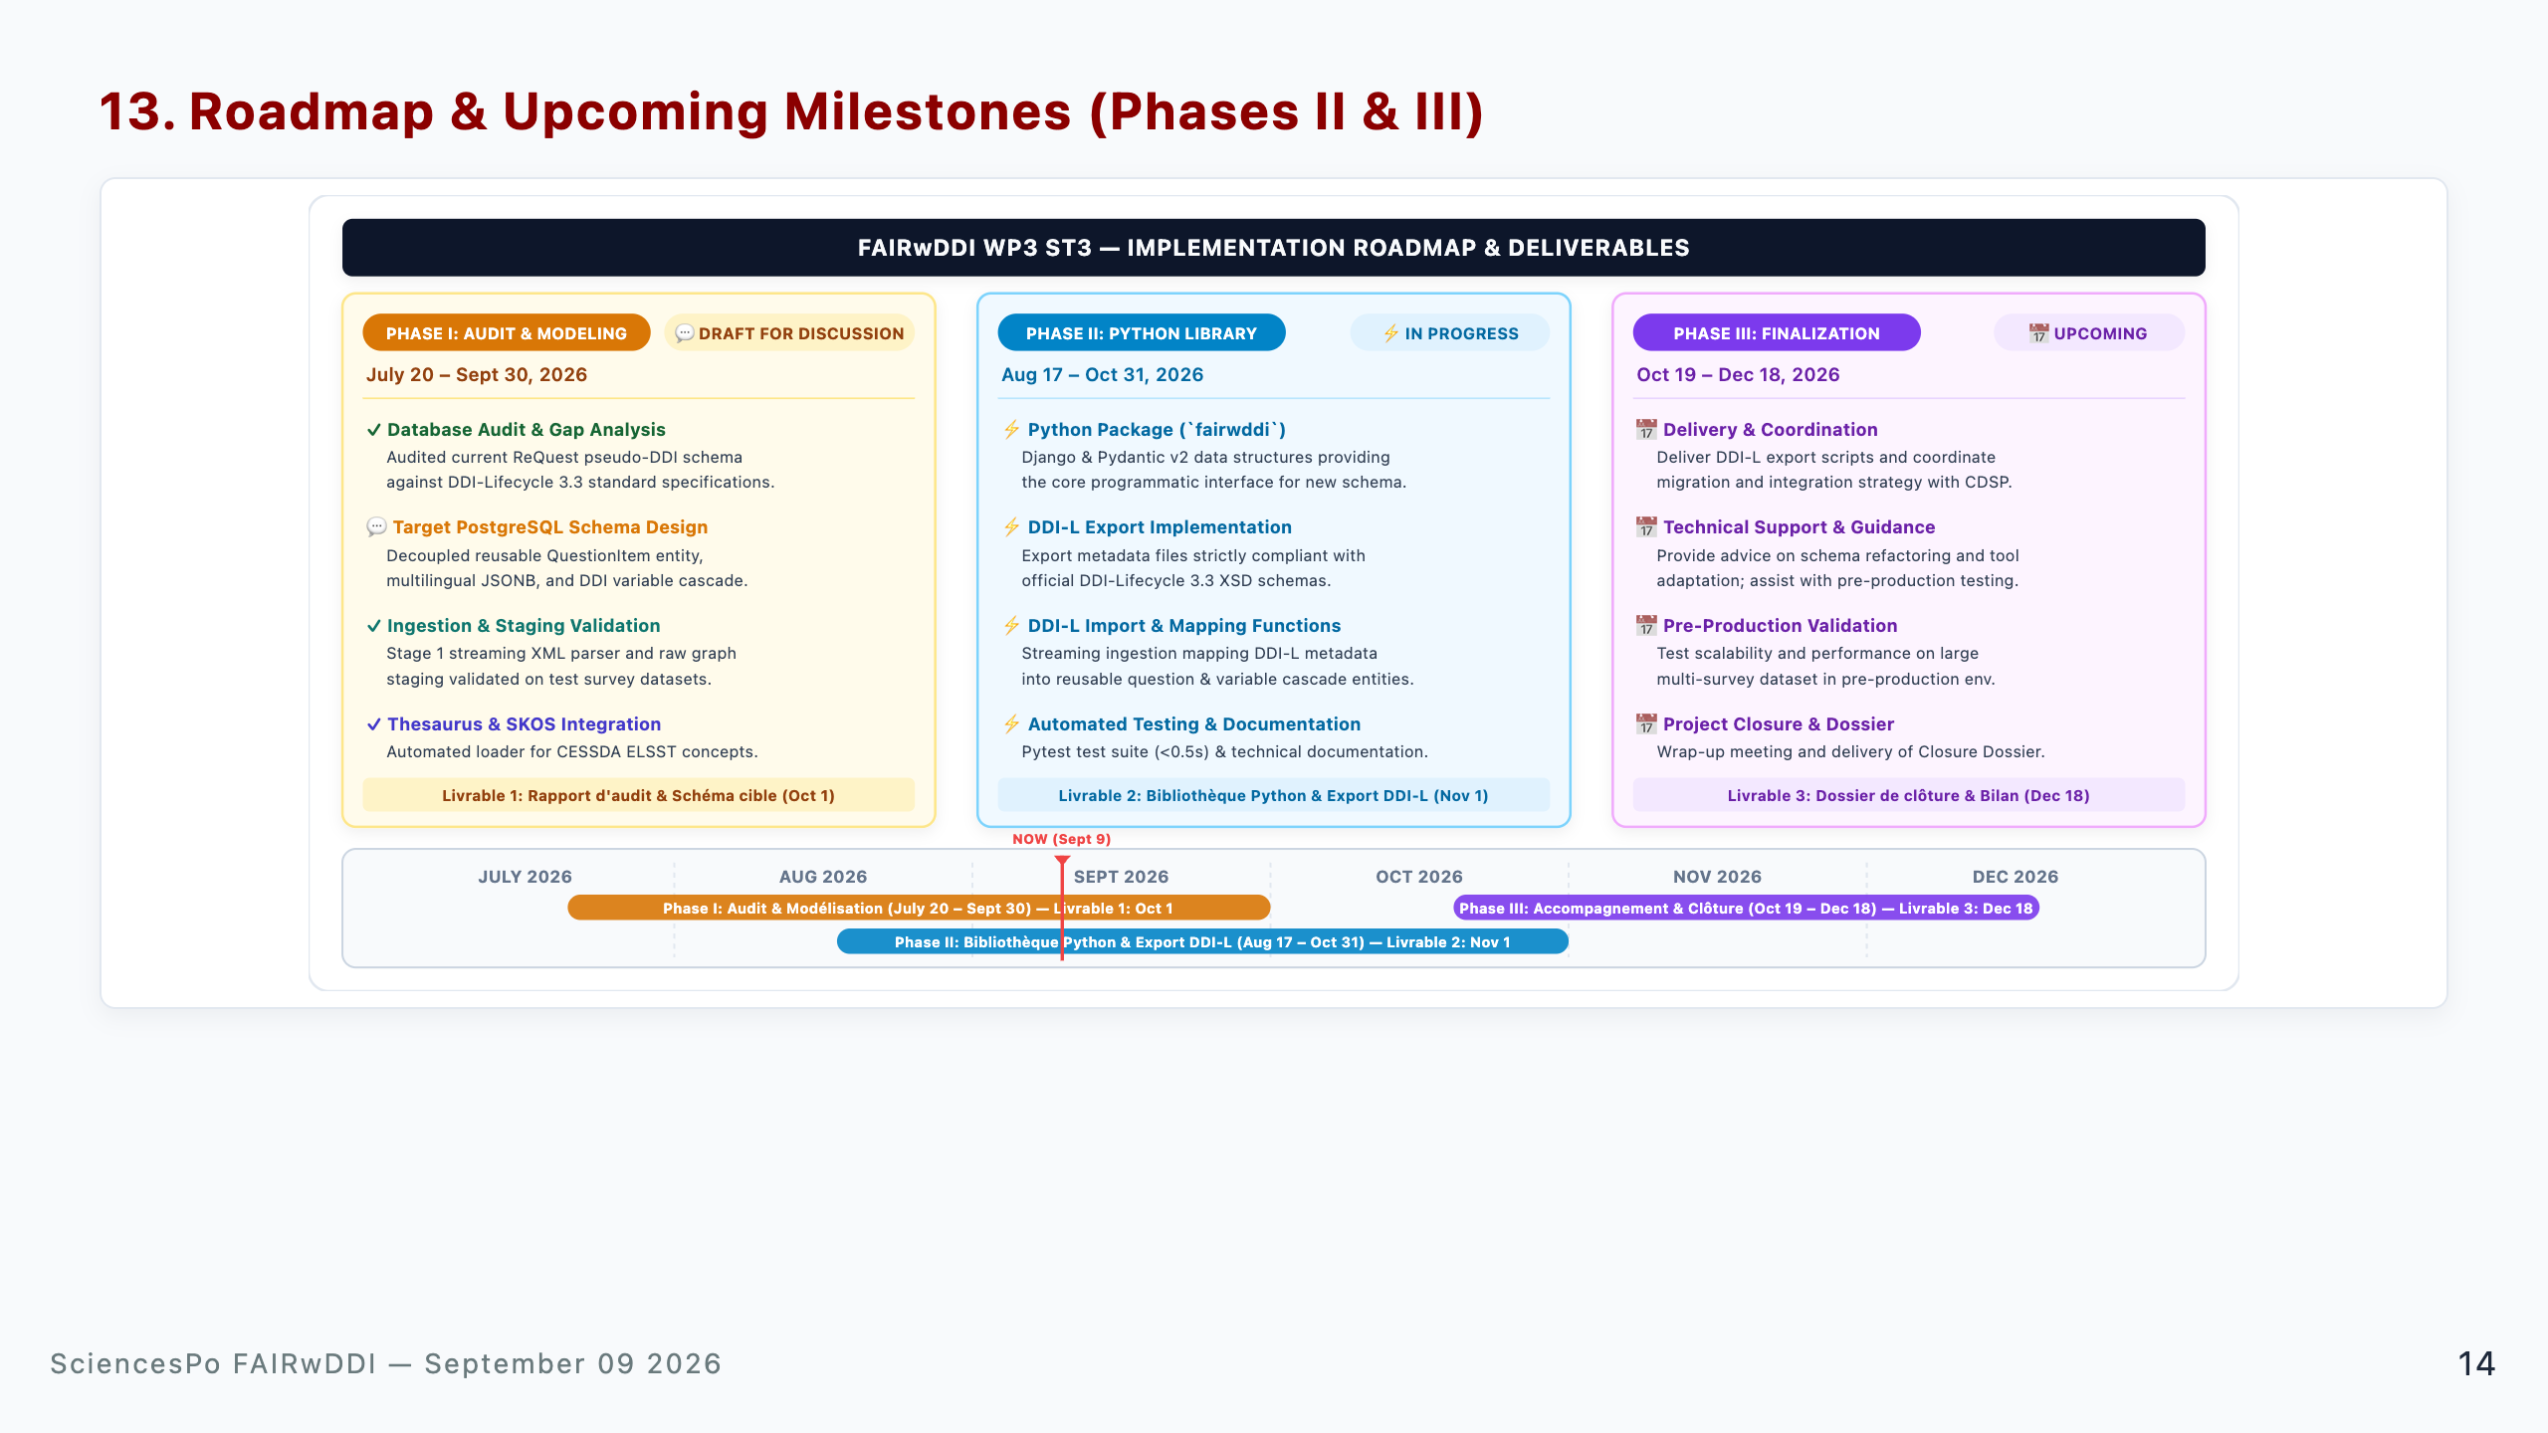
Notes:
Speaker Talking Cues: - Phase I (Audit & Modeling | July 20 – Sept 30): Focuses on Livrable 1 (Rapport d'audit & Schéma cible, due Oct 1). Initial schema draft and Stage 1 streaming staging ready for CDSP review. - Phase II (Python Library & DDI-L Export | Aug 17 – Oct 31): Focuses on Livrable 2 (Bibliothèque Python reQuest & scripts for DDI-L import/export, strictly XSD compliant, due Nov 1). - Phase III (Support & Finalization | Oct 19 – Dec 18): Focuses on Livrable 3 (Dossier de clôture, due Dec 18), providing technical guidance and assisting CDSP with pre-production validation.

Slide 15
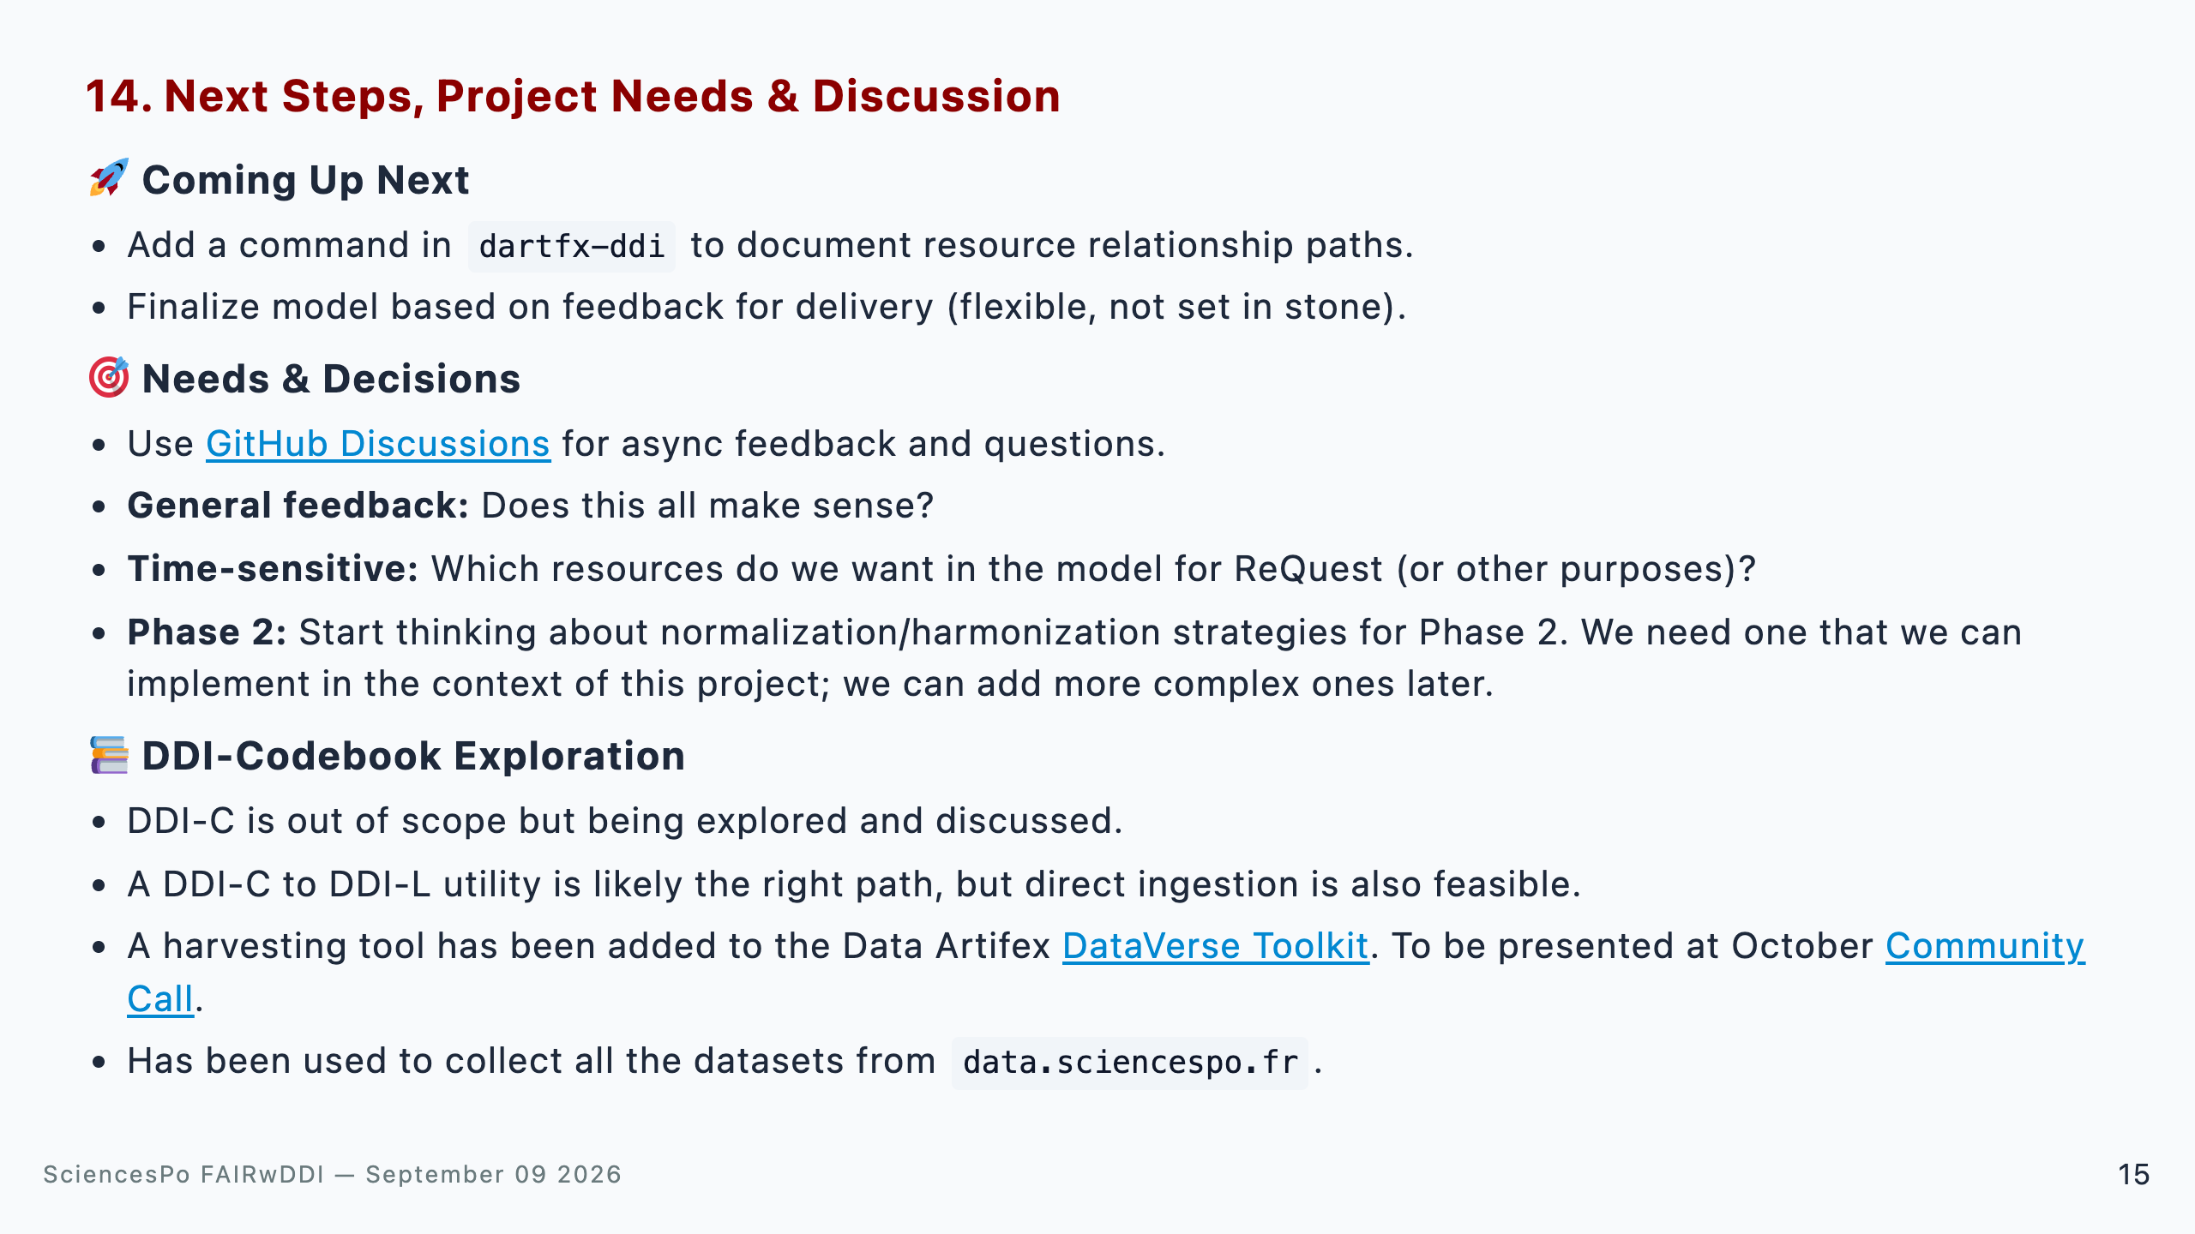
Notes:
Speaker Talking Cues: - Coming up next: Mention the upcoming dartfx-ddi relationship command and emphasize that the target model is flexible based on feedback. - Needs & Decisions: Invite CDSP to use GitHub Discussions. Ask for feedback on whether the direction makes sense, which resources are high priority for ReQuest, and agree on practical normalization for Phase II. - DDI-Codebook: Clarify that DDI-C is out of scope for ST3, but DataVerse Toolkit has already harvested data.sciencespo.fr to test DDI-C -> DDI-L conversion pathways. - Open floor for discussion.

