Slide 1
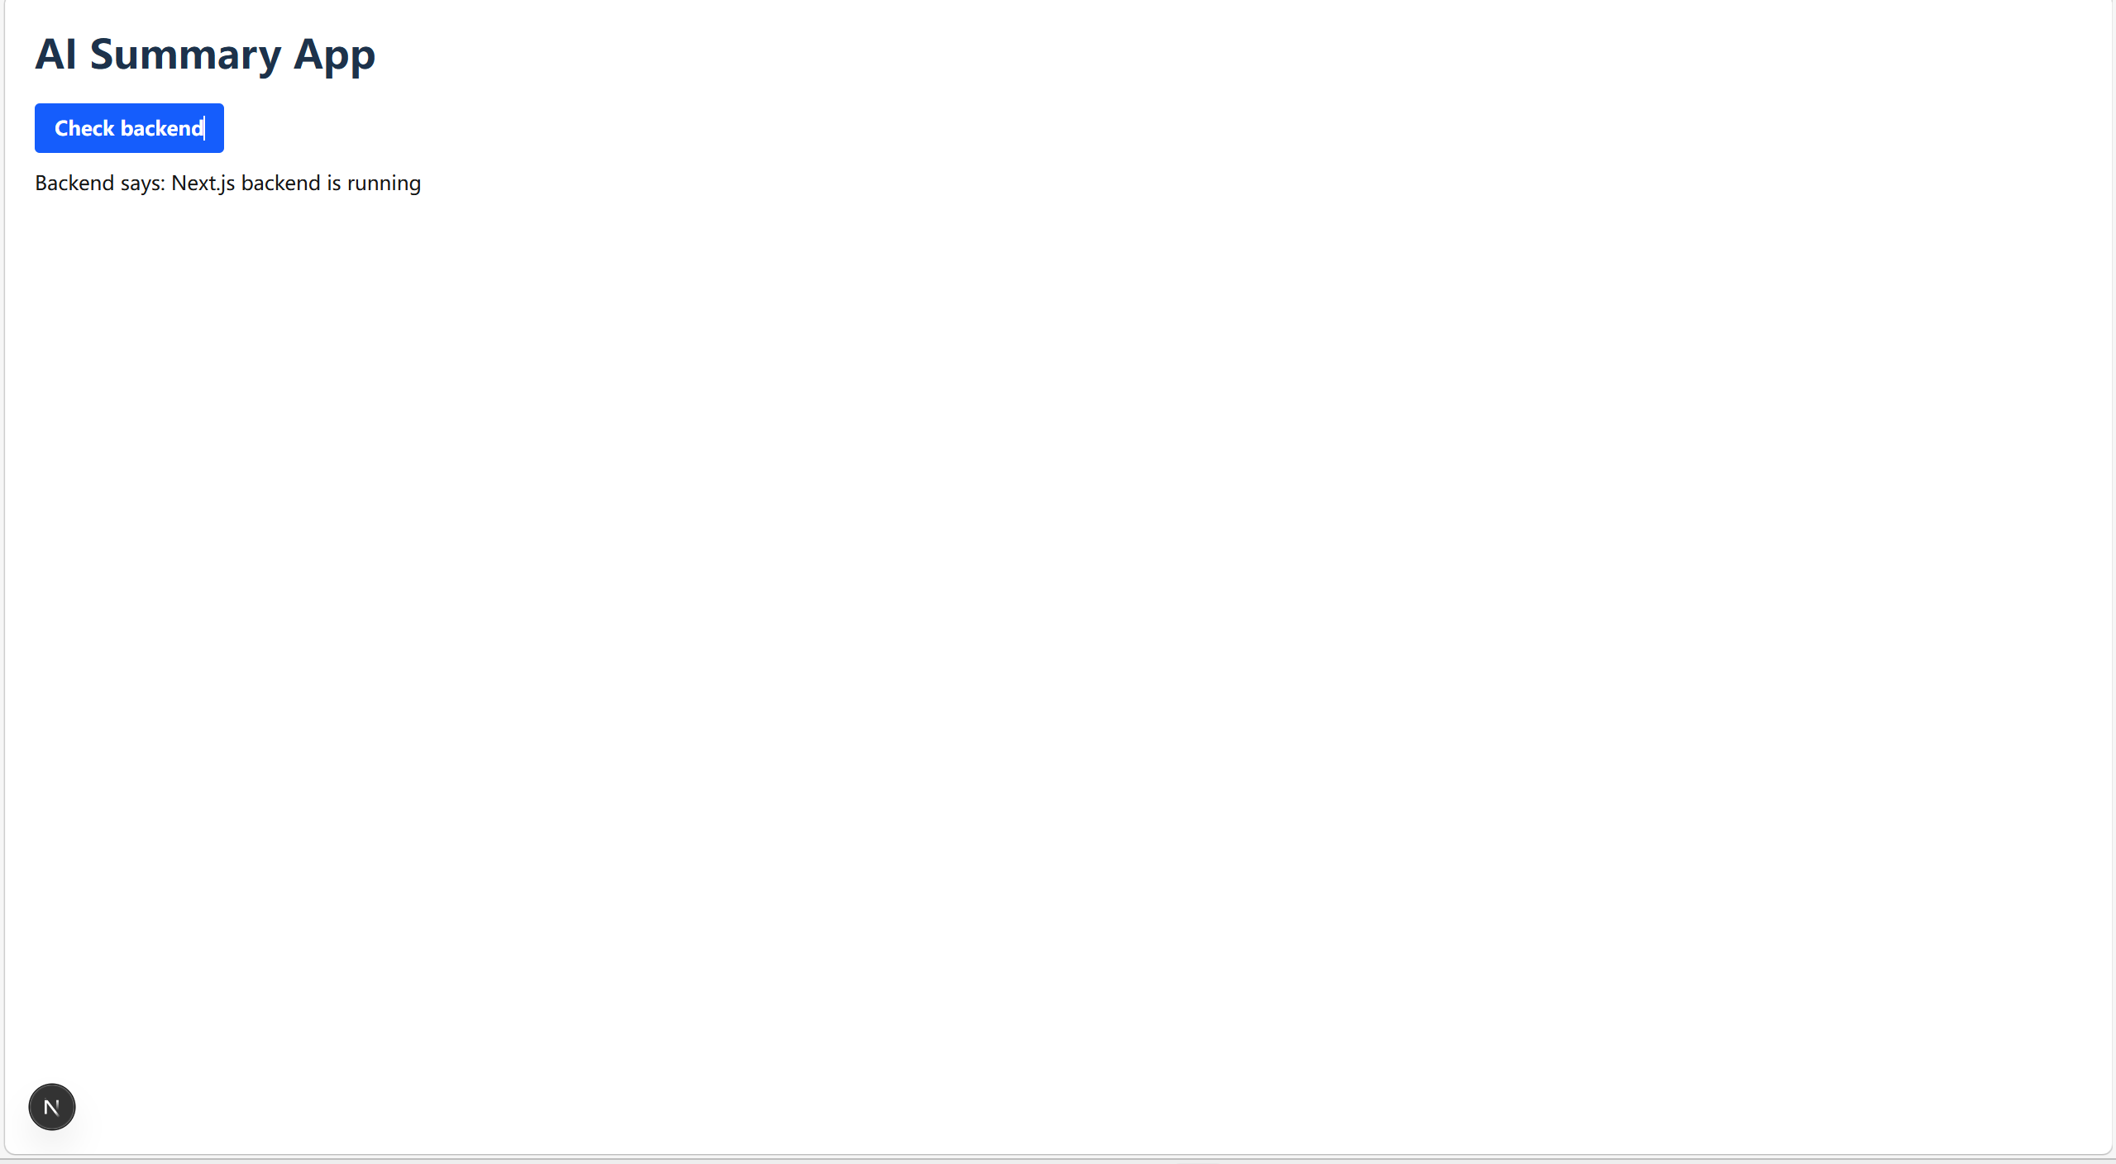
Task 1.md — Screenshots for Steps

Slide 2
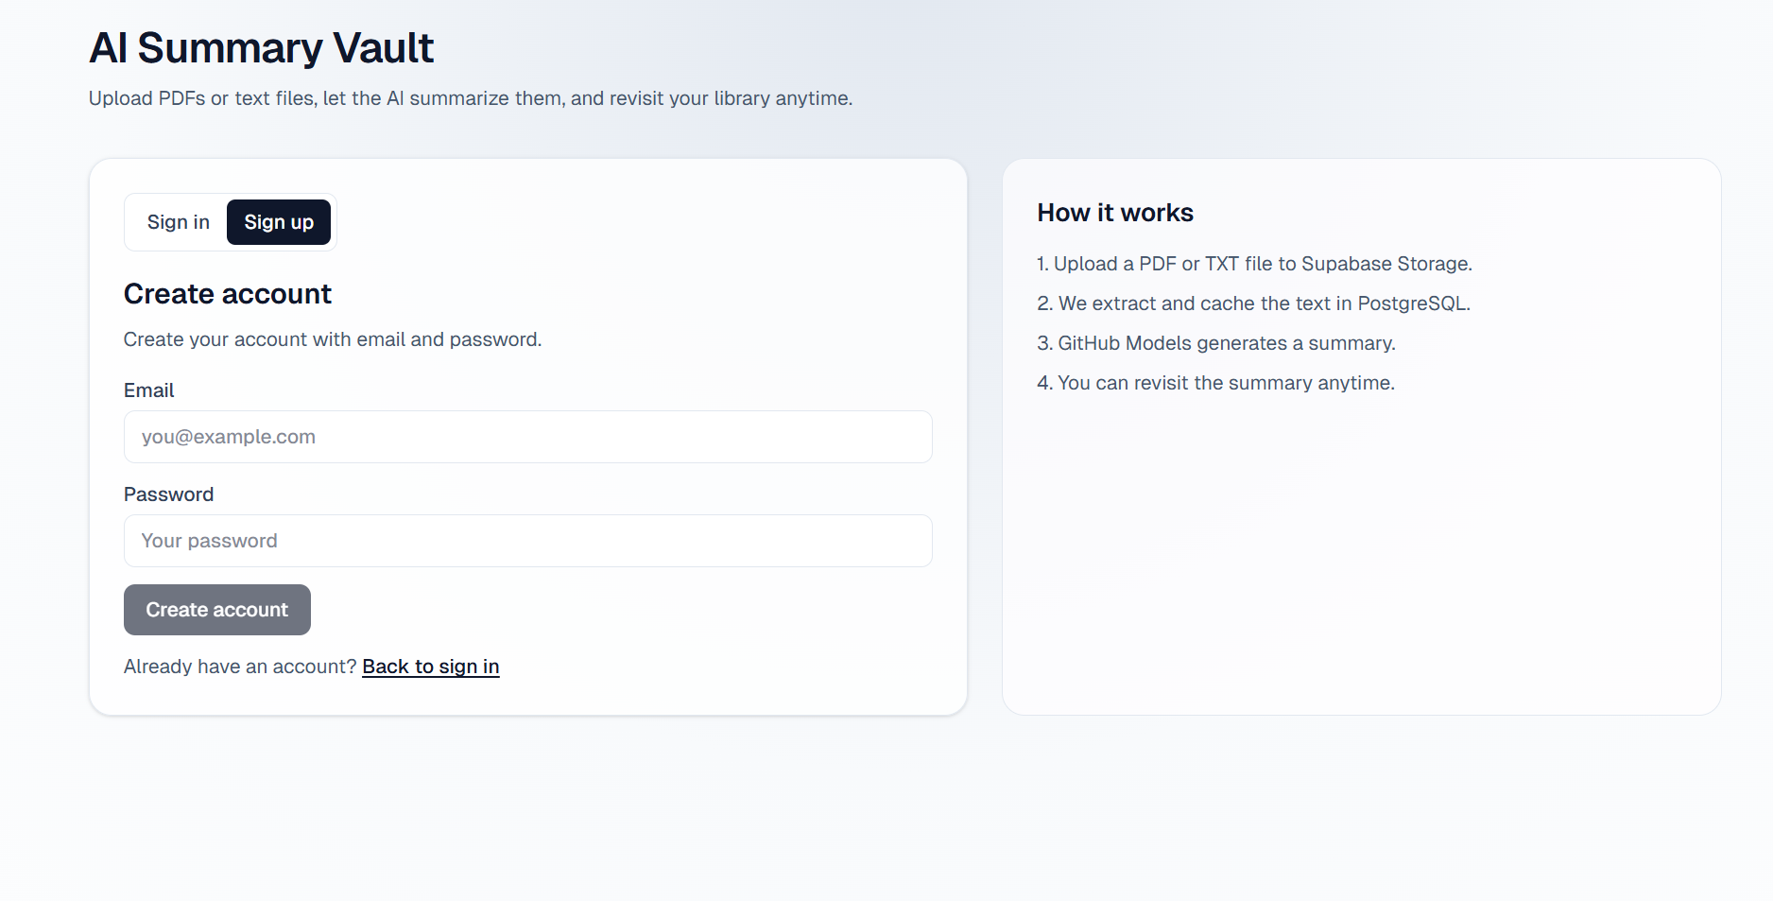
2a Step-by-Step Guide with Screenshots
1 Input your email and pwd you want to use for auth and confirm it in your email box

Slide 3
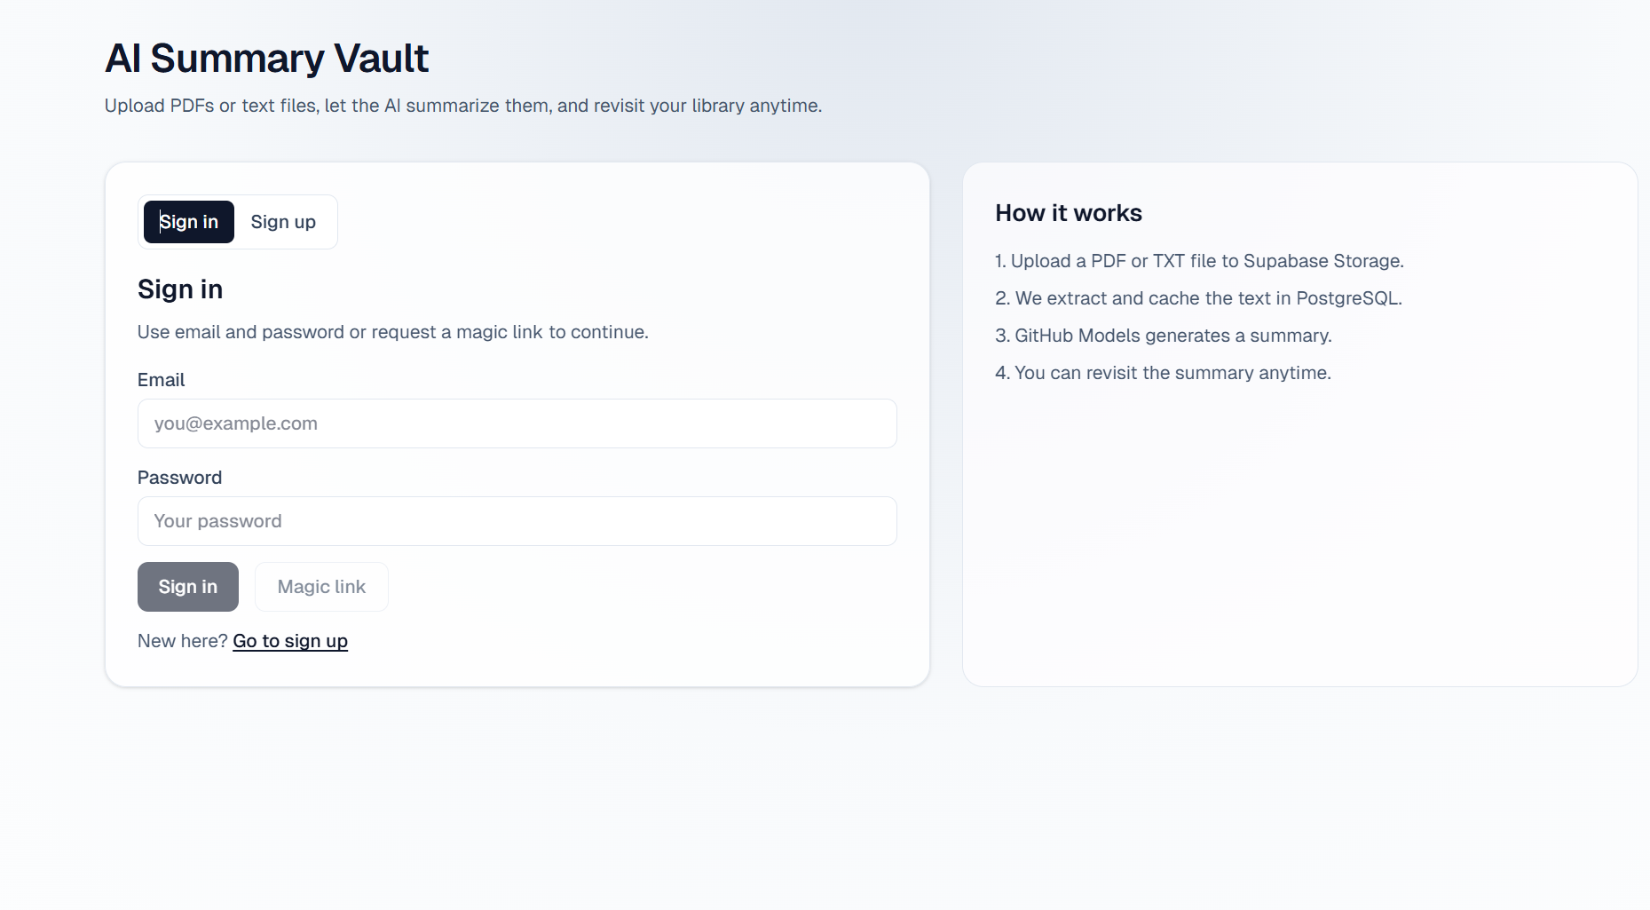
2 Sign in by using your email and pwd

Slide 4
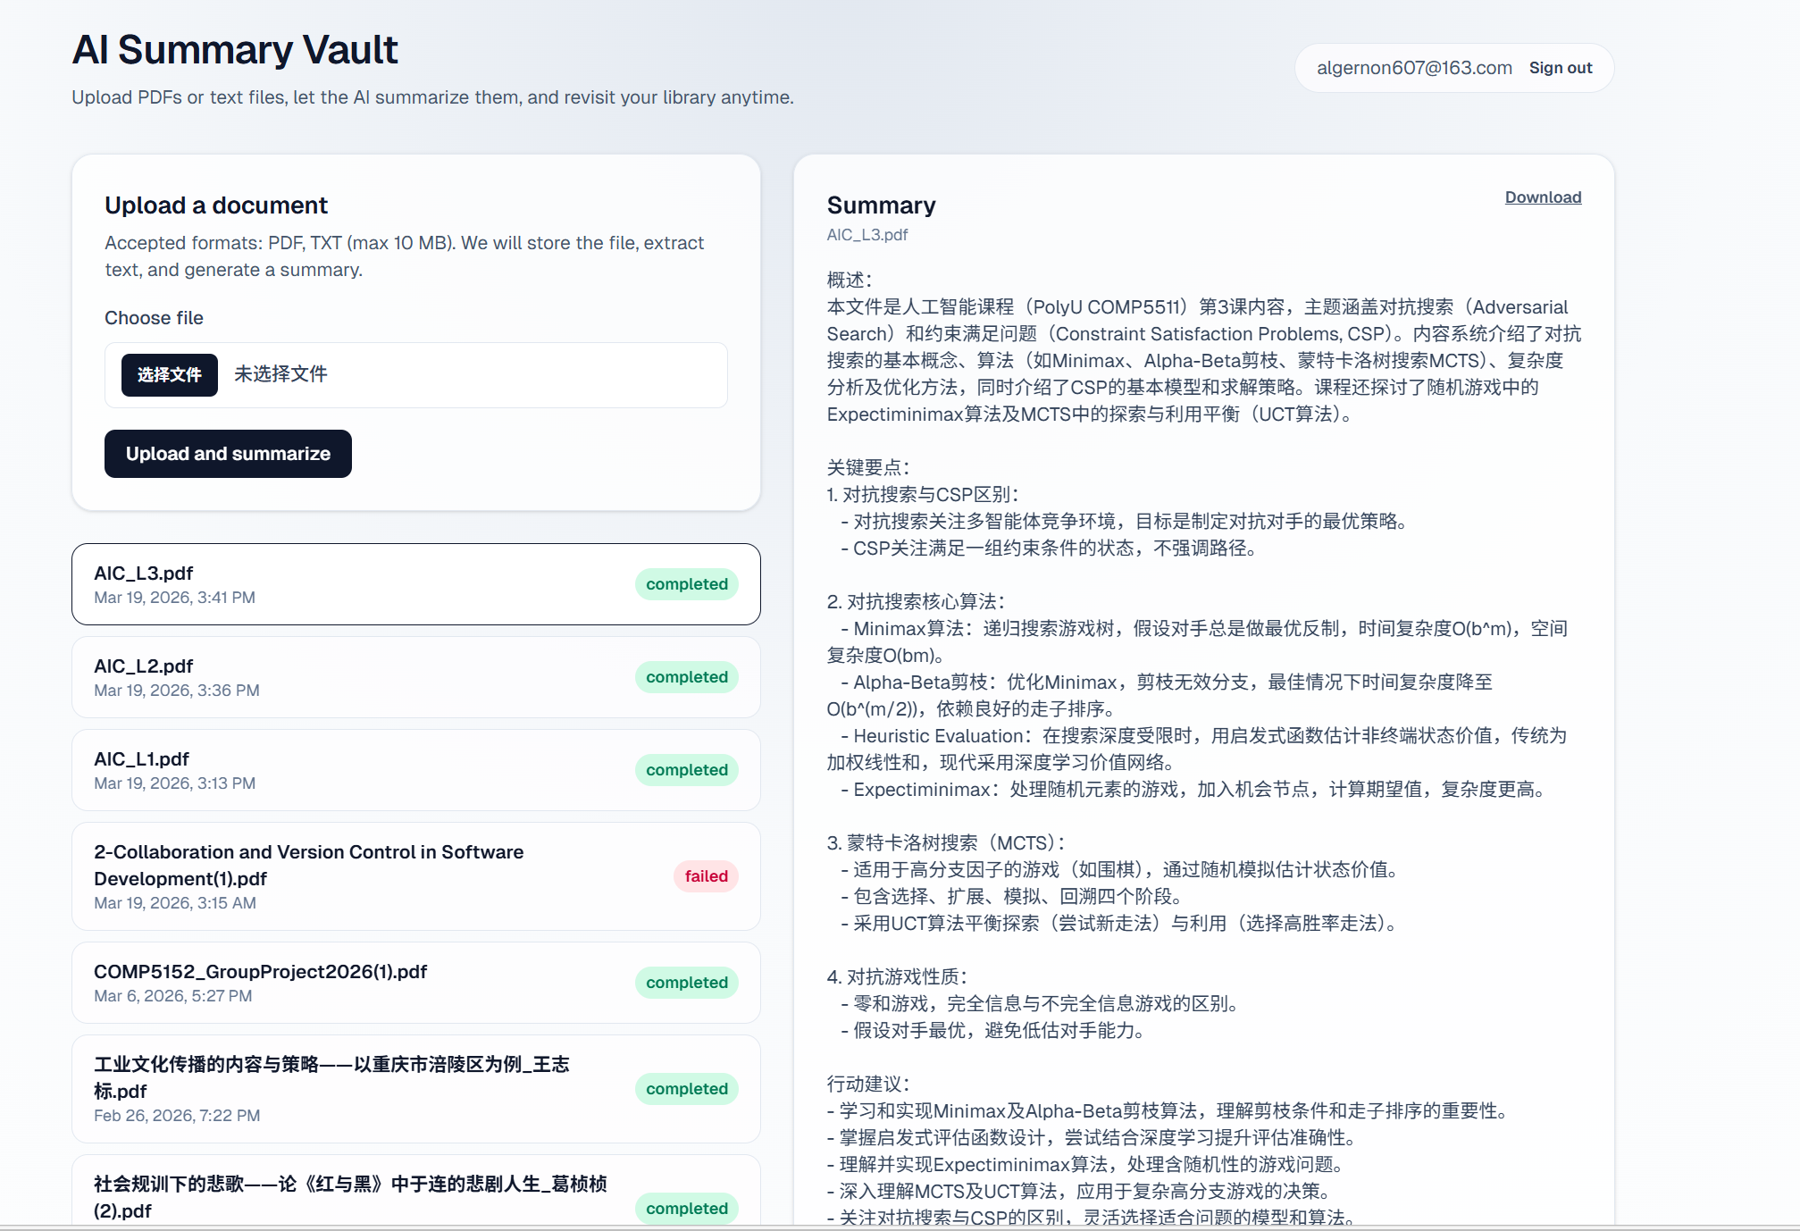
3 upload
4 click

Slide 5
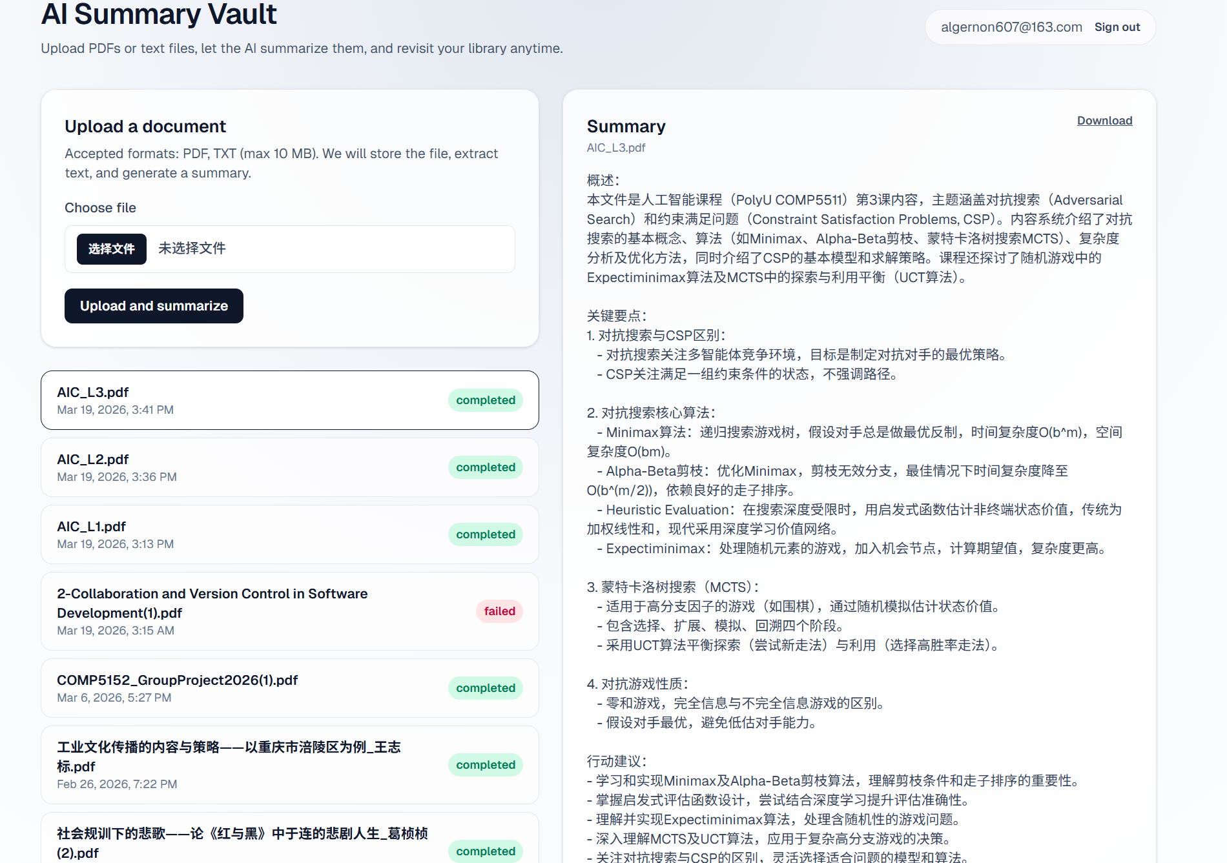
2b Happy Path (Standard or Expected Use)

Slide 6
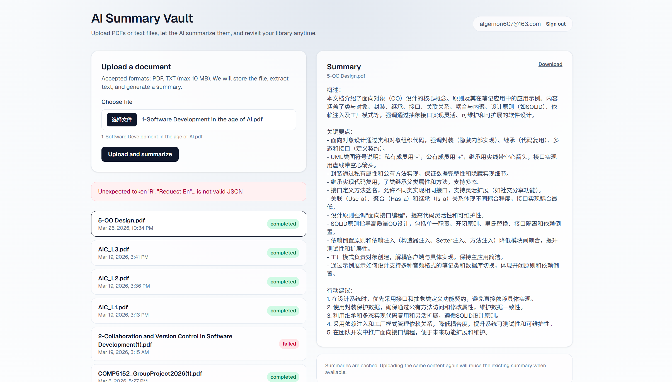
2b Exception Path (Unexpected, Error, or Edge Cases)
The file size is exceeding

Slide 7
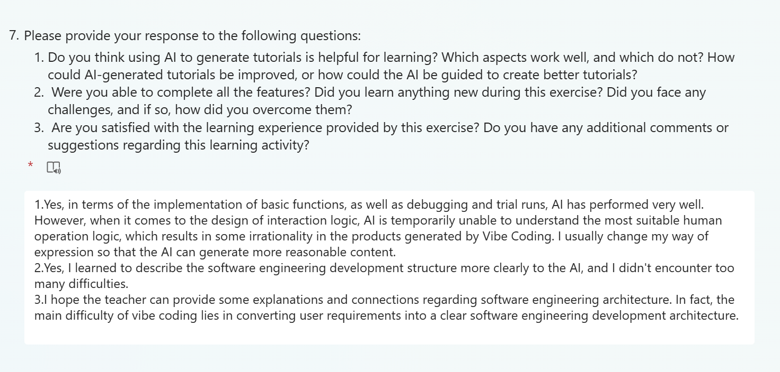
2c Other Reflections and Summary

