Slide 1


Human Actor as Policy for a Reinforcement Learner
Johnathan Kunz

Slide 2
My Idea
Good AI’s are Important
Designing or training good AI’s is a hard, and time consuming
My goal is teach an agent from an experts actions.
Notes:
Designing good AI’s is a hard problem, requiring both programming skills and a thorough understanding of how to best play the game.
My goal is to separate these 2 concerns, so that a programmer does not need to teach the game how to play well, but can instead be taught by another's input.

Slide 3
The environment
Simple Pong Like Game
The max number of bounces to win the game is 10

Slide 4

Experiment Structure
For experiments I run 2 big computations,
Expert Experience Gathering
Agent learning
Normal Reward Structure
+10 x number of bounces
+5 if ball is even with paddle
-25 if the game has been lost
Notes:
For experiments I run 2 big computations,
One where good experience behavior is added to memory
And one where the system learns like a normal deep learning system without adding to its own memory
The basis for the code came from assignment 3, modified for my experiments and to use my custom environment

Slide 5
Experiments
Experiment Name | Experiment Description | Result
0: Normal Deep Learning | Standard Deep Learning Neural Net System | Solved in 1000 iterations
1: Simple Follow Human | Try to emulate any Human Action, flat reward | Not Solved
2: Simple Follow Expert | Try to emulate Expert Action, flat reward | Not Solved
3: More Complex Follow Expert | Try to emulate Expert Action, use actual game reward | Not Solved
4: Follow Expert Epsilion Actions | Try to emulate Expert, where expert fakes epsilon learning | Not Solved
5:Follow Expert, Agent Explore | Expert collects ‘good experience’ Agent explores and learns | Solved in 500 iterations

Slide 6
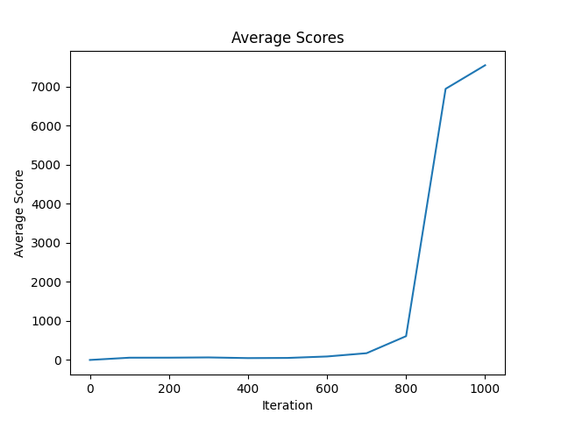
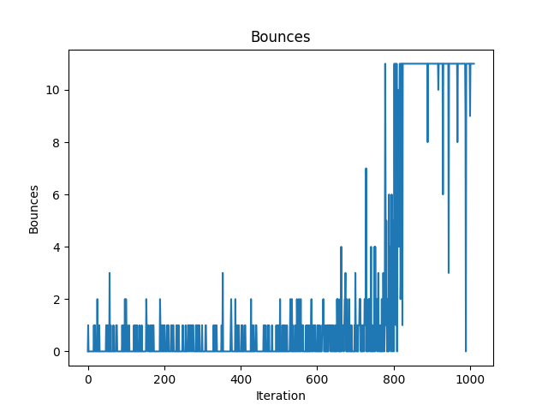
Experiment 0: Solve the Problem Normally
Standard Deep Neural Net Learning

Slide 7
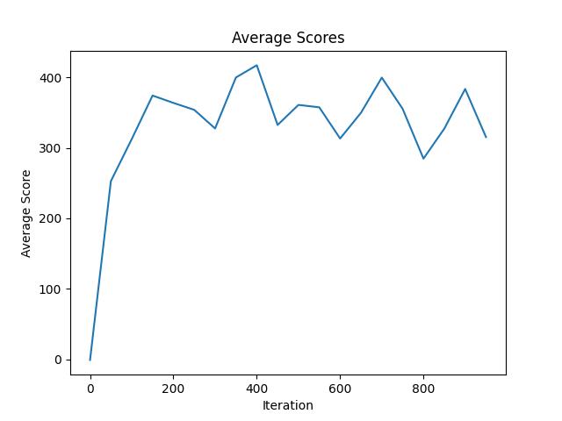
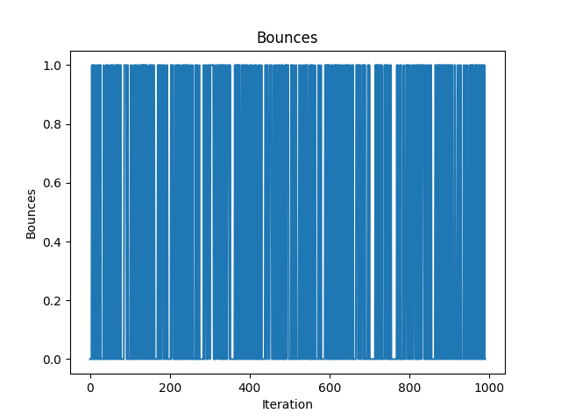
Experiment 2: Simple Follow Expert
Expert collects good experiences, all given rewards of 1 to attempt to have them be learned as good

Slide 8
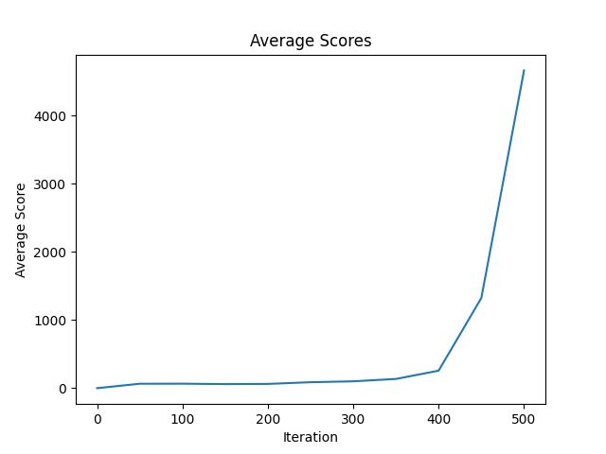
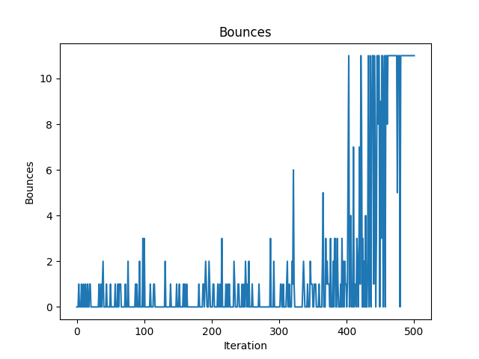
Experiment 5: Follow Expert, Agent exploration
Expert Collects Good Experience
Agent learns and Explores like normal
Notes:
At this point, I decided a new approach was necessary, I changed to gathering epsilon learning expert experience in the first section, then exploring and learning in the second section. With this approach I hoped that the experts good actions would supplement the agents exploration to get good results.
This method worked! It solved the problem about twice as fast as the standard methods

Slide 9
Comparison
Experiment 0 solves the problem in 800 iterations, Experiment 5 solves the problem in 500 iterations
Experiment 0
Experiment 5

Slide 10
Conclusion
Trained the agent almost twice as fast as normal agent
Methodology works

