Slide 1
CORES for Monocular Depth Estimation
Computer Vision — Project 2
Names and student IDs

Slide 2
Problem and research question
Monocular depth models can produce plausible predictions outside their training domain.
Train a lightweight depth estimator on indoor NYU Depth v2.
Treat outdoor KITTI as out-of-distribution.
Question: can signed convolutional responses reliably detect the shift?
2

Slide 3
Experimental pipeline
NYU RGB → FastDepth-style MobileNetV2 → signed responses → CORES score.
42,826 train / 4,758 validation / 654 NYU test images.
1,000 KITTI OOD images; common RGB resolution 224 × 304.
Depth: RMSE, AbsRel, δ1–δ3. OOD: AUROC and FPR95.
3

Slide 4
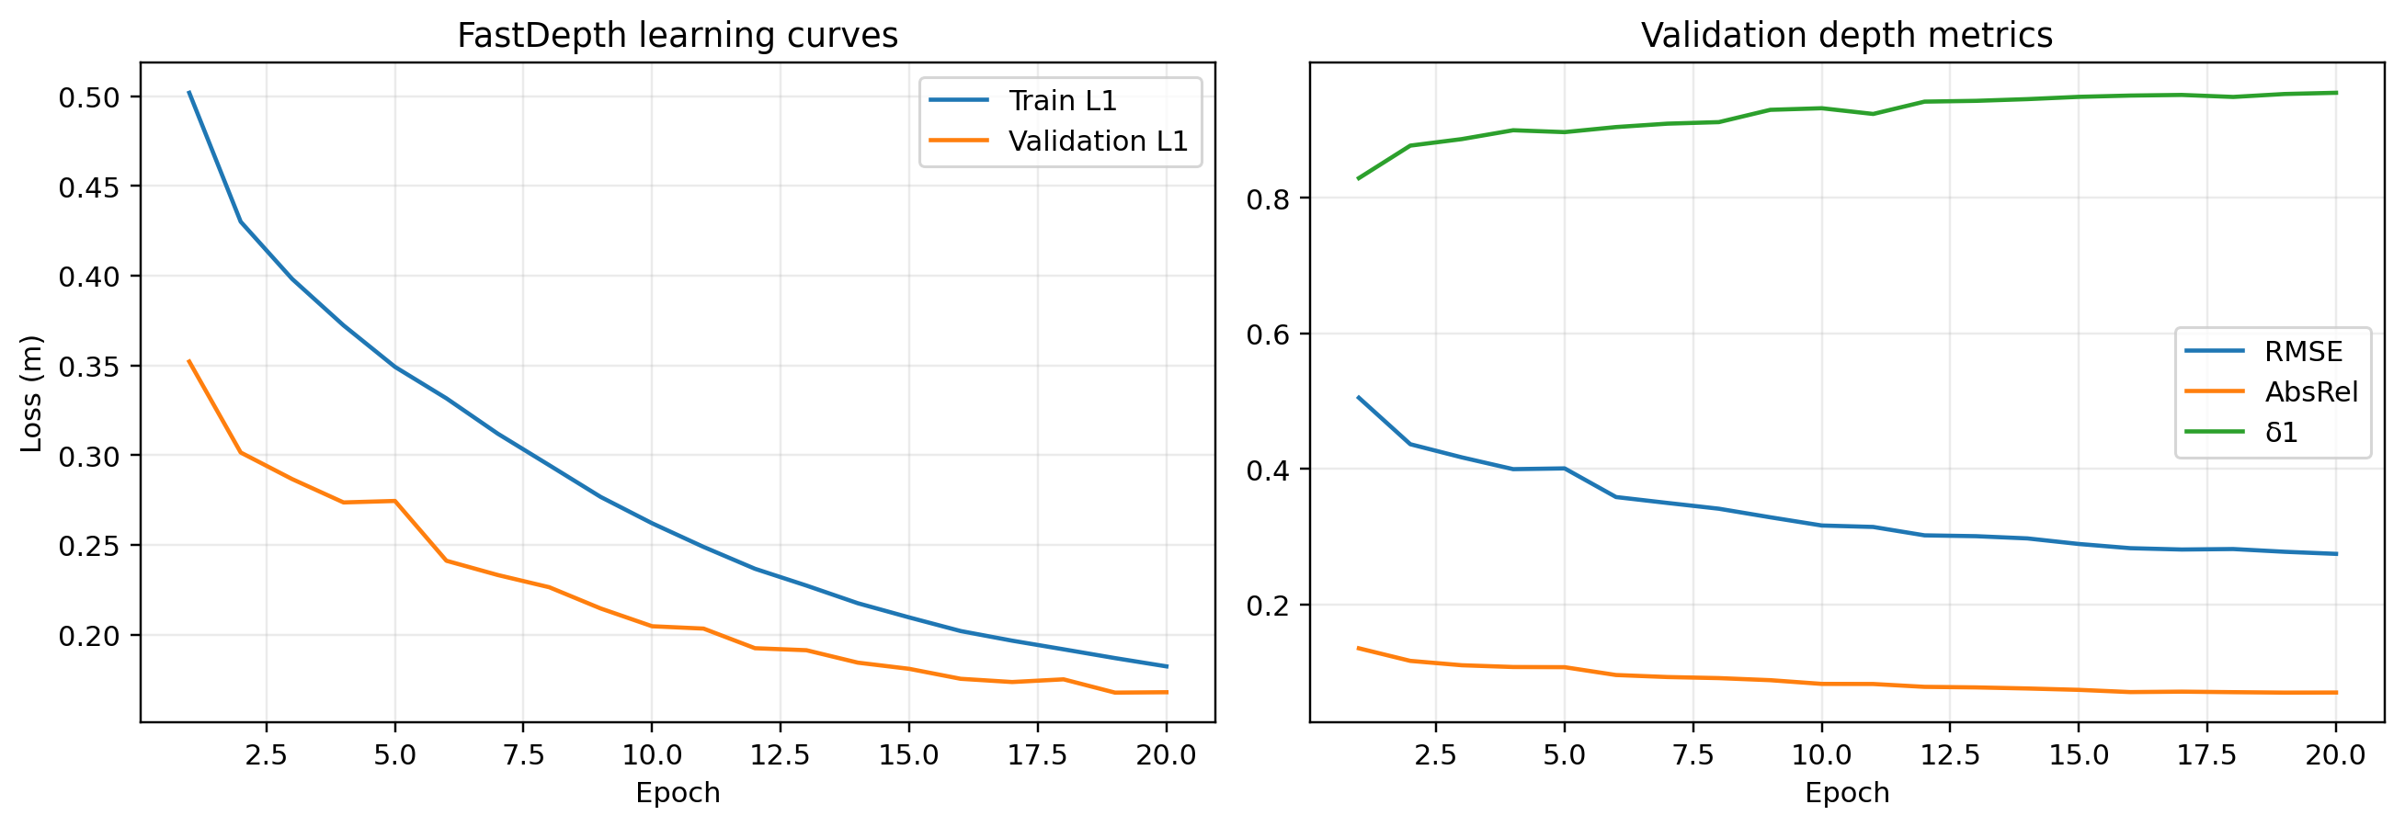
Depth-estimation baseline
2.39M parameters; MobileNetV2 encoder and depthwise FastDepth-style decoder.
AdamW, masked metric L1, mixed precision, 20 epochs.
Best checkpoint selected at epoch 19 using NYU validation only.
KITTI OOD: RMSE 9.8854, AbsRel 0.6912, δ1 0.0792 at 0–80 m.
Recovery checkpoints make long Kaggle runs resumable.
4

Slide 5
CORES adaptation
For every kernel: signed spatial maximum and minimum.
Magnitude measures distance beyond calibrated positive/negative thresholds.
Frequency measures how often thresholds are crossed.
Classifier backtracking has no direct dense-regression analogue: evaluate all channels and a 20% extreme-channel variant.
5

Slide 6
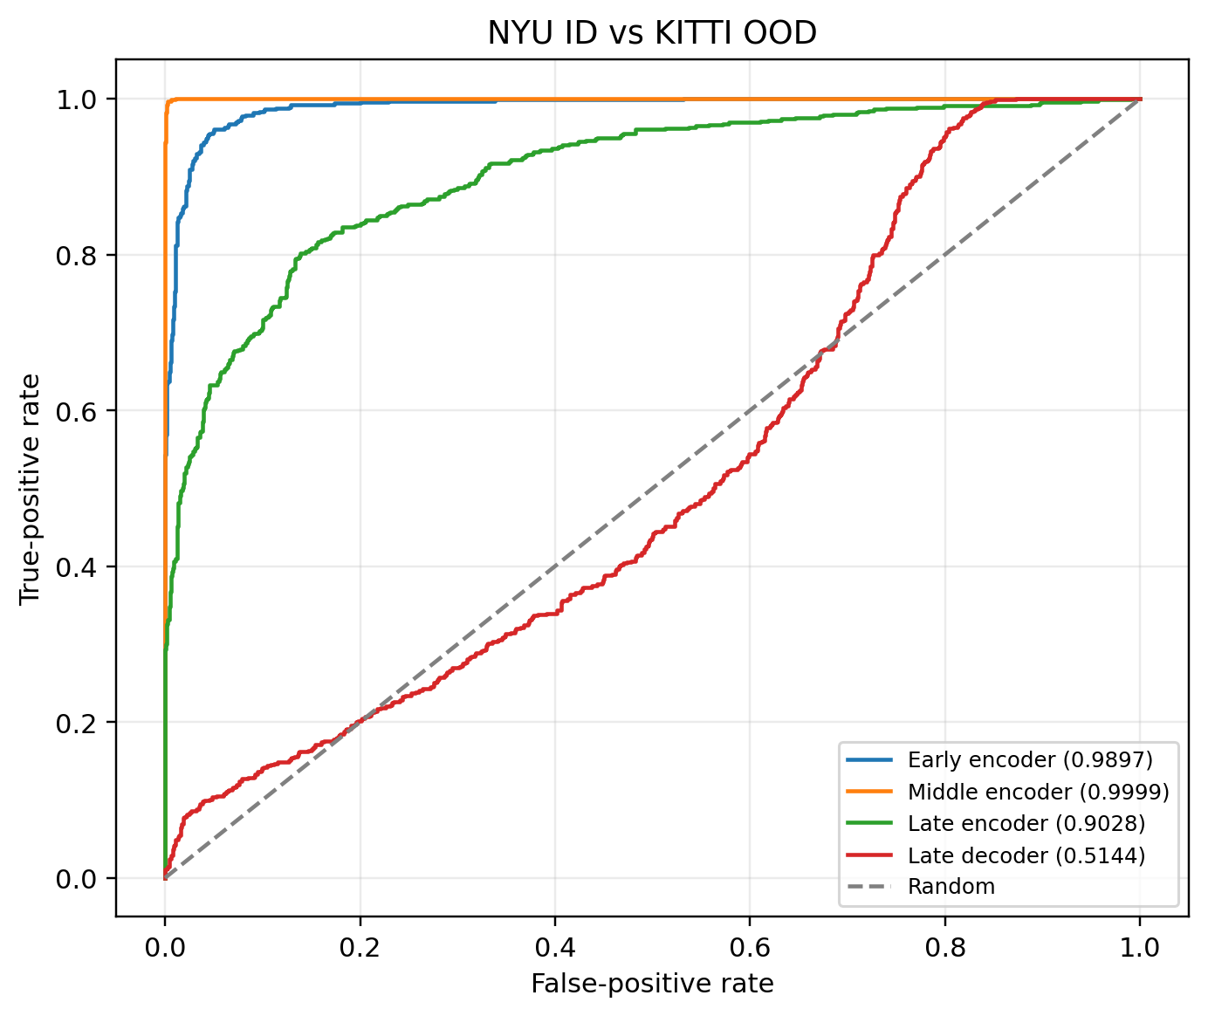
Where is the OOD signal?
Early encoder: AUROC 0.9897, FPR95 0.044.
Middle encoder: AUROC 0.9999, FPR95 0.001.
Late encoder: AUROC 0.9028, FPR95 0.466.
Late decoder: AUROC 0.5144, FPR95 0.798.
6

Slide 7
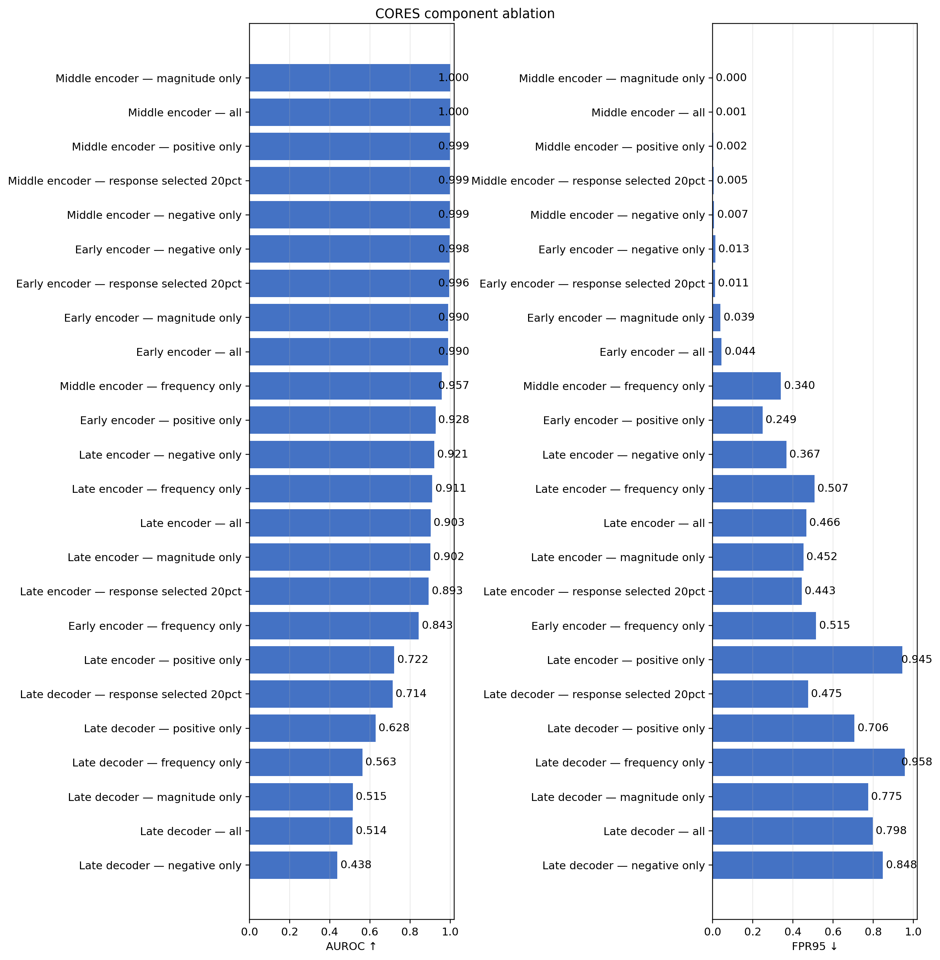
Main result: magnitude is sufficient
Middle encoder, magnitude-only: AUROC 0.999943 and FPR95 0.000.
Response frequency slightly degrades detection.
The decoder is close to random.
Intermediate encoder responses retain the strongest domain information.
7

Slide 8
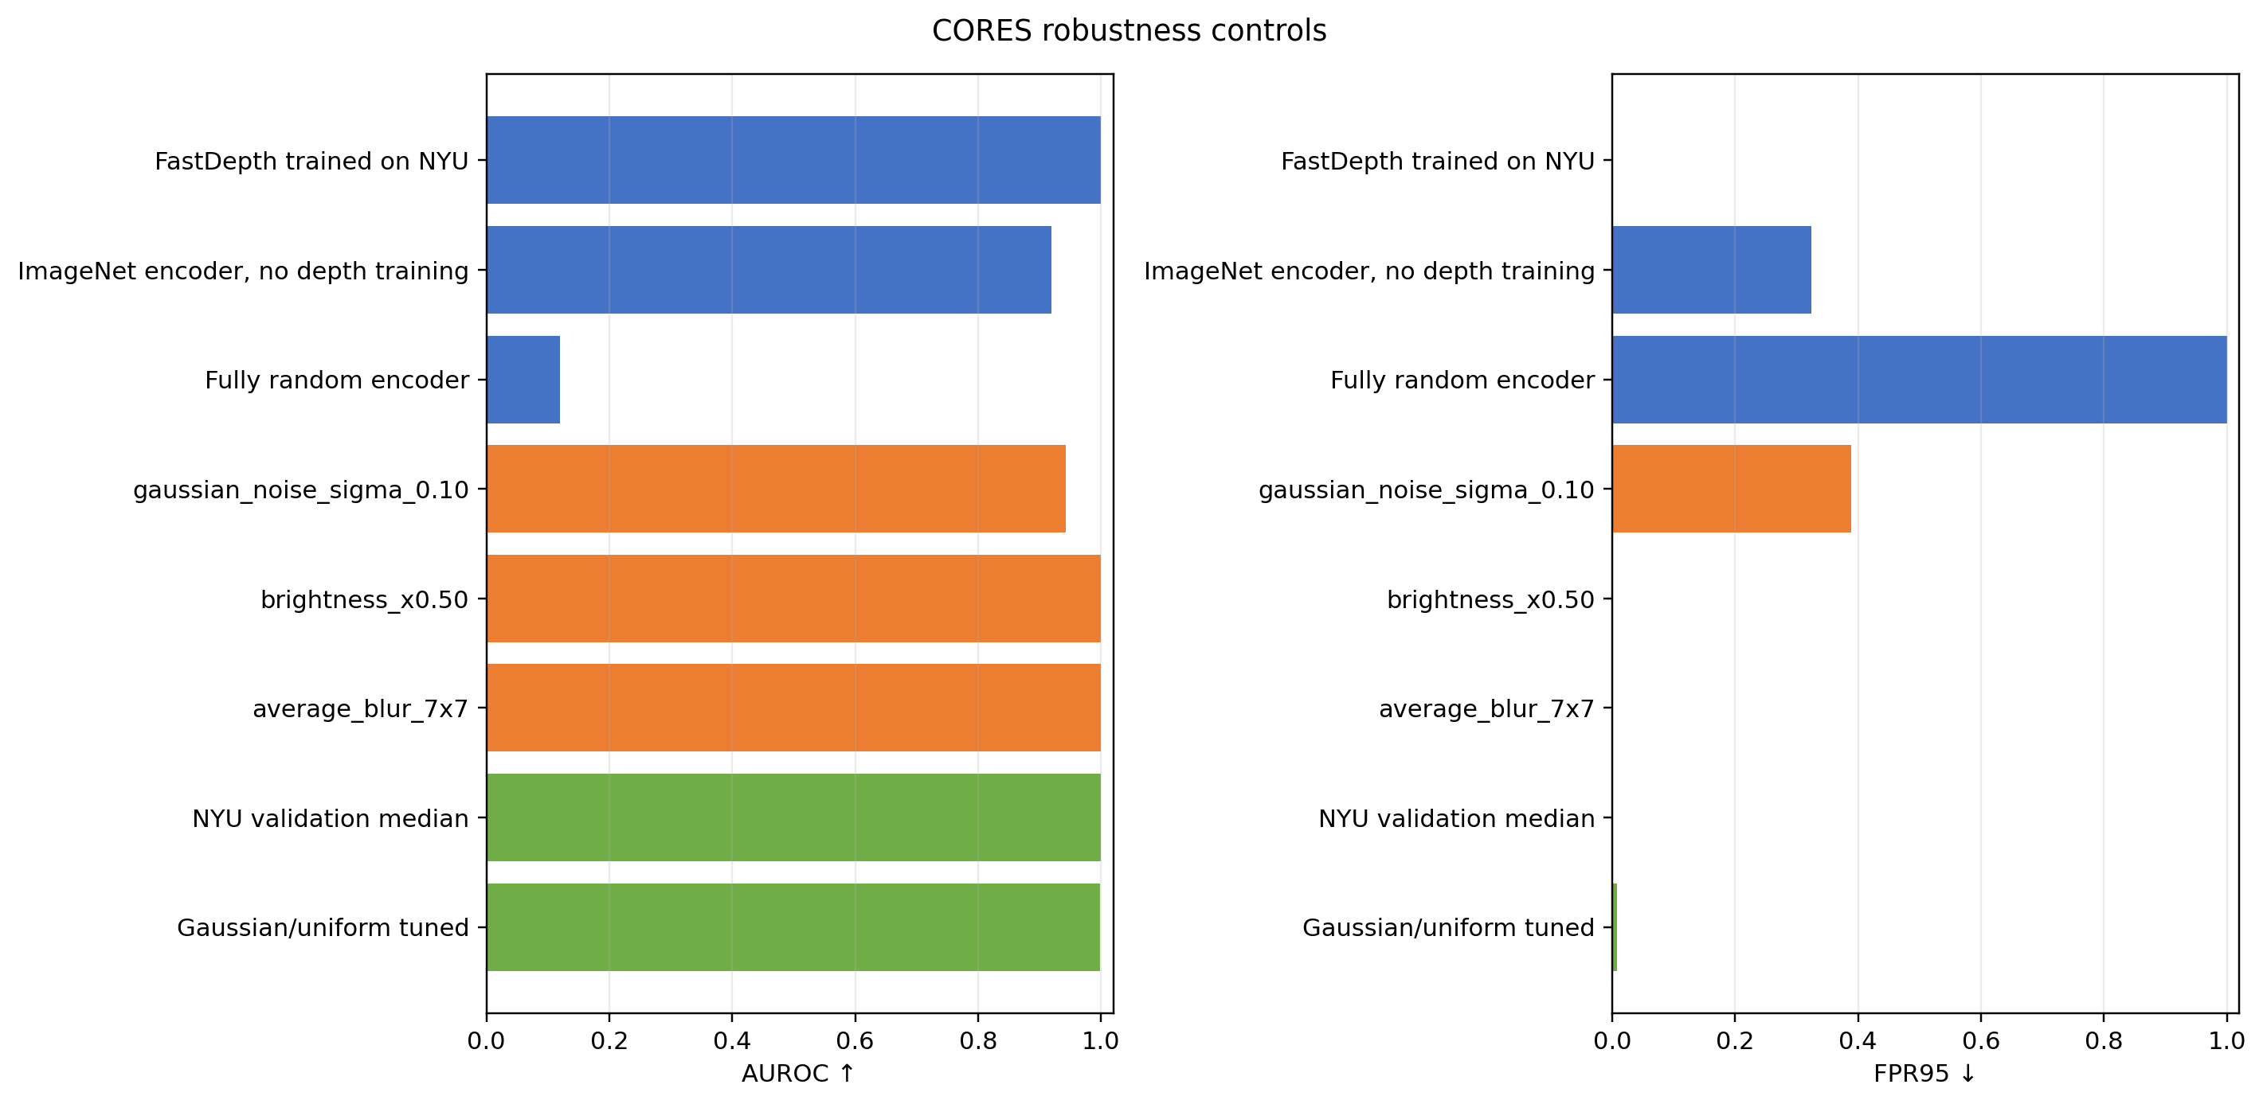
Controls: not just colour or random features
Trained FastDepth: 0.99994 / 0.000.
ImageNet encoder without depth training: 0.91886 / 0.324.
Random encoder: 0.45062 / 1.000.
RGB Mahalanobis baseline: 0.82283 / 0.759.
Depth training creates most of the useful response separation.
8

Slide 9
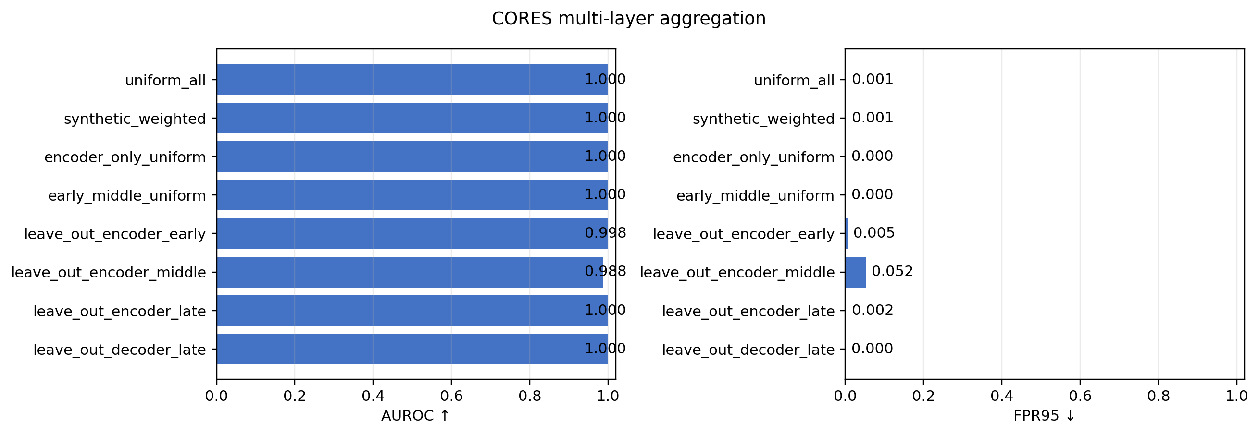
Multi-layer contribution
All-layer mean: 0.999737 / 0.001.
Encoder-only mean: 0.999884 / 0.000.
Removing middle encoder: 0.987777 / 0.052.
No aggregation beats middle magnitude-only.
Pure synthetic noise saturates the weighting criterion.
9

Slide 10
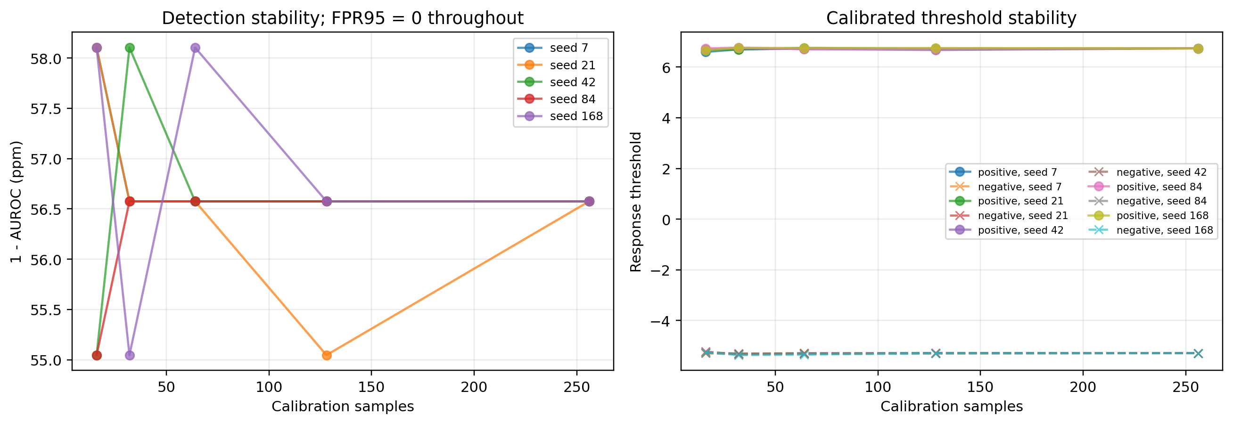
Calibration stability
Five seeds × five calibration-set sizes.
Only 16 ID images: mean AUROC 0.999943.
FPR95 remains zero in all 25 trials.
Synthetic threshold protocol: AUROC 0.99868, FPR95 0.007.
10

Slide 11
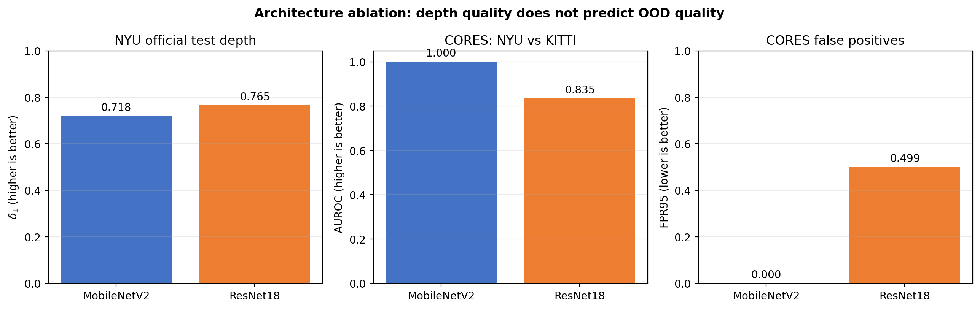
Architecture ablation: ResNet18
ResNet18: 11.38M parameters versus MobileNetV2's 2.39M.
NYU-test delta1 improves from 0.7181 to 0.7652.
Middle-magnitude CORES falls from 0.999943 / 0.000 to 0.834523 / 0.499.
ImageNet-only ResNet18 is stronger than its depth-trained version.
Depth quality does not predict OOD quality; the response signal is architecture-dependent.
11

Slide 12
Failure cases and limitations
NYU indoor versus KITTI roads is a broad, visually easy domain shift.
The NYU model is capped at 10 m, so KITTI metric depth deteriorates sharply.
Gaussian near-OOD corruption: AUROC 0.94273, FPR95 0.388.
One trained checkpoint per architecture; parameter count is not isolated.
FastDepth-style MobileNetV2, not an exact MobileNetV1 reproduction.
Dense-prediction channel selection is an explicit adaptation of CORES.
12

Slide 13
Conclusions
CORES transfers effectively from classification to dense depth estimation.
The middle encoder magnitude is the simplest and strongest detector.
Weak late/decoder layers can dilute multi-layer aggregation.
The result is stable, but naturally occurring near-OOD remains open.
ResNet18 confirms that near-perfect CORES separation is not universal.
Repository contains notebook, checkpoints, raw tables, figures, tests and report.
13

