Slide 1
qpcrviia7
An R package for easy analysis of Q-RT-PCR data

Slide 2
Overview
Read and prepare files
Quality control
Plot Delta CT and relative expression calculation
To add in the future:
Fold change
Statistics

Slide 3
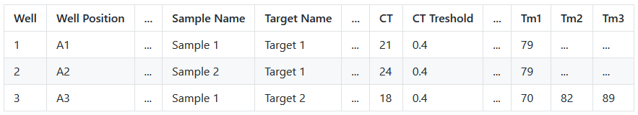
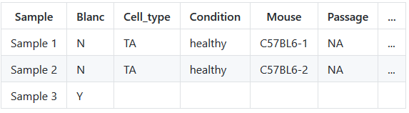
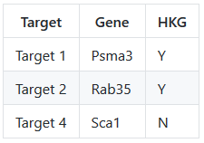
1. Prepare and load the files
Raw data file without any adaptations
Sample annotation
Primer annotation

Slide 4
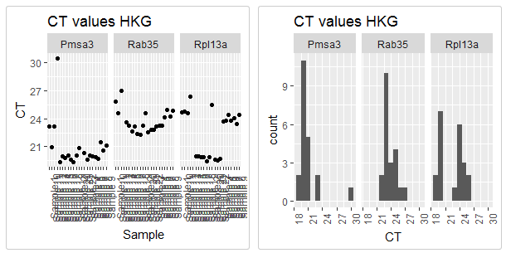
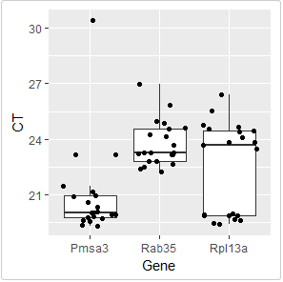
2. Quality control: housekeeping genes
Expression of Rpl13a biphasic ➔ remove_primer()

Slide 5
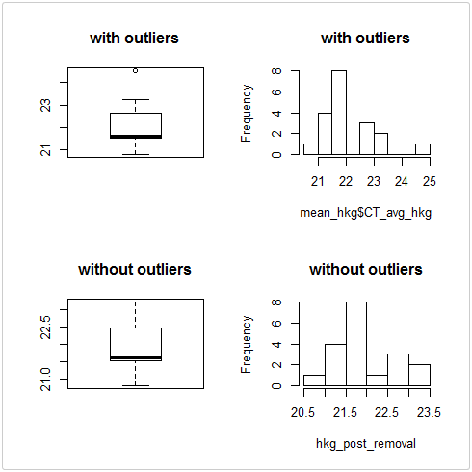
2. Quality control: remove outliers

Slide 6
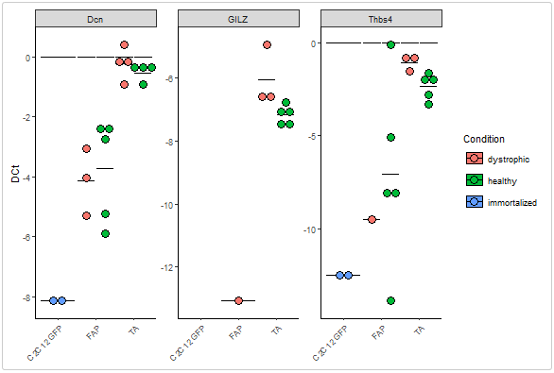
3. Plot delta CT and relative expression

