Slide 1

SHV1 STATION Irregularity Log
Jeffrey Walley
Ctec 259 portfolio
Spring 2025

Slide 2

CTEC 259 Server-Side Web Dev|Portfolio Project | spring 2025
Create and use a virtual environment & Create a requirements file that can be used to fetch necessary dependencies for a project.
Build a working Flask route that utilizes URL variables.
Build a Jinja template that properly utilizes a template. conditional statement and/or a template loop & Build a Jinja template that inherits from another base template.
Read and utilize data from a form submission, Properly implement CSRF Protection, Properly utilize the url_for() function, & Properly implement form validation error display within a Jinja template.
Create a valid Flask-SQLAlchemy database model class, Create a one-to-many relationship between model classes using foreign keys, & Display data from a database in a page.
Properly implement a user login system that utilizes password hashing, Display the information of a logged-in user in a template, & Properly store form-submitted data within a database on submission.
Properly define a custom 404 page, Properly implement text file logging, & Properly utilize “include” in a Jinja template.
Properly create and read data from a many-to-many relationship using Flask-SQLAlchemy models.
Properly implement the Post/Redirect/Get pattern, Properly implement pagination to split database results into multiple pages.
Properly implement a password reset.
Properly utilize a CSS Framework like Bootstrap.
Properly utilize Blueprints to define blueprint-specific routes.
Display an understanding of the REST API pattern.
Complete a small tutorial on an alternative Server-Side Web Framework to Flask (such as Django, Ruby on Rails, Laravel or Express).
Display an understanding of how to deploy a Flask application, either on a specialized service (like Heroku) or on a linux server.

Slide 3
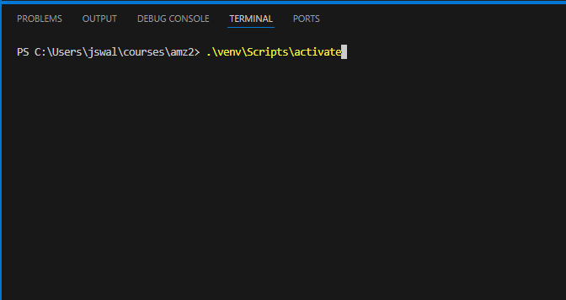
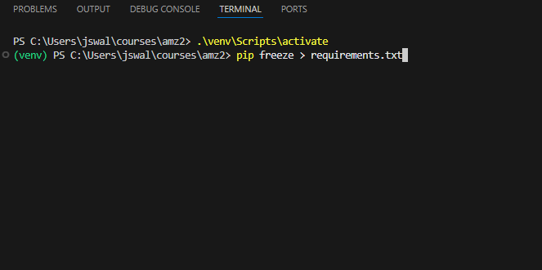
Create and use a virtual environment & Create a requirements file that can be used to fetch necessary dependencies for a project.

Slide 4

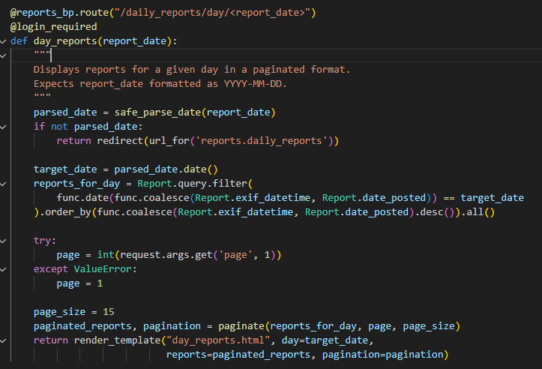
Build a working Flask route that utilizes URL variables.

Slide 5
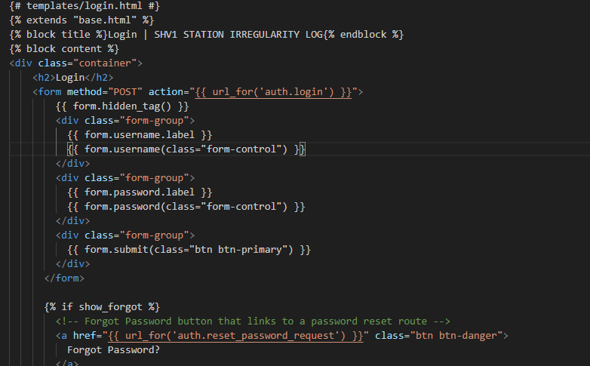
Build a Jinja template that properly utilizes a template conditional statement and/or a template loop & Build a Jinja template that inherits from another base template,

Slide 6
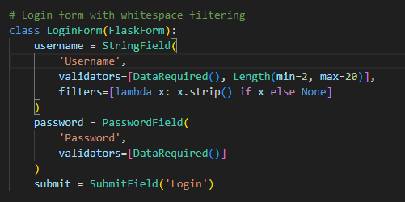
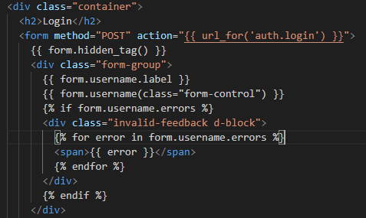
Read and utilize data from a form submission, Properly implement CSRF Protection, Properly utilize the url_for() function, & Properly implement form validation error display within a Jinja template

Slide 7
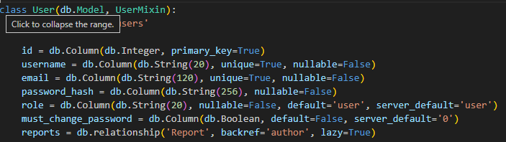
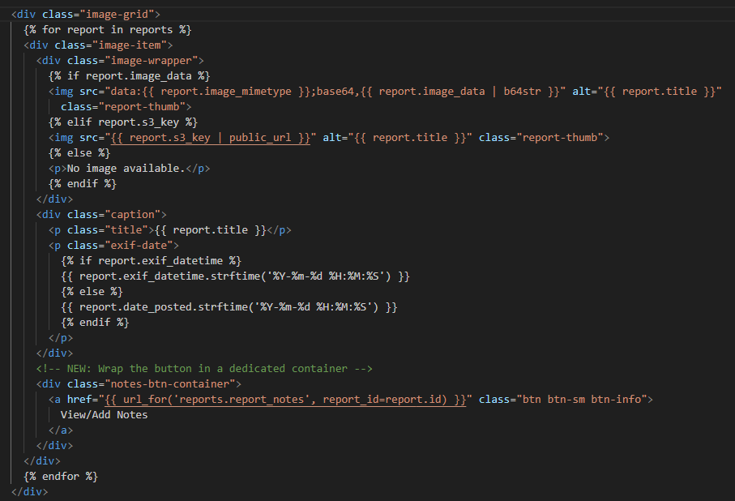
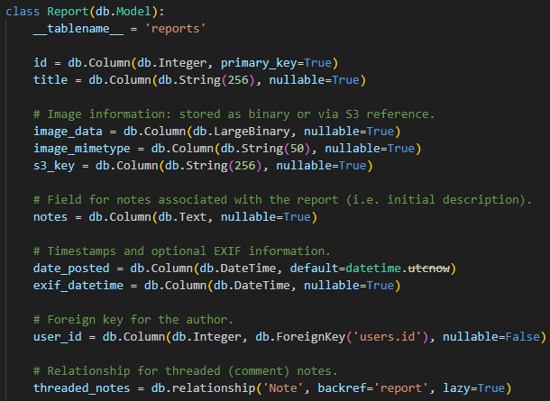
Create a valid Flask-SQLAlchemy database model class, Create a one-to-many relationship between model classes using foreign keys, & Display data from a database in a page

Slide 8
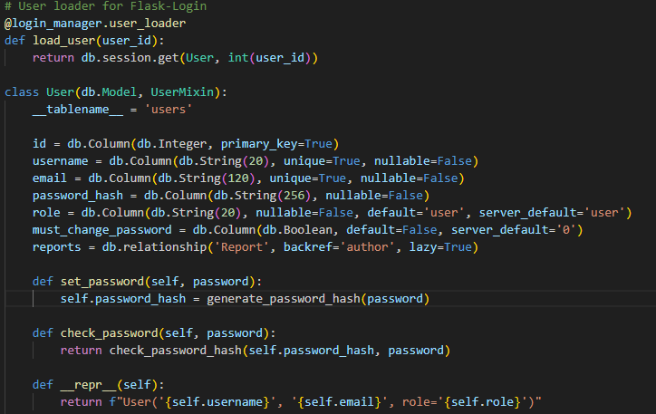
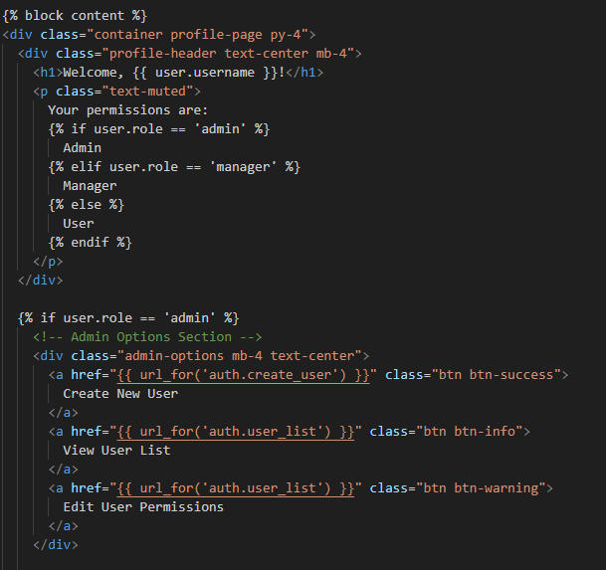
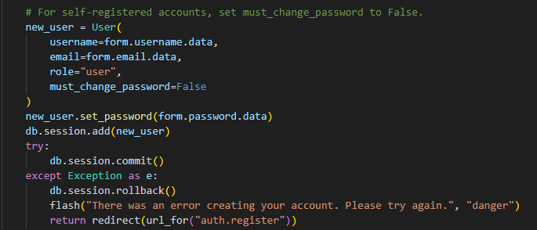
Properly implement a user login system that utilizes password hashing, Display the information of a logged-in user in a template, & Properly store form-submitted data within a database on submission

Slide 9
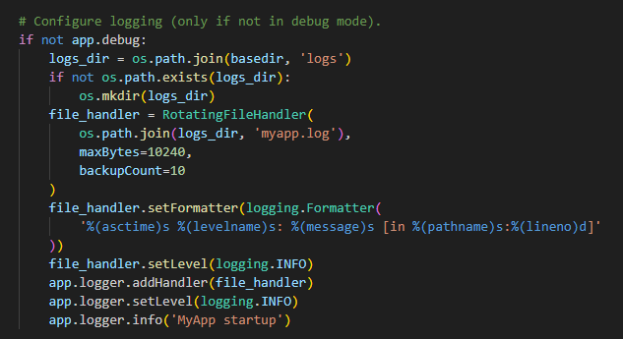
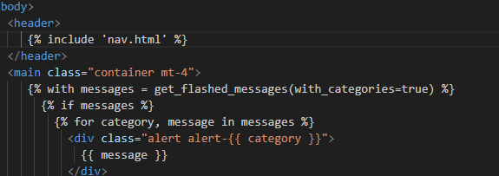
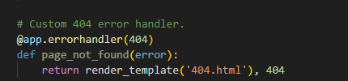
Properly define a custom 404 page, Properly implement text file logging, & Properly utilize “include” in a Jinja template

Slide 10
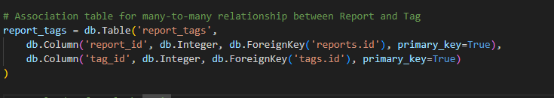
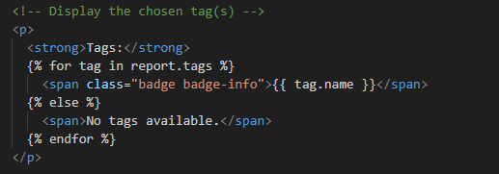
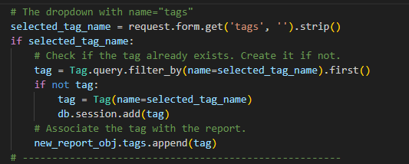
Properly create and read data from a many-to-many relationship using Flask-SQLAlchemy models

Slide 11
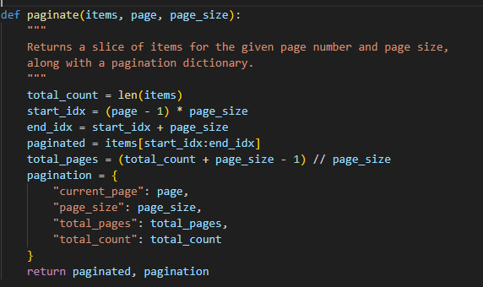
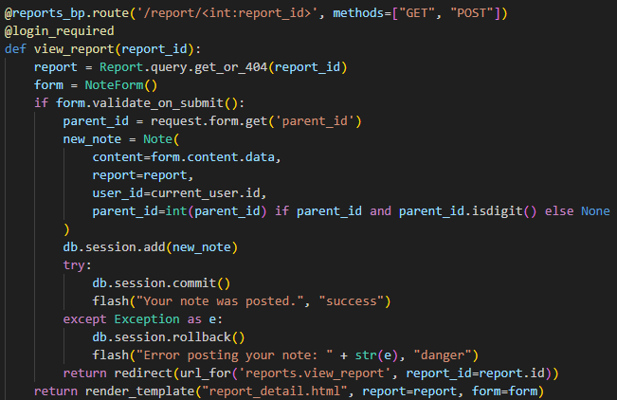
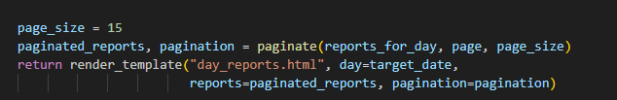
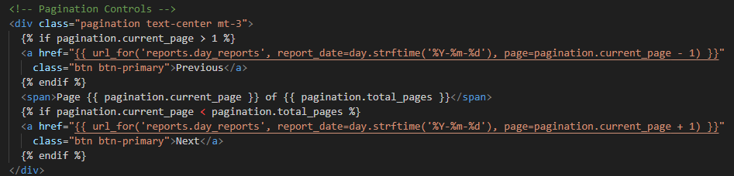
Properly implement the Post/Redirect/Get pattern & Properly implement pagination to split database results into multiple pages

Slide 12
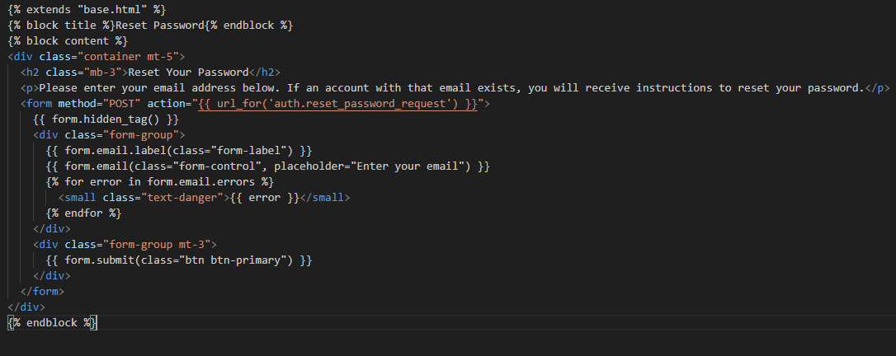
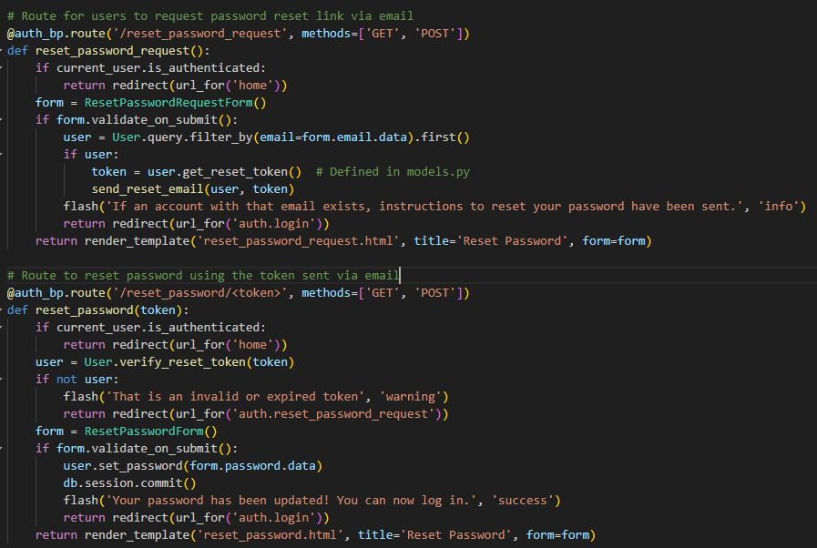
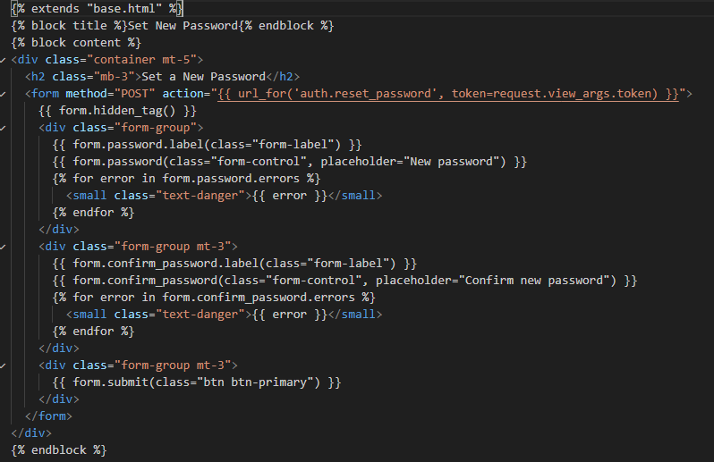
Properly implement a password reset

Slide 13
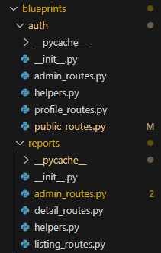
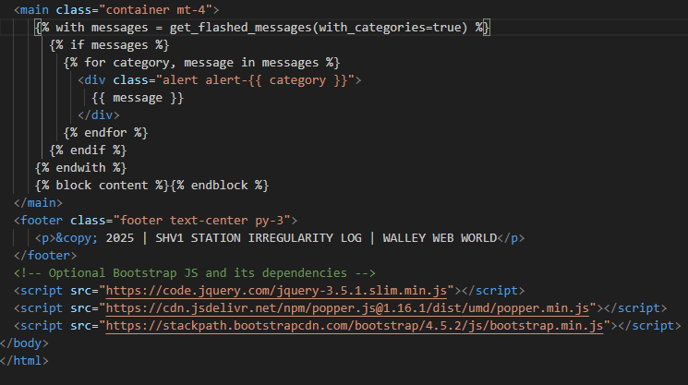
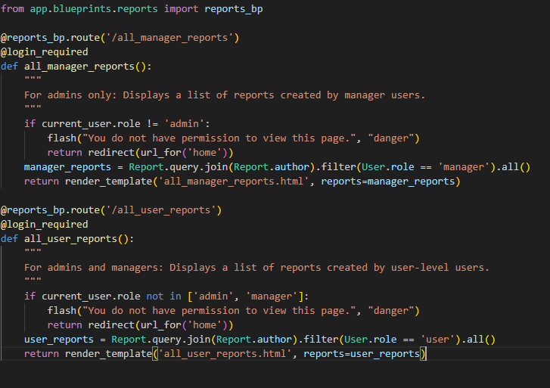
Properly utilize a CSS Framework like Bootstrap & Properly utilize Blueprints to define blueprint-specific routes

Slide 14
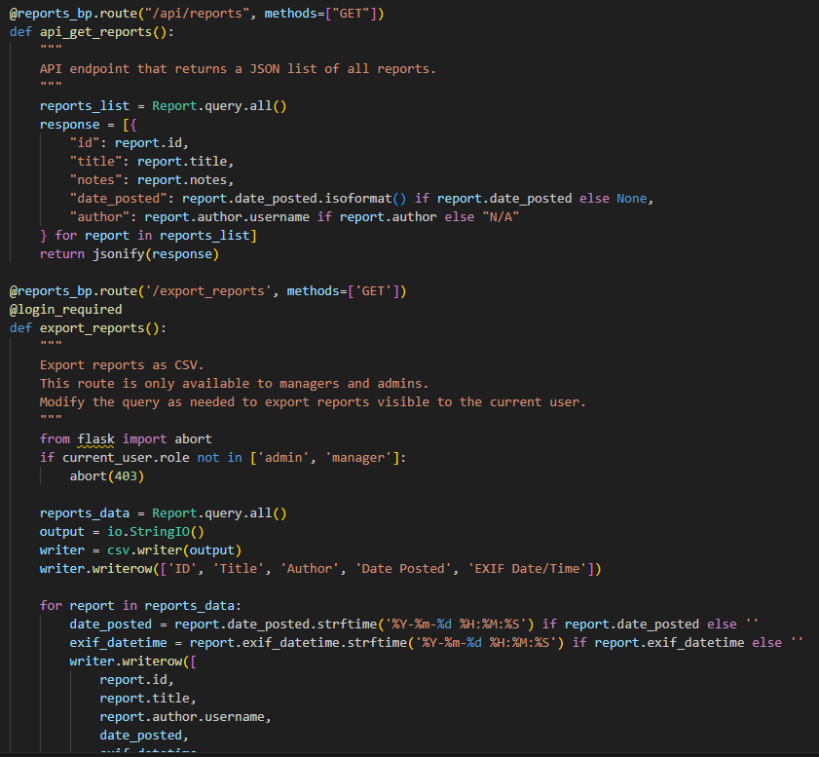
Display an understanding of the REST API pattern

Slide 15
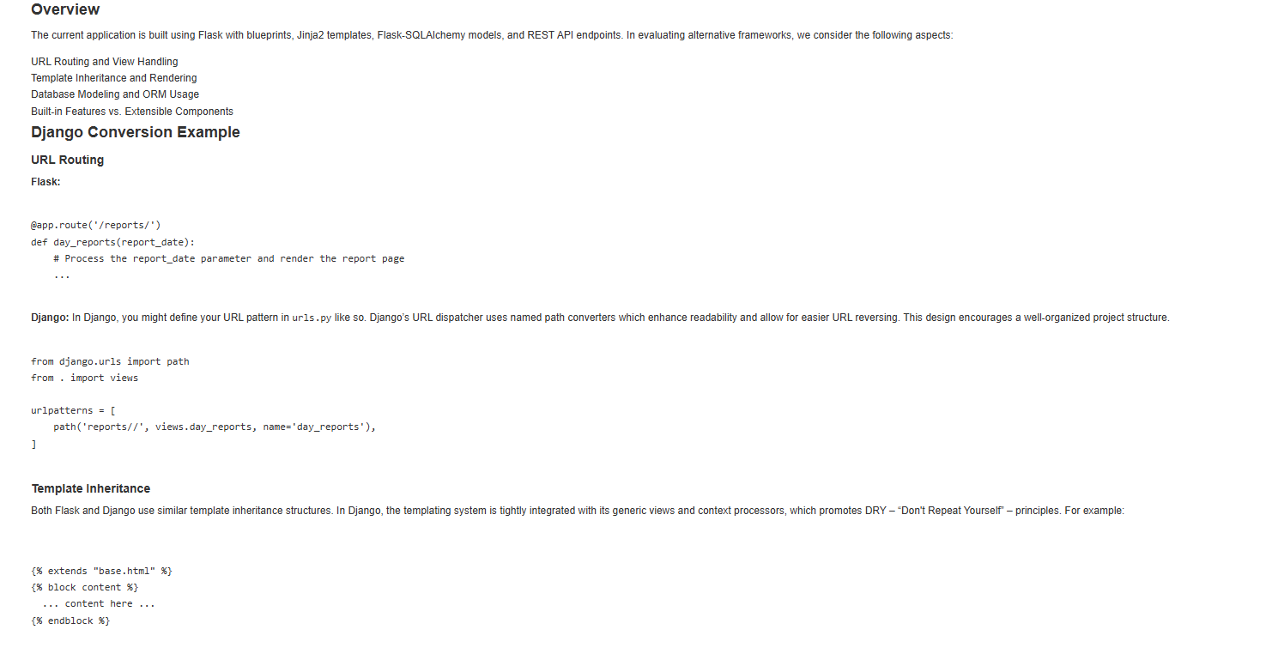
Complete a small tutorial on an alternative Server-Side Web Framework to Flask (such as Django, Ruby on Rails, Laravel or Express)

Slide 16
Display an understanding of how to deploy a Flask application, either on a specialized service (like Heroku) or on a linux server
Deploying a Flask application is not too complex once you have everything in order. First, you need to get your project ready by making sure you have all your project files, your templates, and your static files in one place. Create a file called requirements.txt that lists all the Python libraries your app depends on. You also need a Procfile that tells the hosting service how to run your app. For example, if your Flask app is in a file called app.py and your application object is named app, your Procfile might have this line: “web: gunicorn app:app”.
When you push your project to GitHub, you can use services like Heroku or Railway to deploy your app. With these platforms, you connect your GitHub repository via their dashboard or use a command-line tool. You also set environment variables in their settings such as “FLASK_ENV=production” and your secret keys, which helps the service know that your app is ready for the live stage. The hosting service uses the Procfile command to run your application using Gunicorn, and they offer helpful tools for logging and scaling as your app grows.
If you prefer to run your own Linux server, you have a bit more work to do but also complete control. You begin by cloning your project on the server, setting up a virtual environment, and installing your dependencies with the requirements file. You then test your app with Gunicorn using a command like: “gunicorn app:app”. To ensure that your app runs continuously, you can create a “systemd” service that starts the app each time the server boots and restarts it if needed. It is common to place Nginx in front of your app as a reverse proxy so that all HTTP requests are handled properly and to manage secure connections with SSL (using services such as Let's Encrypt). This method requires you to configure firewall settings and domain records carefully. In both cases, the key ideas are to manage your dependencies, set your configuration options via the environment, and make sure that the process running your app is well secured.

Slide 17

Thank You!
JSWALLEY@ROCKETMAIL.com

