Slide 1
Working with the Registry
CTEC 104
Introduction to Scripting

Slide 2
Overview
What is the Registry?
Working with Keys
Working with Properties

Slide 3
The Registry
The Registry is a database of configuration settings for your Windows operating system
Remember that the Registry is a PSProvider and shows up as a drive
The Registry has a very similar structure to FileSystems as it uses a directory structure to store configuration settings
The Registry is made up of sections that are called hives
There are five or hives created in the Registry, but we are only concerned with two of them
1 ) HKEY_CLASSES_ROOT (HKCR)
HKEY_CURRENT_USER (HKCU)
HKEY_LOCAL_MACHINE (HKLM)
HKEY_USERS (HKU)
HKEY_CURRENT_CONFIG (HKCC)
PowerShell is designed to access the hives HKLM and HKCU

Slide 4
The Registry
The hives in the Registry follow a tree hierarchy that is similar to the file system directory structure
The hive is made up of keys
Keys have properties and sub-keys
A subkey can be thought of as a sub-folder or child-folder
The keys and sub-keys make up the hierarchy of the Registry, and the properties store all of the data configuration values
HKLM and HKCU are the root keys for their respective hives
When we say root, we are referring to starting point.

Slide 5
The Registry
In real-world system administration, you do not mess with the Registry very much because you can easily wreck the entire computer
The real value in Registry editing is to remove keys for malware or unwanted software that will not properly uninstall
Note: It is important to remember that the keys and sub-keys only create a hierarchy to store properties. The properties are the data that is actually used by the computer.

Slide 6
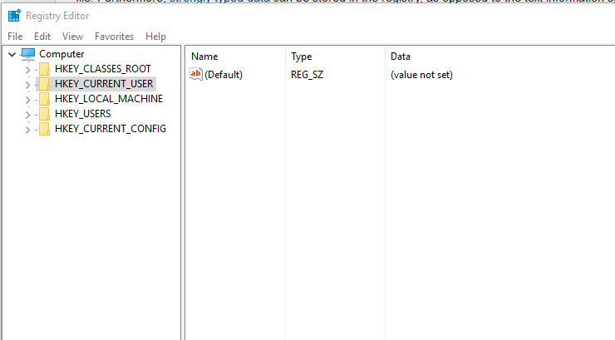
Accessing the Registry via GUI
View the registry via Registry Editor in Windows 10

Slide 7
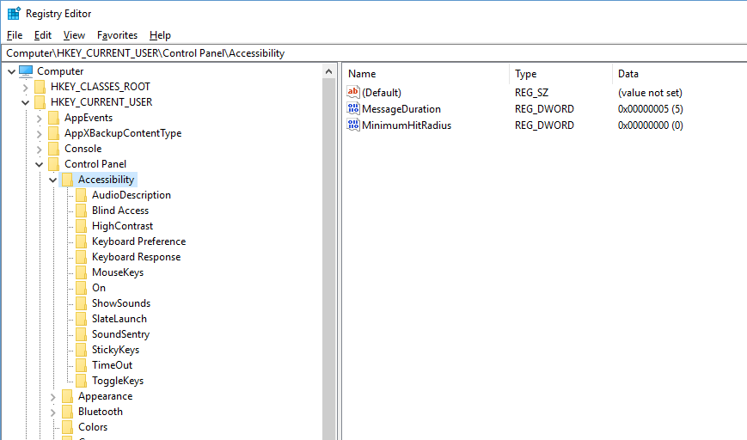
regedit
Current Selected Key
Names
Properties
Values
Sub-keys

Slide 8
Hive Key Local Machine (HKLM
HKLM is the abbreviation for Hive Key Local Machine
This hive stores:
The majority of configuration information for the operating system and installed software
The boot configuration for your computer
Information about currently detected hardware
The Hardware subkey holds data pertaining to the BIOS, processors, and other hardware devices
The Software subkey holds data pertaining to software settings and UI configuration

Slide 9
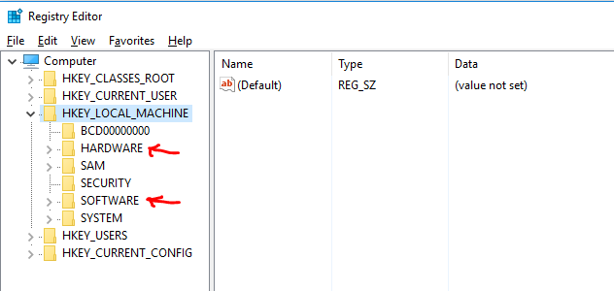
Hive Key Local Machine (HKLM)

Slide 10
Hive Key Current User - HKCU
HKCU is the abbreviation for Hive Key Current User
This hive stores:
Configuration information for the currently logged in user
This includes display settings, environment variables, mapped network drives, keyboard layout, desktop wallpapers, etc…
Many of the settings from Control Panel are stored here

Slide 11
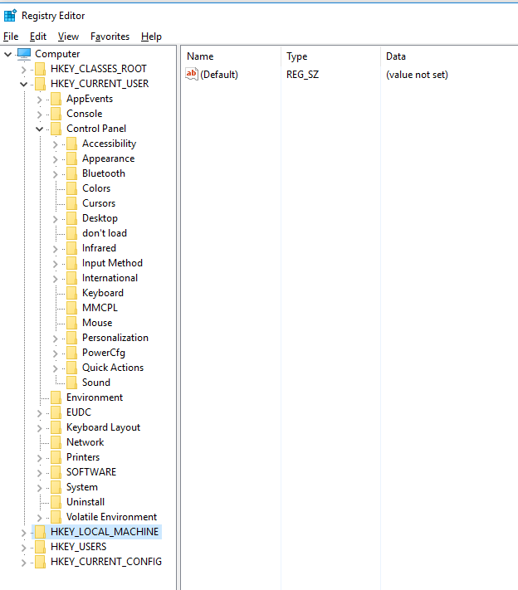
Hive Key Current User (HKCU)

Slide 12
Retrieving Keys with get-childitem
Registry keys create the hierarchy used to store data
The get-childitem command is used to display the sub-keys of a Registry key
To display the sub-keys for the Control Panel:
get-childitem "HKCU:\Control Panel" |select name
To display the entire tree structure of sub-keys and their sub-keys:
get-childitem "HKCU:\Control Panel" -Recurse | select name

Slide 13
Using the Include parameter
# This retrieves all keys from the Mozilla subkey
Get-ChildItem -Path HKCU:\SOFTWARE\Mozilla\* -Include *
# If you don’t use a wildcard (*) in the path name, no keys will be returned
Get-ChildItem -Path HKCU:\SOFTWARE\Mozilla\ -Include *
The Path parameter must be used with the Include parameter

Slide 14
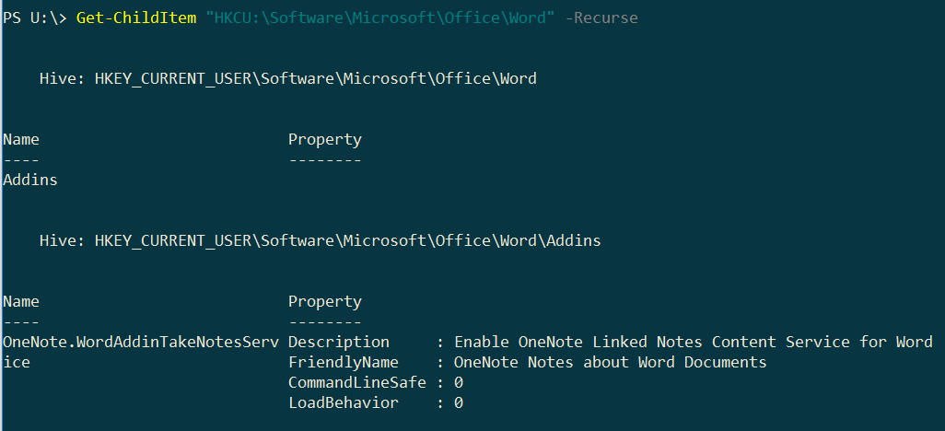
Getting all keys from Microsoft Word
Get-ChildItem "HKCU:\Software\Microsoft\Office\Word" –Recurse
- You shouldn’t be blocked from accessing any of the keys

Slide 15
Creating and Renaming Keys
To create a new key:
new-item -Path “HKCU:\...\ParentKey”
-Name NewKey
In this command, the path must specify the full hierarchy of the parent key
To rename a key:
rename-item –Path “HKCU:\...\Key”
–NewName Key2

Slide 16
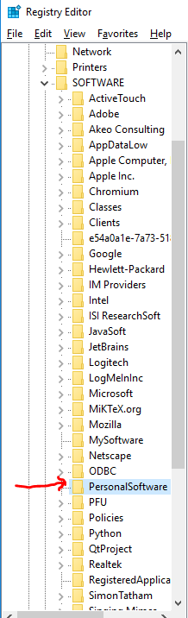
Example of Creating New Key
If we want to create a new key called PersonalSoftware
New-Item -Path "HKCU:\Software" -Name PersonalSoftware

Slide 17
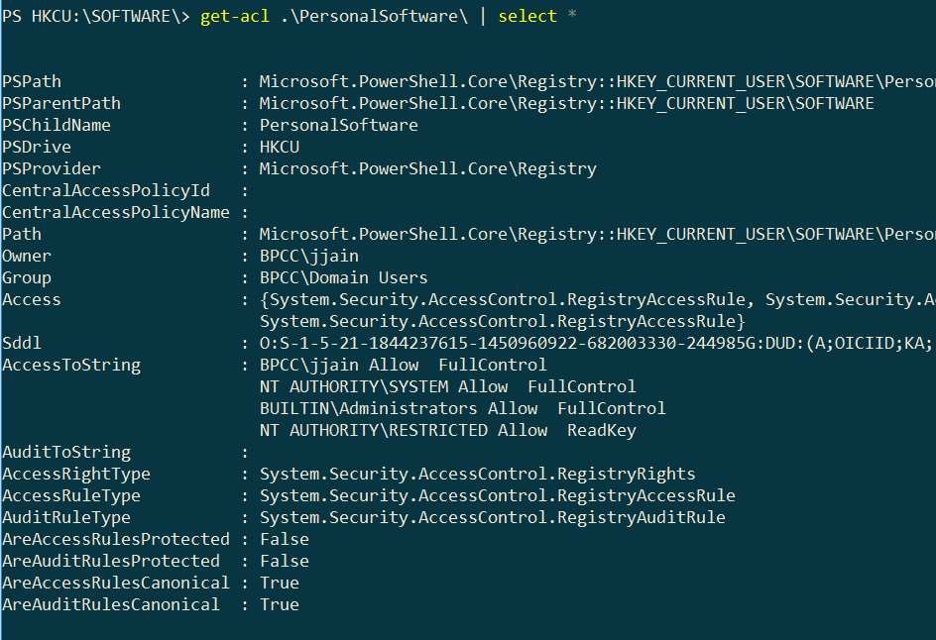
Viewing permissions of Key
To view permissions of a key:
cd HKCU:\SOFTWARE\
get-acl PersonalSoftware

Slide 18
Get Key Properties
The properties store the data in the Registry
To display the properties for a Registry key:
get-itemproperty -Path “HKCU:\...\Key”
To display an individual property for a Registry key:
get-itemproperty -Path “HKCU:\...\Key”
–Name PropertyName

Slide 19
Setting Key Properties
To create a new property or change the value of an existing property:
set-itemproperty -Path “HKCU:\...\Key”
-Name Property -value XX
To rename a property:
rename-itemproperty -Path “HKCU:\...\Key”
-Name Prop1 –NewName Prop2

Slide 20

Example of Creating New Property
If we want to create a new property called StartVal with a value of 10 for the PersonalSoftware key
Set-ItemProperty -Path "HKCU:\Software\PersonalSoftware" -Name StartVal -value 10
To verify that the property was created:
Get-ItemProperty -Path "HKCU:\Software\PersonalSoftware"

Slide 21
Removing Key Property
To remove a property:
remove-itemproperty -Path “HKCU:\...\Key”
-Name Property

Slide 22
Example of Removing a Property
To remove a property:
Get-Item -Path HKCU:\SOFTWARE\PersonalSoftware | Remove-ItemProperty -Name StartVal
Your Property should be gone from regedit now

Slide 23
Removing Keys
To remove a key:
remove-item -Path “HKCU:\...\Key” –Recurse
This command will remove this key and all of its sub-keys
It is important to review the contents of the key before removing it
Without the Recurse parameter, you will be prompted to confirm the removal

Slide 24
Example of Removing Key
To remove the PersonalSoftware key:
Remove-Item -Path HKCU:\SOFTWARE\PersonalSoftware
The PersonalSoftware key should not show up in regedit anymore

Slide 25
Homework
1) Watch this short video on the registry:
https://www.youtube.com/watch?v=E6ROLfd8RFo
2) Complete Registry Exercises

