Slide 1
Working with Services and Processes
CTEC 104
Introduction to Scripting

Slide 2
Overview
What is a Service and a Process?
Windows Services
Service Properties
Standard Services Commands
Processes
Process Properties
Standard Processes Commands

Slide 3
What is an Application?
Let’s start with something we’re familiar with: an application
An application is a program which you interact with on your computer:
- Skype, Microsoft Office, Chrome, etc…
An application has many different associated processes
For example, each tab in Chrome is a separate process

Slide 4
What is a Process?
A process is an instance of a particular executable file or application
Processes usually exit when an application closes
Some programs (especially antivirus and backup) have background processes which constantly scan your computer

Slide 5
What is a Service?
A service is a type of process that runs in the background and does not interact with the desktop.
Almost all services run as an instance of svchost.exe
Services usually run when windows boots up
Enable the creation and management of long running processes
Can run long after the user logs off

Slide 6
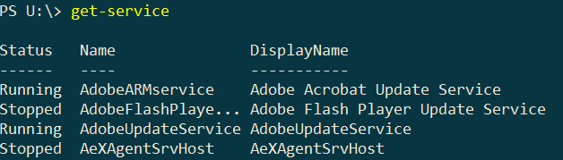
Get-Service
To see the services on your computer use the command:
get-service
This displays all of the services on your computer
This command displays three properties
Status displays which services are running and which are stopped
Name is the name of the service
DisplayName is a short description of the service

Slide 7
Filtering Services
The first thing you will notice is that the list of services is kind of long
There are many command options to display only certain services
The following only displays services beginning with the letter b:
get-service b*
The following only displays services with the word “remote” in the description
get-service –DisplayName *remote*
#10

Slide 8
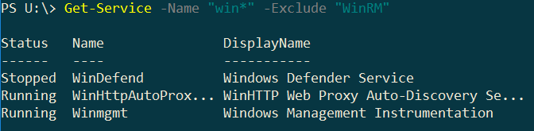
Search and Exclude
Get services beginning with a search string and an exclusion:
Get-Service -Name "win*" -Exclude "WinRM"
#11

Slide 9
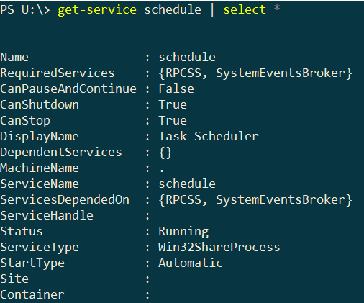
Service Properties
Services have several other properties not displayed by the get-service command
These can be displayed using a select command:
Get-Service schedule | select *
Sort by status property value:
Get-Service "s*" | Sort-Object status
#1
#14

Slide 10
Service Properties
Get-Service Spooler | select *
Get-Service Winmgmt | select *
#2
#3
CanShutdown property
→ Indicates whether the service should be notified when the system is shutting down.
#4
CanPauseAndContinue property
→ Indicates whether the service can be paused and resumed.

Slide 11
Display Running and Stopped Services
Running Services:
Get-Service | Where-Object {$_.Status -eq "Running"}
To find alias for where use:
- Shows running services
Show Stopped Services:
Get-Service | Where-Object {$_.Status -eq "Stopped"}
#12
#6a
Get-Alias where
#6b

Slide 12
Get Dependent Services
Dependent Services of WinRM service:
Get-Service "WinRM" –DependentServices
List Services that have dependent services:
Get-Service |
Where-Object {$_.DependentServices} |
Format-List -Property Name,DependentServices, @{
Label="NoOfDependentServices";Expression={$_.dependentservices.count}
}
#15

Slide 13
Important Service Properties
Some of the important service properties are:
RequiredServices – lists the other services that must be running in order for this service to work correctly
DependentServices – lists the other services that need this service to be running
CanPauseAndContinue – if True, the service can be paused and resumed
CanStop – if True, the service can be stopped; if False, the service must be running at all times
StartType – specifies how the service is started

Slide 14
Standard Commands
If a service is currently not running, you can start it with:
start-service servicename
If you want to stop a running service, use:
stop-service servicename
You cannot normally stop a service that has dependent services; to override this use:
stop-service servicename -Force

Slide 15
Standard Commands
If a service has CanPauseAndContinue set to True, it can be paused and resumed
To pause a service use:
suspend-service servicename
To resume the service use:
resume-service servicename

Slide 16
Processes
Every program running on your computer runs as a process
At any moment, there are hundreds of processes running
To view all active processes use the following command:
get-process
#7

Slide 17
Search for process
The output of the get-process command is too long to be practical
You can use wildcard options to search for specific processes
For example, to display processes that start with the letter m:
get-process m*

Slide 18
Process Properties
The properties displayed by the get-process command can be broken into two categories
Handles, NPM, PM, WS, and CPU all provide amounts of memory and CPU utilization of the process
ID, SI, and ProcessName identify the process
The second category of properties are the ones we are concerned with

Slide 19
Process Properties
The identification properties for processes are:
ID is a unique number identifying the process
ProcessName is the name of the process
SI is the Session ID; this one requires a little explanation
Each user accessing a system has a unique session ID
Session ID 0 is associated with system boot and core system processes
Session ID 1 is for the first user
Session ID 2 is for the second user, etc.
Normally, there will not be very many session ID’s

Slide 20
Process Properties
Each process has many more properties not shown by get-process
To view these:
get-process name | select *
The property list is quite long, but one other property is valuable to know about:
Path – identifies the executable program associated with the process

Slide 21
Standard Commands
To stop a process by its id number:
stop-process ID
To stop a process by its name use:
stop-process -Name processname
The above command will stop all processes with the given name

Slide 22
Standard Commands
To start a new process, you can use the start-process command
Normally, this command is unnecessary
When using this command, you must give the name of the program to run:
start-process notepad
For Windows system programs that are located in directories that are part of the system path no directory is required
Otherwise, you must give the full path to the program

Slide 23
Find number of running processes and services
# Count all process Session IDs
(get-process).SI.count
# Count all services
(get-service).count
# Count all running services
(get-service | where {$_.status -eq "Running"}).count
#7a

Slide 24
Finding process associated with program
get-process notepad | select id,si,path,name
To stop process, you can use the process name or id:
Stop-Process –name notepad
Stop-Process <ProcessId>
#8a
#8b

Slide 25
Find number of dependent processes of Spooler service
1)Find dependent services of Spooler
Get-service Spooler | select DependentServices
2) Now to count number of Dependent Services
Get-Service Spooler| Where-Object {$_.DependentServices.count -eq "2"}
#15
#13

Slide 26
Service Host (svchost)
- Services are organized into logical groups that are all somewhat related, and then a single Service Host instance is created to host each group.
- There are different service hosts for storage, security, user data ,networking, audio, graphics, and hardware.
Get-Process svchost
#9a

Slide 27
Security with svchost
get-process svchost | select id,path
To identify a suspicious process you could look for duplicate ids or unfamiliar paths. You can also look online for known svchost processes on Windows 10.
#9b

Slide 28
Homework
Read Chapter 6 in the book
Complete Services and Processes Exercises

