Slide 1
Introduction to PowerShell
CTEC 104
Introduction to Scripting

Slide 2
Overview
Attendance / Questions
What is Scripting?
Why Learn Scripting?
Starting PowerShell
The Help System
PowerShell Commands
Objects
Convenience Options

Slide 3
What is Scripting?
Scripting or a scripting language is a method of programming for certain run-time environments that automates the execution of tasks
Run-time environment: a specific operating system or device
Scripting is a way to programmatically access the operating system
Interpreted rather than compiled language
Each command is executed one after another in sequence
Use cases
Software applications
Web pages
Operating systems
Embedded systems
Examples: PowerShell, Unix Shell, PHP, Perl, Python, JavaScript

Slide 4
Why learn Scripting?
As a network security professional you will be expected to audit and monitor systems and servers using a scripting language. You will also be expected to write scripts to test the security of systems and check log files of servers.
As a systems administrator you will be expected to write scripts to monitor and test performance, secure systems, and debug server issues.
As a software developer you will be expected to know scripting languages to interact with source control (Git), troubleshoot applications, and download/install packages.

Slide 5
What is PowerShell?
PowerShell is a scripting tool provided for advanced Windows system administration
It provides hundreds of commands to make the Sys Admin’s job easier
System Administrator: A system administrator, or sysadmin, is a person who is responsible for the upkeep, configuration, and reliable operation of computer systems; especially multi-user computers, such as servers.
You can run simple commands at the command prompt or build advanced scripts that can automatically create and provision hundreds of user accounts, connect to remote servers, and secure networks.
Additionally, in 2016, PowerShell was open sourced so that Mac and Linux users can also use PowerShell in their native environments

Slide 6
Why PowerShell?
Before PowerShell, VBScript was an attempt at offering scripting capabilities with Windows
Disadvantage: not fully supported by Windows OS
PowerShell was released in 2006 to provide a scripting interface with full compatibility with the Windows OS
Although, we can do many of the same tasks through the GUI, PowerShell makes it easier to write scripts to quickly execute tasks that might have taken hours using a GUI
In recent Microsoft products, everything that you can do in the GUI, you can do in PowerShell
In fact, many of the actions you take through the GUI are actually executed via PowerShell commands running in the background

Slide 7
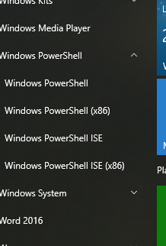
Starting PowerShell
To Start PowerShell, go to the Start Menu and find the Windows PowerShell folder
There are four options in this folder as shown in the picture
PowerShell is what you will normally run.
The (x86) version is available for compatibility with older 32-bit systems.
We will learn about the ISE later in this course

Slide 8
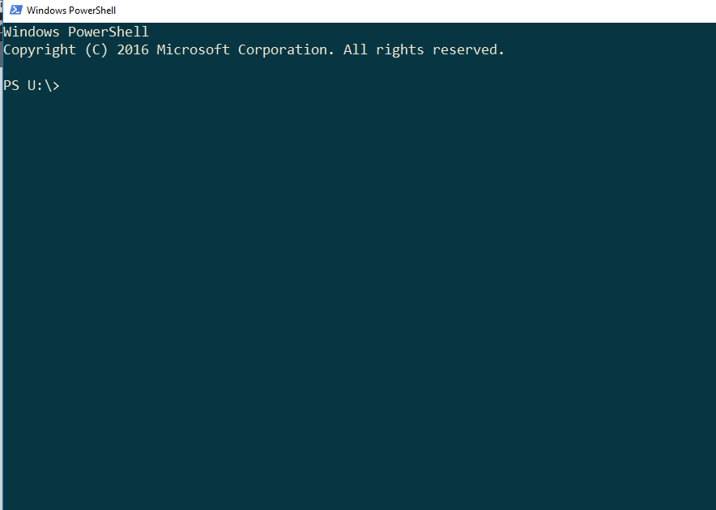
Getting Started
When you open up PowerShell, you should see the following window:
This blinking cursor here is where you type your commands in
The text here tells you which directory you are currently in. I am in my U directory or my U drive by default

Slide 9

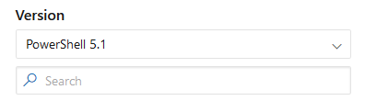
Documentation and PowerShell versions
To find what PowerShell version you’re using:
$PSVersionTable.PSVersion
Make sure you’re version is 5 or above
Reading documentation is the key to your success with scripting and PowerShell
You can think of documentation as an instruction manual
The PowerShell documentation is found here: https://docs.microsoft.com/en-us/powershell/module/
Make sure you have the correct version of PowerShell selected
Bookmark the documentation in your web browser
Output of the $PSVersionTable.PSVersion command
PowerShell version selection on the documentation page

Slide 10
The Help System
Microsoft provides an extensive help system for PowerShell
This is one of the most valuable tools you will have in this course
One of the goals of this course is to have a thorough understanding of the Microsoft help system and how to use it
We are now living in a time where there are no books in print that adequately describe the modern PowerShell system
You need to learn how to use online resources to learn PowerShell

Slide 11
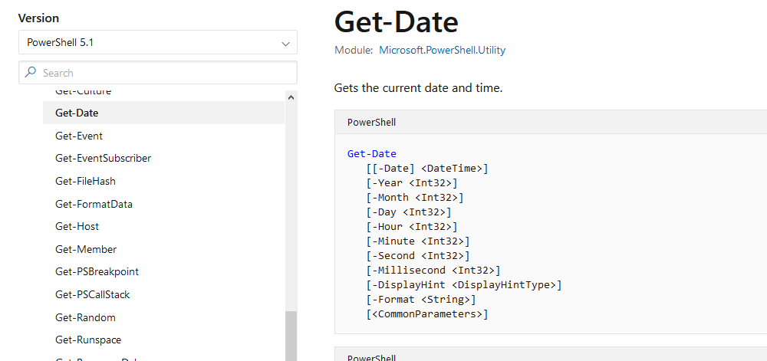
The Help System
The Get-Help command is used to get information about commands and certain topics
A basic example:
get-help get-date -online
This opens up the online help in your default web browser. I recommend changing your default web browser to Firefox or Chrome.
For a full description of the command type:
get-help get-date -full

Slide 12
The Help System
To view examples of Get-Date in use type:
get-help get-date –examples
Another valuable command for the Microsoft help system is:
Update-Help
This command downloads all of the currently available help files from the Microsoft site
Be sure to be running as Administrator when you run this command or else you will get a bunch of errors
This command might take a while or it might even fail if the network does not have correct permissions to access the Microsoft online help repository

Slide 13
PowerShell Commands
PowerShell has hundreds of commands that can be used
PowerShell can execute 4 kinds of named commands:
Cmdlets
PowerShell scripts (files with extension .ps1)
PowerShell functions
Standalone executable programs

Slide 14
cmdlets
Cmdlets (pronounced commandlets) make up the majority of commands that you will use in this course
All Cmdlets have a standard naming format of verb-noun
Some examples are:
Get-Command
Enable-ScheduledJob
Export-Csv
Get-Host
New-Service
Set-Location
To run a Cmdlet, enter the name at the prompt and add any desired parameters and then press the enter key

Slide 15
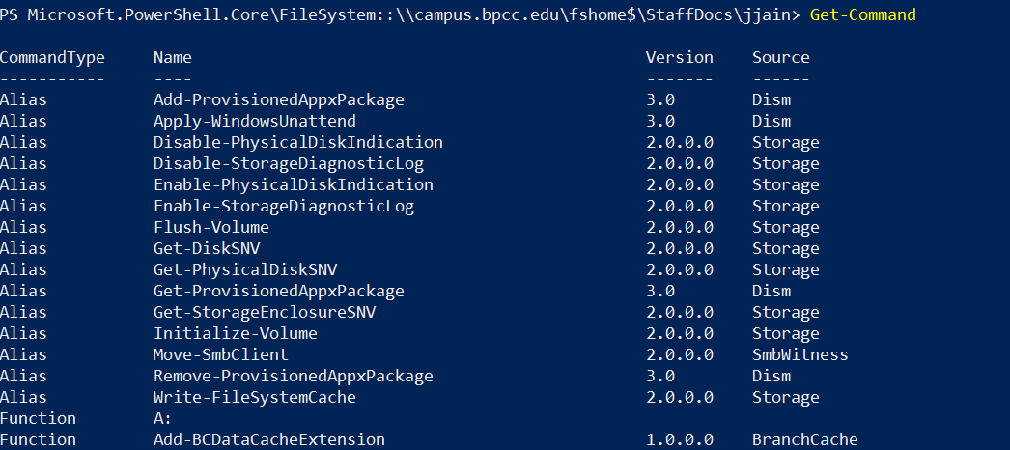
Get-Command
The Get-Command lists all commands that are installed on the computer. It will take a while for the command to complete execution as there are a LOT of commands in PowerShell:

Slide 16
Get-Command
Note the following:
There are three different command types:
Alias
Function
cmdlet
Note the source column
This tells us which module the command comes from
The commands can come from Microsoft themselves or 3rd party entities
For instance the Get-Help command comes from the Microsoft.PowerShell.Core module
Many of the Microsoft modules come pre-installed but you can also install 3rd party modules and other Microsoft modules on your computer
3) If you would like to interrupt the command while it’s running, hit the keys Ctrl + C on your keyboard
- You might want to do this if the command is taking to long to run or you want to cancel the command.

Slide 17
Now let’s try it out……
Type in the following commands one at a time at the PowerShell prompt and then hit Enter. Note what each command does.
Get-Command
Get-Command –verb “get”
Get-Command –noun “service”
Get-Help Get-Command
Get-Help Get-Command –Online
Get-Help Get-Command –examples
Get-Help Get-Command –detailed
Get-Help Get-Command –full
Get-Command -?
Get-Help –Full –Name Get-Command

Slide 18
Aliases
Aliases are provided as shortcuts to reduce typing
Standard aliases refer to cmdlets and substitute for the cmdlet names
Examples of aliases are:
cls – refers to Clear-Host
dir – refers to Get-Childitem
gps – refers to Get-Process
type – refers to Get-Content
To see the list of all available aliases, type:
get-alias

Slide 19
Run the following cmdlets:
Type in the following commands one at a time at the PowerShell prompt and then hit Enter. Note what each command does.
Get-Alias
Get-Alias ls
Get-Alias rm
Get-Alias cat
Get-Alias dir
Get-Command Get-Command
Get-Help Get-Help
Get-Alias -Name gp*, sp* -Exclude *ps
Get-Alias -Definition Get-ChildItem
Get-Alias | Where-Object {$_.Options -Match "ReadOnly"}

Slide 20
Functions
Functions work much the same as Cmdlets and are defined for various purposes
The important difference with functions is that you can write your own
Many functions use the same verb-noun naming standard as Cmdlets, but they are not required to
You can give a function any name you desire
We will look at functions in depth later in the course

Slide 21
Naming conventions
For the most part uppercase and lowercase are ignored with PowerShell commands
Examples:
Get-Command and get-command are the same
cls and CLS are the same

Slide 22
Parameters
Parameters are just extra information that we give a command so that it does something extra
PowerShell commands use two types of parameters
Named parameters must have the name of the parameter provided in order to be used
Positional parameters can be used without giving the parameter name; these are identified by their position in the command input
In the online help, named parameters are identified as being named
On the other hand, positional parameters have a position number given
Position numbers are usually 0, 1, and 2
These numbers specify the order the parameters must appear in when typed

Slide 23
Named Parameters
Named parameters are explicitly present in a PowerShell command:
Get-Command –Module “Microsoft.PowerShell.Core”
Name of the command
The named parameter
The value of the parameter
This retrieves all commands that are found in the Microsoft.PowerShell.Core module

Slide 24
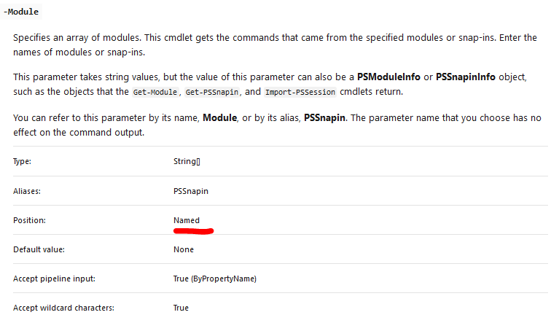
So how do we know if a parameter is named or positional?
When we go to the Get-Command documentation page on the PowerShell website and we scroll down to the parameters section we can find the –Module parameter and we see that it’s a named parameter

Slide 25
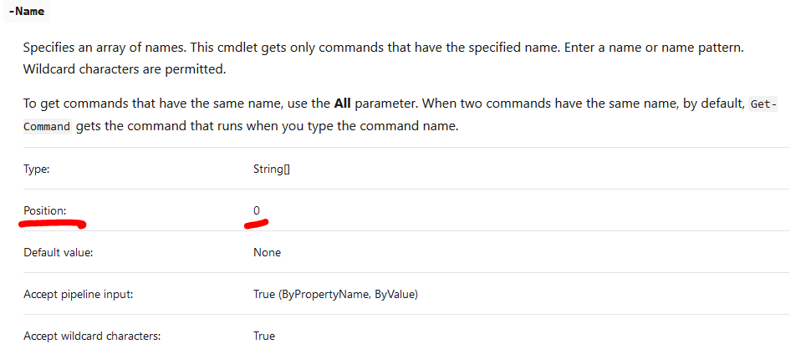
Positional Parameters
A positional parameter does not have a specified parameter named.
The parameter names are assumed by the order in which they are put in
So for example, the text in quotation marks is considered to be parameter 0
Remember in PowerShell, we start counting from 0 not 1.
Example:
Get-Command Get-Alias
This is the name of the command
This is a positional parameter
Get-Alias is a positional parameter at position 0

Slide 26
Objects
In older shell systems (like Linux shells and the Command prompt), the output of commands was always in text
In PowerShell, commands produce output as Objects
Objects are data items made up of properties and methods
This provides an incredibly large amount of data to be packaged into an object and displayed and manipulated via PowerShell

Slide 27

Date Object
The following command is used to get the current date and time:
get-date
This command displays the current date and time using a default format
There is actually much more to this output than what is currently shown on the screen

Slide 28
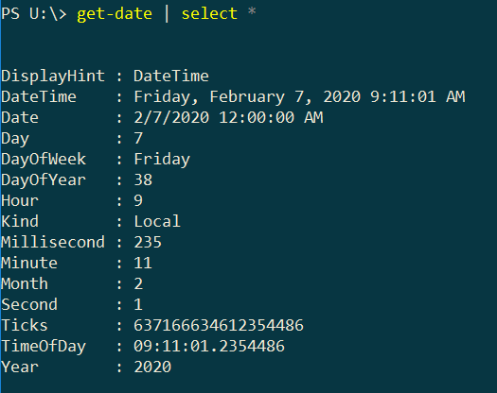
Objects
The Select-Object command is used to view the properties of an object
The alias for Select-Object is select
To view all of the properties of a date object:
get-date | select *
To view individual properties, you can use a comma delimited list, like:
get-date | select day, month, year

Slide 29
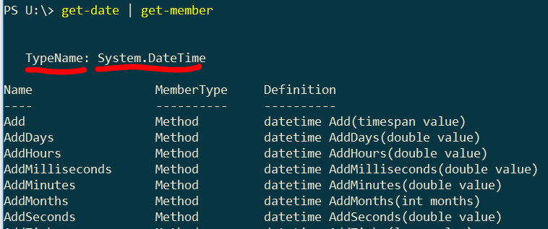
Objects
The Get-Member command is used to display the type of an object along with all of its methods and properties
Type:
get-date | get-member
The Type Name shows that this is a System.DateTime object
All of the available methods are shown
The property values are not shown like with the Select-Object command
Instead, this command shows the system functions used to retrieve the property values

Slide 30
Convenience Options
The wildcard character can be used with many parameters to specify multiple items
The following are two common wildcard options:
To get all commands that start with the letter m:
get-command m*
To get all commands that contain the text Event:
get-command *event*

Slide 31
Copy and Paste in Powershell
The Copy and Paste feature works a little differently in PowerShell
To copy:
Highlight a line of text and Right-Click on the mouse
When you Right-Click, the highlighted text will un-highlight
To paste:
Right-Click the mouse a second time at the blinking cursor, and the copied text will be pasted at the prompt

Slide 32
Using the keyboard to retrieve previous commands
Note the only area where the mouse works in PowerShell is when copying and pasting. Everything else you should do with your keyboard.
The Up Arrow can be used to retrieve previous commands that were entered at the prompt
You can press the Up Arrow multiple times to cycle though your previous commands
After selecting a command, you can also Back Arrow the cursor and edit the command

Slide 33
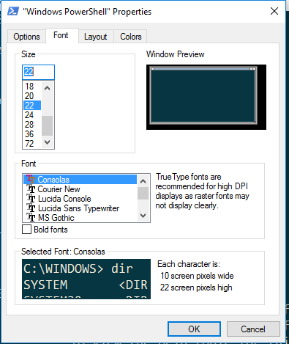
PowerShell Properties
The PowerShell window has many properties to define how the window will display
To see the properties, Right-Click in the window title bar and select Properties
One of the most useful properties is the font size
You can use this to make the window text larger or smaller

Slide 34
PowerShell Properties
The PowerShell window has many properties to define how the window will display
To see the properties, Right-Click in the window title bar and select Properties
One of the most useful properties is the font size
You can use this to make the window text larger or smaller

Slide 35
Homework
Read Chapter 1 – 4 in the textbook
Do the labs at the end of each chapter
Complete and submit Powershell Basics Exercise in canvas

