Slide 1
More about PowerShell
CTEC 104
Introduction to Scripting

Slide 2
Overview
Attendance / Questions
Additional Commands
The Pipeline
Parentheses
Working with Output
PowerShell Providers

Slide 3
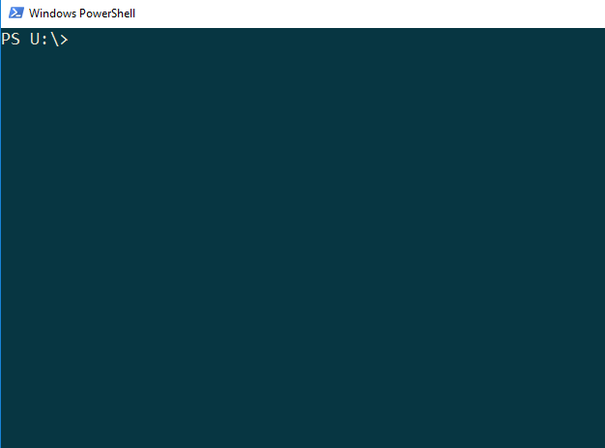
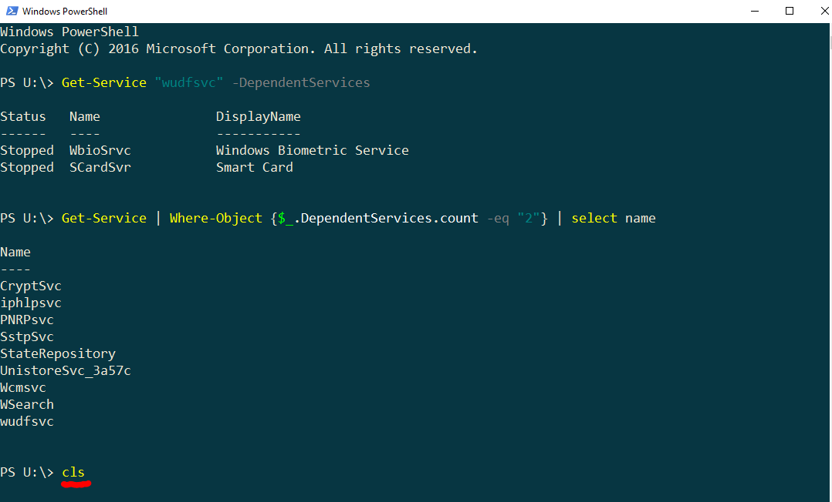
Clear-Host
cls is the alias for clear-host
This command clears the screen

Slide 4
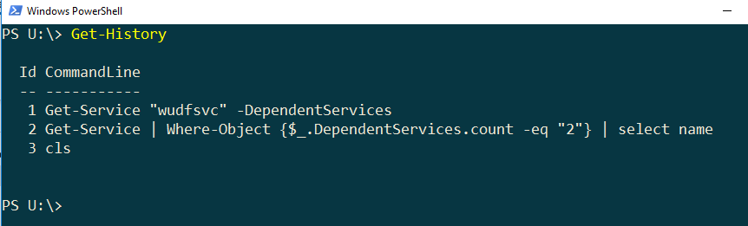
Get-History
get-history lists all of the commands that have been entered in the current PowerShell session

Slide 5
Practice: Get-History
Type in the following commands one at a time at the PowerShell prompt and then hit Enter. Note what each command does.
Get-History
Get-Service
Get-History | Where-Object {$_.CommandLine -like "*Service*"}
Get-History -Count 1
Get-History | Format-List -Property *

Slide 6
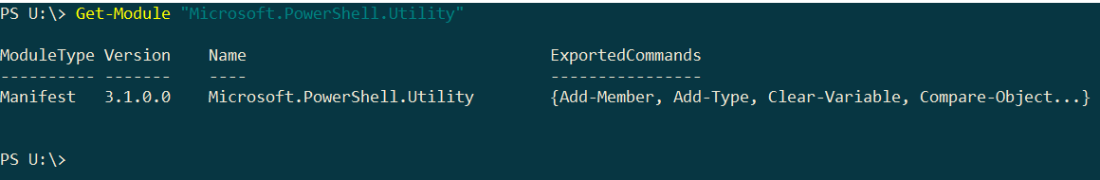
Get-Module
To see the modules currently loaded on your computer:
Get-Module –ListAvailable
To search for specific modules:
Get-Module "Microsoft.PowerShell.Utility"

Slide 7
Get-Command
You can search for commands based on a given type:
get-command –Type cmdlet
get-command –Type function
This is an example of using Named Parameters

Slide 8
Using Parameters
The Module parameter lists the commands found in a particular module
get-command –Module Microsoft.PowerShell.Core
The Verb parameter lists the commands containing a particular verb:
get-command –Verb update
PowerShell has a formally defined set of legal verbs for Cmdlets
To see this list type:
get-verb
1
2

Slide 9
The Pipeline
The Pipeline is one of the most important features available in PowerShell
It is a simple concept: the output of one command becomes the input for the next command
Using this concept, data is “piped” through a series of commands to produce some final result
Get-Command | select name
This vertical bar is called the pipeline operator

Slide 10
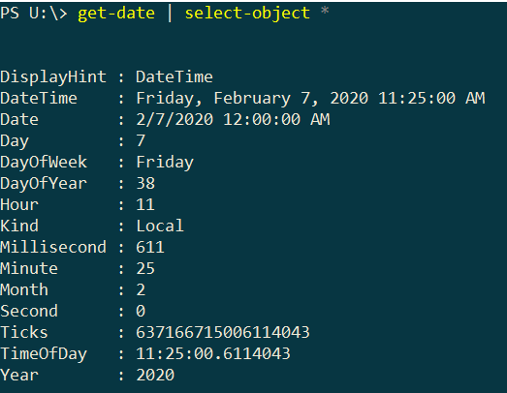
Using the pipeline
Example:
get-date | select-object *
In this example, the output of the get-date command (a DateTime object) becomes the input to the select-object command. The vertical bar is the PwerShell pipe symbol.

Slide 11
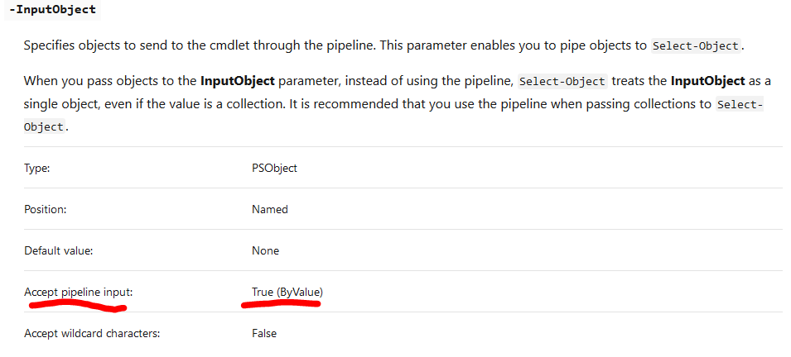
The Pipeline
In order to pipe input to a command, the command must have parameters that accept pipeline input
You can find out what these parameters are in the help system
In the help for a command, the parameters that accept pipeline input are identified
Pipeline input can be in one of two forms
by Value – the input must be a matching object type for the parameter
by Property Name – the object has a property name that is the same as the parameter name

Slide 12
Pipeline practice
Run the following commands in your U drive:
mkdir test
cd test
echo “Hello World” | new-item test.txt
echo “Hi there again” >> test.txt
mkdir, cd, and echo are aliases for PowerShell commands. Find the full PowerShell command names for these aliases using get-alias.

Slide 13
Parentheses
When parentheses are used in a PowerShell command, the operations inside the parentheses run first before the rest of the command
The following is an example of parentheses in a command:
get-date | select *
(get-date).DayOfWeek
The first command gets the current date and time and displays all of its properties. The second command runs the get-date and stores the result as a temporary variable. Then the DayOfWeek property is displayed from that variable.

Slide 14
Working with Output - Transcript
The first good command to know is:
Start-Transcript
This command logs all commands and output from the current session and saves this information in a text file
A randomly generated filename is created (usually in your Documents folder) and stores all the commands
This is good for logging and auditing of Windows instances
You can use this command to log all of your activity so that you don’t have to write it down yourself
To stop the transcript:
Stop-Transcript

Slide 15
Working with Output – Writing to txt file
Normally, output from commands displays in the PowerShell window
You can use the out-file command to redirect output to a specified text file
Try this yourself in your U drive:
Get-Command | out-file commands.txt
Get-Date | Out-File date.txt –append
Get-Content date.txt

Slide 16
Working with Output – Writing to CSV file
Output from commands can be stored in csv files and later imported into other commands
You can also use csv files to save information and review it with Excel
This is one of the easy ways to retain data objects between PowerShell sessions
To create a csv file:
cmd | export-csv file.csv
To import that data to another command:
import-csv file.csv | cmd

Slide 17
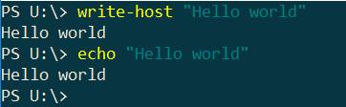
Writing Output to the Terminal Window
The Write-Host command can be used to display messages to the PowerShell window
Example:
write-host “Hello”
This command is normally not used in a PowerShell session, but it can be useful when you start writing scripts
The alias for write-host is echo

Slide 18
PowerShell Providers
A PowerShell provider, or PSProvider, is an adapter. It’s designed to take some kind of data storage and make it look like a disk drive.
PowerShell uses a set of providers to access resources on the computer
Alias – stores PowerShell aliases
Certificate – stores certificates for signed resources
Environment – stores system environment variables
File System – accesses the file system
Function – stores PowerShell functions
Registry – accesses the registry
Variable – stores PowerShell variables
WSMan – accesses Web Services for Management
Providers Documentation

Slide 19
PowerShell Provider Capabilities
Each provider has capabilities. Here are some of the common ones:
ShouldProcess—The provider supports the use of the -WhatIf and -Confirm parameters, enabling you to “test” certain actions before committing to them.
Filter—The provider supports the -Filter parameter on the cmdlets that manipulate providers’ content.
Credentials—The provider permits you to specify alternate credentials when connecting to data stores. There’s a -credential parameter for this.
Transactions—The provider supports the use of transactions, which allows you to use the provider to make several changes, and then either roll back or commit those changes as a single unit.
Providers Documentation

Slide 20
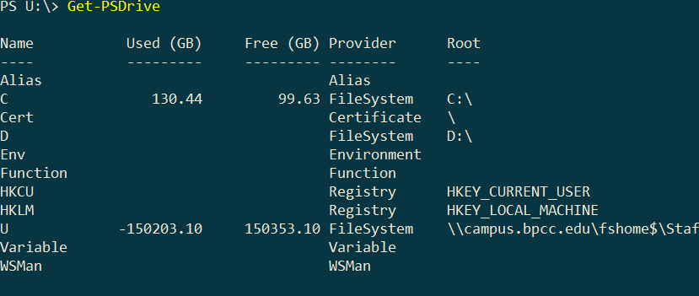
PowerShell Provider Capabilities
A provider is used to createa PSDrive
A PSDrive uses a single provider to connect to some piece of data storage.
To see all PSDrives:
Get-PSDrive

Slide 21
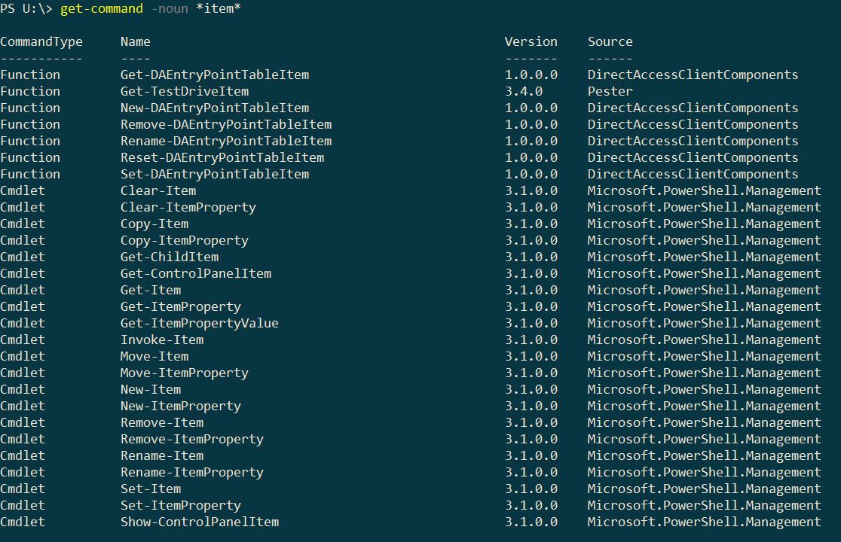
Commands to use Providers
The cmdlets you use with a PSDrive have the word Item somewhere in their noun:
Get-Command –noun *item*

Slide 22
get-psdrive
# Get information about U: drive
Get-PSDrive U
# Get all drives supported by file system provider
Get-PSDrive -PSProvider FileSystem

Slide 23
get-psdrive
# Get information about U: drive
Get-PSDrive U
# Get all drives supported by file system provider
Get-PSDrive -PSProvider FileSystem

Slide 24
Homework
Read Chapters 5 and 6 in the book
Complete More PowerShell Basics Exercise

