Slide 1
Working with the File System Provider
CTEC 104
Introduction to Scripting

Slide 2
Overview
File System Basics
Standard Commands
File Properties
File Permissions

Slide 3
File System Basics
The file system includes all of the system drives where files are stored
The FileSystem is organized around: drives, folders, and files.
Drives are the top-level object that contains files and folders
Folders are a kind of container, capable of containing both files and other folders
Files are an endpoint object that store raw data
The FileSystem provider lets you get, add, change, clear, and delete files and directories in PowerShell
See about_FileSystem_Provider

Slide 4
File System Basics
Files are referred to as items in the Windows file system
That’s why you’ll see that most commands dealing with the file system have the noun item in them
The ChildItem noun refers to items (files or folders) contained within an item (folder)
The ItemProperty noun refers to attributes of an item such as read-only, creation time, length, and so on.

Slide 5
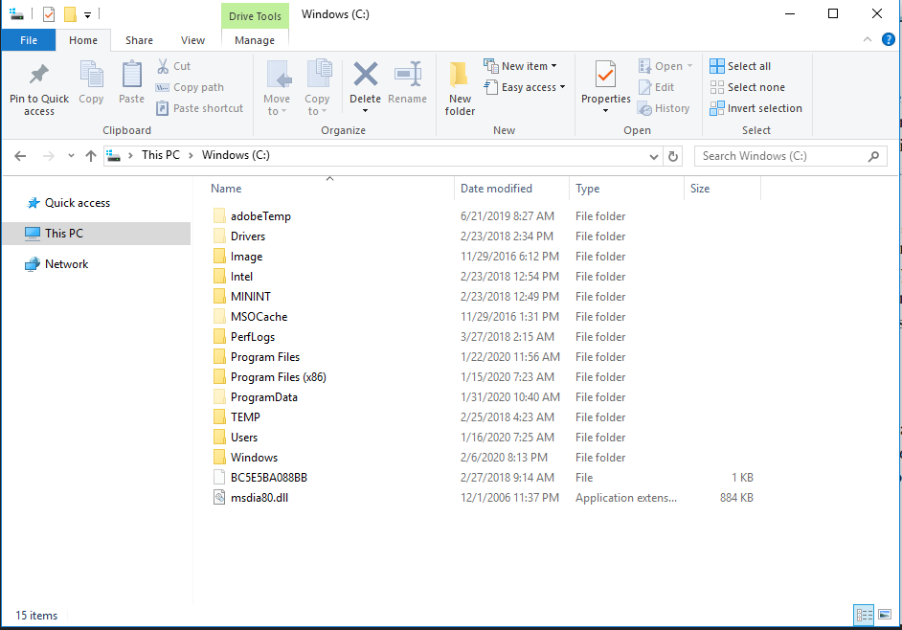
Accessing the File System
You are most likely used to accessing File Systems via the File Explorer in Windows 10

Slide 6
Directory Structure
The file system uses a hierarchical structure made up of directories
The top level directory is identified with a backslash
Example: The top level directory for the C drive is C:\
The directories created in C:\ are its child directories; also called subdirectories
The child directories contained in those directories are their subdirectories
Files are then stored in these directories
This creates an organization system for file storage

Slide 7
File System Diagram
The directory hierarchy looks like:
Each directory name is separated by a backslash.
Example from above:
C:\
DirA
DirB
DirC
SubDir1
SubDir2
C:\
C:\DirA
C:\DirA\SubDir1

Slide 8
Navigating FileSystem
These commands are used to navigate through a filesystem and add/modify/delete items
cd Change directory
copy Copy a file
del Delete a file or directory
dir Directory listing
mkdir Make a new directory
move Move a file
ren Rename a file
rmdir Remove a directory

Slide 9
Common Aliases
Alias | Full Command
dir / ls | Get-ChildItem
cd | Set-Location
pwd | Get-Location
gp | Get-ItemProperty
del | Remove-Item
cp | Copy-Item
ren | Rename-Item
cat | Get-Content
mv | Move-Item

Slide 10
cd
The cd command is used to change the directory where you are currently at
For instance, enter the following commands in PowerShell:
cd C:\
cd windows
cd system32
cd ..
cd ..
What is your current directory after this series of commands?

Slide 11
Changing Drives
When switching to a new drive, you can specify the drive letter without using cd
For instance:
cd E: will take you to the E drive
You can also just enter:
E:
In PowerShell, put in a Thumb Drive and switch to that drive letter. Then switch back to the C Drive.
What directory on the thumb drive are you taken to?
Where are you returned to on the C Drive?

Slide 12
copy
The copy command is used to copy files
Its format is “copy filename new-filename”
A simple example is:
copy file1.txt file2.txt
You can copy the file to a different directory:
cd \dir1
copy file1.txt c:\dir2

Slide 13
del
The del command deletes files
Its format is “del filename”
Example:
cd \dir1
del file1.txt

Slide 14
dir or ls
The dir command is used to perform a directory listing
This listing will contain all of the files and directories that are in your current working directory
Example:
cd \dir1
dir
You can use wildcard options to display certain content:
dir m*
This command will only display files that begin with the letter m.

Slide 15
mkdir and rmdir
The mkdir and rmdir commands are used to create and delete directories
To create a new directory:
cd c:\
mkdir dir3
To delete a directory:
rmdir dir2
Note: you can only delete a directory if it is empty.

Slide 16
move
The move command is used to move a file to a different location
Example:
cd \dir1
move file1.txt C:\dir2
You can also change the file’s name when you move it:
move file1.txt C:\dir2\file2.txt

Slide 17
ren
The ren command is used to rename a file or directory
Example:
cd \dir1
ren file1.txt file2.txt
Side Note: The ren command is rarely used because the move command accomplishes the same thing.

Slide 18
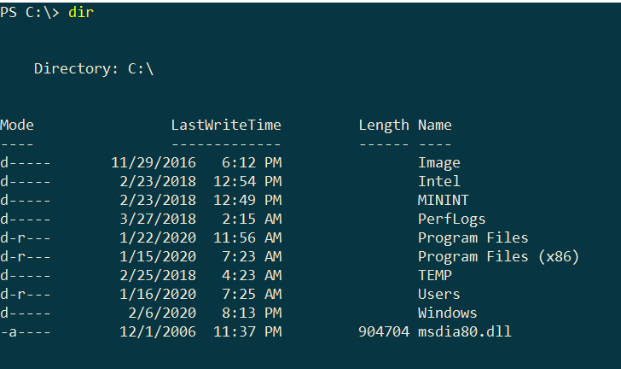
File Properties
When you perform a dir, the output lists all of the files and directories in the current directory
This output includes four properties: mode, last write time, length and name
Files and directories actually have many more properties that are not being displayed by the dir command

Slide 19
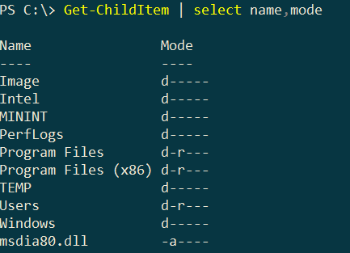
File Properties – mode property
The mode property has 6 possible values. An item can have 0 or more of the values:
d - Directory
a - Archive
r - Read-only
h - Hidden
s - System
l - Reparse point

Slide 20
Select all item properties
To see the full file properties for a file, there are two commands
First:
get-item filename | select *
This command works equally well for files or directories
Second:
dir | select *
This second command will display the properties for every file in the directory
In most cases, the get-item command will be the preferred command

Slide 21
Select specific item properties
The previous slide showed examples of displaying all file properties
The select command can also be used to select specific properties by listing the property names
Example:
dir | select name, length, attributes

Slide 22
Get specific file properties
The previous slide showed examples of displaying all file properties
The select command can also be used to select specific properties by listing the property names
Example:
dir | select name, length, attributes

Slide 23
File Permissions
An important set of information not contained in the file properties is the file permissions
The file permissions define the access rights that user’s have when accessing the files and directories
The get-acl command is used to get the permissions for a file or directory
Example:
get-acl filename
The get-acl command displays limited output by itself
Use the select command to see the full properties:
get-acl filename | select *

Slide 24
Important File Permissions Properties
Some of the most useful properties in the file permissions are:
Owner – current owner of the file
Group – group that the owner is a part of
AccessToString – the access rights displayed in human readable format
To select specific acl properties:
Get-Acl test.txt | select owner, group

Slide 25
Set-Acl
The Set-Acl cmdlet changes the security descriptor of a specified item, such as a file or a registry key, to match the values in a security descriptor that you supply.
The Set-Acl command uses an AclObject to set the acl value of an item
Set-Acl can be used with file system or registry providers
Set-Acl can be used to change the security settings of files, directories, and registry keys.

Slide 26
Common Aliases
Alias | Full Command
dir / ls | Get-ChildItem
cd | Set-Location
pwd | Get-Location
gp | Get-ItemProperty
del | Remove-Item
cp | Copy-Item
ren | Rename-Item
cat | Get-Content
sc | Set-Content
ac | Add-Content
mv | Move-Item

Slide 27
FileSystem Exercise – Part Two
Using the PowerShell commands or their aliases:
Set your location to the U-Drive (C- Drive if you’re not on a BPCC computer)
List all files and directories in your current directory
Create a directory called CTEC104 if you have not already
Set your location to this directory
Make two directories: test1 and test2
In the test1 directory create a file called test1.txt that contains the text “test1”

Slide 28
FileSystem Exercise – Part Two
7) In the test1 directory create a file called test2.txt that contains the text “test2”
8) Copy the test2.txt file to your test1 directory
9) Copy your test1.txt file to your test2 directory
10) List the contents of both directories
11) Move the test2\test1.txt file to your test1 directory
12) Move the test2\test1.txt file to your test1 directory
13) List the contents of both directories

Slide 29
FileSystem Exercise – Part Two
14) Get the content of both text files
15) Add the following content to both files:
“Hello World”
16) View the content of both files
17) Set the content of both text files to be:
“This is the new content”
18) Get the permissions (acl) of both files
19) Rename both files to renamedFile.txt
20) Delete all files and directories created in this exercise

