Slide 1
PowerShell Functions and Modules
CIT 104

Slide 2
Overview
Introduction
Functions
Pipeline Support
Modules

Slide 3
Introduction
Functions are created and work the same way as scripts
The one significant difference is that functions should be created so that they can be used in command pipelines
To do this, a function must be able to receive input from the pipeline and send output to the pipeline
You also want the function to be able to accept additional command line parameters

Slide 4
Introduction
Functions can have any name that you want to give them, but it is advised that you follow the PowerShell standard of verb-noun
The list of standard verbs can be viewed with:
get-verb
The noun should reflect what the function is used for
For related functions, you should use some standard noun motif

Slide 5
Functions
In these slides, I will be demonstrating how to create functions that are fully pipeline enabled
To start, the format for defining a function is as follows:
function FunctionName {
cmd
cmd
cmd
}

Slide 6
Functions
To be used in the pipeline, functions need to support four capabilities:
Named parameters
Positional parameters
Receiving input from the pipeline
Writing output to the pipeline

Slide 7
Functions
The most basic type of function parameter is a named parameter
With a named parameter, the name of the parameter must be given on the command line in front of the parameter value
The following is an example:
cmd –Parm value
Parameter
Name
Parameter
Value

Slide 8
Functions
The format for creating named parameters is:
function FunctionName {
param(
$Parm1,
$Parm2
)
cmds
}
In this example, two parameters are created named Parm1 and Parm2
To use these at the command line:
FunctionName –Parm1 val –Parm2 val2
Notice the comma after the parameter name.

Slide 9
Functions
You can give named parameters a default value:
param(
$Parm1 = 100,
$Parm2
)
In this example, Parm1 will be given a value of 100 if no parameter is given on the command line

Slide 10
Functions
To make a parameter mandatory:
param(
[parameter(Mandatory=$true)]
$Parm1,
$Parm2
)
In this example, Parm1 is a mandatory parameter and Parm2 is optional
Parameters are always optional by default

Slide 11
Functions
You can define a data type for parameters to perform error checking
For example:
param(
[int] $Parm1,
[string] $Parm2
)
In this example, Parm1 is an integer, and Parm2 is a string

Slide 12
Functions
Positional parameters do not have to have the parameter name in front of the parameter value
The following is an example:
cmd value
Positional Parameter 0

Slide 13
Functions
To make a positional parameter :
param(
[parameter(Position=0)]
$Parm1,
$Parm2
)
In this example, Parm1 is a positional parameter at position 0
Parm2 remains a named parameter

Slide 14
Functions
Computers start counting at 0, so the first positional parameter is 0
The second positional parameter is 1
The third positional parameter is 2
You will rarely ever see more than three positional parameters

Slide 15
Functions
One closing comment on named and positional parameters
If you do not define positional parameters, PowerShell will treat the parameters as positional by the order they appear in the param block
You can give parameters to the function without the parameter names, and PowerShell will match them to the param block in the order that they appear
Needless to say, this can cause errors
It is much better to explicitly define positional parameters

Slide 16
Pipeline Support
The goal of creating functions is to have functions that can be used just like Cmdlets on the command line
This includes full pipeline support for input and output

Slide 17
Pipeline Support
The first step is to define the function to act like a Cmdlet
To do this use:
function FunctionName {
[CmdletBinding()]
param(
...
The CmdletBinding feature tells PowerShell to use this function in the same manner as a Cmdlet

Slide 18
Pipeline Support
In PowerShell, the data passed in the pipeline will be an object or array of objects
Most frequently, it will be an array of objects
You specify a parameter to receive pipeline input in the following manner
param(
[parameter(Mandatory=$true,
ValueFromPipeline=$true)]
$Parm
In this example, Parm will be assigned the objects from the pipeline

Slide 19
Pipeline Support
When using pipeline input, you need to define a process block in your function
Example:
function FunctionName {
param(
[parameter(Mandatory=$true,
ValueFromPipeline=$true)]
$Parm
)
process {
cmds
}
}
The process block works the same as a regular function block

Slide 20
Pipeline Support
To send output to the pipeline, you use the write-output command
Normally, the output will be a variable containing an array of objects
Example:
$var = Array of objects
write-output $var
The write-output command will normally be placed at the end of your function’s process block

Slide 21
Modules
Once you have created a function, you need to place it in a module in order to use it in PowerShell
Modules contain sets of related functions
These can be easily imported into your PowerShell sessions

Slide 22
Modules
There are many modules available that are provided for accessing various resources
Some of these include:
Active Directory
SharePoint
Microsoft Exchange
Microsoft Office
To see the modules currently available on your system:
get-module –listavailable
If you need a module that is not currently on your system, you can download it from the Internet

Slide 23
Modules
To import a module into your PowerShell session:
import-module ModuleName
Normally, modules auto-import when you use a function in that module, so you rarely need to use this command
One key exception is if you need to edit one of your modules, you will have to remove it and re-import it to access the changes

Slide 24
Modules
Your personal modules are placed in your documents folder in the following location:
$HOME\documents\WindowsPowerShell
This folder will have a Modules folder
Each module will have a folder with the Module name
Inside that folder the module will be named:
ModuleName.psm1

Slide 25
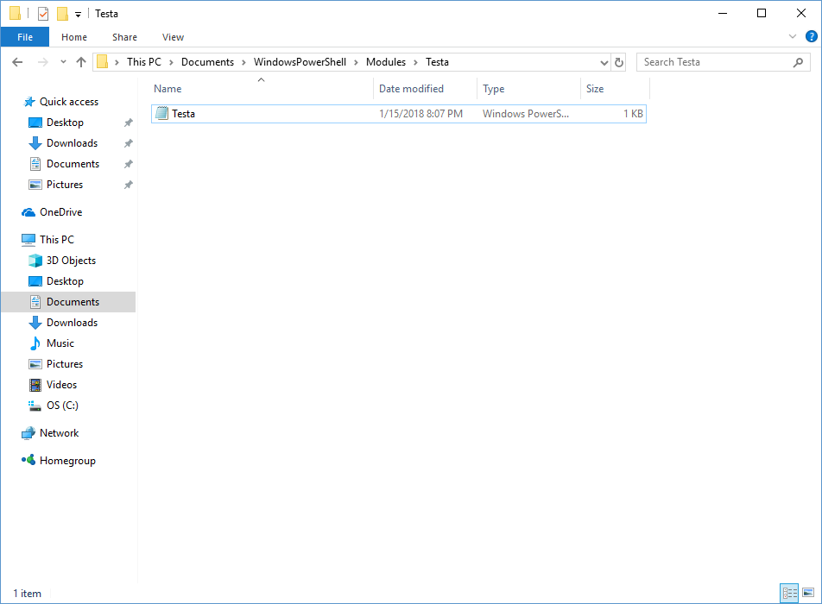
Modules
The following is an example module:

