Slide 1
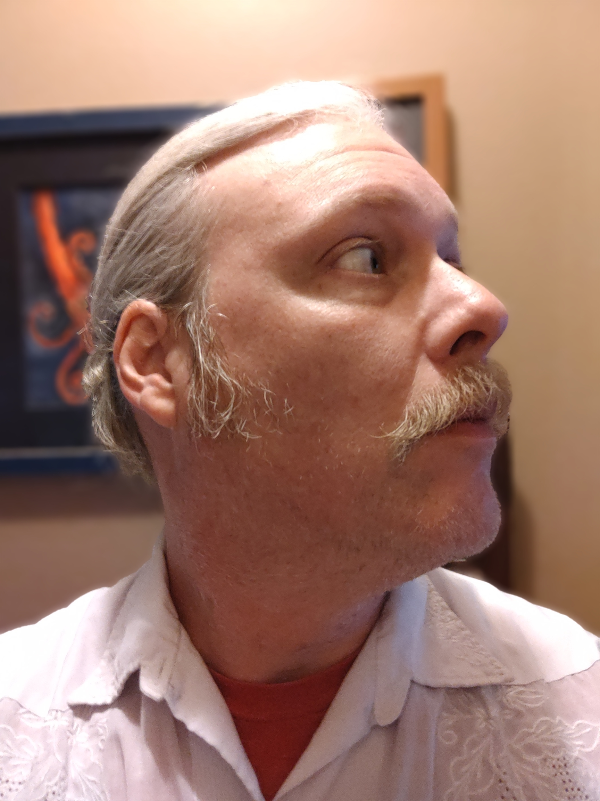
Jeffrey Walley
Cyber Security and Networking Student

Slide 2
Contents
Resume
Cover Letter
Academic Plan
Statement of Professional Goals
Personal Mission Statement
Letters of Recommendation
References
Leadership Experience
Community Involvement

Slide 3
Resume

Slide 4
Cover Letter

Slide 5
Academic Plan
Spring 2022
CTEC-101
CTEC-102
CTEC-104
CTEC-107
Fall 2022
CTEC-112
CTEC-114
CTEC-155
MATH-102
Spring 2023
CTEC-172
CTEC-210
CTEC-279
CTEC-280
Fall 2023
CTEC-170
CTEC-287
CTEC-Elective
CTEC-299

Slide 6
Statement of Professional Goals

Slide 7
Personal Mission Statement

Slide 8
Letters of Recommendation

Slide 12
References

Slide 13
Leadership Experience

Slide 14
Community Involvement

