Slide 1
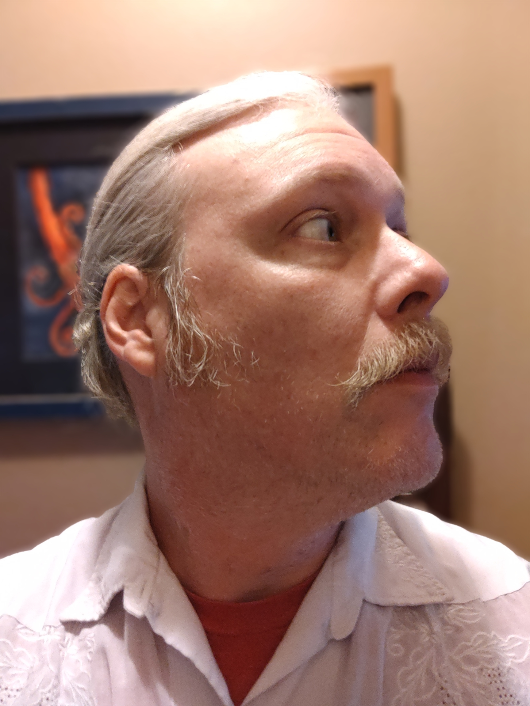
Jeffrey Walley
Cyber Security and Networking Student

Slide 2
Contents
Resume
Cover Letter
Academic Plan
Statement of Professional Goals
Personal Mission Statement
Letters of Recommendation
References
Leadership Experience
Community Involvement

Slide 3
Resume

Slide 4
Cover Letter

Slide 5
Academic Plan
Spring 2022
CTEC-101
CTEC-102
CTEC-104
CTEC-107
Fall 2022
CTEC-112
CTEC-114
CTEC-155
MATH-102
Spring 2023
CTEC-172
CTEC-210
CTEC-279
CTEC-280
Fall 2023
CTEC-170
CTEC-287
CTEC-Elective
CTEC-299

Slide 6
Statement of Professional Goals
Increase My Core Skills in Computer Networking
1
Secure a job and Advance my position
2
Obtain Certifications for my desired field
3
Become an Expert in Cyber Security
4
Continue to Increase my Emotional Intelligence
5

Slide 7
Personal Mission Statement

Slide 8
Letters of Recommendation

Slide 12
References
Jeffrey S. Walley (225) 931-4152 Jeffreywalley@student.bpcc.edu
Reference #1 Rachael Martin Office Director Acupuncture Shreveport 745 Olive St, Shreveport, LA 71104 (318) 221-0781
Rachael worked with me as a manager at Grimaldi’s Pizzeria in St. Vincent Mall in Shreveport. We helped train employees for the restaurant.
Reference #2 Matthew Dinkins Senior Information Technologies Supervisor Snapfish 100 Montgomery St, Suite 1430 San Francisco, CA 94104 (800)558-8224
Matthew was my supervisor when we were both working Tech Support at Softdisk Internet Service Provider and Software publishing company.
Reference #3 Ian Crooks Plumbing and Irrigation Specialist Conserva Irrigation 3050 Knolin Dr, Unit 3, Bossier City, LA 71112 (318) 741-4124
I worked as Ian’s supervisor at Grimaldi’s Pizza. Ian was later my supervisor at Conserva.

Slide 13
Leadership Experience
When Grimaldi’s closed all Louisiana stores, I was able to find a job as a worker at HobbyTown. I quickly learned to work on small electric and combustion engines that I had never experienced. I quickly became a manager at the Shreveport store, allowing the owners to continue running the store for an additional 6 months from their home in Monroe.
While working at Grimaldi’s Pizzeria in Shreveport we were pleased with our amazing restaurant opening. The corporate office expected business of $5,000 per night for the opening weekend, but our team hit nearly 3 times that. We finished with $40,000 our opening and beat the Baton Rouge location in weekend sales.
After closing my own business, I was looking for a job. I got an opportunity to start as a morning line prep member at Schlittz and Giggles, a restaurant and bar in Baton Rouge. Through hard work I advanced to Manager of the restaurant, both front and back of the house. While working with Last In Concepts I was lucky to meet and be mentored by 3 amazing business minds: a friend and direct Supervisor Charles Kelly, CEO of Last In Concepts Brandon Landry, and Founder of Raising Cane’s Todd Graves. We worked hard to increase efficiency, decrease waste and labor hours, all while increasing quality of product and driving sales increases of over 11% per year in our first year.
I was lucky to find a position at a business that was opening in Baton Rouge when I first moved there in 2004. I worked very closely with the business owners for many years before they decided to close the shop for good. I made up my mind to take up their mantle and open the shop in a new location, across the street, and opened up Walley’s Pop Comics LLC. I ran the business by myself for 3 years. I researched and created my own LLC, started my own retail location, and was chosen as a Top 10 Comic Book Store Clerk in America by the Los Angeles times in 2010.

Slide 14
Community Involvement
Supporter of Local Artists
Champion of Regional Musicians
Fraternity of Neighborhoods
Food Bank Volunteer
Handyman for the Elderly and Needy

