Slide 1
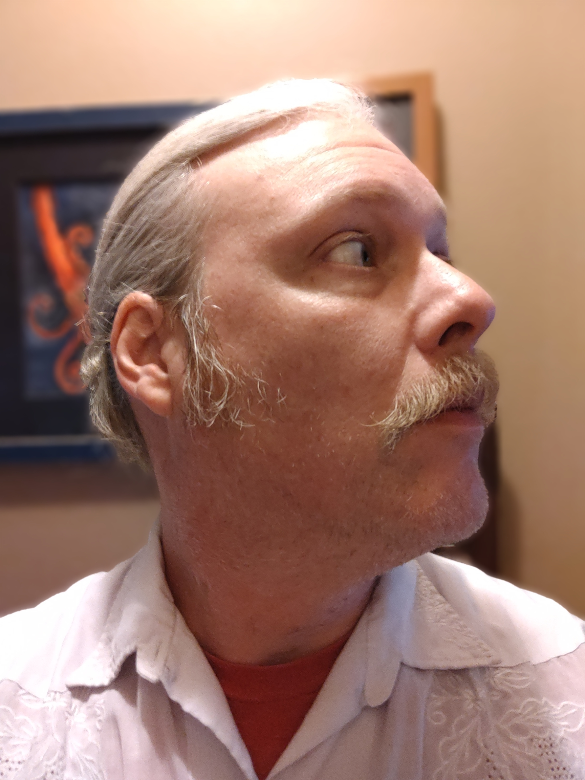
Jeffrey Walley
Cyber Security and Networking Student

Slide 2
Contents
Resume
Cover Letter
Academic Plan
Statement of Professional Goals
Personal Mission Statement
Letters of Recommendation
References
Leadership Experience
Community Involvement

Slide 3
Resume

Slide 4

Cover Letter

Slide 5
Academic Plan
Fall 2022 – Fall 2023

Slide 6
Statement of Professional Goals

Slide 7
Personal Mission Statement

Slide 8
Letters of Recommendation

Slide 12
References

Slide 13
Leadership Experience

Slide 14
Community Involvement

