Slide 1
Building a Personal Computer
Presented By: Jeffrey S. Walley
CTEC-112 IT Hardware Support
Fall 2022

Slide 2
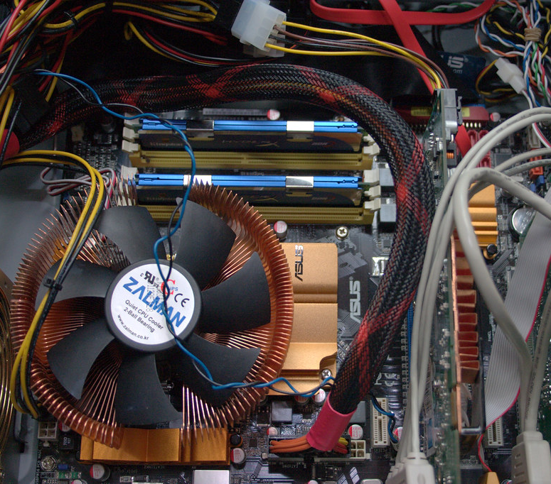
Use Cases for the PC
School work
Office and Productivity
Digital Art
Gaming
Virtualization
Docker
Web browsing & Entertainment

Slide 3

Build Budget
I am looking to spend $1200 on this PC Build.

Slide 4
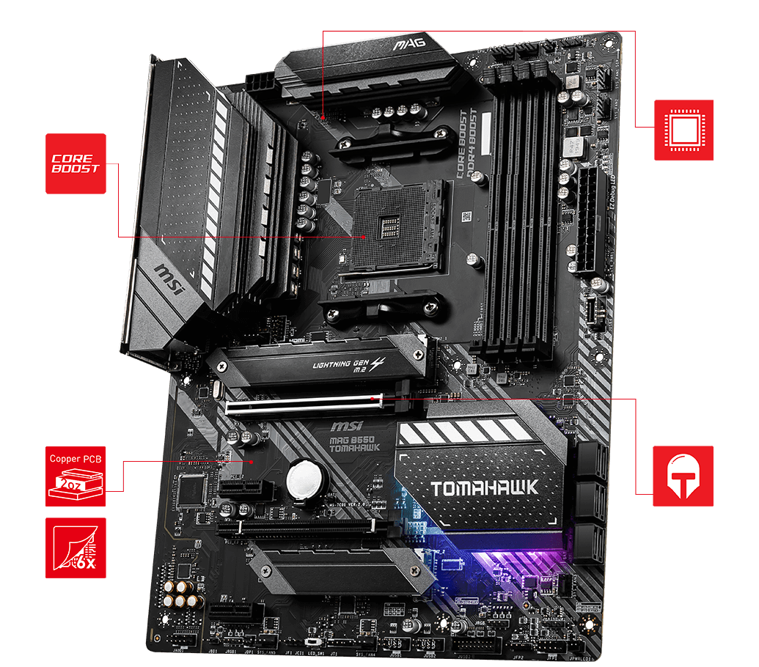
MOTHERBOARD: MSI MAG B550 Tomahawk
AMD AM4 Socket
Full sized ATX
6GB/s SATA
USB 3.2
1G & 2.5G LAN RJ-45
Dual M.2 22.80 & 22x110
DD4 with Memory Boost

Slide 5
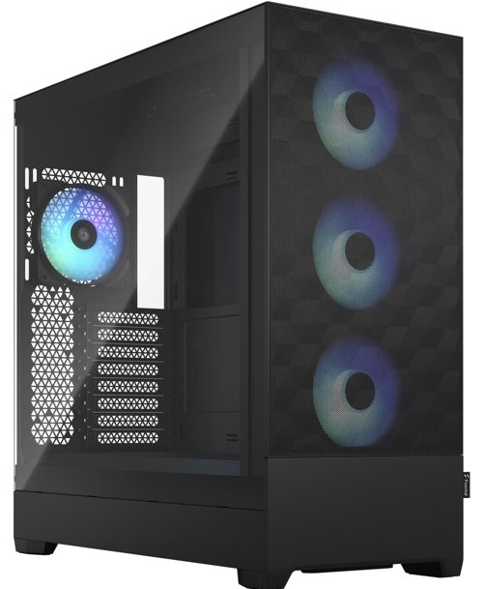
Desktop PC Case
Fractal Design
Pop xl atx
High-AirFlow
Full ATX Desktop
2x 5.25” bays
3x Storage trays
3.5” & 2.5” / tray
Front I/O:
2x USB 3.0
Headphone / Mic
Power / Reset
Increased Airflow

Slide 6
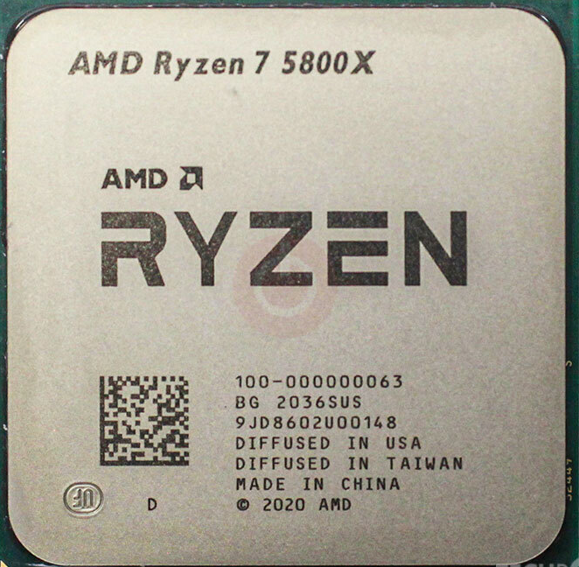
Central Processor Unit
AMD Ryzen 7 5800x
8 Core / 16 Thread
3.8 GHz / up to 4.7 GHz
7nm Vermeer Zen 3
32MB L3 / 4MB L2 Cache
TDP 105W

Slide 7
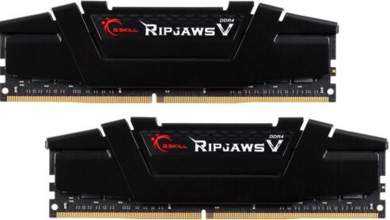
PC Memory (RAM)
G-Skill Ripjaw v
32GB (2x 16GB)
DDR4 SDRAM 3200
PC4-25600
Timing: 16-18-18-38

Slide 8
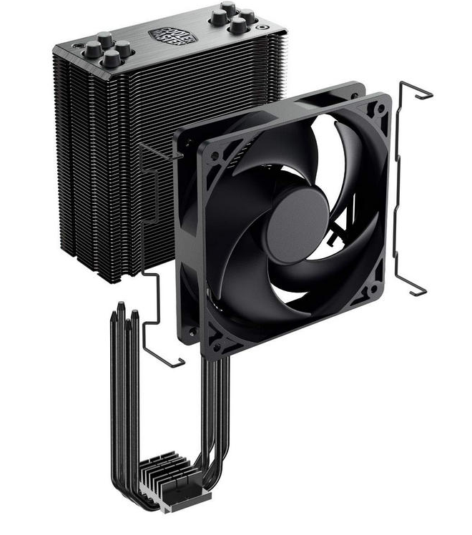
CPU Cooling Unit
4 Heat Pipes Direct Contact
Nickle Black Fins
Brushed Aluminum Surface
42 CFM Airflow
Noise Level: 26.0 dBA

Slide 9
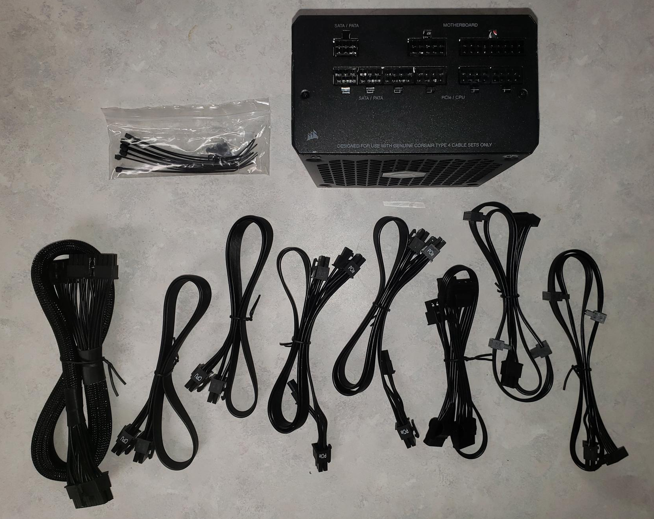
Power Supply (PSU)
Corsair RM850
850 Watt
Low Noise
Modular Connectors
Gold Efficiency Rating

Slide 10
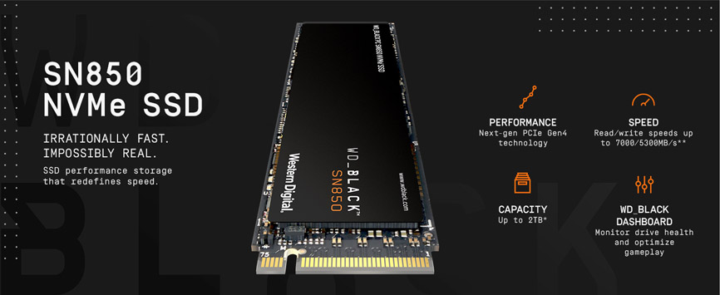
Storage Device 01- C:\
OS – SSD
Western Digital Black SN850
500GB
7000 MB/s read
5300 MB/s write
NVME / M.2 2280
PCIe 4.0

Slide 11
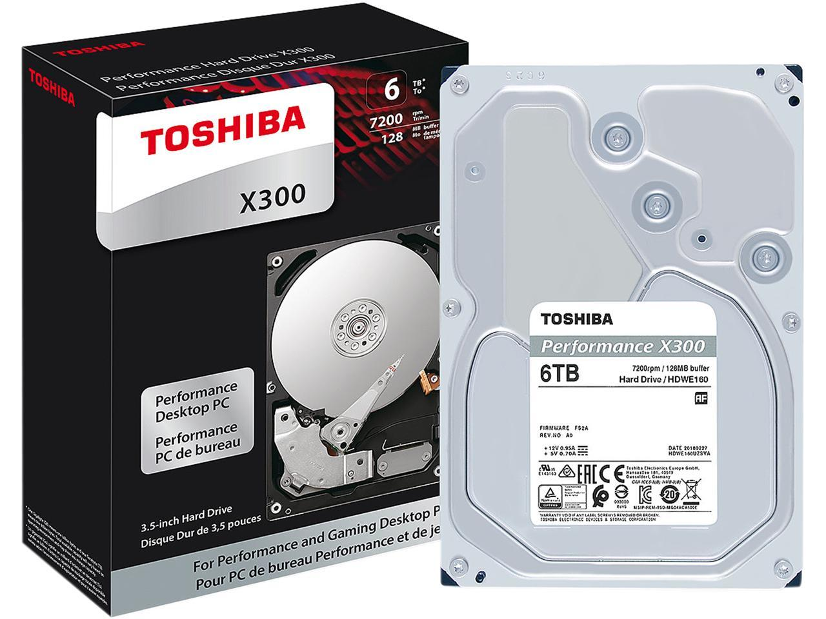
Storage Device 02- S:\
Toshiba x300
6TB
7200 RPM
256 MB Cache
6Gb/s SATA 3
Application Data
Virtual Machines
Images
Movies & Music
Games

Slide 12
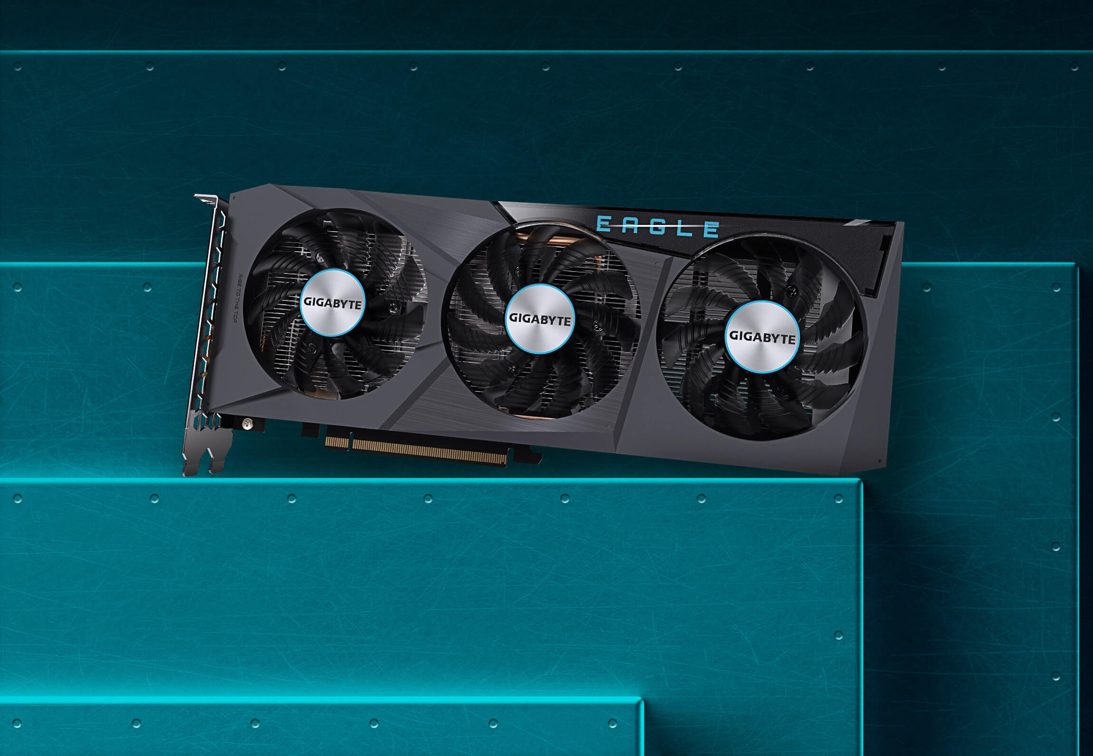
Video Card (GPU) GIGABYTE Radeon RX 6600
AMD Radeon 6600
8GB 128-bit GDDR6
PCIe 4.0
1792 Stream Processors
28 Ray Accelerators
2491MHz Boost

Slide 13
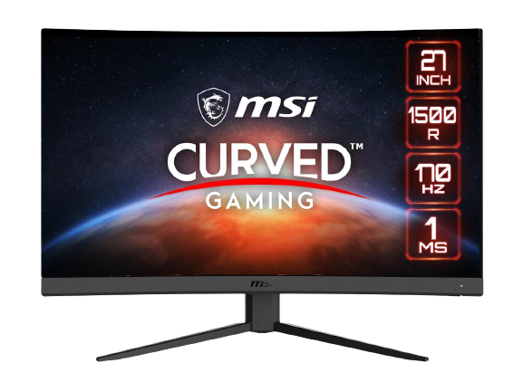
Monitor
MSI Optix G27c4 27”
Curved Monitor
27” Curved Display
1920 x 1080
170 Hz Refresh Rate
1ms Response Time
AMD Freesync
Wide Color Gamut
Frameless Design
Purchasing 2 for dual Monitor setup

Slide 14






Operating System & Additional Apps
Ubuntu OS
LibreOffice
Krita (for Digital Art)
GIMP (for Digital Photography)
VMWare Workstation Pro (Virtualization)
Docker (Container Deployment)
+ Steam, Epic and GoG for Gaming
This Photo by Unknown Author is licensed under CC BY-SA-NC

Slide 15
Final Budget
Motherboard:
MSI B550 Tomahawk $169.99
PC Case:
Fractal Pop XL Black $109.99
Processor:
AMD Ryzen 7 5800x 8-core $248.00
RAM:
G.SKILL Ripjaw V Series 32 GB $89.78
Cooling:
Cooler Master Hyper 212 Black $54.99
Power Supply:
Corsair RM850 850 Watt $114.99
SSD:
Western Digital Black SN850 500 GB $69.99
HDD:
Toshiba X300 6 TB $144.99
Video Card
GIGABYTE Radeon RX 6600 $219.99
Monitor
2x MSI Optix 27” Curved $399.98
OS & Additional Software: FREE
Subtotal from NewEgg $1622.69

Slide 16
Conclusion:
In this project I attempt to build a computer for Productivity, Virtualization, Entertainment, and Gaming for $1200. I chose a MSI B550 Tomahawk Motherboard with an 8-core AMD Ryzen 7 5800x CPU as the brains of the computer. I am personally a ‘Team Red’ member and normally purchase AMD chipsets. I chose the MSI B550 because I currently have an MSI B450 in a computer and have never had any issue with performance, so I like the MSI brand. The computer will feature a Cooler Master Hyper 212 CPU cooler and a Fractal Design Pop XL Air Full ATX case, for excellent air flow and easy future upgrading. It will feature 32 GB of G.Skill DDR4 3200 RAM, which should be plenty for multi-tasking even my most demanding applications. The OS will be installed on a super fast 500 GB SSD drive, and I will have a 6 TB HDD for applications, data storage, and games. The video card will be a Radeon RX 6600 with 8Gb of GDDR6 memory which should play AAA games at high quality for a few more years.
If I had stopped with the initial build, I would have successfully built the Desktop for a subtotal of slightly more than $1200. I added 2 monitors for a dual monitor setup and ended up spending another $400. The subtotal with the monitors is $1622.69 on the Newegg.com website. I will end up adding a mechanical keyboard and triple monitor mount to bring the subtotal up to $1900 or more eventually.
I currently have 2 monitors and multiple keyboards and mice, so I can successfully build the desktop for a price within my budget (excluding Tax and Shipping). If I am to build this system, I will wait until Black Friday or Cyber Monday when many of these parts will be discounted.

