Slide 1
Building a Personal Computer
Presented By: Jeffrey S. Walley
CTEC-112 IT Hardware Support
Fall 2022

Slide 2
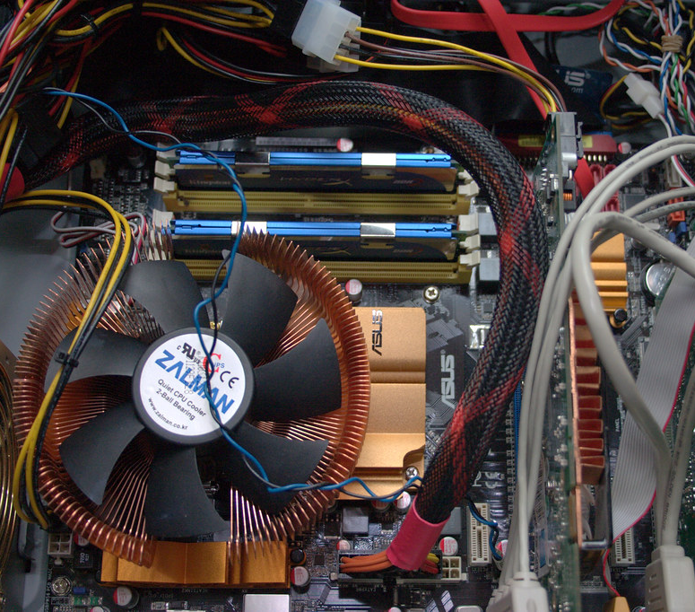
Use Cases for the PC
Office
Digital Art
Gaming
Virtualization
AMD
MSI
Liquid Cooled

Slide 3

PC Budget
With this PC Build I am looking to spend around $1200.

Slide 4
MOTHERBOARD
Which CPU Socket
Which Board Type
What Features built in
Class | Group 1 | Group 2
Class 1 | 82 | 95
Class 2 | 76 | 88
Class 3 | 84 | 90

Slide 5
Two Content Layout with SmartArt
First bullet point here
Second bullet point here
Third bullet point here
Task 1
Task 2
Task 3

Slide 6
Add a Slide Title - 2

Slide 7
Add a Slide Title - 1

Slide 8
Add a Slide Title - 3

Slide 10
Add a Slide Title - 4

Slide 11
Title and Content Layout with Chart

