Slide 1
Building a Personal Computer
Presented By: Jeffrey S. Walley
CTEC-112 IT Hardware Support
Fall 2022

Slide 2
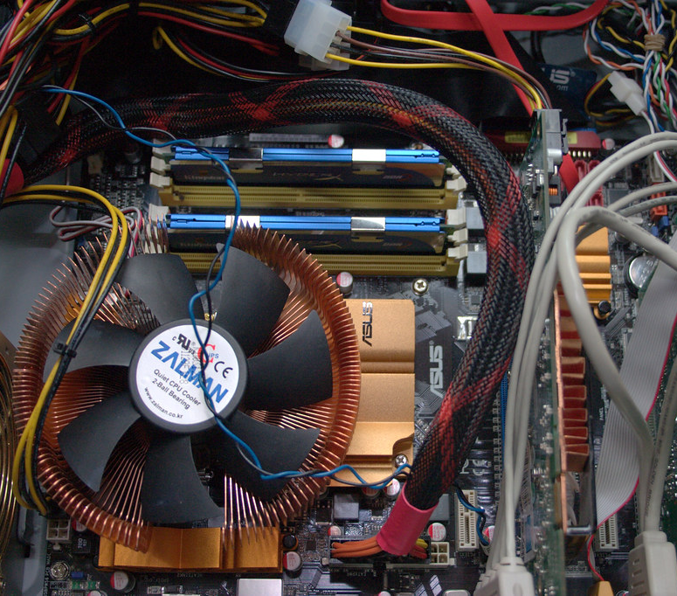
Use Cases for the PC
School work
Office and Productivity
Digital Art
Gaming
Virtualization
Docker
Web browsing & Entertainment

Slide 3

Build Budget
I am looking to spend $1200 on this PC Build.

Slide 4
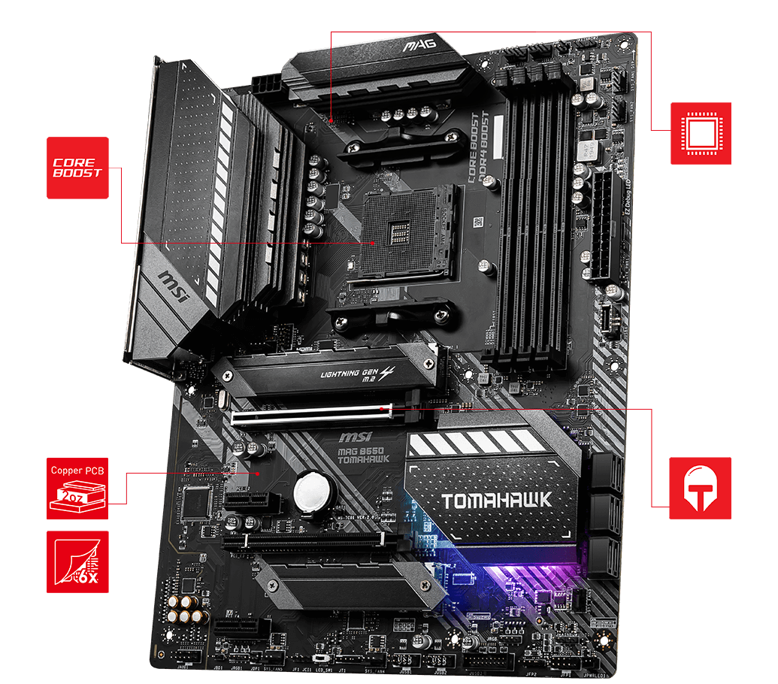
MOTHERBOARD: MSI MAG B550 Tomahawk
AMD AM4 Socket
Full sized ATX
6GB/s SATA
USB 3.2
1G & 2.5G LAN RJ-45
Dual M.2 22.80 & 22x110
DD4 with Memory Boost

Slide 5
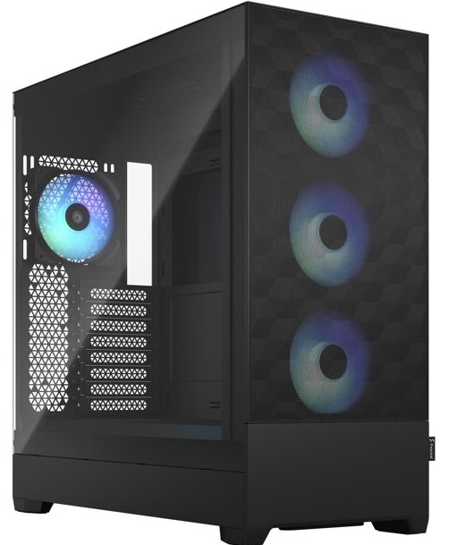
Desktop PC Case
Fractal Design
Pop xl atx
High-AirFlow
Full ATX Desktop
2x 5.25” bays
3x Storage trays
3.5” & 2.5” / tray
Front I/O:
2x USB 3.0
Headphone / Mic
Power / Reset
Increased Airflow

Slide 6
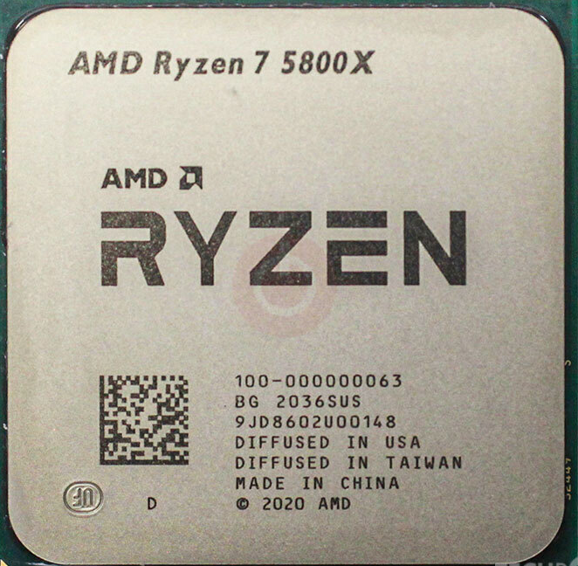
Central Processor Unit
AMD Ryzen 7 5800x
8 Core / 16 Thread
3.8 GHz / up to 4.7 GHz
7nm Vermeer Zen 3
32MB L3 / 4MB L2 Cache
TDP 105W

Slide 7
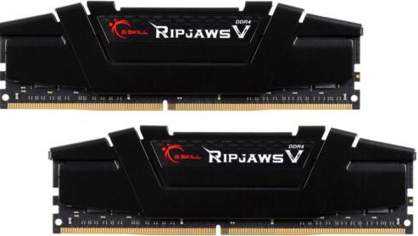
PC Memory (RAM)
G-Skill Ripjaw v
32GB (2x 16GB)
DDR4 SDRAM 3200
PC4-25600
Timing: 16-18-18-38

Slide 8
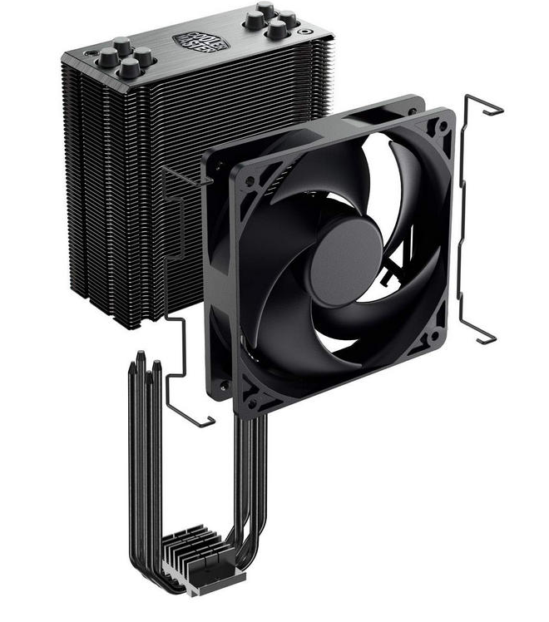
Cooling Unit
4 Heat Pipes Direct Contact
Nickle Black Fins
Brushed Aluminum Surface
42 CFM Airflow
Noise Level: 26.0 dBA

Slide 9
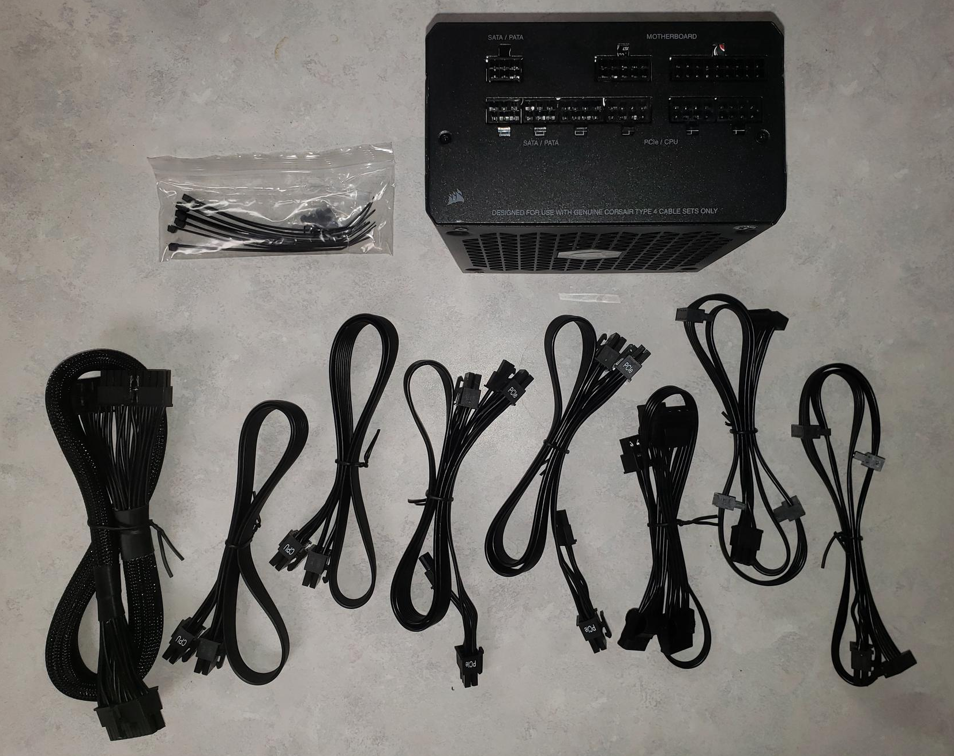
Power Supply (PSU)
Corsair RM850
850 Watt
Low Noise
Modular Connectors
Gold Efficiency Rating

Slide 10
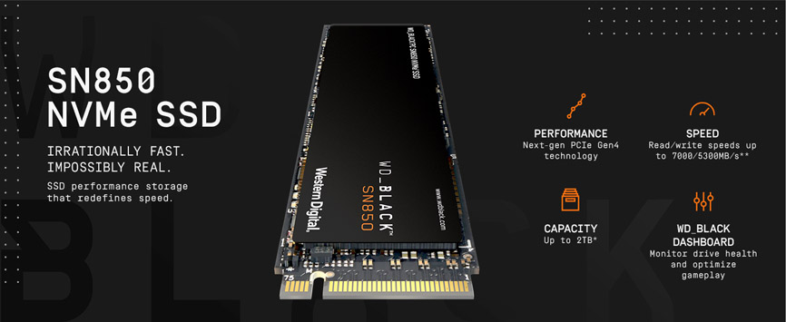
Storage Device 01- C:
OS – SSD
Western Digital Black SN850
500GB
7000 MB/s read
5300 MB/s write
NVME / M.2 2280
PCIe 4.0

Slide 11
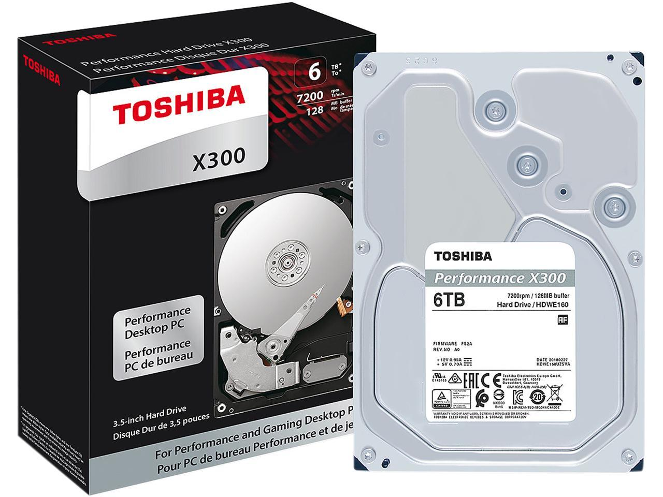
Storage Device 02- S:
Toshiba x300
6TB
7200 RPM
256 MB Cache
6Gb/s SATA 3
Application Data
Virtual Machines
Images
Movies & Music
Games

Slide 12
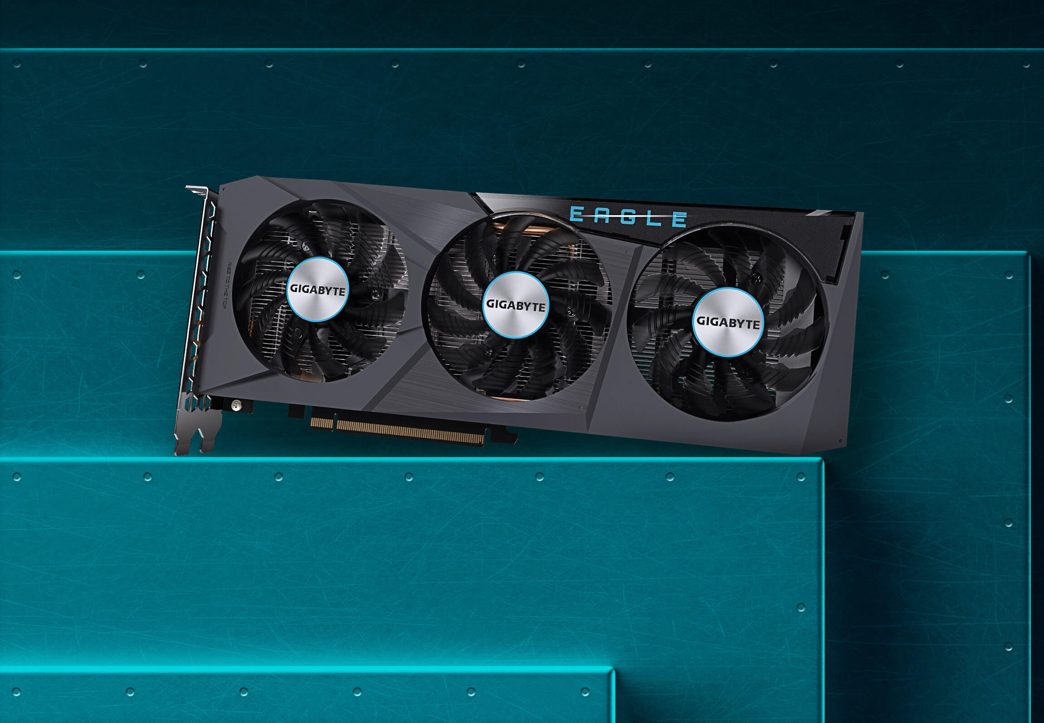
Video Card (GPU) GIGABYTE Radeon RX 6600
AMD Radeon 6600
8GB 128-bit GDDR6
PCIe 4.0
1792 Stream Processors
28 Ray Accelerators
2491MHz Boost

Slide 13
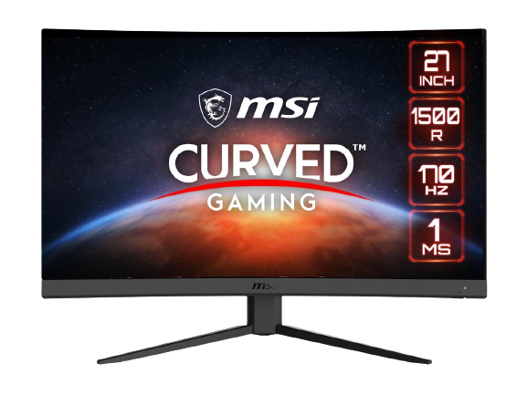
Monitor
MSI Optix G27c4 27”
Curved Monitor
27” Curved Display
1920 x 1080
170 Hz Refresh Rate
1ms Response Time
AMD Freesync
Wide Color Gamut
Frameless Design
Purchasing 2 for dual Monitor setup

Slide 14






Operating System & Additional Apps
Ubuntu OS
LibreOffice
Krita (for Digital Art)
GIMP (for Digital Photography)
VMWare Workstation Pro (Virtualization)
Docker (Container Deployment)
+ Steam, Epic and GoG for Gaming
This Photo by Unknown Author is licensed under CC BY-SA-NC

Slide 15
Final Budget
Motherboard:
MSI B550 Tomahawk $169.99
PC Case:
Fractal Pop XL Black $109.99
Processor:
AMD Ryzen 7 5800x 8-core $248.00
RAM:
G.SKILL Ripjaw V Series 32 GB $89.78
Cooling:
Cooler Master Hyper 212 Black $54.99
Power Supply:
Corsair RM850 850 Watt $114.99
SSD:
Western Digital Black SN850 500 GB $69.99
HDD:
Toshiba X300 6 TB $144.99
Video Card
GIGABYTE Radeon RX 6600 $219.99
Monitor
2x MSI Optix 27” Curved $399.98
OS & Additional Software: FREE
Subtotal from NewEgg $1622.69

Slide 16
Conclusion:
In this project I attempt to build a computer for Productivity, Virtualization, Entertainment, and Gaming for $1200. I chose a MSI B550 Tomahawk Motherboard with an 8-core AMD Ryzen 7 5800x CPU as the brains of the computer. The computer will feature a Cooler Master Hyper 212 CPU cooler and a Fractal Design Pop XL Air Full ATX case, for easy future upgrading. It will feature 32 GB of G.Skill DDR4 3200 RAM, along with a 500 GB SSD drive for the OS, and 6 TB of HDD for applications, data storage, and games. The video card will be a Radeon RX 6600 with 8Gb of GDDR6 memory.
If I had stopped with the initial build, I would have successfully built the Desktop for a subtotal of slightly more than $1200, pre-Black Friday / Cyber-Monday deals. I added 2 monitors for a dual monitor setup and ended up spending another $400. The subtotal with the monitors is $1622.69 on the Newegg.com website. I will end up adding a mechanical keyboard and triple monitor mount to bring the subtotal up to $1900 or more eventually.
I currently have 2 monitors and multiple keyboards and mice, so I can successfully build the desktop for a price within my budget (excluding Tax and Shipping). If I am to build this system, I will wait until Black Friday or Cyber Monday when many of these parts will be discounted.

