Slide 1
Building a Personal Computer
Presented By: Jeffrey S. Walley
CTEC-112 IT Hardware Support
Fall 2022

Slide 2
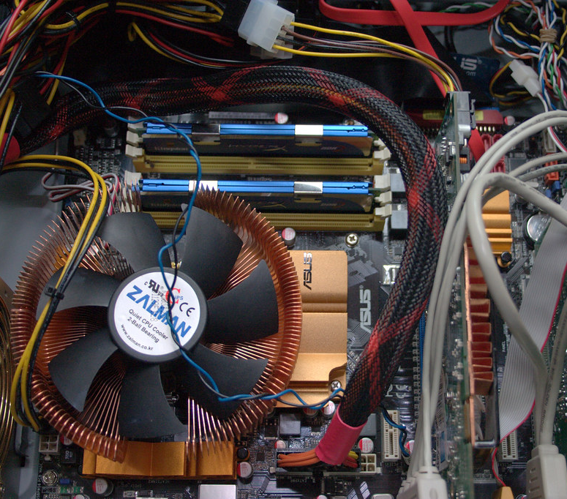
Use Cases for the PC
School work
Office and Productivity
Digital Art
Gaming
Virtualization
Docker
Web browsing & Entertainment
Notes:
I want to build a multi-core computer to use for school, office tasks, virtualization, digital art, personal entertainment, and gaming. I will create a machine that is faster than my current computer, which is an AMD Ryzen 5 2600 with 6 cores operating at 3.4GHz with 16GB of Ram. I do have a spare monitor and some keyboards and mice already, so I can save some money by building only the PC tower.

Slide 3

Build Budget
I am looking to spend $1200 on this PC Build.
Notes:
I do not want to spend more than $1200 on the system. I am not interested in RGB lights in my system, so I can save some money by purchasing parts based on performance value, not looks.

Slide 4
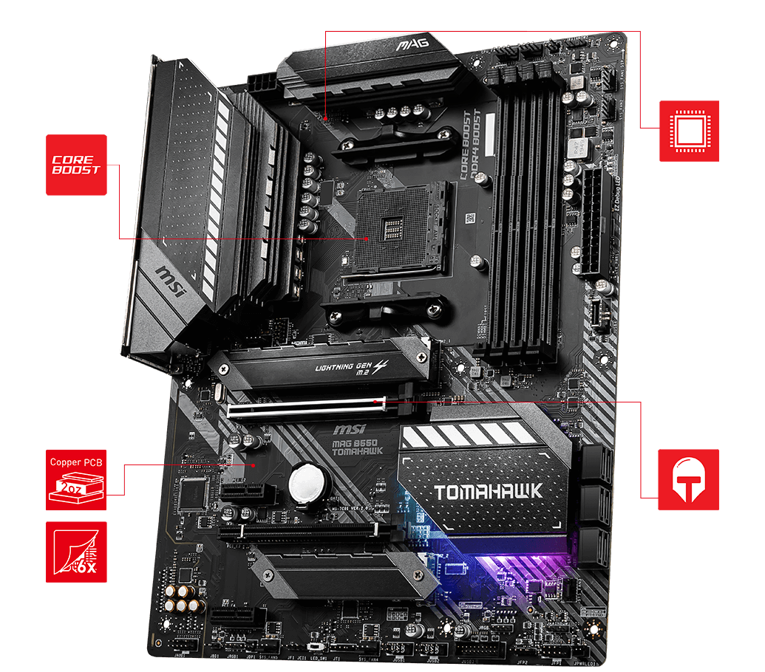
MOTHERBOARD: MSI MAG B550 Tomahawk
AMD AM4 Socket
Full sized ATX
6GB/s SATA
USB 3.2
1G & 2.5G LAN RJ-45
Dual M.2 22.80 & 22x110
DD4 with Memory Boost
Notes:
I am choosing an MSI Motherboard for use with AMD CPUs. I have always been a fan of AMD products and my current computer has an MSI motherboard which has served me well. I am choosing the MSI MAG Tomahawk B550 as the motherboard. The board features 3 x 6GB Sata connections, USB 3.2, 1 and 2.5 Gigabit Ethernet, dual M.2 connections, and support for 128GB DDR4 RAM. I found the board for $169.99 at NewEgg.com.

Slide 5
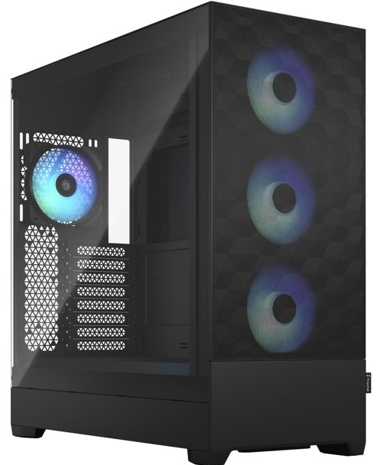
Desktop PC Case
Fractal Design
Pop xl atx
High-AirFlow
Full ATX Desktop
2x 5.25” bays
3x Storage trays
3.5” & 2.5” / tray
Front I/O:
2x USB 3.0
Headphone / Mic
Power / Reset
Increased Airflow
Notes:
My desk has enough room for a full-size computer, so I will build the system in a Full ATX PC tower. I chose the Fractal Design Pop XL High-Airflow so that I will have negative air pressure with great ventilation in the system. I will have plenty of room to expand the system in the future. The case is available for $109.99 on NewEgg.

Slide 6
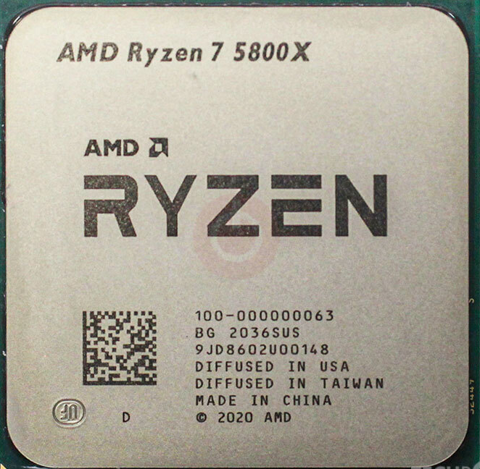
Central Processor Unit
AMD Ryzen 7 5800x
8 Core / 16 Thread
3.8 GHz / up to 4.7 GHz
7nm Vermeer Zen 3
32MB L3 / 4MB L2 Cache
TDP 105W
Notes:
The Processor I chose is an AMD Ryzen 7 5800x which has 8 cores and 16 threads running at 3.8GHz, with a 4.7GHz boost. This processor is powerful enough to run the programs that I use without issue and should be a decent CPU for at least 5 years. The Ryzen 7 5800x is available at NewEgg for $248.00 making it a superb value.

Slide 7
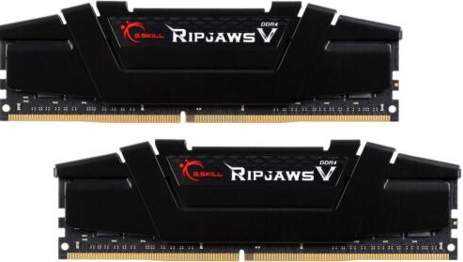
PC Memory (RAM)
G-Skill Ripjaw v
32GB (2x 16GB)
DDR4 SDRAM 3200
PC4-25600
Timing: 16-18-18-38
Notes:
My system will contain 32GB of G.Skill Ripjaw V series DDR4 3200 RAM. The motherboard supports up to 128GB, so I can easily add more RAM in the future and easily have 64 or 96GB without replacing these modules. The G.Skill is a ridiculously low $89.78 currently, at NewEgg.

Slide 8
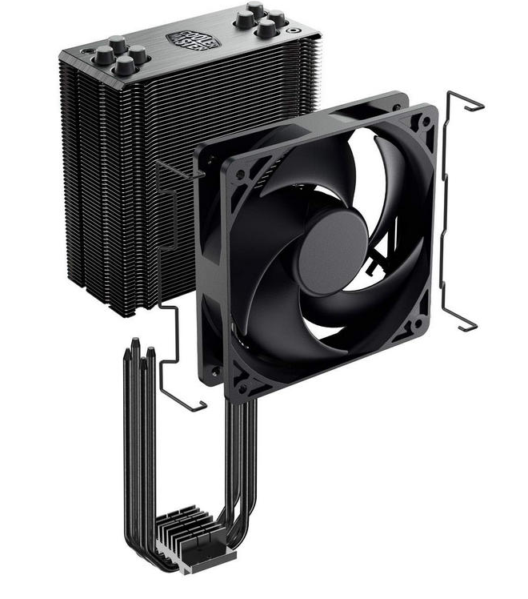
CPU Cooling Unit
4 Heat Pipes Direct Contact
Nickle Black Fins
Brushed Aluminum Surface
42 CFM Airflow
Noise Level: 26.0 dBA
Notes:
AMD Processors tend to run hot, so I will get a decent CPU cooler. I will not spend extra for liquid cooling. I chose a Cooler Master Hyper 212, with no RGB, which saves a few dollars.

Slide 9
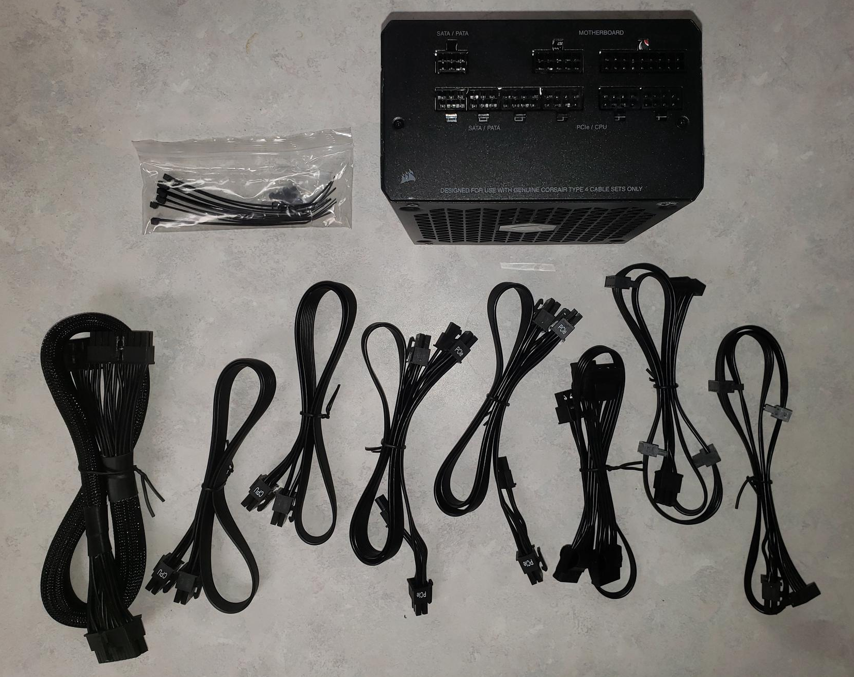
Power Supply (PSU)
Corsair RM850
850 Watt
Low Noise
Modular Connectors
Gold Efficiency Rating
Notes:
The system will be powered by a Corsair RM850, which produces 850 Watts of power. I want a powerful PSU for the computer so that it will have ample energy to run any powered peripheral devices. The cooler costs $54.99 and the PSU runs $149.99, both at NewEgg.

Slide 10
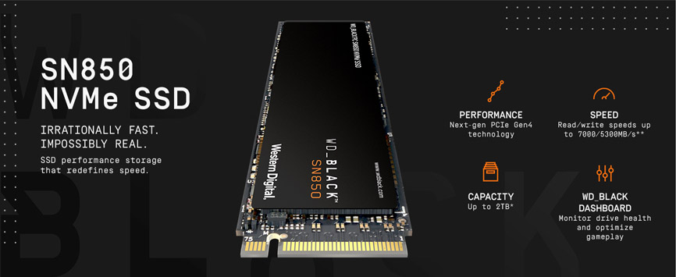
Storage Device 01- C:\
OS – SSD
Western Digital Black SN850
500GB
7000 MB/s read
5300 MB/s write
NVME / M.2 2280
PCIe 4.0
Notes:
For storage I chose a WD (Western Digital) Black SSD for the operating system and a 6TB Toshiba HDD for data and application use. The solid-state drive has extremely fast read speed of up to 7000MB/s through the motherboard’s PCIe 4 connection.

Slide 11
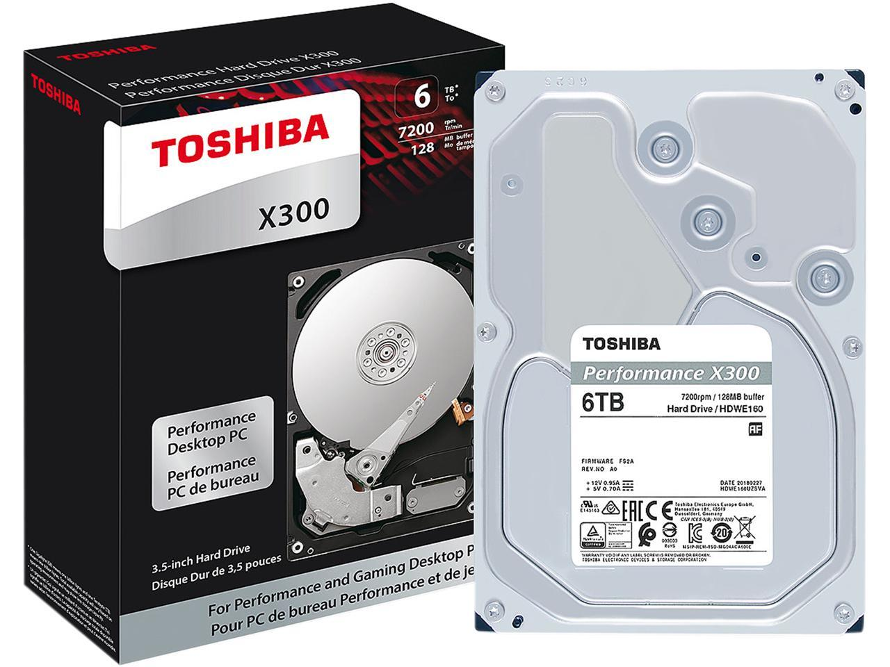
Storage Device 02- S:\
Toshiba x300
6TB
7200 RPM
256 MB Cache
6Gb/s SATA 3
Application Data
Virtual Machines
Images
Movies & Music
Games
Notes:
The HDD will be used to hold application data, video and audio files, along with games. The HDD runs at 7200 RPM and can transfer data at up to 6GB/s (6000MB/s) through it’s SATA 3 connection. I have 1 additional M.2 and 2 additional SATA 3 connections for future upgrading. Western Digital’s SSD can be purchased for $69.99 and the Toshiba Hard Disk Drive is $144.99, both from NewEgg.

Slide 12
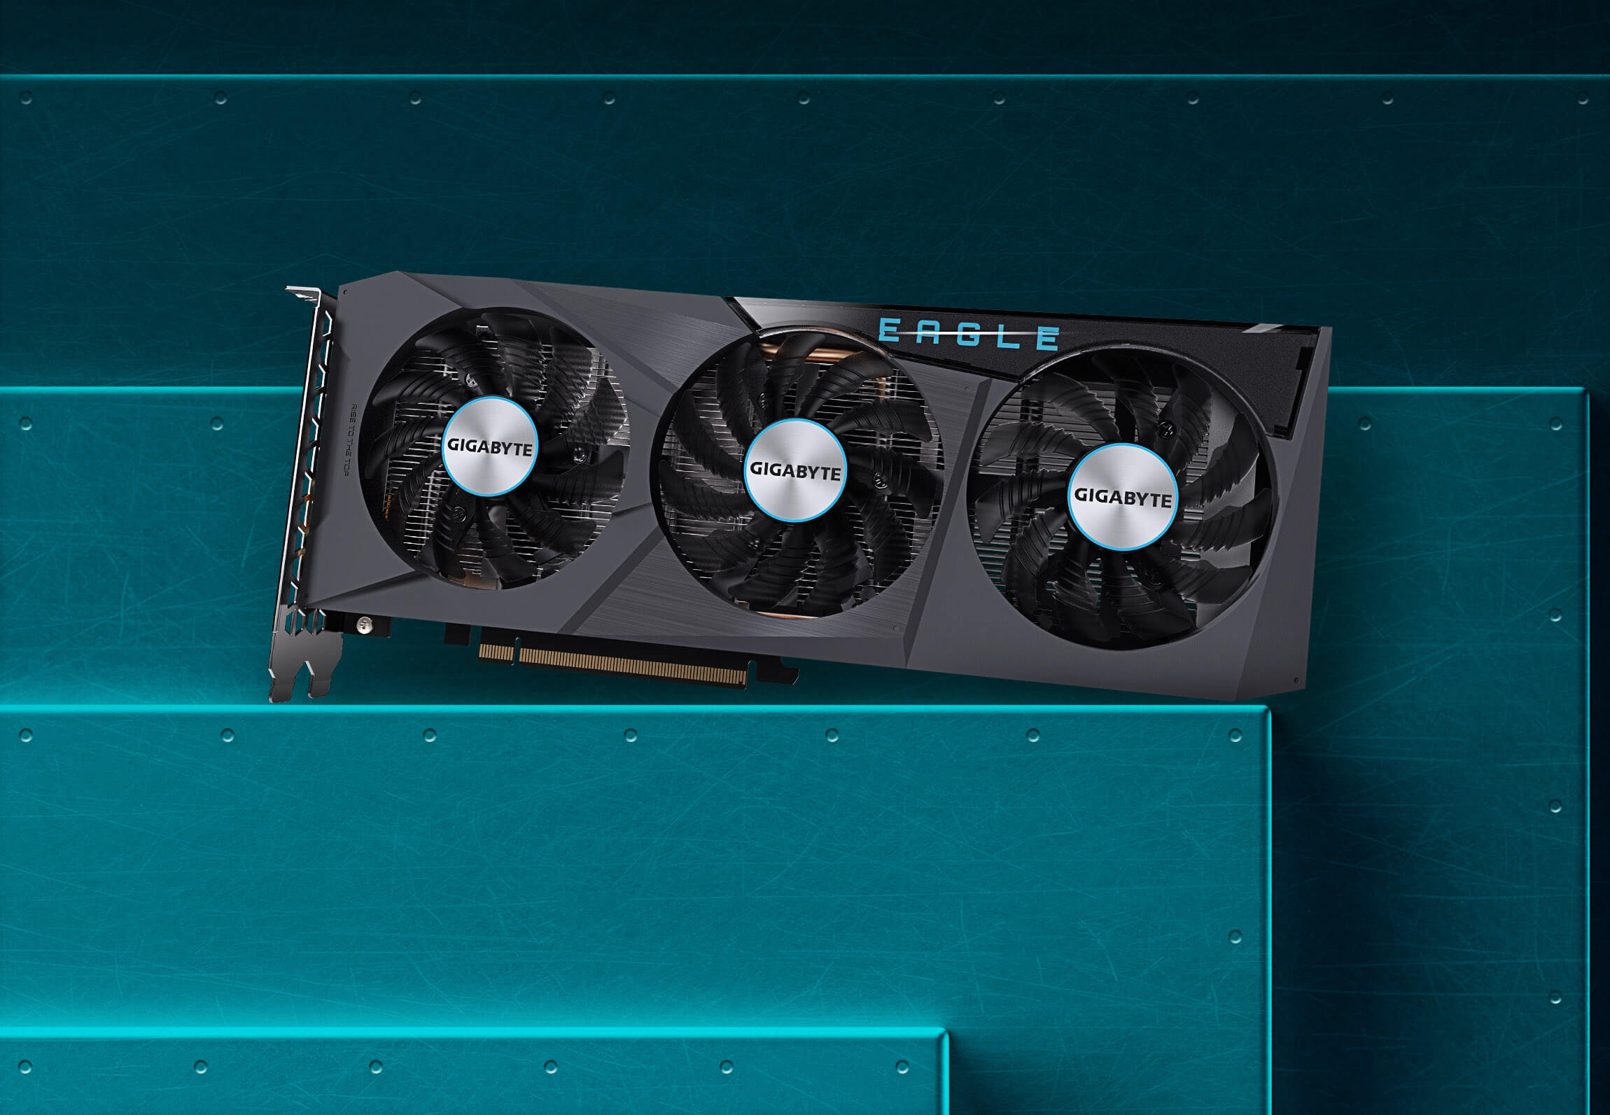
Video Card (GPU) GIGABYTE Radeon RX 6600
AMD Radeon 6600
8GB 128-bit GDDR6
PCIe 4.0
1792 Stream Processors
28 Ray Accelerators
2491MHz Boost
Notes:
I will add a Gigabyte AMD Radeon RX 6600 to one of the PCIe 4 expansion slots as my GPU. The card features 8GB or GDDR6 Memory and is considered an entry level to mid-range Graphics card. This will allow me to play AAA games for years. The Gigabyte Radeon RX 6600 can be purchased for $219.99 on NewEgg.

Slide 13
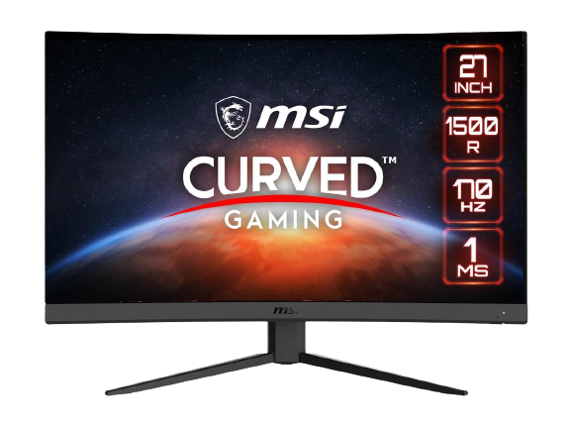
Monitor
MSI Optix G27c4 27”
Curved Monitor
27” Curved Display
1920 x 1080
170 Hz Refresh Rate
1ms Response Time
AMD Freesync
Wide Color Gamut
Frameless Design
Purchasing 2 for dual Monitor setup
Notes:
To create a dual display setup, I can upgrade my current monitors with 2 MSI Optix 27” Curved HD Monitors for $199.99 each. The monitors feature 1920x1080 display (HD) at up to 170 Hz with a 1 millisecond response time.

Slide 14






Operating System & Additional Apps
Ubuntu OS
LibreOffice
Krita (for Digital Art)
GIMP (for Digital Photography)
VMWare Workstation Pro (Virtualization)
Docker (Container Deployment)
+ Steam, Epic and GoG for Gaming
This Photo by Unknown Author is licensed under CC BY-SA-NC
Notes:
I will run Ubuntu on the machine and therefore save some money by using a free Linux Operating System. I use a digital art program called Krita and will install that on the system. Libre Office is a wonderful free alternative to Microsoft Office which can edit and save files in Microsoft Office formats. Another piece of freeware that I use often is GIMP for photo editing. I currently have a license for VMWare Workstation Pro and will install that onto the system for virtualization. Docker is a free application, also and I will download it to work with containers on the machine.

Slide 15
Final Budget
Motherboard:
MSI B550 Tomahawk $169.99
PC Case:
Fractal Pop XL Black $109.99
Processor:
AMD Ryzen 7 5800x 8-core $248.00
RAM:
G.SKILL Ripjaw V Series 32 GB $89.78
Cooling:
Cooler Master Hyper 212 Black $54.99
Power Supply:
Corsair RM850 850 Watt $114.99
SSD:
Western Digital Black SN850 500 GB $69.99
HDD:
Toshiba X300 6 TB $144.99
Video Card
GIGABYTE Radeon RX 6600 $219.99
Monitor
2x MSI Optix 27” Curved $399.98
OS & Additional Software: FREE
Subtotal from NewEgg $1622.69
Notes:
If I stopped with the initial build, I would have successfully built the Desktop for a subtotal of slightly more than $1200. I added 2 monitors for a dual monitor setup and ended up spending another $400. The subtotal with the monitors is $1622.69 on the Newegg.com website.

Slide 16
Conclusion:
In this project I attempt to build a computer for Productivity, Virtualization, Entertainment, and Gaming for $1200. I chose a MSI B550 Tomahawk Motherboard with an 8-core AMD Ryzen 7 5800x CPU as the brains of the computer. I am personally a ‘Team Red’ member and normally purchase AMD chipsets. I chose the MSI B550 because I currently have an MSI B450 in a computer and have never had any issue with performance, so I like the MSI brand. The computer will feature a Cooler Master Hyper 212 CPU cooler and a Fractal Design Pop XL Air Full ATX case, for excellent air flow and easy future upgrading.
The PC will feature 32 GB of G.Skill DDR4 3200 RAM, which will be plenty for multi-tasking even my most demanding applications. The OS will be installed on a super fast 500 GB SSD drive, and I will have a 6 TB HDD for applications, data storage, and games. The video card will be a Radeon RX 6600 with 8Gb of GDDR6 memory which will play AAA games at high quality for a few years.
If I stopped with the initial build, I would have successfully built the Desktop for a subtotal of slightly more than $1200. I added 2 monitors for a dual monitor setup and ended up spending another $400. The subtotal with the monitors is $1622.69 on the Newegg.com website. I will end up adding a mechanical keyboard and triple monitor mount to bring the subtotal up to $1900 or more eventually.
I currently have 2 monitors and multiple keyboards and mice, so I can successfully build the desktop for a price within my budget (excluding Tax and Shipping). If I am to build this system, I will wait until Black Friday or Cyber Monday when many of these parts will be discounted.
Notes:
I currently have 2 monitors and multiple keyboards and mice, so I can successfully build the desktop for a price within my budget (excluding Tax and Shipping). If I am to build this system, I will wait until Black Friday or Cyber Monday when many of these parts will be discounted.

