Slide 1


DATA BREACH or DATA SCRAPE ?
the LinkedIn 2021 Data Leak
CTEC-114 Fall 2022
Jeffrey S. Walley

Slide 2

What company was involved?
Linkedin was the company involved in the data breach.

Slide 3

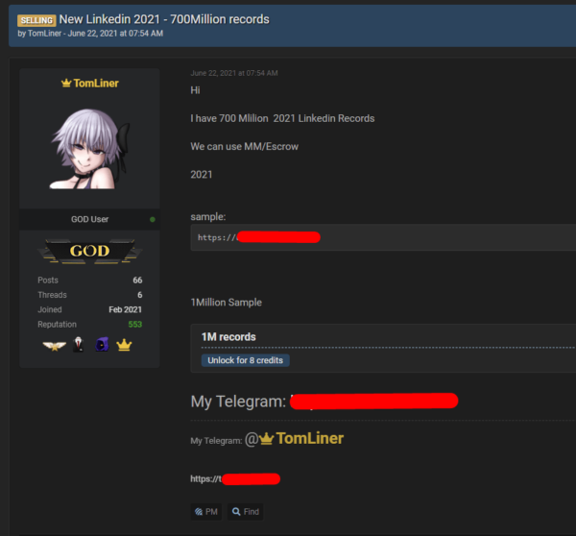
Who perpetrated the breach?
A user known as ‘TomLiner’, using the moniker ‘GOD user’ perpetrated the information gathering.

Slide 4

What exactly happened?
LinkedIn’s API (Application Programming Interface) was misused by a third party to gain access to the personal data of millions of users.

Slide 5
When did the breach take place?

