Slide 1
Forms
CTEC 130

Slide 2
What Forms Do

Slide 3
Web Requests
When a user wants something from a web server, they send a web request
This request contains information on the content the user wants to see, the page they’re looking at, cookie and session information and tons of other stuff
Web requests are “stateless”
The site doesn’t remember who is looking at what
The user provides all the details of what they want every time they make a request
Sites exist not just to display information, but to retrieve and store information as well

Slide 4
What Forms Do
A Form is the most common tool used on a site to send user-submitted data to a server
The information sent in a form is passed as either “get” or “post” information
Get - aka Query, values are passed in as part of the URL
Post - values are passed in as a data object sent in the request
Sites are built to have special endpoints that expect user-submitted information
While Forms are necessary to know how to build, this course won’t cover how to handle them on the back-end

Slide 5

Form Attributes
Method
Usually “get” or “post”
Action
The address that the form data is sent to when it’s submitted
If not provided, is assumed to be the same page displaying the form

Slide 6
Building Basic Forms

Slide 7
<input>
The most common tag in your form
Represents a field that the user can modify/update
The type of input is defined by the type attribute:
type=”text”
type=”submit”
type=”email”
And many, many others
The data being sent is named via the name attribute
name=”user_name”
The data in this input will be sent under the variable “user_name”
Will usually also have an id to connect it to labels

Slide 8
<label></label>
Provides a context for the input for the user
It’s where you put the text to describe the input
Has a for attribute that connects it to an <input> with the same id
for=”name”
Connects this label to the <input> with an id=”name”
Text to display in a label is placed between the <label></label> tags
While not necessary, it’s often good practice to place the input field inside of a <label>

Slide 9
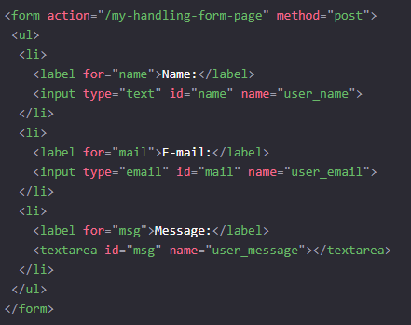
Example Form

Slide 10
<button>
Can be used outside of forms as well
Has a type attribute
type=”submit” - submits the form
type=”reset” - resets the form to default values
type=”button” - doesn’t do anything, can be hooked into JavaScript
Instead of using a button, you also have the option of using <input type=”submit” value=”Click Me”>

Slide 11
Form Structure

Slide 12
Form Structure
Surrounded by <form></form> tags
Can contain multiple <label>, <input> and <button> tags
Can contain just about any other HTML element as well:
<ul> and <li>
<div>
<span>
The <input>s and <button>s are tied to the <form> they’re in, but you can use whatever tags you like to organize them

Slide 13
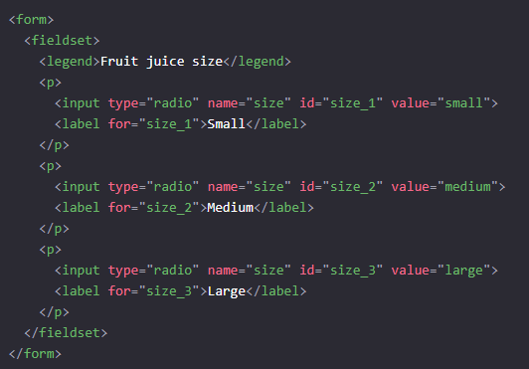
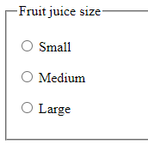
<fieldset> and <legend>
A <fieldset> is a grouping of <inputs> that are related
You can provide a <legend> to act as a label for the set

Slide 14
Form Controls

Slide 15
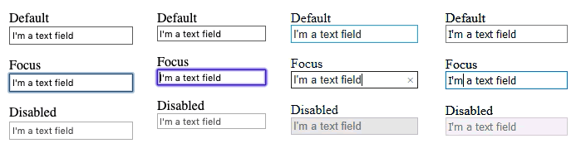
Single Line Text Fields

Slide 16
Password Field

Slide 17
Hidden Content
Doesn’t display in the browser, but exists in the source code and is sent with the rest of the form data
Often used by web servers to check that a valid submission is taking place

Slide 18
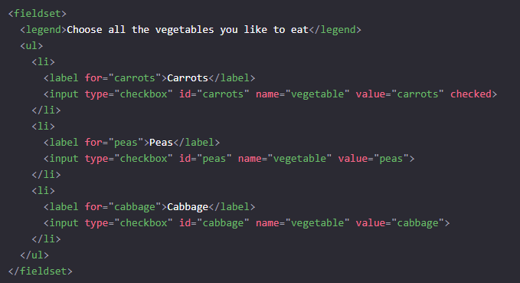
Checkboxes

Slide 19
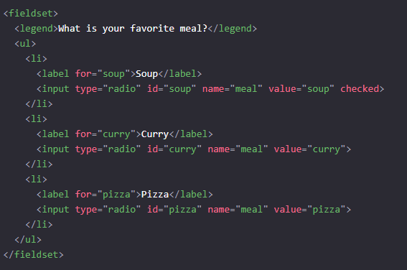
Radio Buttons

Slide 20

File

Slide 21

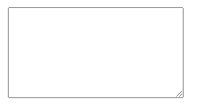
Multi-Line Text Fields

Slide 22
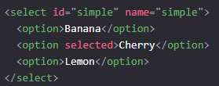

Select Box

Slide 23
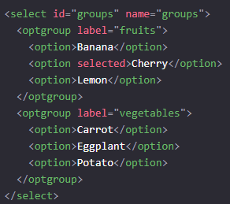
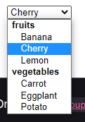
SelectBox with optgroup

Slide 24
HTML5 Input Types

Slide 25
HTML5 Input Types
With HTML5, input types were added that include extra functionality via the browser
Fields can validate themselves
Fields can bring up different kinds of input methods

Slide 26
Validation
Client-Side Validation - the website makes sure all values are within acceptable parameters before sending to the web server
Server-Side Validation - the server checks sent values before processing them
Proper interactive sites should use both client-side and server-side validation
Hackers won’t limit themselves to just using your provided web-form
Even so, client-side validation helps normal users enter valid information

Slide 27

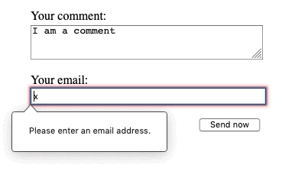
Email Address Field

Slide 28

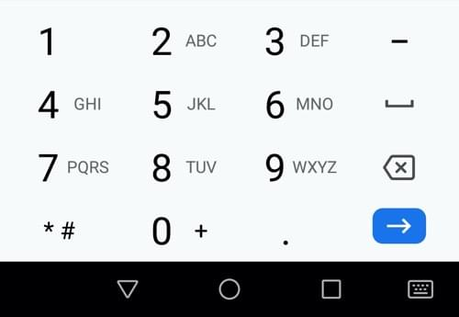
Phone Number Field

Slide 29

URL Field

Slide 30
Numeric Field

Slide 31

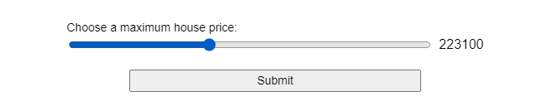
Slider

Slide 32
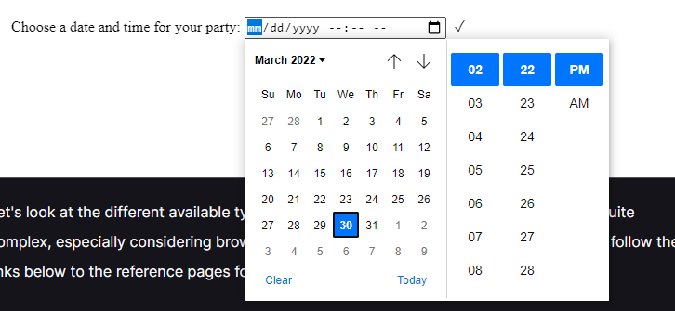
DateTime

Slide 33

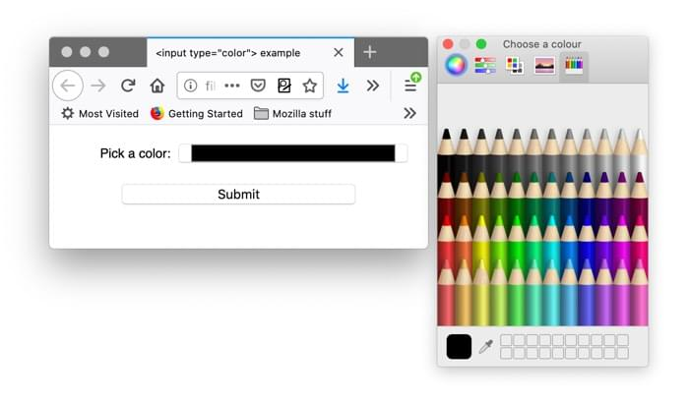
Color Picker

