Slide 1
CTEC-130: HTML & CSS Portfolio
JEFFREY WALLEY

Slide 2
Content
Week 01: About Me
Week 02: More About Me
Weeks 03, 04 & 05: Introducing CSS
Week 06: Utilizing Flex Box and Grid
Week 07: CSS Dropdown Menus & Multi-Tier Dropdown menus

Slide 3
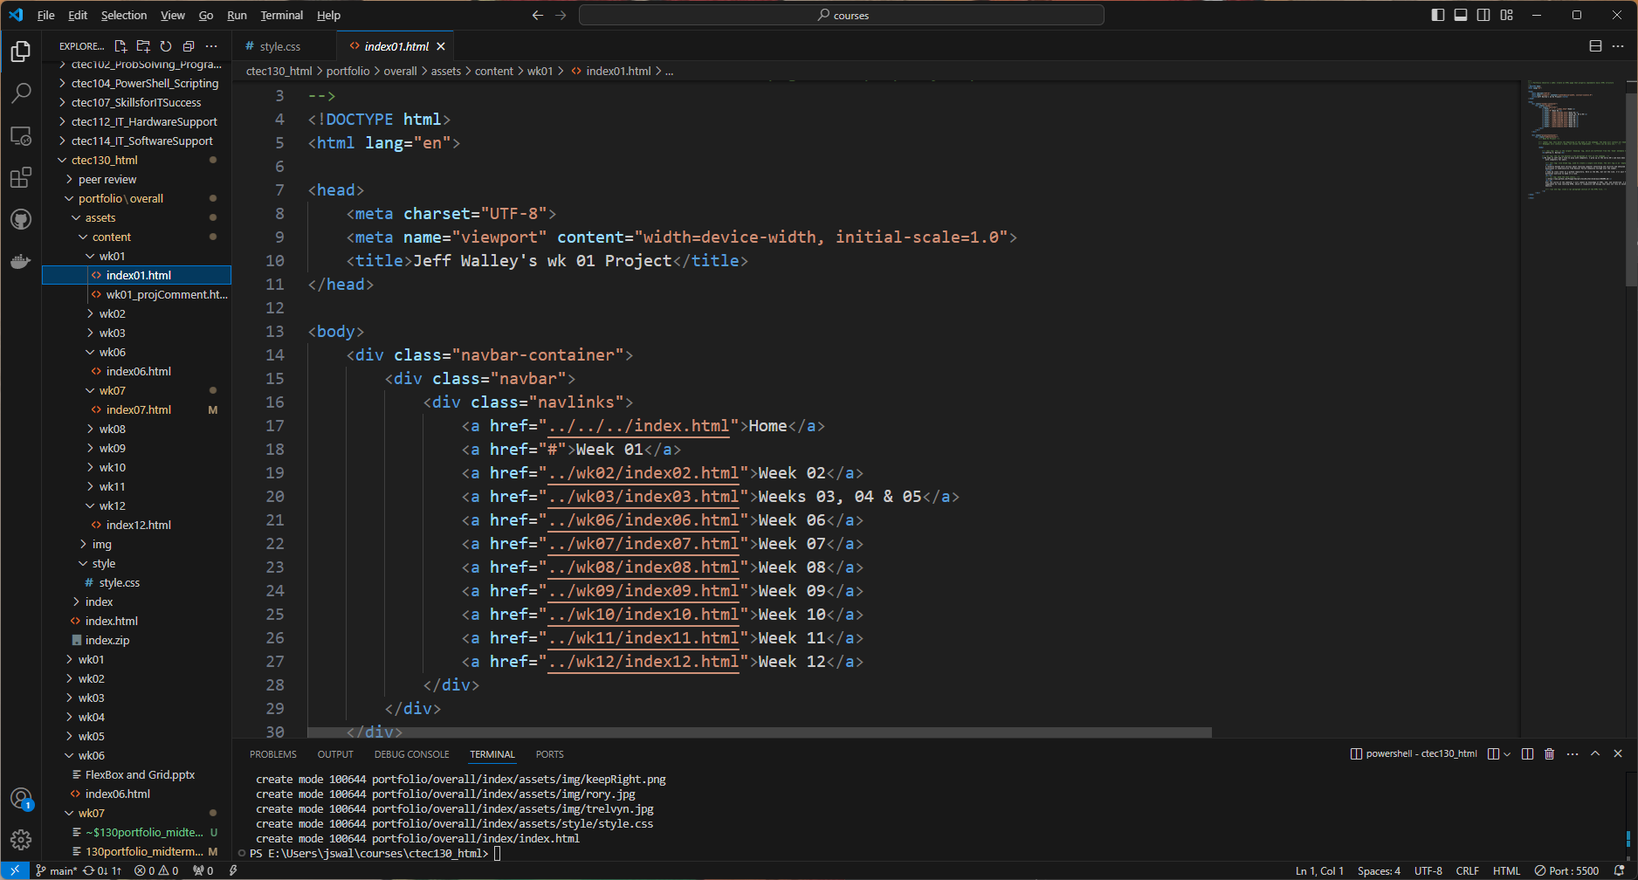
Week 01: About Me
Create an HTML page that implements basic HTML structure.
Start with DOCTYPE. Needs HTML, Head, and Body, along with closing tags for each.

Slide 4
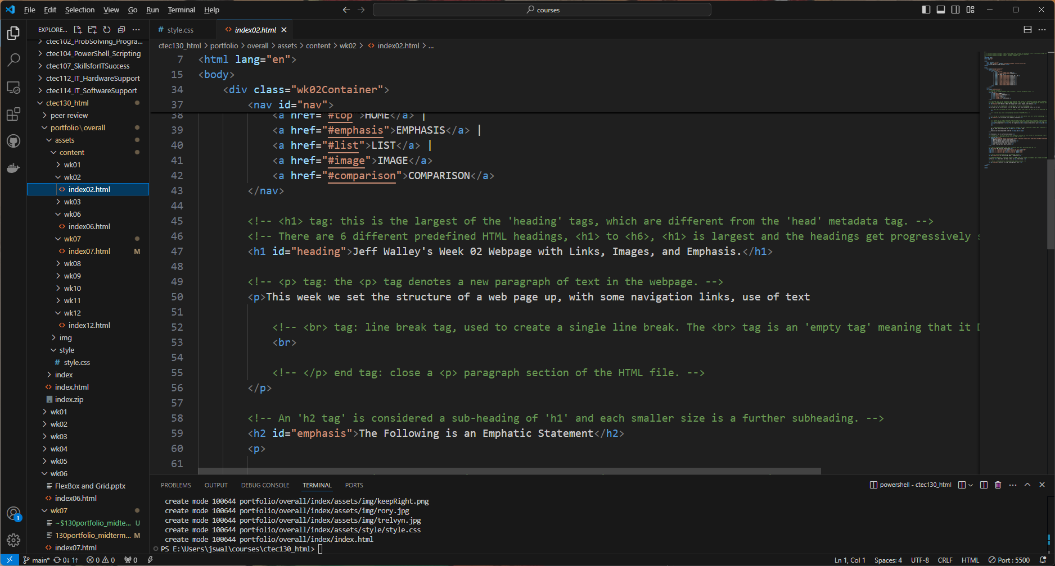
Week 02: More About Me
Create HTML page that provides no validation errors.
Properly implement multiple levels of Headings on an HTML page.
Properly create a document fragment link.
I created fragments using the <a href> element and referencing and ‘id’ assigned to different divisions in the code.

Slide 5
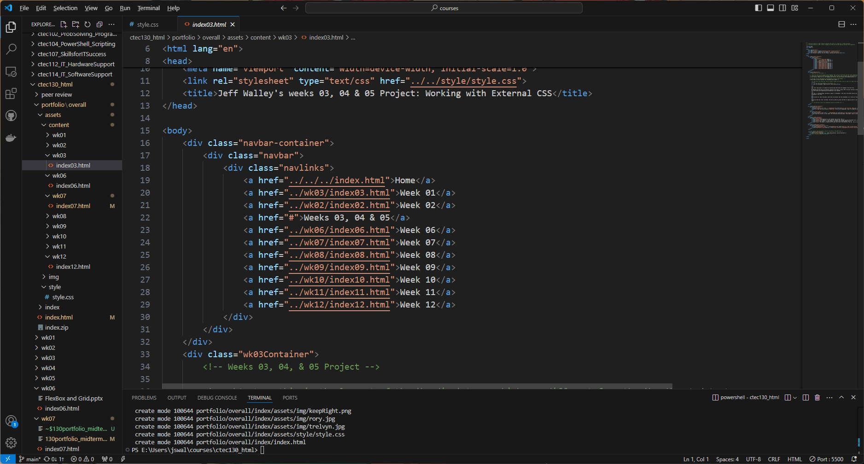
Week 03: External CSS Demo 01
Properly implement CSS styles on a page via a linked stylesheet.
In the HTML code, inside the <head> element, we add the: <link> element with the reference location for the .css file.

Slide 6
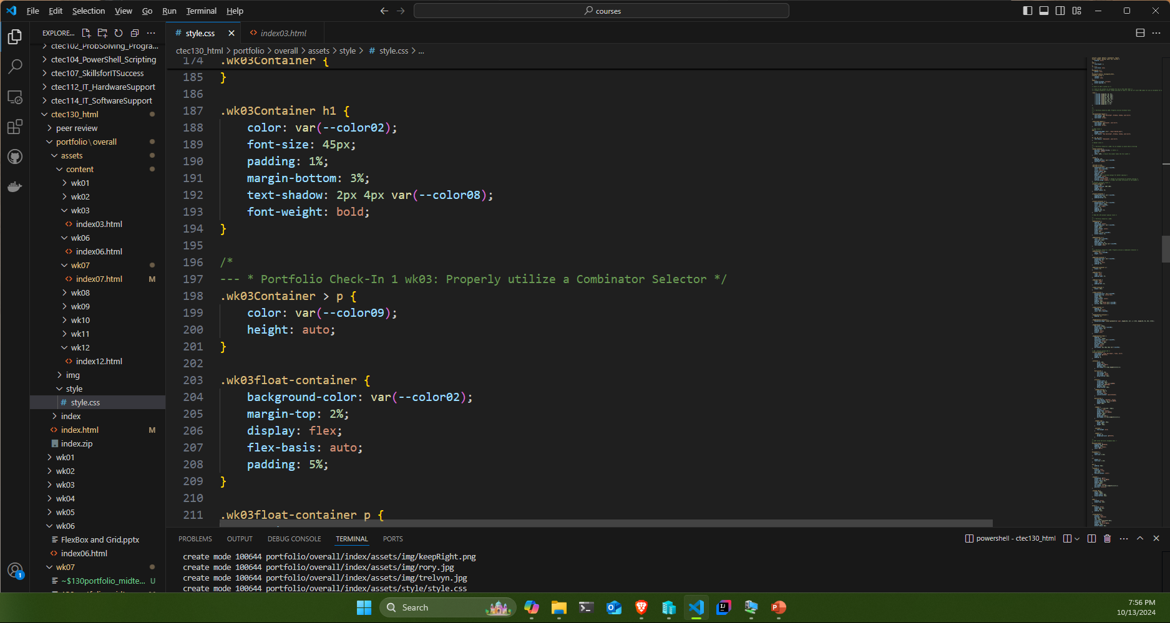
Week 03B: External CSS Demo 01
Create a webpage with HTML and CSS that modifies multiple text properties.
In the .wk03Container h1 the font color and size are changed using CSS.
Properly Target a class or id attribute as part of styling a page.
In the above the CSS is calling on class names within the HTML code.
Properly utilize a Combinator Selector as part of styling a page.
In ‘.wk03Container > p’ I utilize a combinator selector.

Slide 7
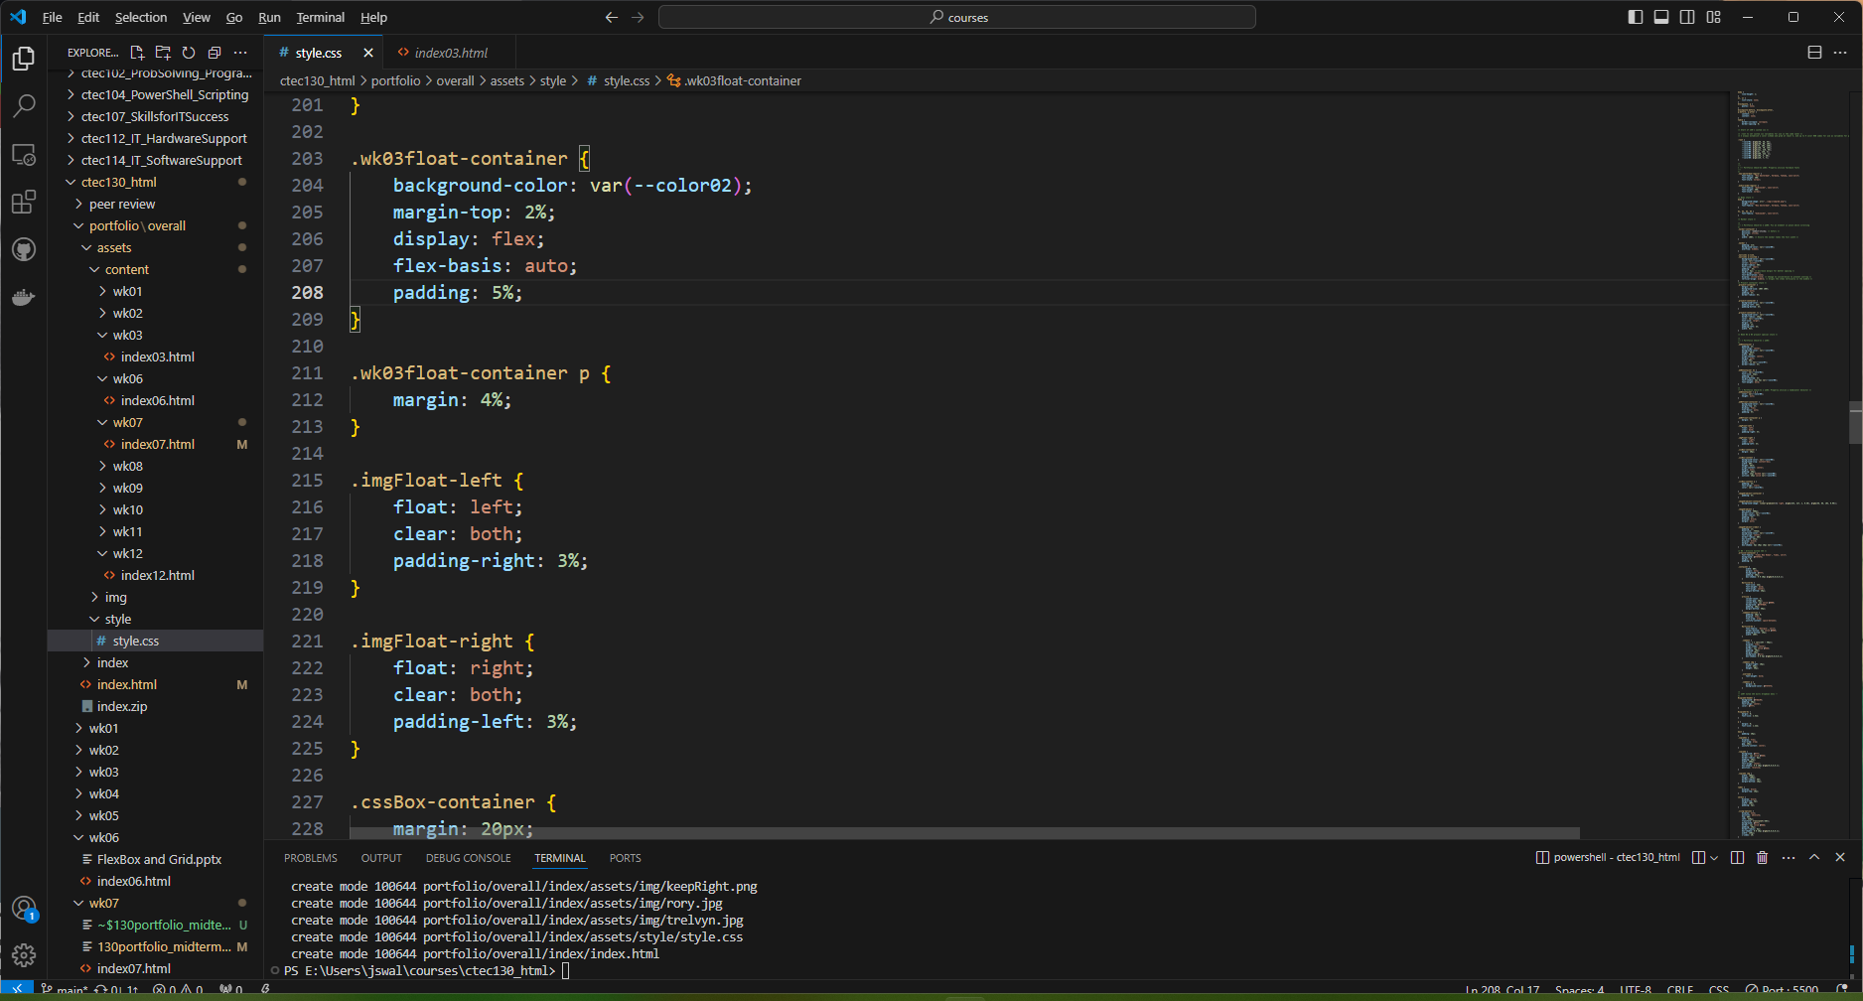
Week 03C: External CSS Demo 01
Properly float an element in an HTML page without obvious visual errors.

Slide 8
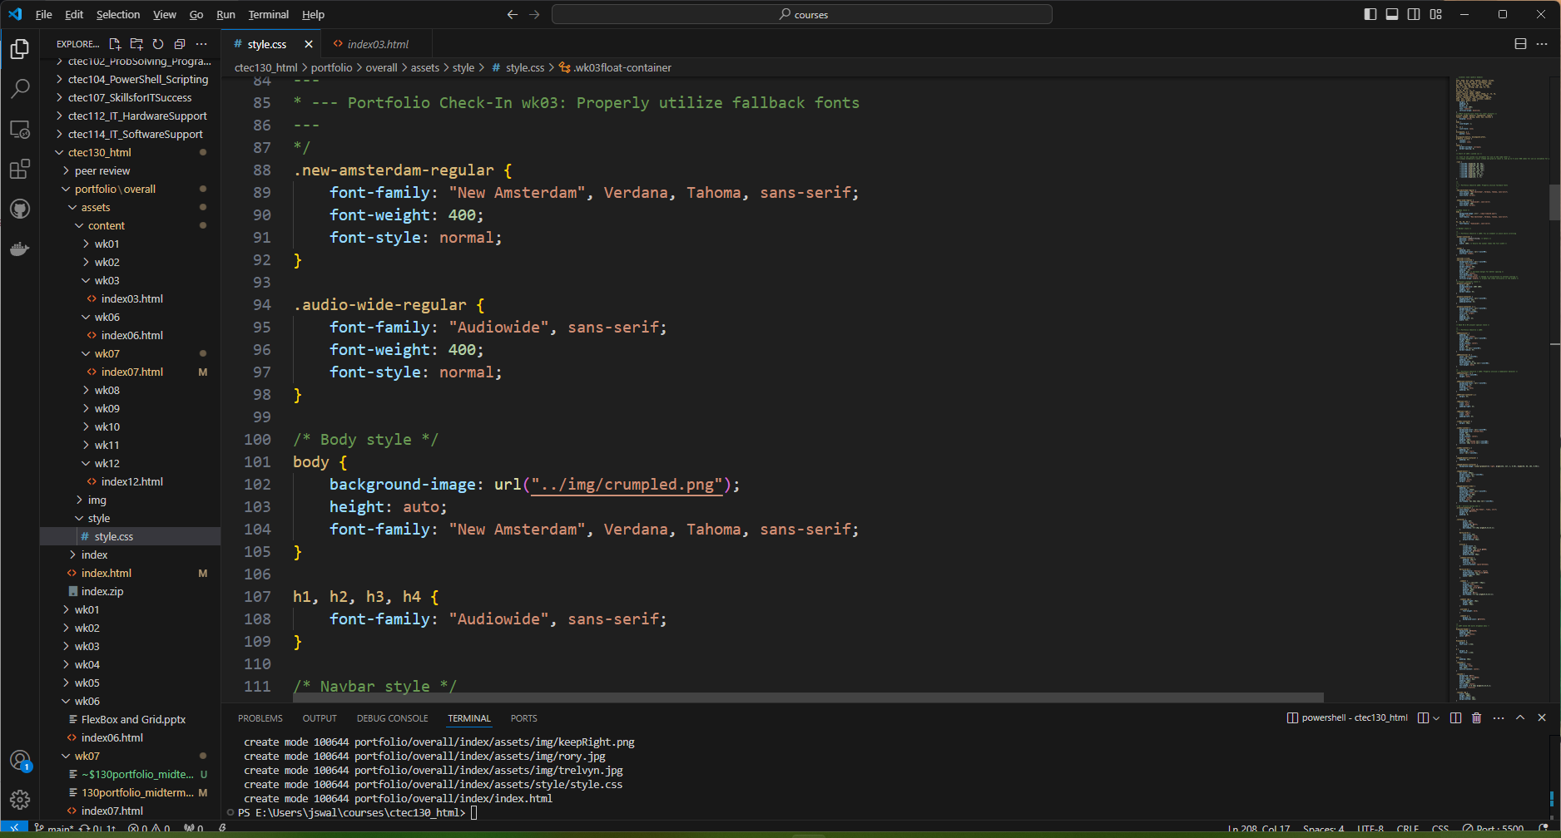
Week 03D: External CSS Demo 01
Properly utilize fallback fonts in a working CSS rule.
Properly implement a background image via CSS.

Slide 9
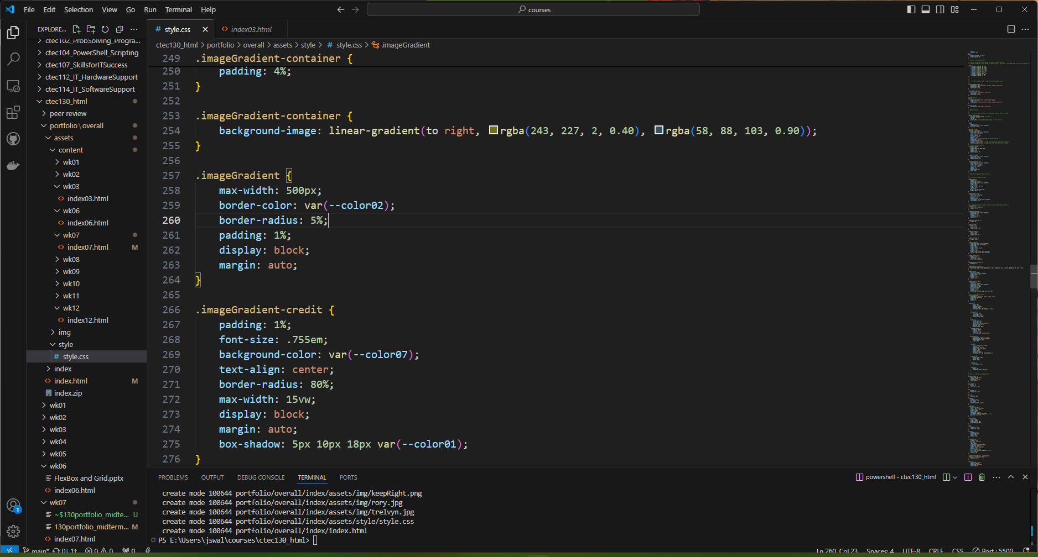
Week 04: Background Image & Box Model
Utilize styles that modify “box-model” properties (margin, padding, border) as part of a well-styled page.
Properly implement a CSS Gradient.
Properly implement a CSS Box Shadow.

Slide 10
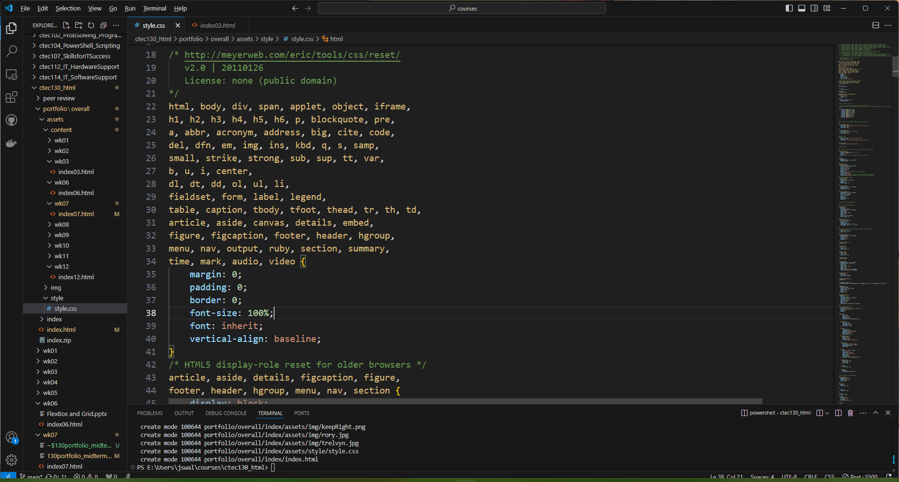
Week 04B: CSS Reset, Gradient, and Box Shadow
Properly implement a basic CSS Reset.

Slide 11
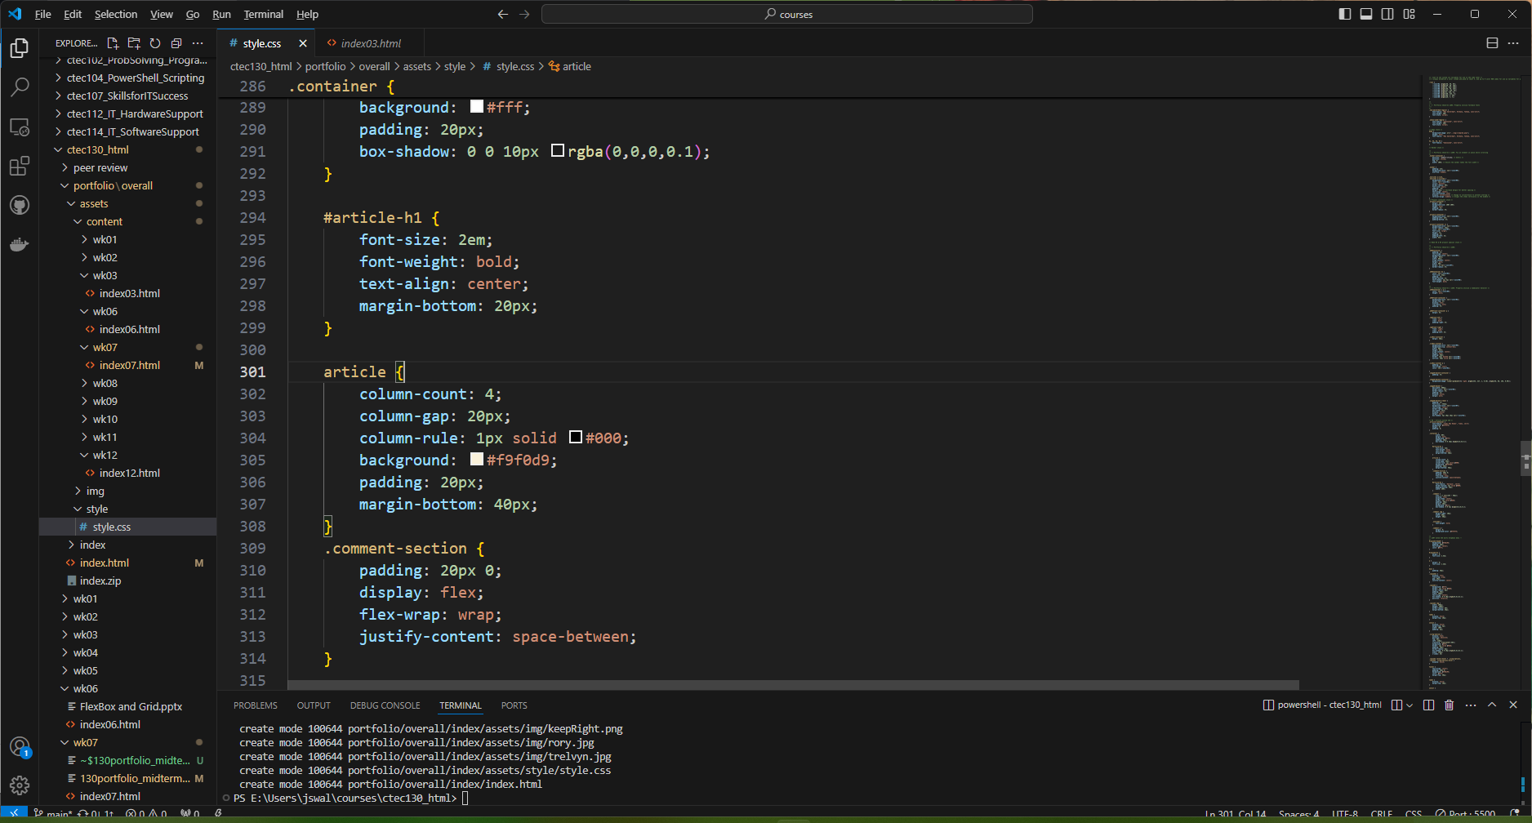
Week 05: CSS Columns
Properly implement and style CSS columns using CSS column properties.

Slide 12
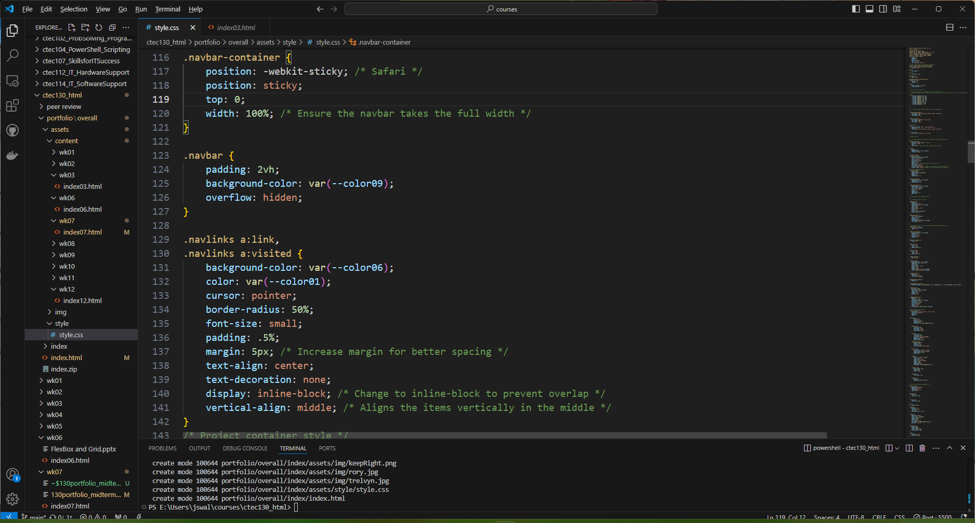
Week 05B: Navbar Links, CSS Fixed Element
Properly organize a horizontal navigation section with left-to-right links.
Fix an element in place while scrolling using CSS without damaging the surrounding layout.

Slide 13
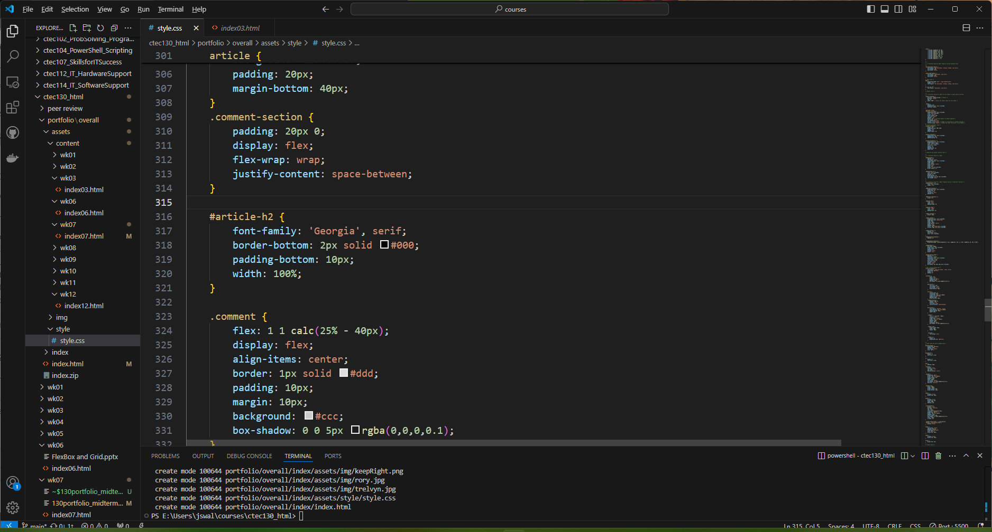
Week 06: Flex Box
Properly utilize Flex Box and/or Grid.

Slide 14
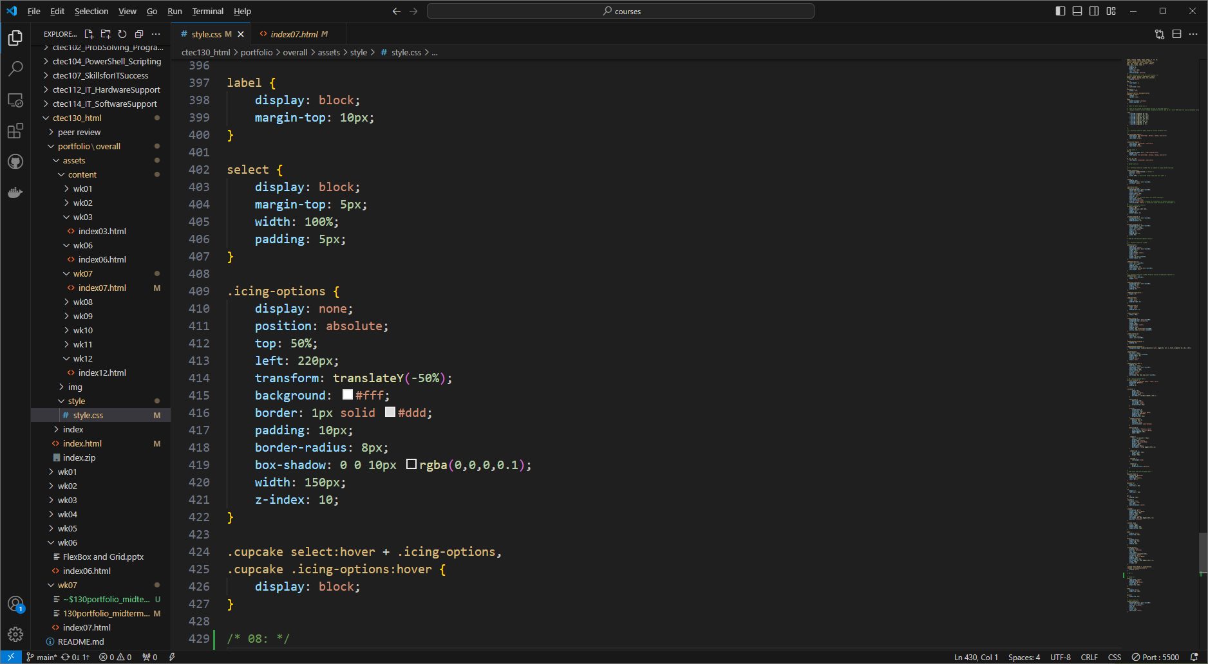
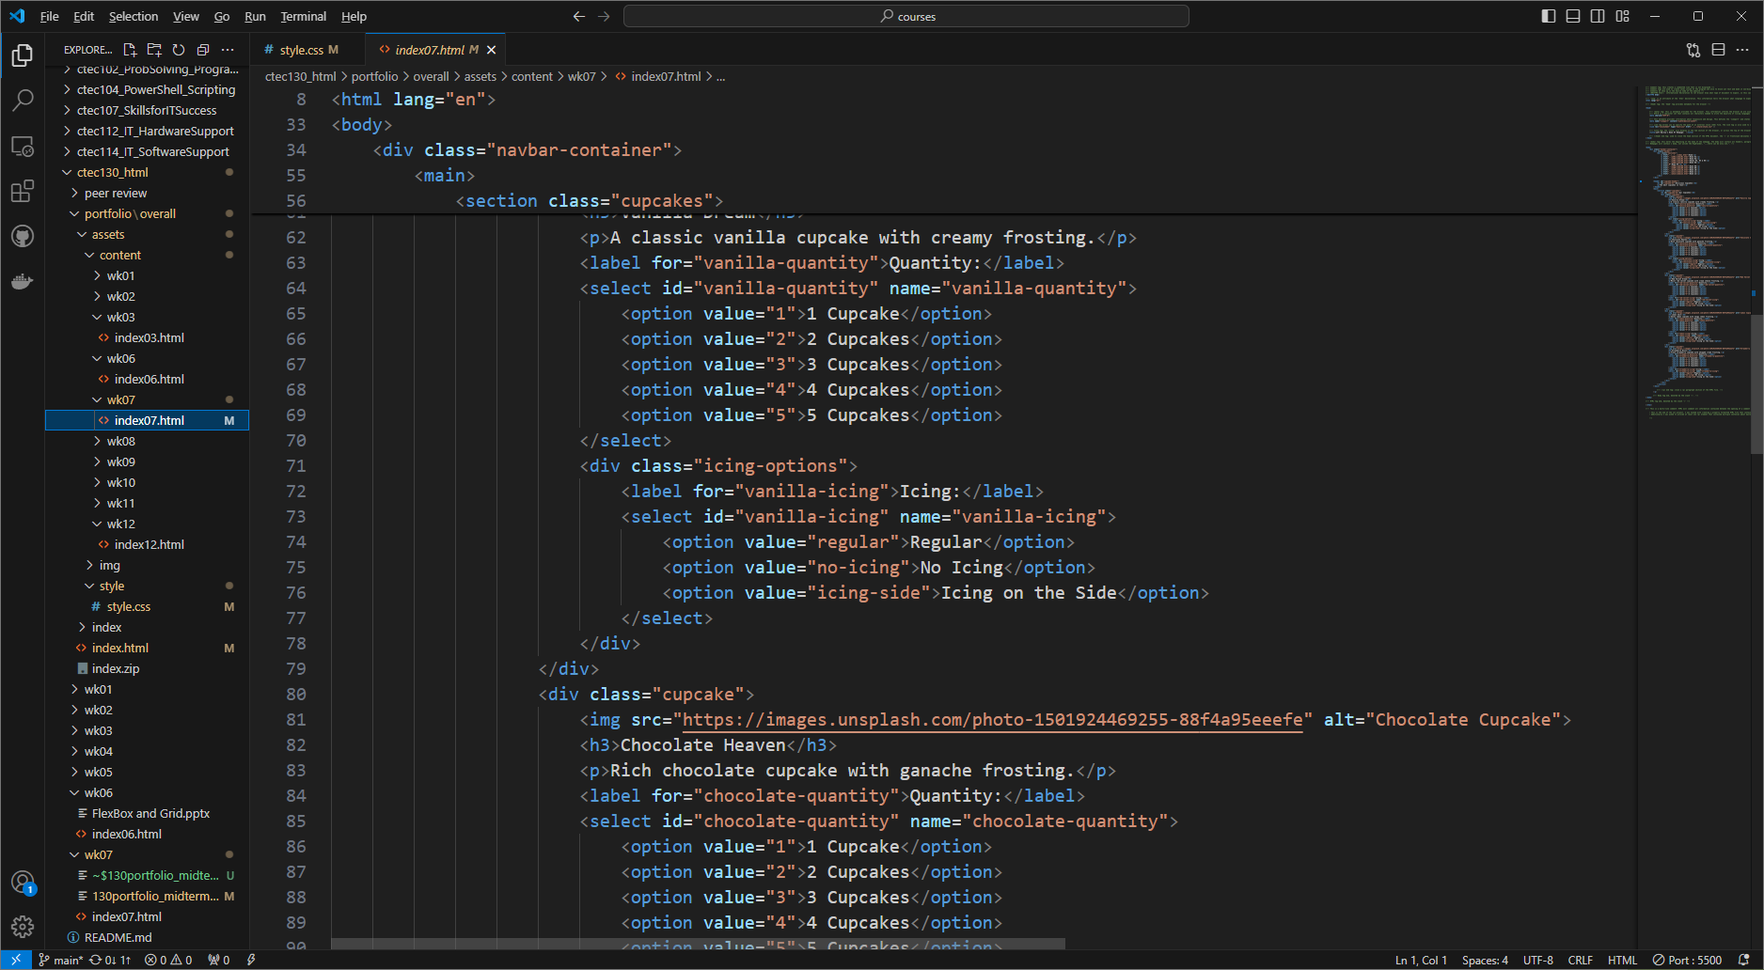
Week 07: CSS Dropdown and Multi-tier Dropdown Menus
Create a CSS Dropdown menu.
Create a multi-tier CSS Dropdown menu.

Slide 15
Add a Slide Title - 2

