Slide 1

Java™ Software Solutions: Foundations of Program Design
Ninth Edition
Chapter 5
Conditionals and Loops
Copyright © 2018 Pearson Education, Inc. All Rights Reserved
Notes:
If this PowerPoint presentation contains mathematical equations, you may need to check that your computer has the following installed:
1) MathType Plugin
2) Math Player (free versions available)
3) NVDA Reader (free versions available)

Slide 2
Conditionals and Loops
Now we will examine programming statements that allow us to:
make decisions
repeat processing steps in a loop
Chapter 5 focuses on:
boolean expressions
the if and if-else statements
comparing data
while loops
iterators
the ArrayList class
more G U I controls

Slide 3
Outline (1 of 9)
Boolean Expressions
The if Statement
Comparing Data
The while Statement
Iterators
The ArrayList Class
Determining Event Sources
Managing Fonts
Check Boxes and Radio Buttons

Slide 4
Flow of Control
Unless specified otherwise, the order of statement execution through a method is linear: one after another
Some programming statements allow us to make decisions and perform repetitions
These decisions are based on boolean expressions (also called conditions) that evaluate to true or false
The order of statement execution is called the flow of control

Slide 5
Conditional Statements
A conditional statement lets us choose which statement will be executed next
They are sometimes called selection statements
Conditional statements give us the power to make basic decisions
The Java conditional statements are the:
if and if-else statement
switch statement
We’ll explore the switch statement in Chapter 6

Slide 6
Boolean Expressions (1 of 3)
A condition often uses one of Java’s equality operators or relational operators, which all return boolean results:
equal to
not equal to
less than
greater than
less than or equal to
greater than or equal to
Note the difference between the equality operator
and the assignment operator

Slide 7
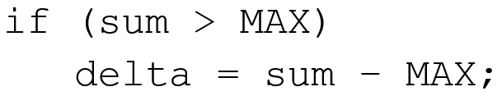
Boolean Expressions (2 of 3)
An if statement with its boolean condition:
First, the condition is evaluated: the value of sum is either greater than the value of MAX, or it is not
If the condition is true, the assignment statement is executed; if it isn’t, it is skipped
See Age.java

Slide 8
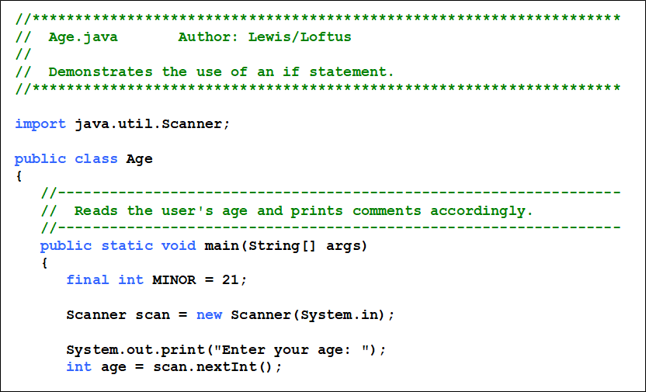
Listing 5.1 (1 of 3)

Slide 9
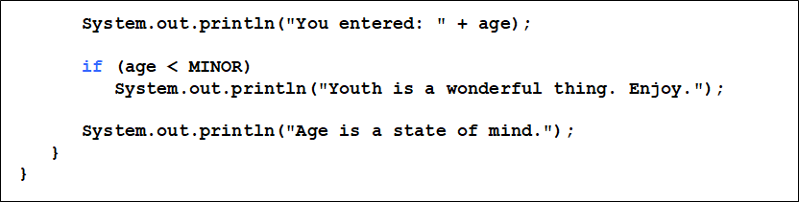
Listing 5.1 (2 of 3)

Slide 10
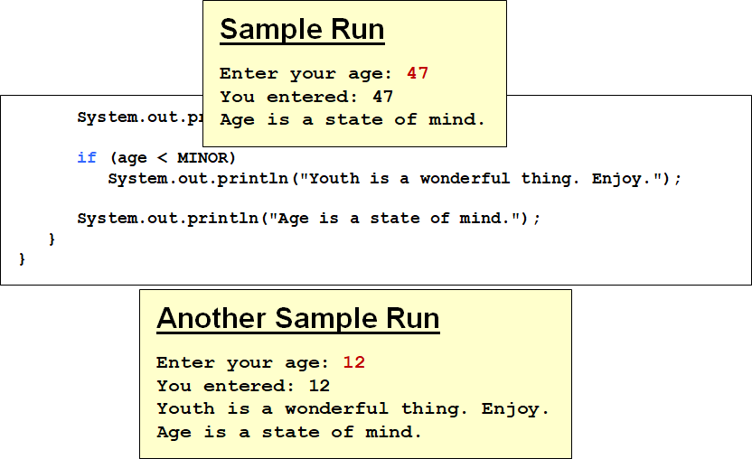
Listing 5.1 (3 of 3)

Slide 11
Logical Operators (1 of 2)
Boolean expressions can also use the following logical operators:
Logical NOT
Logical AND
Logical OR
They all take boolean operands and produce boolean results
Logical NOT is a unary operator (it operates on one operand)
Logical AND and logical OR are binary operators (each operates on two operands)

Slide 12
Logical NOT
The logical NOT operation is also called logical negation or logical complement
If some boolean condition a is true, then
is false; if a is
false, then
Logical expressions can be shown using a truth table:
a | Exclamation point a
true | false
false | true

Slide 13


Logical AND and Logical OR (1 of 2)
The logical AND expression
is true if both a and b are true, and false otherwise
The logical OR expression
is true if a or b or both are true, and false otherwise

Slide 14
Logical AND and Logical OR (2 of 2)
A truth table shows all possible true-false combinations of the terms
Since
each have two operands, there
are four possible combinations of a and b
a | b | a ampersand ampersand b | a pipe pipe b
true | true | true | true
true | false | false | true
false | true | false | true
false | false | false | false

Slide 15
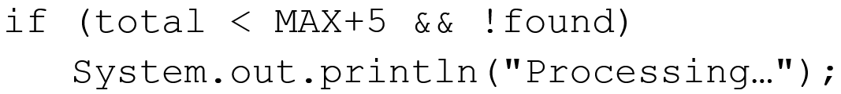
Logical Operators (2 of 2)
Expressions that use logical operators can form complex conditions
All logical operators have lower precedence than the relational operators
The
operator has higher precedence than

Slide 16
Boolean Expressions (3 of 3)
Specific expressions can be evaluated using truth tables
total less than sign MAX | found | exclamation point found | total less than sign MAX ampersand ampersand exclamation point found
false | false | true | false
false | true | false | false
true | false | true | true
true | true | false | false

Slide 17
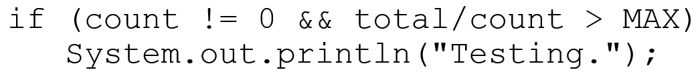
Short-Circuited Operators
The processing of
is “short-circuited”
If the left operand is sufficient to determine the result, the right operand is not evaluated
This type of processing should be used carefully

Slide 18
Outline (2 of 9)
Boolean Expressions
The if Statement
Comparing Data
The while Statement
Iterators
The ArrayList Class
Determining Event Sources
Managing Fonts
Check Boxes and Radio Buttons

Slide 19
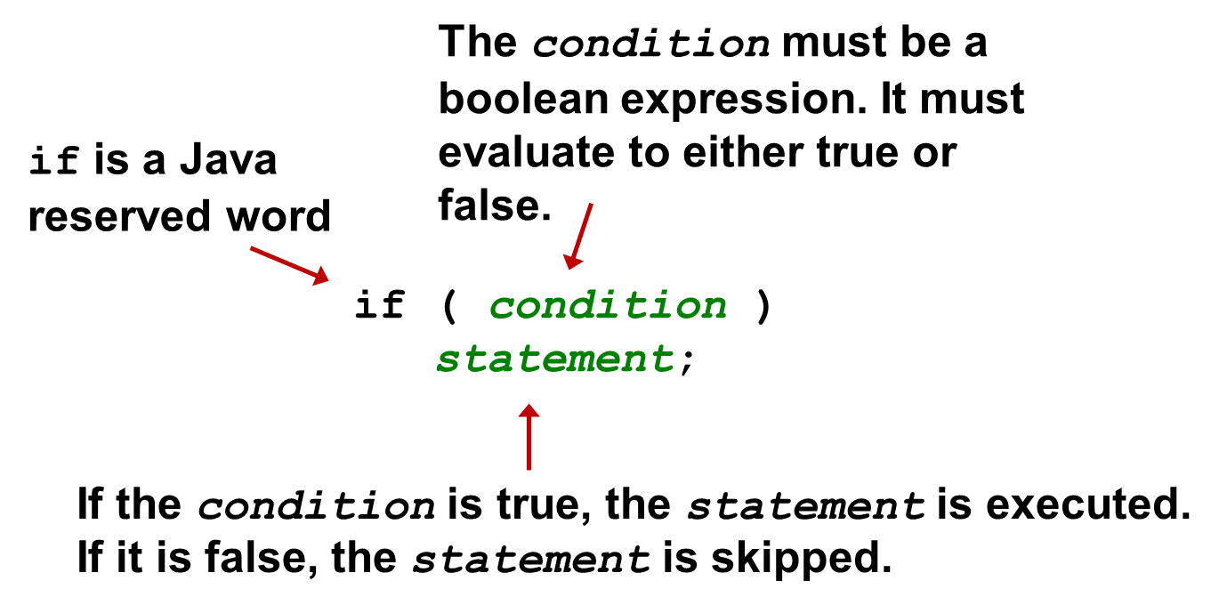
The if Statement
Let’s now look at the if statement in more detail
The if statement has the following syntax:

Slide 20
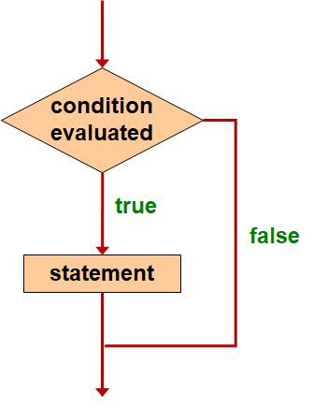
Logic of an If Statement

Slide 21
Indentation
The statement controlled by the if statement is indented to indicate that relationship
The use of a consistent indentation style makes a program easier to read and understand
The compiler ignores indentation, which can lead to errors if the indentation is not correct
“Always code as if the person who ends up maintaining your code will be a violent psychopath who knows where you live.”
-- Martin Golding

Slide 22
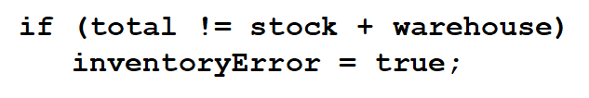
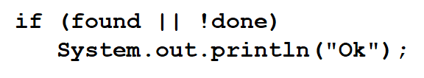
Quick Check 1 (1 of 2)
What do the following statements do?

Slide 23
Quick Check 1 (2 of 2)
What do the following statements do?
Sets the boolean variable to true if the value of total is not equal to the sum of stock and warehouse
Prints “Ok” if found is true or done is false

Slide 24
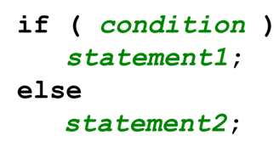
The if-Else Statement
An else clause can be added to an if statement to make an if-else statement
If the condition is true, statement1 is executed; if the condition is false, statement2 is executed
One or the other will be executed, but not both
See Wages.java

Slide 25
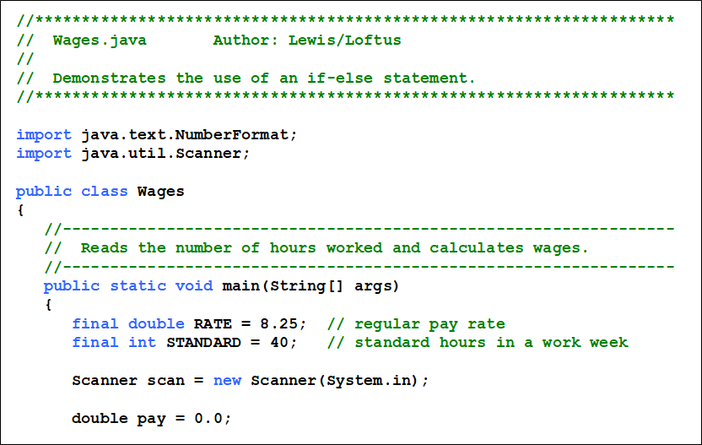
Listing 5.2 (1 of 3)

Slide 26
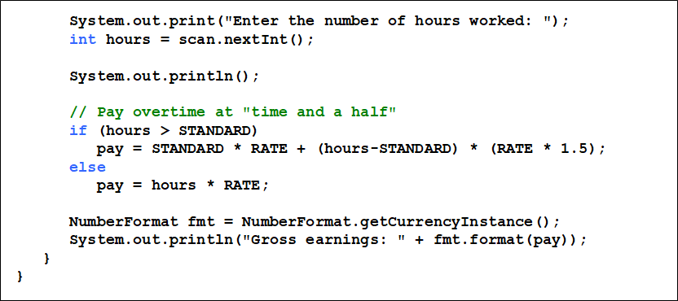
Listing 5.2 (2 of 3)

Slide 27
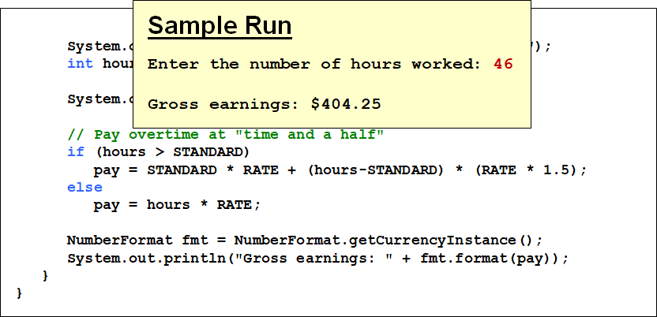
Listing 5.2 (3 of 3)

Slide 28
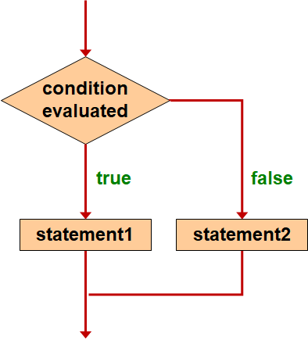
Logic of an if-Else Statement

Slide 29
The Coin Class
Let’s look at an example that uses a class that represents a coin that can be flipped
Instance data is used to indicate which face (heads or tails) is currently showing
See CoinFlip.java
See Coin.java

Slide 30
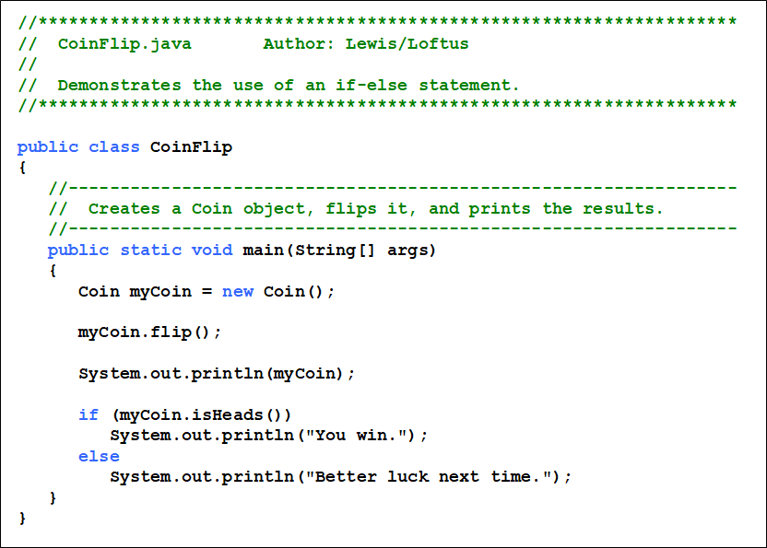
Listing 5.3 (1 of 2)

Slide 31
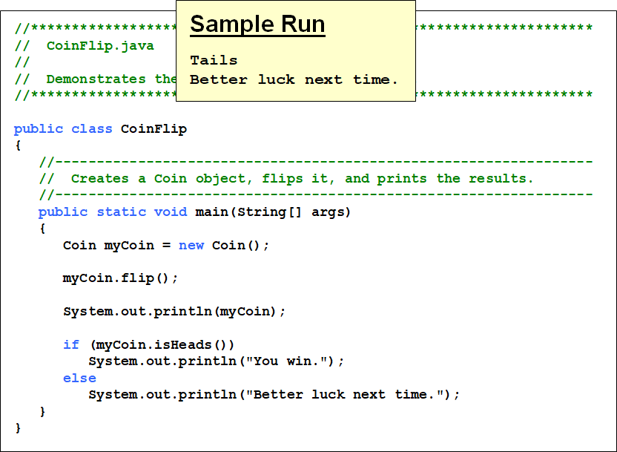
Listing 5.3 (2 of 2)

Slide 32
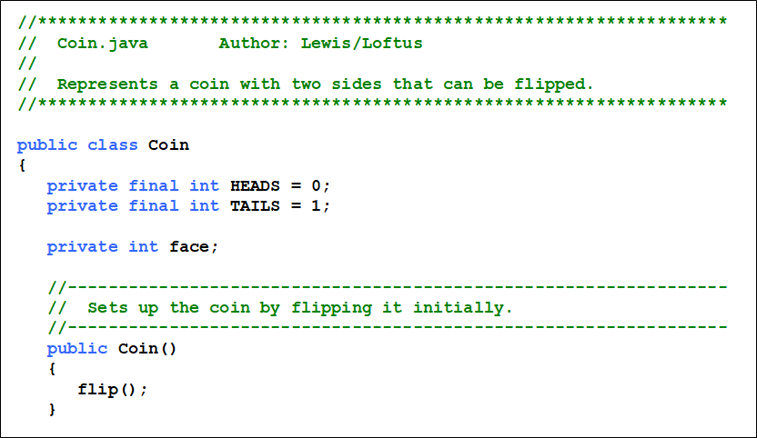
Listing 5.4 (1 of 3)

Slide 33
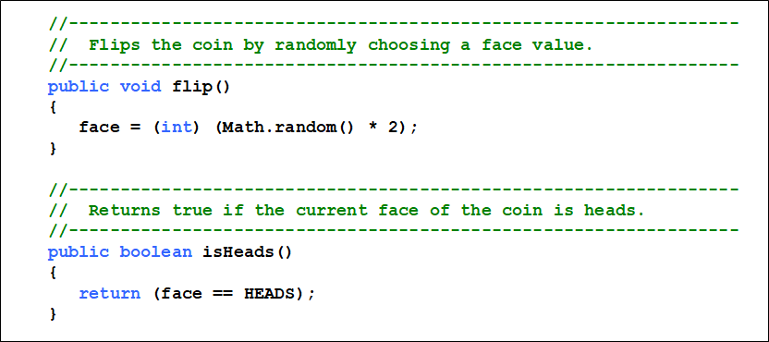
Listing 5.4 (2 of 3)

Slide 34
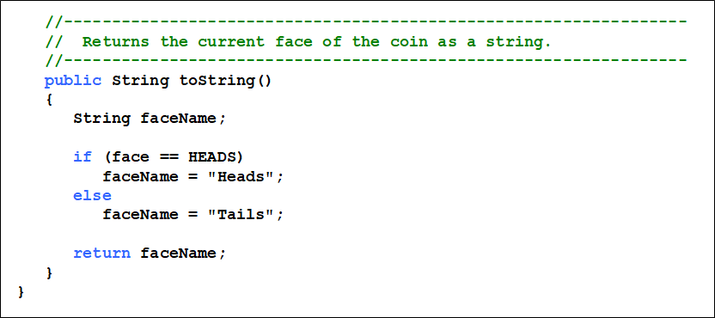
Listing 5.4 (3 of 3)

Slide 35
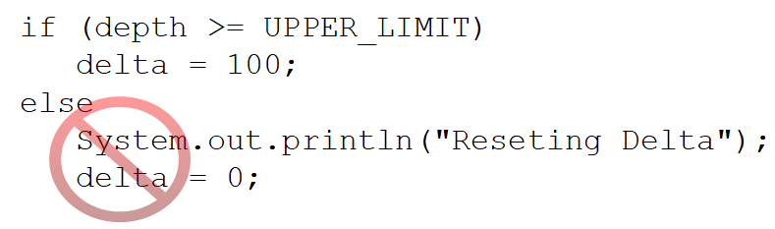
Indentation Revisited
Remember that indentation is for the human reader, and is ignored by the compiler
Despite what the indentation implies, delta will be set to 0 no matter what

Slide 36
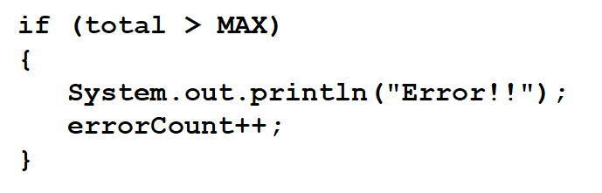
Block Statements (1 of 2)
Several statements can be grouped together into a block statement delimited by braces
A block statement can be used wherever a statement is called for in the Java syntax rules

Slide 37
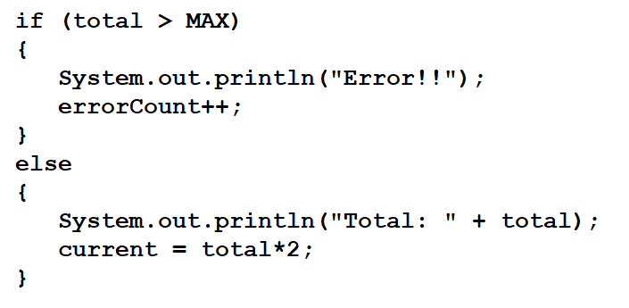
Block Statements (2 of 2)
The if clause, or the else clause, or both, could govern block statements
See Guessing.java

Slide 38
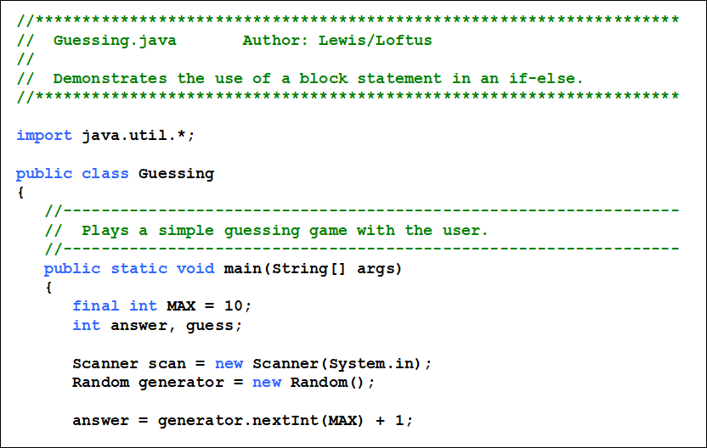
Listing 5.5 (1 of 3)

Slide 39
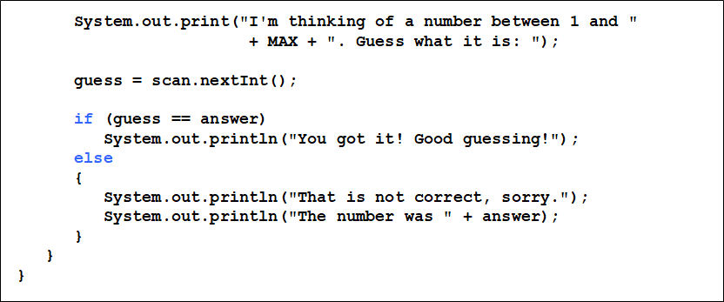
Listing 5.5 (2 of 3)

Slide 40
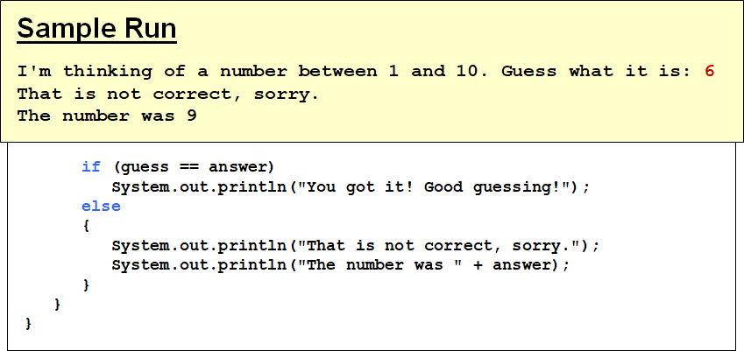
Listing 5.5 (3 of 3)

Slide 41
Nested if Statements
The statement executed as a result of an if or else clause could be another if statement
These are called nested if statements
An else clause is matched to the last unmatched if (no matter what the indentation implies)
Braces can be used to specify the if statement to which an else clause belongs
See MinOfThree.java

Slide 42
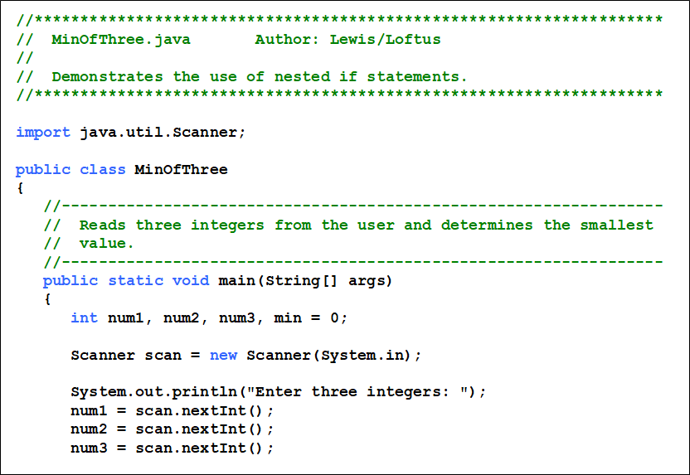
Listing 5.6 (1 of 3)

Slide 43
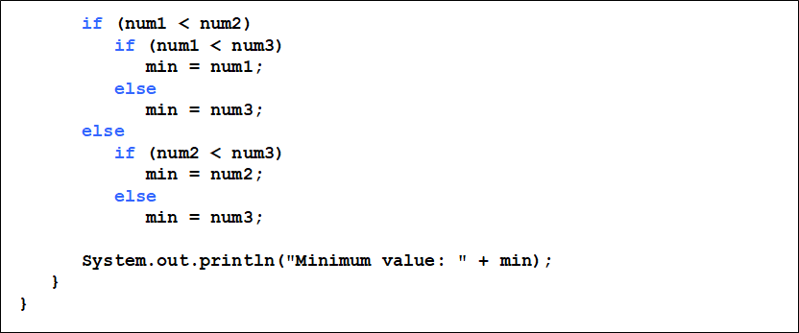
Listing 5.6 (2 of 3)

Slide 44
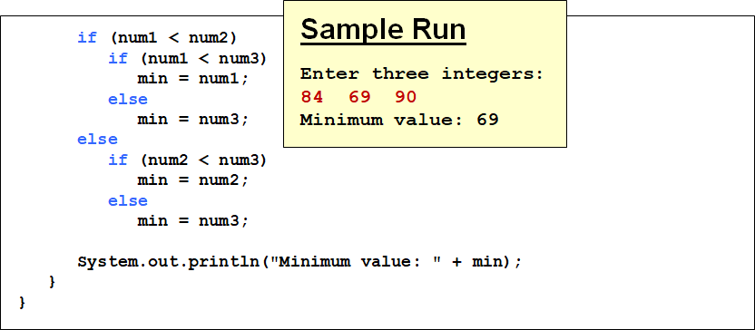
Listing 5.6 (3 of 3)

Slide 45
Outline (3 of 9)
Boolean Expressions
The if Statement
Comparing Data
The while Statement
Iterators
The ArrayList Class
Determining Event Sources
Managing Fonts
Check Boxes and Radio Buttons

Slide 46
Comparing Data
When comparing data using boolean expressions, it’s important to understand the nuances of certain data types
Let’s examine some key situations:
Comparing floating point values for equality
Comparing characters
Comparing strings (alphabetical order)
Comparing object versus comparing object references

Slide 47
Comparing Float Values (1 of 2)
You should rarely use the equality operator
when comparing two floating point values (float or double)
Two floating point values are equal only if their underlying binary representations match exactly
Computations often result in slight differences that may be irrelevant
In many situations, you might consider two floating point numbers to be “close enough” even if they aren’t exactly equal

Slide 48
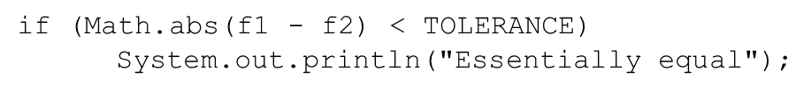
Comparing Float Values (2 of 2)
To determine the equality of two floats, use the following technique:
If the difference between the two floating point values is less than the tolerance, they are considered to be equal
The tolerance could be set to any appropriate level, such as 0.000001

Slide 49
Comparing Characters (1 of 2)
As we’ve discussed, Java character data is based on the Unicode character set
Unicode establishes a particular numeric value for each character, and therefore an ordering
We can use relational operators on character data based on this ordering
For example, the character '+' is less than the character 'J' because it comes before it in the Unicode character set
Appendix C provides an overview of Unicode

Slide 50
Comparing Characters (2 of 2)
In Unicode, the digit characters
are contiguous and
in order
Likewise, the uppercase letters
and lowercase letters
are contiguous and in order
Characters | Unicode Values
0 – 9 | 48 through 57
A – Z | 65 through 90
a – z | 97 through 122

Slide 51
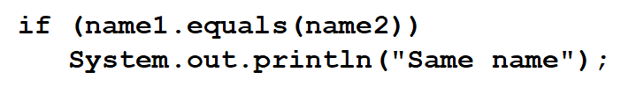
Comparing Strings (1 of 2)
Remember that in Java a character string is an object
The equals method can be called with strings to determine if two strings contain exactly the same characters in the same order
The equals method returns a boolean result

Slide 52
Comparing Strings (2 of 2)
We cannot use the relational operators to compare strings
The String class contains the compareTo method for determining if one string comes before another
A call to name1.compareTo(name2)
returns zero if name1 and name2 are equal (contain the same characters)
returns a negative value if name1 is less than name2
returns a positive value if name1 is greater than name2

Slide 53
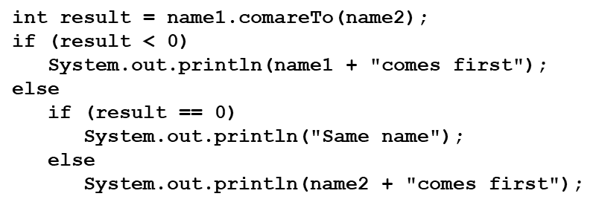
Comparing Strings
Because comparing characters and strings is based on a character set, it is called a lexicographic ordering

Slide 54
Lexicographic Ordering
Lexicographic ordering is not strictly alphabetical when uppercase and lowercase characters are mixed
For example, the string "Great" comes before the string "fantastic" because all of the uppercase letters come before all of the lowercase letters in Unicode
Also, short strings come before longer strings with the same prefix (lexicographically)
Therefore "book" comes before "bookcase"

Slide 55
Comparing Objects
The
operator can be applied to objects - it
returns true if the two references are aliases of each other
The equals method is defined for all objects, but unless we redefine it when we write a class, it has the same
semantics as the
operator
It has been redefined in the String class to compare the characters in the two strings
When you write a class, you can redefine the equals method to return true under whatever conditions are appropriate

Slide 56
Outline (4 of 9)
Boolean Expressions
The if Statement
Comparing Data
The while Statement
Iterators
The ArrayList Class
Determining Event Sources
Managing Fonts
Check Boxes and Radio Buttons

Slide 57
Repetition Statements
Repetition statements allow us to execute a statement multiple times
Often they are referred to as loops
Like conditional statements, they are controlled by boolean expressions
Java has three kinds of repetition statements: while, do, and for loops
The do and for loops are discussed in Chapter 6

Slide 58
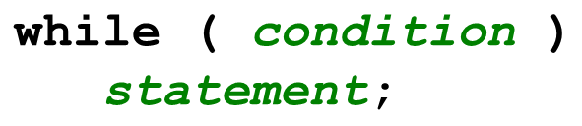
The While Statement (1 of 2)
A while statement has the following syntax:
If the condition is true, the statement is executed
Then the condition is evaluated again, and if it is still true, the statement is executed again
The statement is executed repeatedly until the condition becomes false

Slide 59
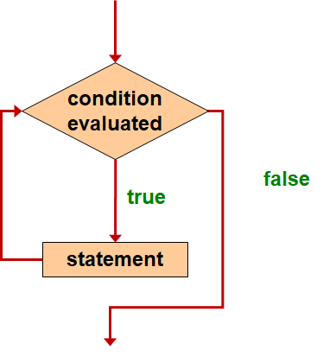
Logic of a While Loop

Slide 60
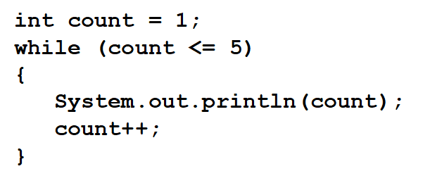
The While Statement (2 of 2)
An example of a while statement:
If the condition of a while loop is false initially, the statement is never executed
Therefore, the body of a while loop will execute zero or more times

Slide 61
Sentinel Values
Let’s look at some examples of loop processing
A loop can be used to maintain a running sum
A sentinel value is a special input value that represents the end of input
See Average.java

Slide 62
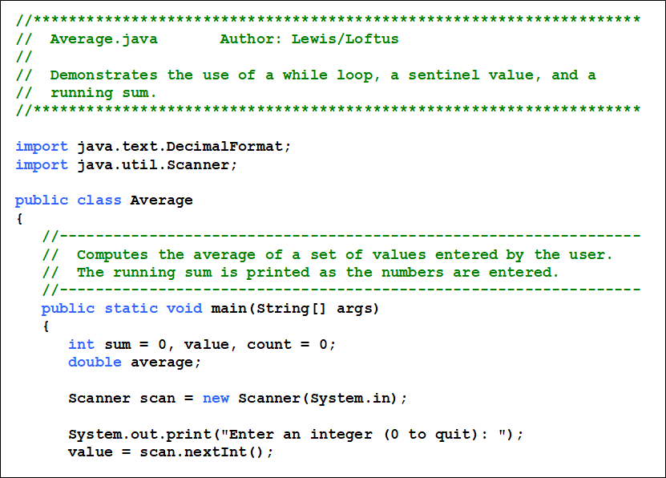
Listing 5.7 (1 of 4)

Slide 63
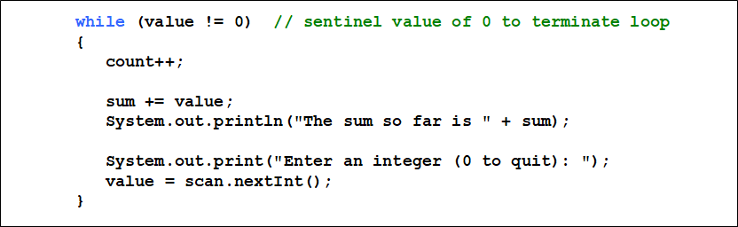
Listing 5.7 (2 of 4)

Slide 64
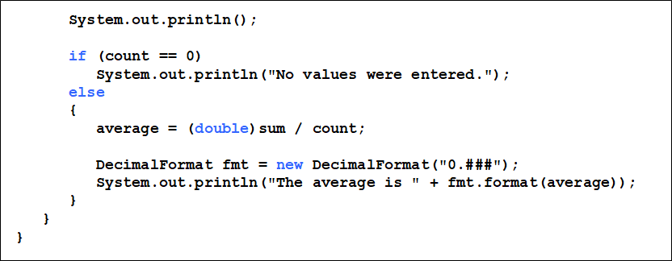
Listing 5.7 (3 of 4)

Slide 65
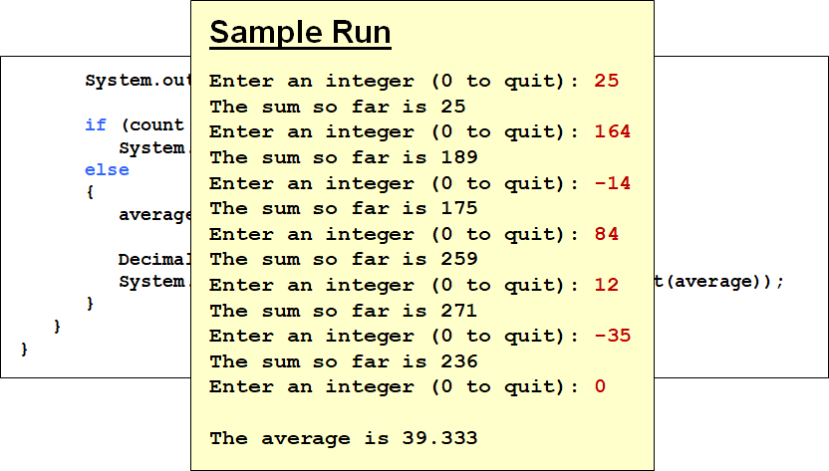
Listing 5.7 (4 of 4)

Slide 66
Input Validation
A loop can also be used for input validation, making a program more robust
It’s generally a good idea to verify that input is valid (in whatever sense) when possible
See WinPercentage.java

Slide 67
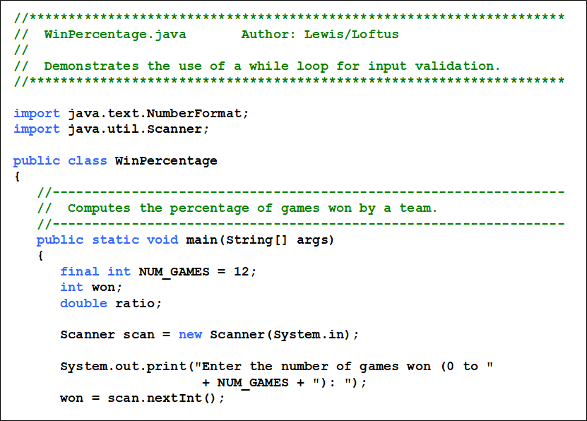
Listing 5.8 (1 of 3)

Slide 68
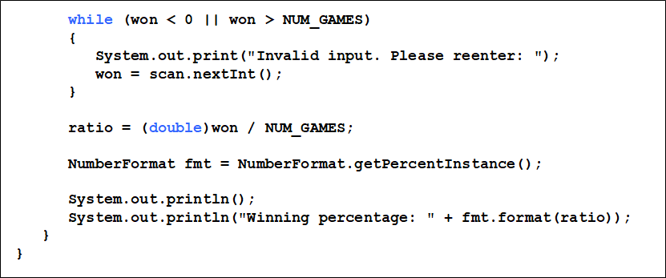
Listing 5.8 (2 of 3)

Slide 69
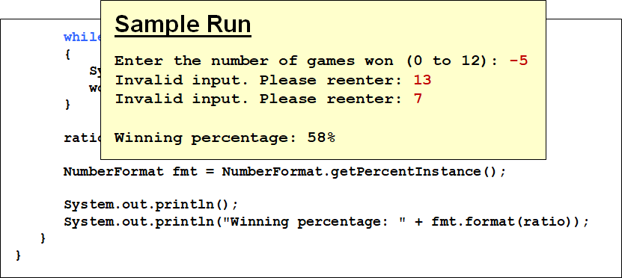
Listing 5.8 (3 of 3)

Slide 70
Infinite Loops (1 of 2)
The body of a while loop eventually must make the condition false
If not, it is called an infinite loop, which will execute until the user interrupts the program
This is a common logical error
You should always double check the logic of a program to ensure that your loops will terminate normally

Slide 71
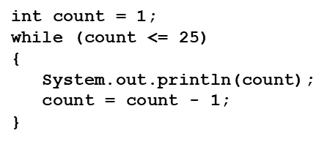
Infinite Loops (2 of 2)
An example of an infinite loop:
This loop will continue executing until interrupted (Control-C) or until an underflow error occurs

Slide 72
Nested Loops
Similar to nested if statements, loops can be nested as well
That is, the body of a loop can contain another loop
For each iteration of the outer loop, the inner loop iterates completely
See PalindromeTester.java

Slide 73
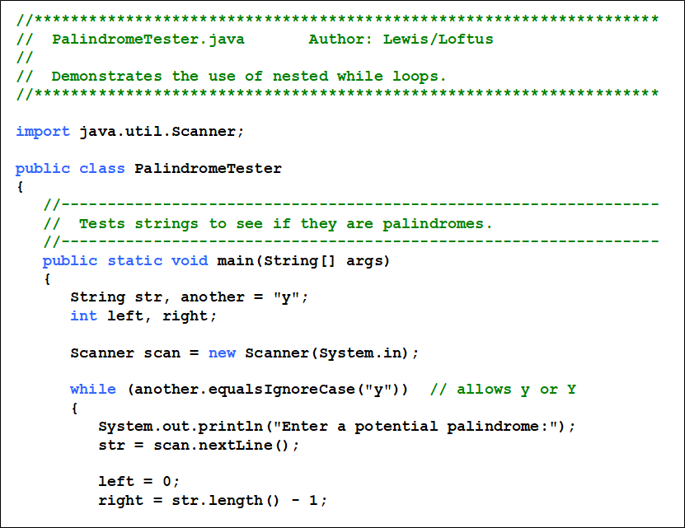
Listing 5.9 (1 of 3)

Slide 74
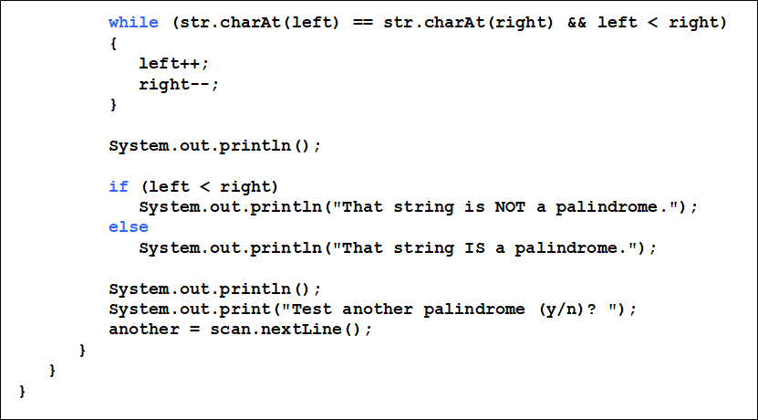
Listing 5.9 (2 of 3)

Slide 75
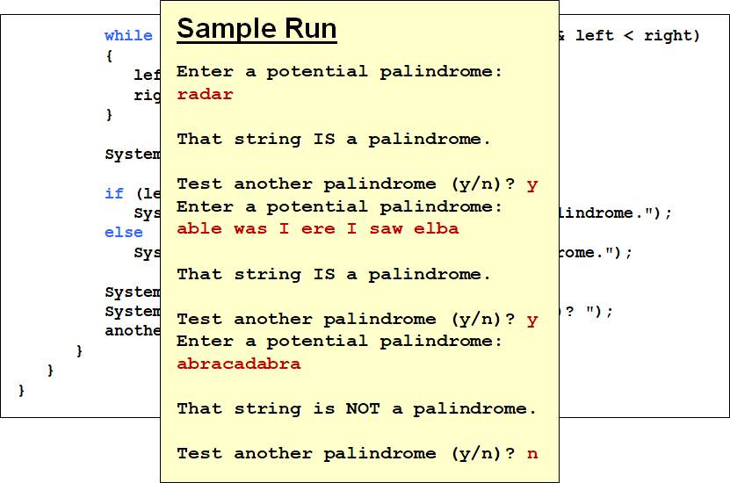
Listing 5.9 (3 of 3)

Slide 76
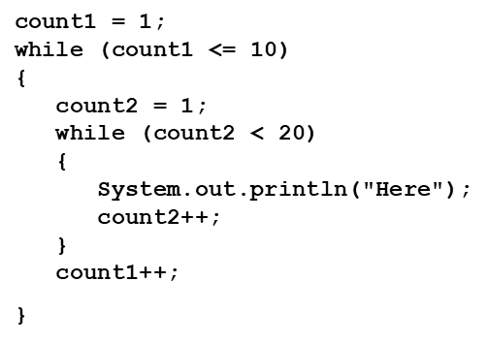
Quick Check 2 (1 of 2)
How many times will the string “Here” be printed?

Slide 77
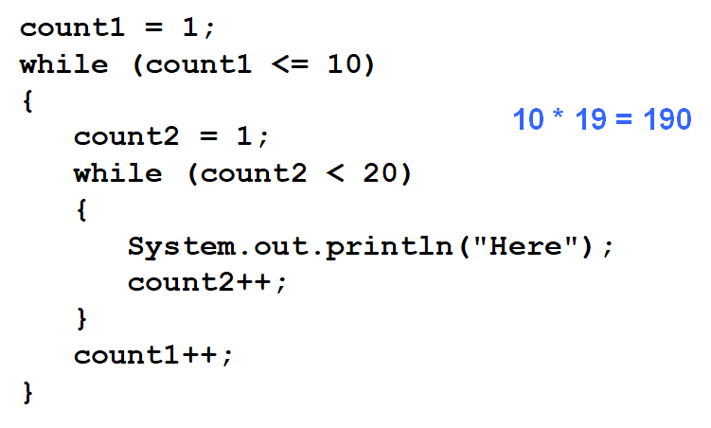
Quick Check 2 (2 of 2)
How many times will the string “Here” be printed?

Slide 78
Outline (5 of 9)
Boolean Expressions
The if Statement
Comparing Data
The while Statement
Iterators
The ArrayList Class
Determining Event Sources
Managing Fonts
Check Boxes and Radio Buttons

Slide 79
Iterators
An iterator is an object that allows you to process a collection of items one at a time
It lets you step through each item in turn and process it as needed
An iterator has a hasNext method that returns true if there is at least one more item to process
The next method returns the next item
Iterator objects are defined using the Iterator interface, which is discussed further in Chapter 7

Slide 80
Iterators (1 of 2)
Several classes in the Java standard class library are iterators
The Scanner class is an iterator
the hasNext method returns true if there is more data to be scanned
the next method returns the next scanned token as a string
The Scanner class also has variations on the hasNext method for specific data types (such as hasNextInt)

Slide 81
Iterators (2 of 2)
The fact that a Scanner is an iterator is particularly helpful when reading input from a file
Suppose we wanted to read and process a list of U R Ls stored in a file
One scanner can be set up to read each line of the input until the end of the file is encountered
Another scanner can be set up for each U R L to process each part of the path
See U R LDissector.java

Slide 82
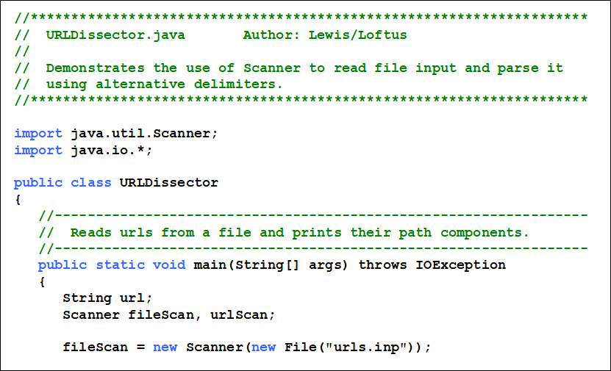
Listing 5.10 (1 of 3)

Slide 83
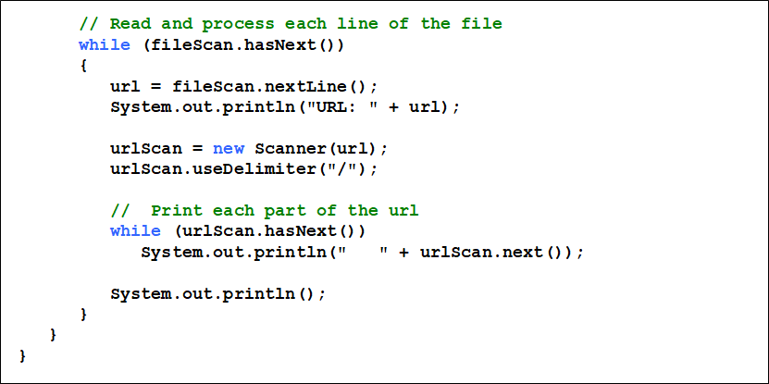
Listing 5.10 (2 of 3)

Slide 84

Listing 5.10 (3 of 3)

Slide 85
Outline (6 of 9)
Boolean Expressions
The if Statement
Comparing Data
The while Statement
Iterators
The ArrayList Class
Determining Event Sources
Managing Fonts
Check Boxes and Radio Buttons

Slide 86
The ArrayList Class (1 of 3)
An ArrayList object stores a list of objects, and is often processed using a loop
The ArrayList class is part of the java.util package
You can reference each object in the list using a numeric index
An ArrayList object grows and shrinks as needed, adjusting its capacity as necessary

Slide 87
The ArrayList Class (2 of 3)
Index values of an ArrayList begin at 0 (not 1):
0 | “Bashful”
1 | “Sleepy”
2 | “Happy”
3 | “Dopey”
4 | “Doc”
Elements can be inserted and removed
The indexes of the elements adjust accordingly

Slide 88

ArrayList Methods
Some ArrayList methods:

Slide 89

The ArrayList Class (3 of 3)
The type of object stored in the list is established when the ArrayList object is created:
This makes use of Java generics, which provide additional type checking at compile time
An ArrayList object cannot store primitive types, but that’s what wrapper classes are for
See Beatles.java

Slide 90

Listing 5.11 (1 of 3)

Slide 91

Listing 5.11 (2 of 3)

Slide 92

Listing 5.11 (3 of 3)

Slide 93
Outline (7 of 9)
Boolean Expressions
The if Statement
Comparing Data
The while Statement
Iterators
The ArrayList Class
Determining Event Sources
Managing Fonts
Check Boxes and Radio Buttons

Slide 94
Determining Event Sources
Recall that you must establish a relationship between controls and the event handlers that respond to events
When appropriate, one event handler object can be used to listen to multiple controls
The source of the event can be determined by using the getSource method of the event passed to the event handler
See RedOrBlue.java

Slide 95

Listing 5.12 (1 of 4)

Slide 96

Listing 5.12 (2 of 4)

Slide 97

Listing 5.12 (3 of 4)

Slide 98

Listing 5.12 (4 of 4)

Slide 99
Outline (8 of 9)
Boolean Expressions
The if Statement
Comparing Data
The while Statement
Iterators
The ArrayList Class
Determining Event Sources
Managing Fonts
Check Boxes and Radio Buttons

Slide 100
Managing Fonts (1 of 3)
The Font class represents a character font, which specify what characters look like when displayed
A font can be applied to a Text object or any control that displays text (such as a Button or Label)
A font is specifies:
font family (Arial, Courier, Helvetica)
font size (in units called points)
font weight (boldness)
font posture (italic or normal)

Slide 101
Managing Fonts (2 of 3)
A Font object is created using either the Font constructor or by calling the static font method
The Font constructor can only take a font size, or a font family and size
To set the font weight or font posture, use the font method, which can specify various combinations of font characteristics
See FontDemo.java

Slide 102

Listing 5.13 (1 of 3)

Slide 103

Listing 5.13 (2 of 3)

Slide 104

Listing 5.13 (3 of 3)

Slide 105
Managing Fonts (3 of 3)
Note that setting the text color is not a function of the font applied
It’s set through the Text object directly
The same is true for underlined text (or a “strike through” effect)

Slide 106
Outline (9 of 9)
Boolean Expressions
The if Statement
Comparing Data
The while Statement
Iterators
The ArrayList Class
Determining Event Sources
Managing Fonts
Check Boxes and Radio Buttons

Slide 107
Check Boxes (1 of 2)
A check box is a button that can be toggled on or off
It is represented by the JavaFX CheckBox class
Checking or unchecking a check box produces an action event
See StyleOptions.java
See StyleOptionsPane.java

Slide 108

Listing 5.14 (1 of 2)

Slide 109

Listing 5.14 (2 of 2)

Slide 110
Check Boxes (2 of 2)
The StyleOptionsPane class uses two layout panes: HBox and VBox
The HBox pane arranges its nodes into a single row horizontally
The VBox pane arranges its nodes into a single column vertically
StyleOptionsPane extends VBox, and is used to put the text above the check boxes
The HBox puts the check boxes side by side

Slide 111

Listing 5.15 (1 of 3)

Slide 112

Listing 5.15 (2 of 3)

Slide 113

Listing 5.15 (3 of 3)

Slide 114
Check Boxes
The event handler method is called when either check box is toggled
Instead of tracking which box was changed, the method just checks the current status of both boxes and sets the font accordingly

Slide 115
Radio Buttons (1 of 2)
Let’s look at a similar example that uses radio buttons
A group of radio buttons represents a set of mutually exclusive options - only one button can be selected at any given time
When a radio button from a group is selected, the button that is currently “on” in the group is automatically toggled off
See QuoteOptions.java
See QuoteOptionsPane.java

Slide 116

Listing 5.16 (1 of 2)

Slide 117

Listing 5.16 (2 of 2)

Slide 118
Radio Buttons (2 of 2)
To establish a set of mutually exclusive options, the radio buttons that work together as a group are added to a ToggleGroup object
The setToggleGroup method is used to specify which toggle group a button belongs to
The isSelected method of a radio button returns true if that button is currently “on”

Slide 119

Listing 5.17 (1 of 4)

Slide 120

Listing 5.17 (2 of 4)

Slide 121

Listing 5.17 (3 of 4)

Slide 122

Listing 5.17 (4 of 4)

Slide 123
Summary
Chapter 5 focused on:
boolean expressions
the if and if-else statements
comparing data
while loops
iterators
the ArrayList class
more G U I controls

Slide 124

Copyright
This work is protected by United States copyright laws and is provided solely for the use of instructors in teaching their courses and assessing student learning. Dissemination or sale of any part of this work (including on the World Wide Web) will destroy the integrity of the work and is not permitted. The work and materials from it should never be made available to students except by instructors using the accompanying text in their classes. All recipients of this work are expected to abide by these restrictions and to honor the intended pedagogical purposes and the needs of other instructors who rely on these materials.

