Slide 1
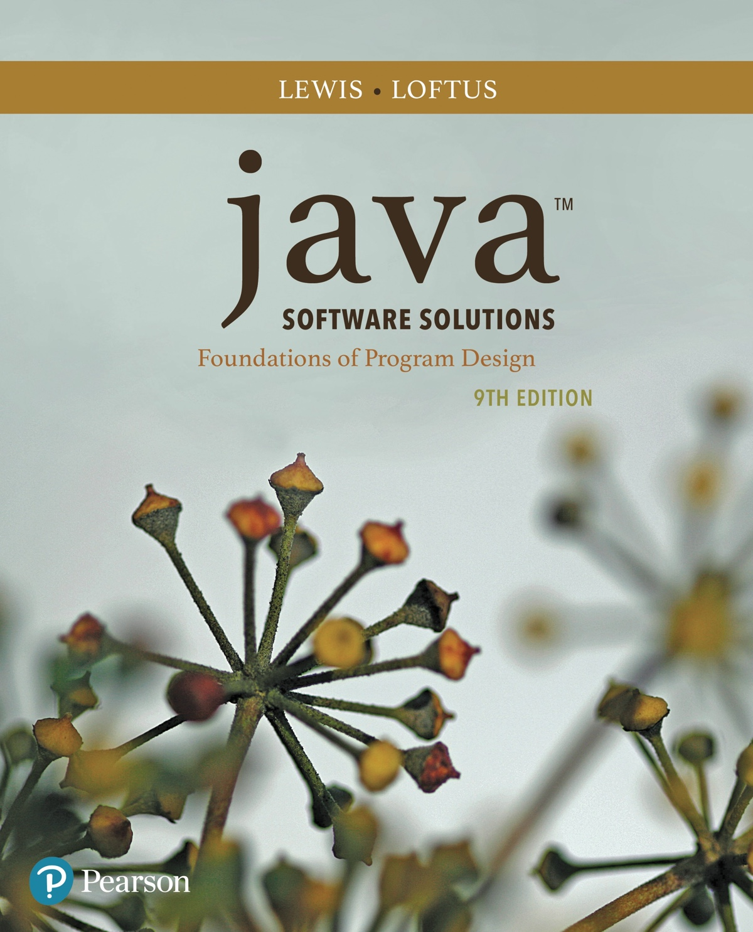
Java™ Software Solutions: Foundations of Program Design
Ninth Edition
Chapter 1
Introduction
Slides in this presentation contain hyperlinks. JAWS users should be able to get a list of links by using INSERT+F7
Copyright © 2018 Pearson Education, Inc. All Rights Reserved
Notes:
If this PowerPoint presentation contains mathematical equations, you may need to check that your computer has the following installed:
1) MathType Plugin
2) Math Player (free versions available)
3) NVDA Reader (free versions available)

Slide 2
Focus of the Course
Object-Oriented Software Development
problem solving
program design, implementation, and testing
object-oriented concepts
classes
objects
encapsulation
inheritance
polymorphism
graphical user interfaces
the Java programming language

Slide 3
Introduction
We start with the fundamentals of computer processing
Chapter 1 focuses on:
components of a computer
how computers store and manipulate information
computer networks
the Internet and the World Wide Web
programming and programming languages
an introduction to Java
an overview of object-oriented concepts

Slide 4
Outline (1 of 6)
Computer Processing
Hardware Components
Networks
The Java Programming Language
Program Development
Object-Oriented Programming

Slide 5
Hardware and Software
Hardware
the physical, tangible parts of a computer
keyboard, monitor, disks, wires, chips, etc.
Software
programs and data
a program is a series of instructions
A computer requires both hardware and software
Each is essentially useless without the other

Slide 6
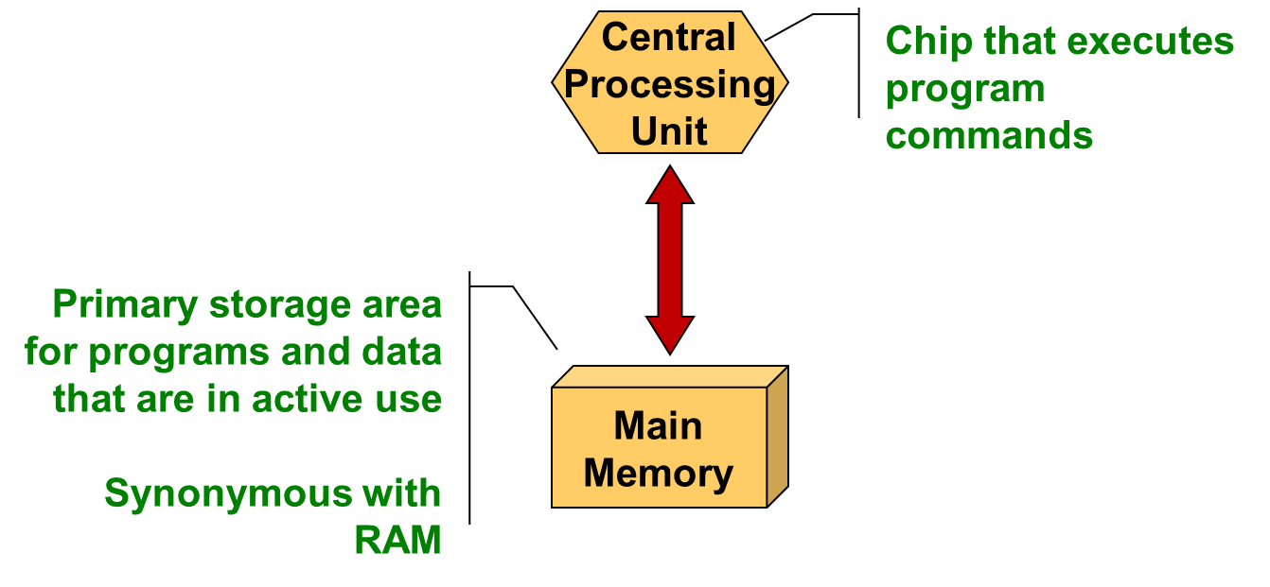
C P U and Main Memory

Slide 7
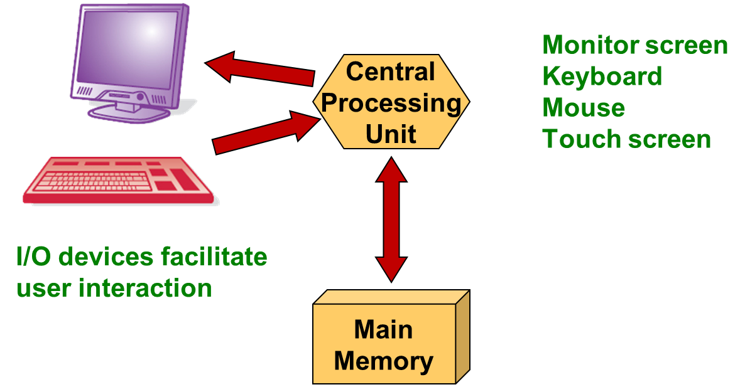
Input / Output Devices

Slide 8
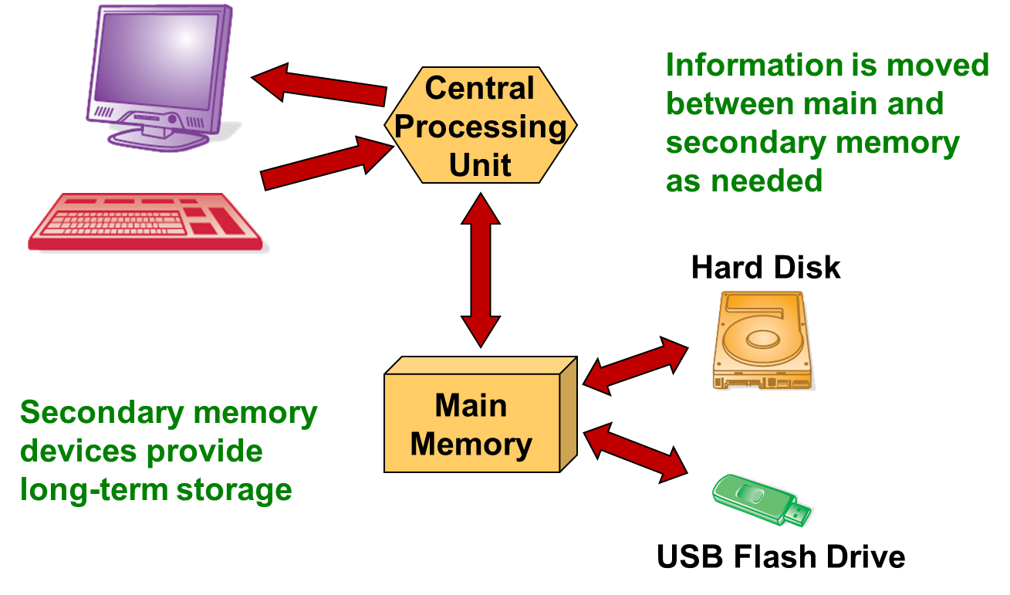
Secondary Memory Devices

Slide 9
Software Categories
Operating System
controls all machine activities
provides the user interface to the computer
manages resources such as the C P U and memory
Windows, Mac O S, Unix, Linux,
Application program
generic term for any other kind of software
word processors, missile control systems, games
Most operating systems and application programs have a graphical user interface (G U I)

Slide 10
Analog versus Digital
There are two basic ways to store and manage data:
Analog
continuous, in direct proportion to the data represented
music on a record album - a needle rides on ridges in the grooves that are directly proportional to the voltages sent to the speaker
Digital
the information is broken down into pieces, and each piece is represented separately
sampling - record discrete values of the analog representation
music on a compact disc - the disc stores numbers representing specific voltage levels sampled at specific times

Slide 11
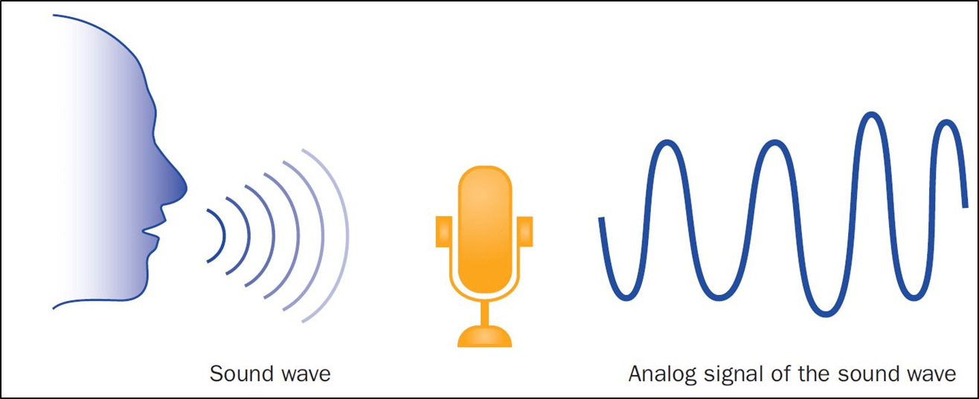
Analog Information

Slide 12
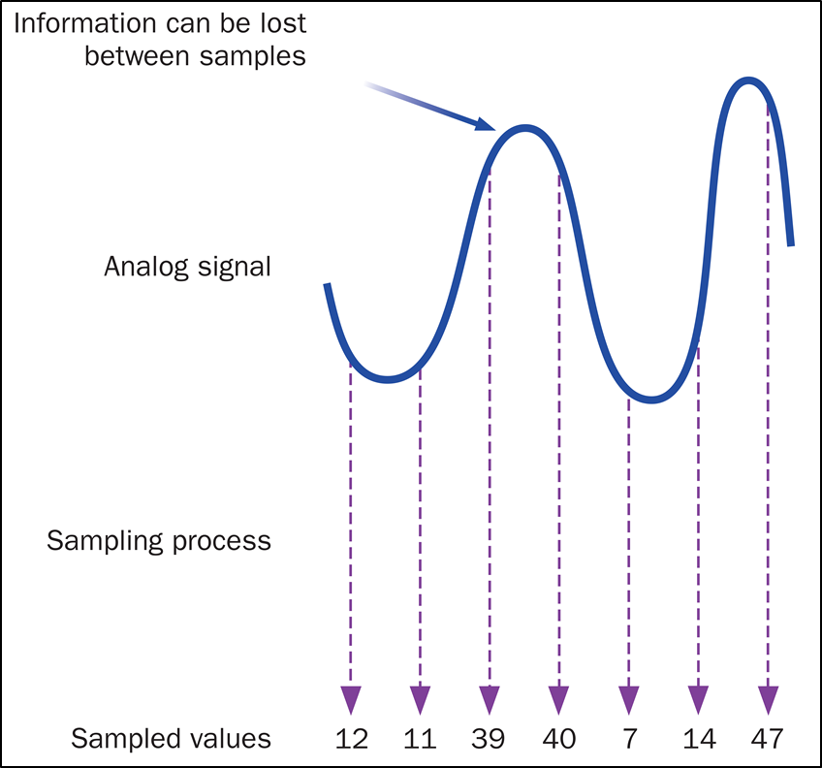
Sampling

Slide 13
Digital Information
Computers store all information digitally:
numbers
text
graphics and images
audio
video
program instructions
In some way, all information is digitized - broken down into pieces and represented as numbers

Slide 14
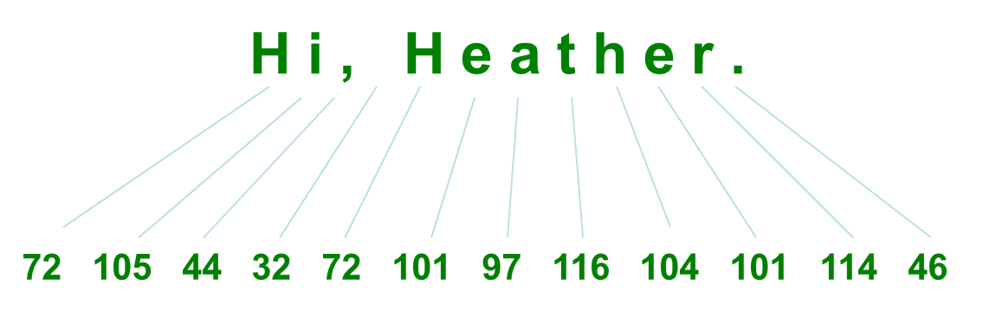
Representing Text Digitally
For example, every character is stored as a number, including spaces, digits, and punctuation
Corresponding upper and lower case letters are separate characters

Slide 15
Binary Numbers
Once information has been digitized, it is represented and stored in memory using the binary number system
A single binary digit (0 or 1) is called a bit
Devices that store and move information are cheaper and more reliable if they have to represent only two states
A single bit can represent two possible states, like a light bulb that is either on (1) or off (0)
Permutations of bits are used to store values

Slide 16
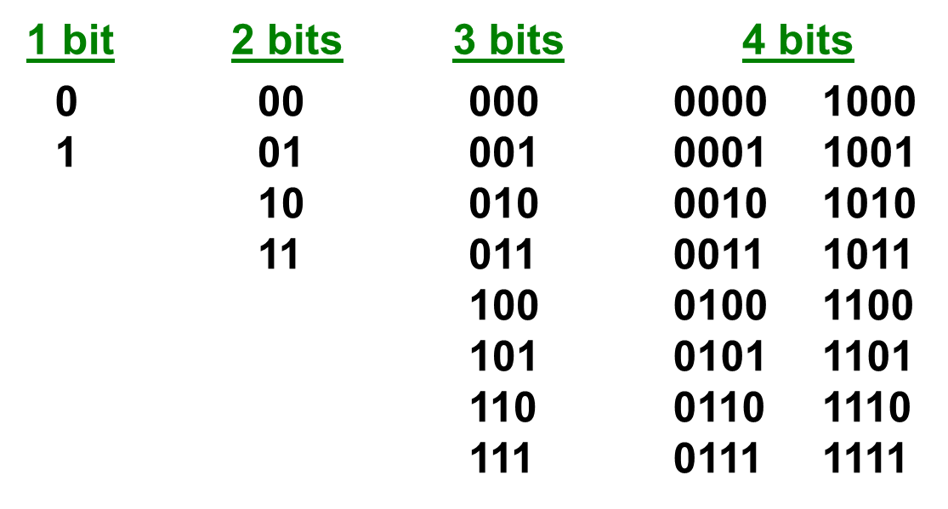
Bit Permutations (1 of 2)
Each additional bit doubles the number of possible permutations

Slide 17
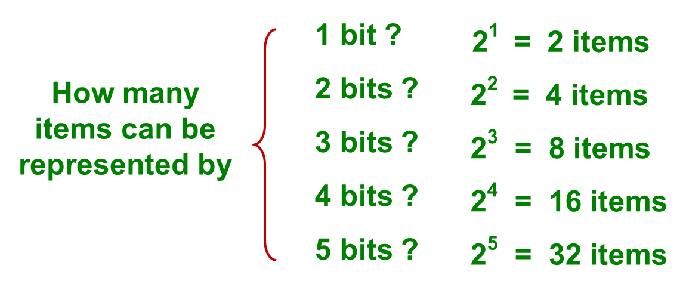
Bit Permutations (2 of 2)
Each permutation can represent a particular item
There are
permutations of N bits
Therefore, N bits are needed to represent
unique items

Slide 18
Quick Check 1 (1 of 2)
How many bits would you need to represent each of the 50 United States using a unique permutation of bits?

Slide 19
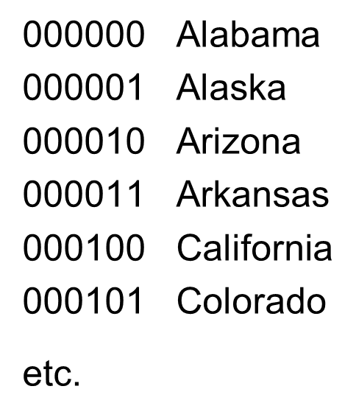
Quick Check 1 (2 of 2)
How many bits would you need to represent each of the 50 United States using a unique permutation of bits?
Five bits wouldn’t be
enough, because
Six bits would give us 64 permutations, and some wouldn’t be used.

Slide 20
Outline (2 of 6)
Computer Processing
Hardware Components
Networks
The Java Programming Language
Program Development
Object-Oriented Programming

Slide 21
A Computer Specification
Consider the following specification for a personal computer:
Intel Dual-Core i7 processor
4 G B RAM
750 G B Hard Disk
High Definition Display with 1366 × 768 resolution
802.11 wireless card

Slide 22
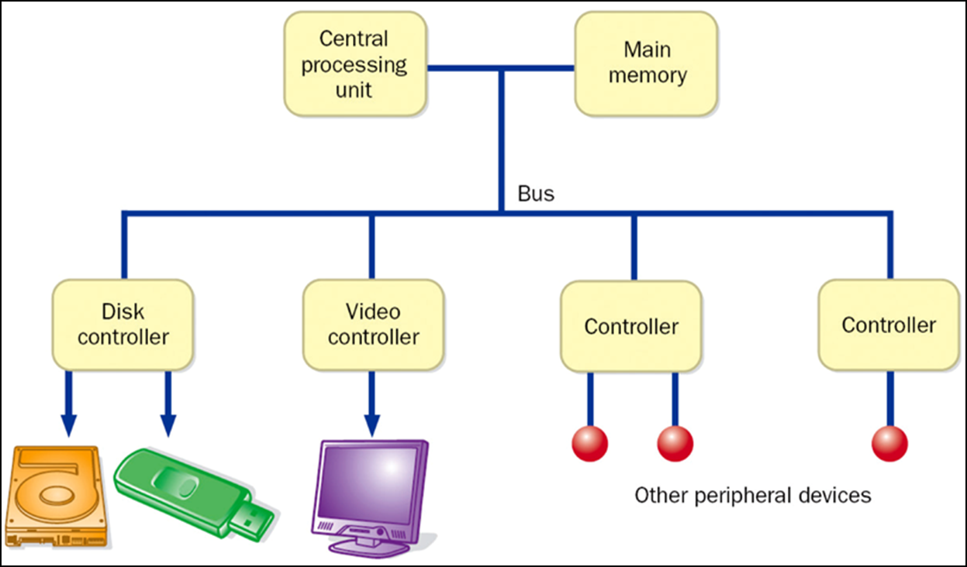
Computer Architecture

Slide 23
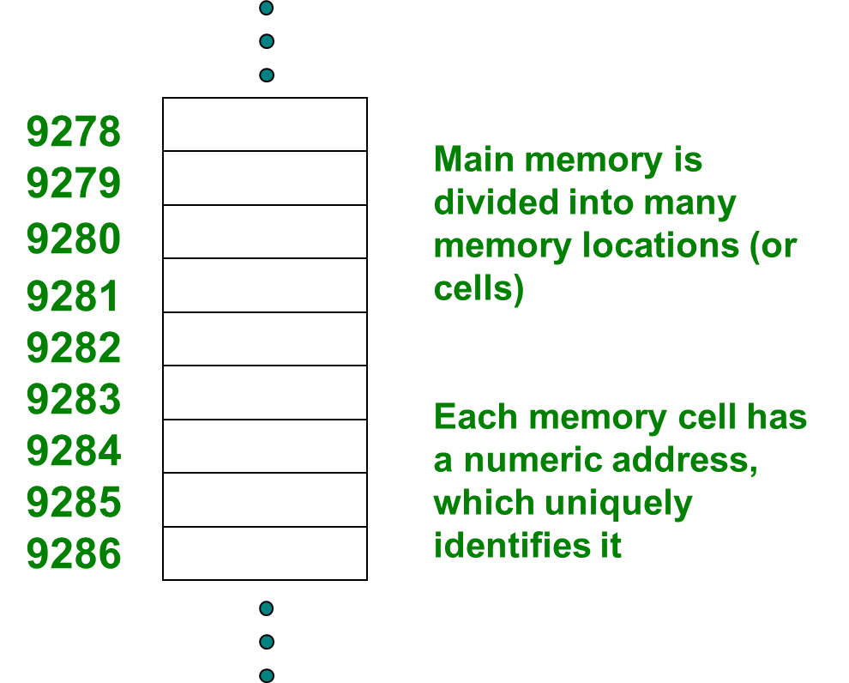
Memory (1 of 2)

Slide 24
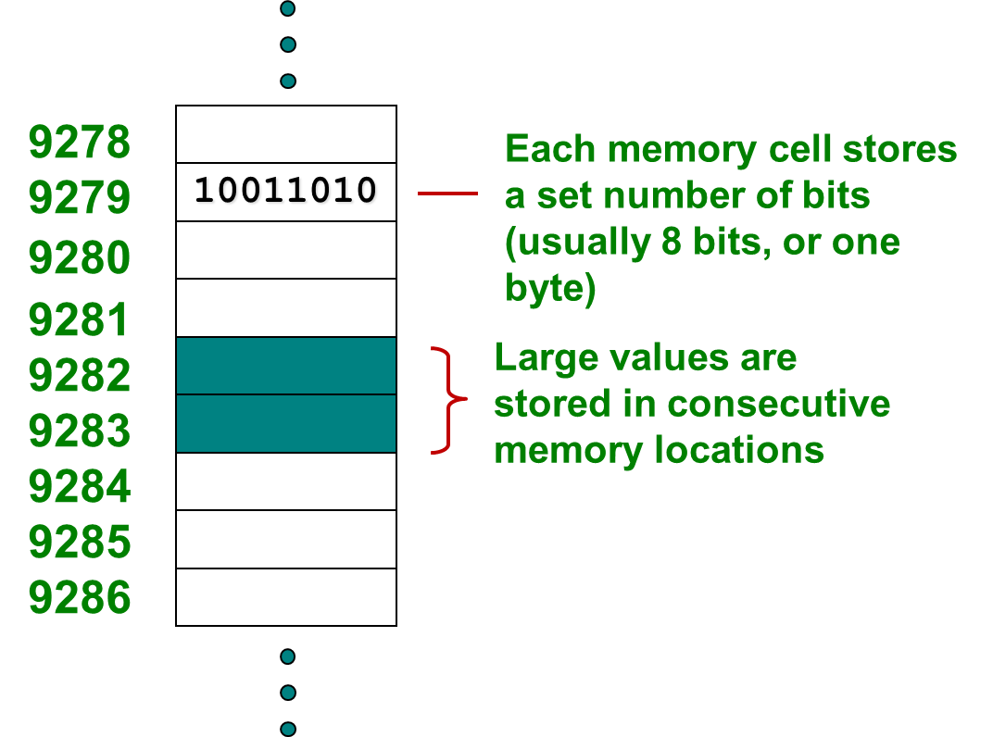
Storing Information

Slide 25
Storage Capacity
Every memory device has a storage capacity, indicating the number of bytes it can hold
Capacities are expressed in various units:
Unit | Symbol | Number of Bytes
kilobyte | K B | 2 to the tenth power = 1024
megabyte | M B | 2 to the twentieth power, over one million
gigabyte | G B | 2 to the thirtieth power, over one million
terabyte | T B | 2 to the fortieth power, over one million
petabyte | P B | 2 to the fiftieth power, a whole bunch

Slide 26
Memory (2 of 2)
Main memory is volatile - stored information is lost if the electric power is removed
Secondary memory devices are nonvolatile
Main memory and disks are direct access devices - information can be reached directly
The terms direct access and random access often are used interchangeably
A magnetic tape is a sequential access device since its data is arranged in a linear order - you must get by the intervening data in order to access other information

Slide 27
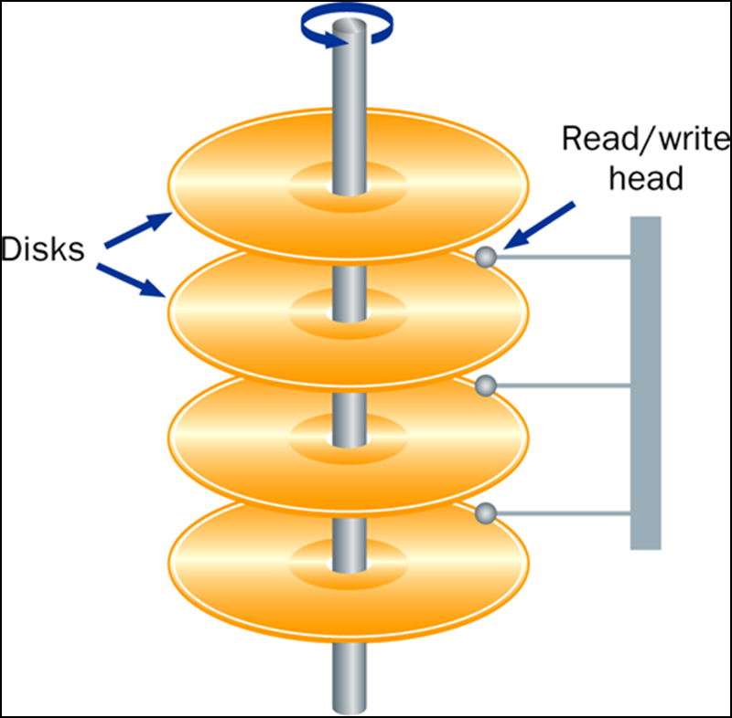
Hard Disk Drive

Slide 28
RAM versus ROM
RAM - Random Access Memory (direct access)
ROM - Read-Only Memory
The terms RAM and main memory are basically interchangeable
ROM could be a set of memory chips, or a separate device, such as a C D ROM
Both RAM and ROM are random (direct) access devices!
RAM probably should be called Read-Write Memory

Slide 29
Compact Discs
A C D-ROM is portable read-only memory
A microscopic pit on a C D represents a binary 1 and a smooth area represents a binary 0
A low-intensity laser reflects strongly from a smooth area and weakly from a pit
A C D-Recordable (C D-R) drive can be used to write information to a C D once
The speed of a C D drive indicates how fast (max) it can read and write information to a C D

Slide 30
D V Ds
A D V D is the same physical size as a C D, but can store much more information
The format of a D V D stores more bits per square inch
A C D can store 650 M B, while a standard D V D can store 4.7 G B
A double sided D V D can store 9.4 G B
Other advanced techniques can bring the capacity up to 17.0 G B
Like C Ds, there are D V D-R discs

Slide 31
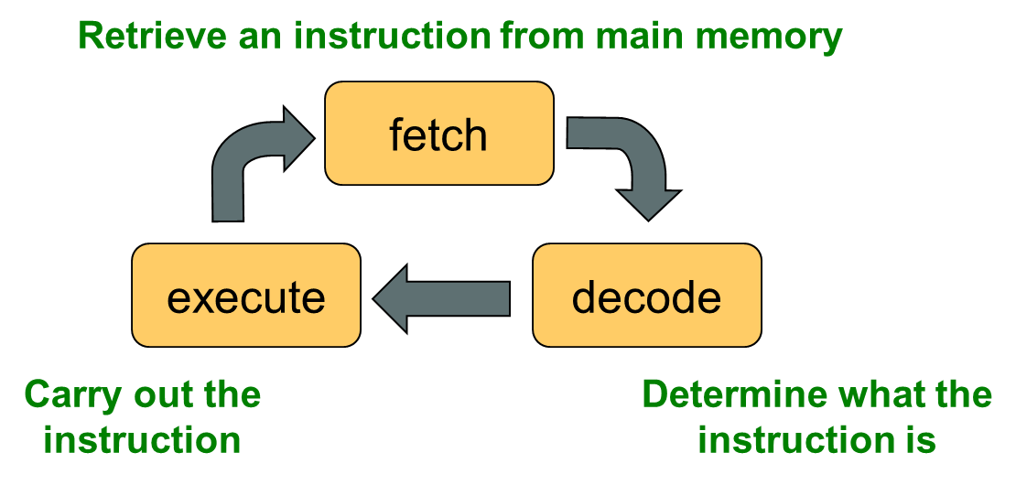
The Central Processing Unit (1 of 3)
A C P U is on a chip called a microprocessor
It continuously follows the fetch-decode-execute cycle:

Slide 32
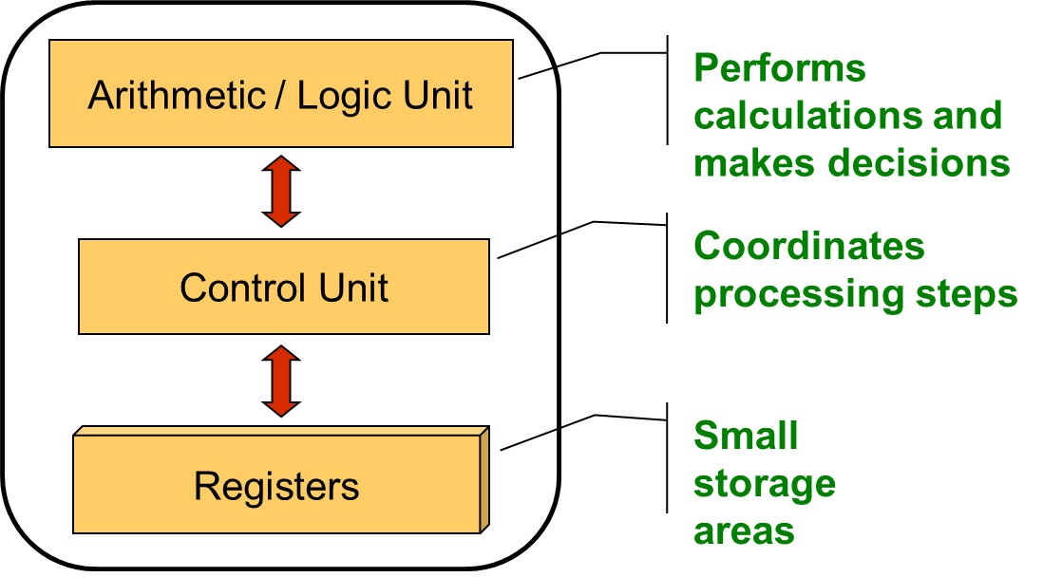
The Central Processing Unit (2 of 3)

Slide 33
The Central Processing Unit (3 of 3)
The speed of a C P U is controlled by the system clock
The system clock generates an electronic pulse at regular intervals
The pulses coordinate the activities of the C P U
The speed is usually measured in gigahertz (G H z)

Slide 34
Monitor
The size of a monitor
is measured diagonally, like
a television screen
A monitor has a certain maximum resolution , indicating the number of picture elements, called pixels, that it can display (such as 1366 by 768)
High resolution (more pixels) produces sharper pictures

Slide 35
Outline (3 of 6)
Computer Processing
Hardware Components
Networks
The Java Programming Language
Program Development
Object-Oriented Programming

Slide 36
Networks
A network is two or more computers that are connected so that data and resources can be shared
Most computers are connected to some kind of network
Each computer has its own network address, which uniquely identifies it among the others
A file server is a network computer dedicated to storing programs and data that are shared among network users

Slide 37
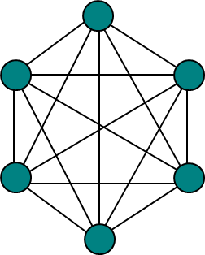
Network Connections (1 of 2)
Each computer in a network could be directly connected to every other computer in the network
These are called point-to-point connections
Adding a computer requires a new communication line for each computer already in the network
This technique is not practical for more than a few close machines

Slide 38
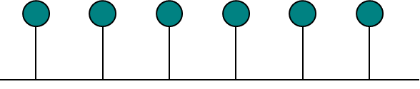
Network Connections (2 of 2)
Most networks share a single communication line
Adding a new computer to the network is relatively easy
Network traffic must take turns using the line, which introduces delays
Often information is broken down in parts, called packets, which are sent to the receiving machine and then reassembled

Slide 39
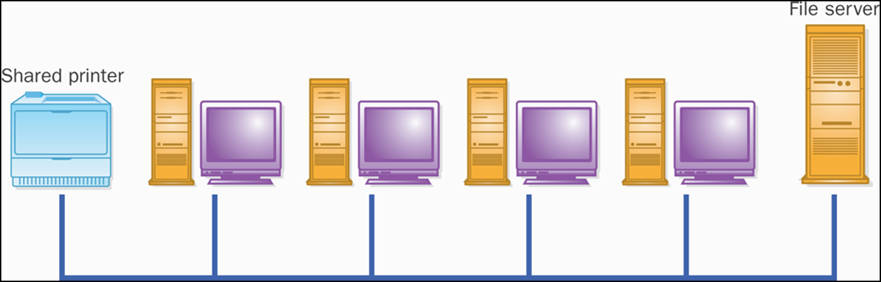
A Computer Network

Slide 40
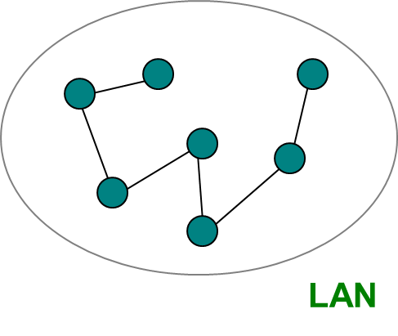
Local-Area Networks
A Local-Area Network (L A N) covers a small distance and a small number of computers
A LAN often connects the machines in a single room or building

Slide 41
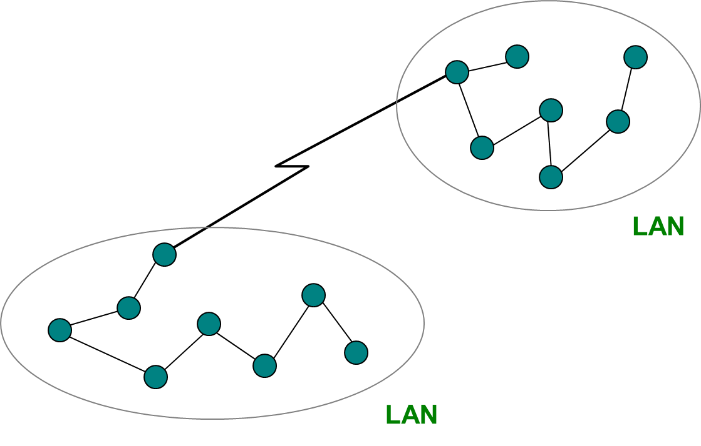
Wide-Area Networks
A Wide-Area Network (W A N) connects two or more LANs, often over long distances

Slide 42
The Internet
The Internet is a W A N which spans the planet
The word Internet comes from the term internetworking
It started as a United States government project, sponsored by the Advanced Research Projects Agency (A R P A)
originally it was called the A R P A NET
The Internet grew quickly throughout the 1980s and 90s

Slide 43
T C P / I P
A protocol is a set of rules that determine how things communicate with each other
The software that manages Internet communication follows a suite of protocols called T C P / I P
The Internet Protocol (I P) determines the format of the information as it is transferred
The Transmission Control Protocol (T C P) dictates how messages are reassembled and handles lost information

Slide 44


I P and Internet Addresses
Each computer on the Internet has a unique I P address, such as:
Most computers also have a unique Internet name, which also is referred to as an Internet address:
The first part indicates a particular computer (hector)
The rest is the domain name, indicating the organization (vt.edu)

Slide 45
Domain Names (1 of 2)
The last part of a domain name, called a top-level domain (T L D), supposedly indicates the type of organization:
edu | educational institution
com | commercial entity
org | non-profit organization
net | network-based organization
Sometimes the suffix indicates the country:
Additional T L Ds have been added, including:
biz, info, t v, name
u k | United Kingdom
a u | Australia
c a | Canada
s e | Sweden

Slide 46
Domain Names (2 of 2)
A domain name can have several parts
Unique domain names mean that multiple sites can have individual computers with the same local name
When used, an Internet address is translated to an I P address by software called the Domain Name System (D N S)
There is no one-to-one correspondence between the sections of an I P address and the sections of an Internet address

Slide 47
The World Wide Web (1 of 2)
The World Wide Web allows many different types of information to be accessed using a common interface
A browser is a program which accesses network resources and presents them
Popular browsers: Internet Explorer, Safari, Firefox
Resources presented include:
text, graphics, video, sound, audio, executable programs
A Web document usually contains links to other Web documents, creating a hypermedia environment
The term Web comes from the fact that information is not organized in a linear fashion

Slide 48
The World Wide Web (2 of 2)
Web documents are often defined using the HyperText Markup Language (H T M L)
Information on the Web is found using a Uniform Resource Locator (U R L):
http://www.google.com
http://www.whitehouse.gov/issues/education
A U R L specifies a protocol (h t t p), a domain, and possibly specific documents
You can also use a browser with other protocols, such as f t p

Slide 49
Outline (4 of 6)
Computer Processing
Hardware Components
Networks
The Java Programming Language
Program Development
Object-Oriented Programming

Slide 50
Java
The Java programming language was created by Sun Microsystems, Inc.
It was introduced in 1995 and it's popularity has grown quickly since
A programming language specifies the words and symbols that we can use to write a program
A programming language employs a set of rules that dictate how the words and symbols can be put together to form valid program statements

Slide 51
Java Program Structure (1 of 3)
In the Java programming language:
A program is made up of one or more classes
A class contains one or more methods
A method contains program statements
These terms will be explored in detail throughout the course
A Java application always contains a method called main
See Lincoln.java

Slide 52
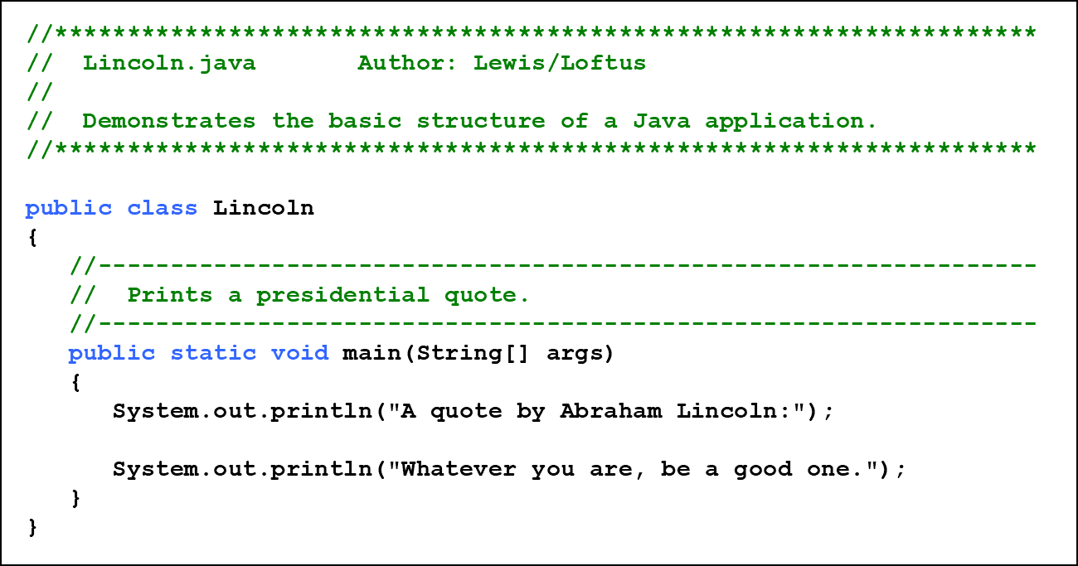
Listing 1.1 (1 of 2)

Slide 53
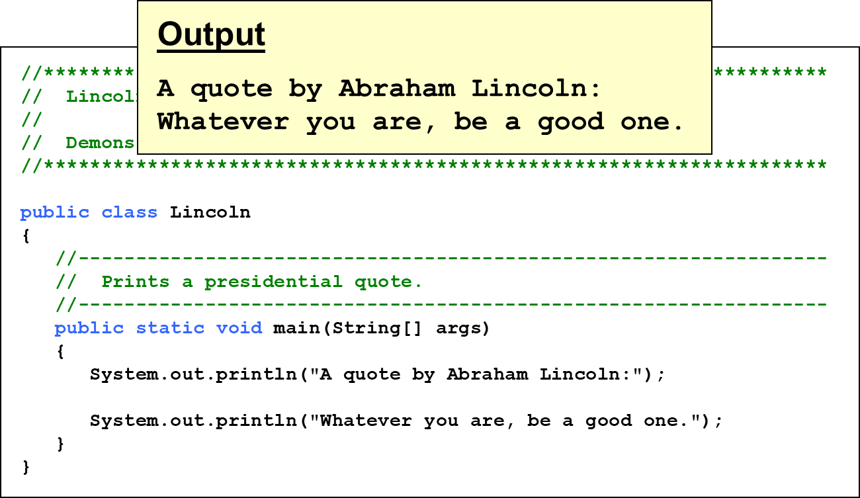
Listing 1.1 (2 of 2)

Slide 54
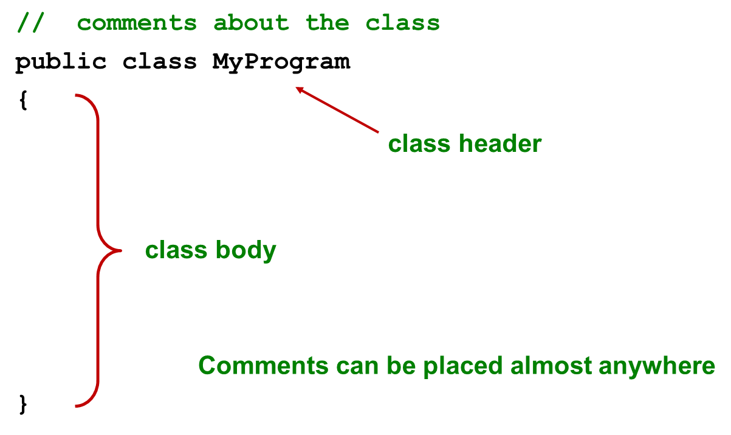
Java Program Structure (2 of 3)

Slide 55
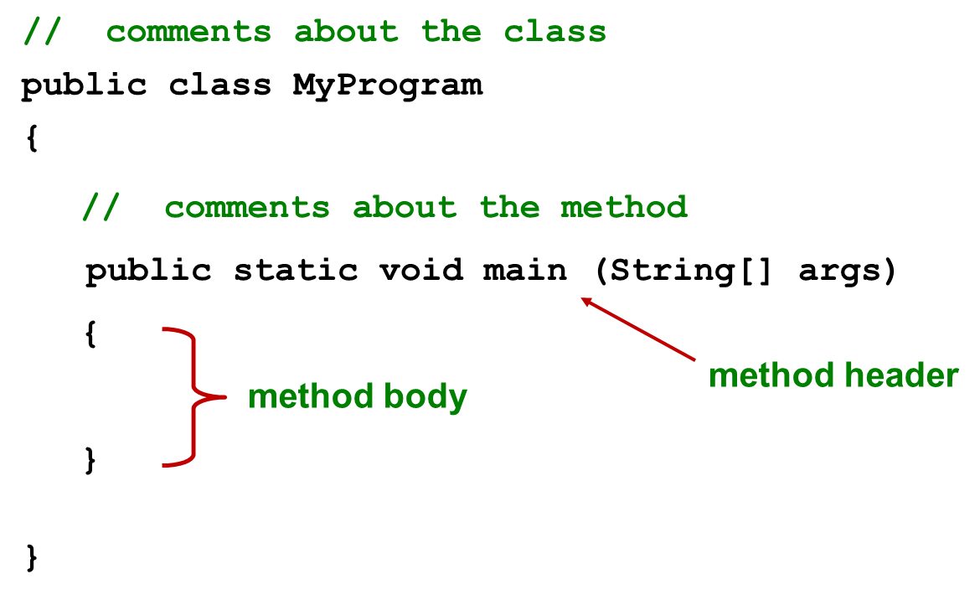
Java Program Structure (3 of 3)

Slide 56
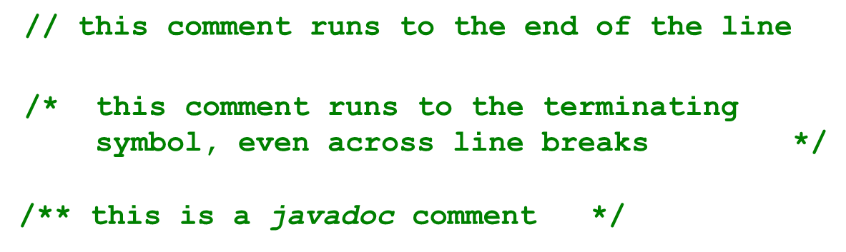
Comments
Comments should be included to explain the purpose of the program and describe processing steps
They do not affect how a program works
Java comments can take three forms:

Slide 57
Identifiers (1 of 2)
Identifiers are the “words” in a program
A Java identifier can be made up of letters, digits, the underscore character ( _ ), and the dollar sign
Identifiers cannot begin with a digit
Java is case sensitive: Total, total, and TOTAL are different identifiers
By convention, programmers use different case styles for different types of identifiers, such as
title case for class names - Linco l n
upper case for constants - MAXIMUM

Slide 58
Identifiers (2 of 2)
Sometimes the programmer chooses the identifier (such as Linco l n)
Sometimes we are using another programmer’s code, so we use the identifiers that he or she chose (such as print l n)
Often we use special identifiers called reserved words that already have a predefined meaning in the language
A reserved word cannot be used in any other way

Slide 59
Reserved Words
The Java reserved words:
abstract
assert
boolean
break
byte
case
catch
char
class
const
continue
default
do
double
else
enum
extends
false
final
finally
float
for
goto
if
implements
import
instanceof
int
interface
long
native
new
null
package
private
protected
public
return
short
static
strictfp
super
switch
synchronized
this
throw
throws
transient
true
try
void
volatile
while

Slide 60
Quick Check 2 (1 of 2)
Which of the following are valid Java identifiers?
grade
quizGrade
NetworkConnection
frame2
3rdTestScore
MAXIMUM
MIN_CAPACITY
student#
Shelves1&2

Slide 61
Quick Check 2 (2 of 2)
Which of the following are valid Java identifiers?
grade | Valid
quizGrade | Valid
NetworkConnection | Valid
frame2 | Valid
3rdTestScore | Invalid - cannot begin with a digit
MAXIMUM | Valid
MIN_CAPACITY | Valid
student# | Invalid - cannot contain the ‘#’ character
Shelves1&2 | Invalid - cannot contain the ‘&’ character

Slide 62
White Space
Spaces, blank lines, and tabs are called white space
White space is used to separate words and symbols in a program
Extra white space is ignored
A valid Java program can be formatted many ways
Programs should be formatted to enhance readability, using consistent indentation
See Lincoln2.java and Lincoln3.java

Slide 63
Outline (5 of 6)
Computer Processing
Hardware Components
Networks
The Java Programming Language
Program Development
Object-Oriented Programming

Slide 64
Program Development
The mechanics of developing a program include several activities:
writing the program in a specific programming language (such as Java)
translating the program into a form that the computer can execute
investigating and fixing various types of errors that can occur
Software tools can be used to help with all parts of this process

Slide 65
Language Levels
There are four programming language levels:
machine language
assembly language
high-level language
fourth-generation language
Each type of C P U has its own specific machine language
The other levels were created to make it easier for a human being to read and write programs

Slide 66
Programming Languages
Each type of C P U executes only a particular machine language
A program must be translated into machine language before it can be executed
A compiler is a software tool which translates source code into a specific target language
Sometimes, that target language is the machine language for a particular C P U type
The Java approach is somewhat different

Slide 67
Java Translation (1 of 2)
The Java compiler translates Java source code into a special representation called bytecode
Java bytecode is not the machine language for any traditional C P U
Bytecode is executed by the Java Virtual Machine (J V M)
Therefore Java bytecode is not tied to any particular machine
Java is considered to be architecture-neutral

Slide 68
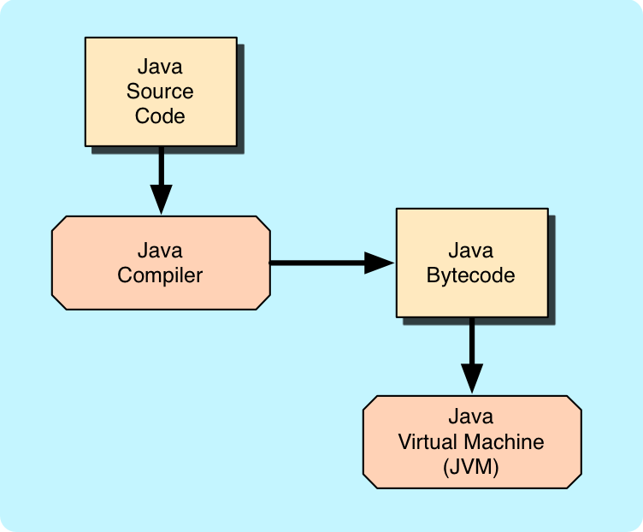
Java Translation (2 of 2)

Slide 69
Development Environments
There are many programs that support the development of Java software, including:
Java Development Kit (J D K)
Eclipse
NetBeans
Blue J
j G R A S P
Though the details of these environments differ, the basic compilation and execution process is essentially the same

Slide 70
Syntax and Semantics
The syntax rules of a language define how we can put together symbols, reserved words, and identifiers to make a valid program
The semantics of a program statement define what that statement means (its purpose or role in a program)
A program that is syntactically correct is not necessarily logically (semantically) correct
A program will always do what we tell it to do, not what we meant to tell it to do

Slide 71
Errors
A program can have three types of errors
The compiler will find syntax errors and other basic problems (compile-time errors)
If compile-time errors exist, an executable version of the program is not created
A problem can occur during program execution, such as trying to divide by zero, which causes a program to terminate abnormally (run-time errors)
A program may run, but produce incorrect results, perhaps using an incorrect formula (logical errors)

Slide 72
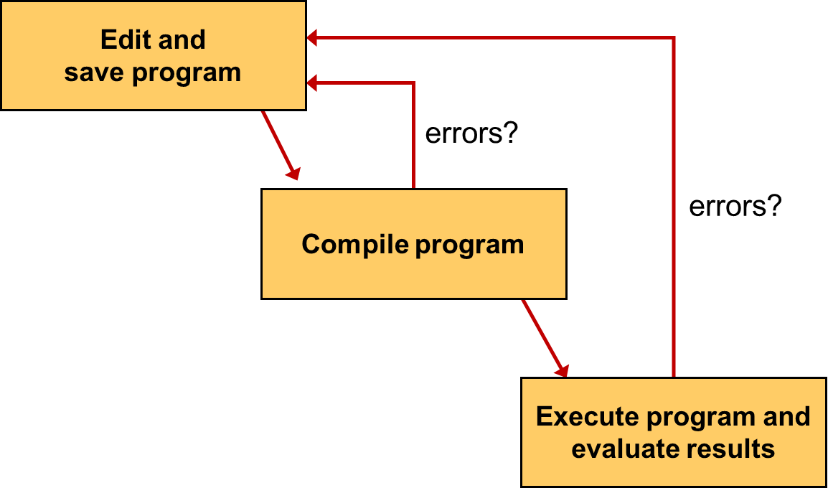
Basic Program Development

Slide 73
Outline (6 of 6)
Computer Processing
Hardware Components
Networks
The Java Programming Language
Program Development
Object-Oriented Programming

Slide 74
Problem Solving (1 of 2)
The purpose of writing a program is to solve a problem
Solving a problem consists of multiple activities:
Understand the problem
Design a solution
Consider alternatives and refine the solution
Implement the solution
Test the solution
These activities are not purely linear - they overlap and interact

Slide 75
Problem Solving (2 of 2)
The key to designing a solution is breaking it down into manageable pieces
When writing software, we design separate pieces that are responsible for certain parts of the solution
An object-oriented approach lends itself to this kind of solution decomposition
We will dissect our solutions into pieces called objects and classes

Slide 76
Object-Oriented Programming
Java is an object-oriented programming language
As the term implies, an object is a fundamental entity in a Java program
Objects can be used effectively to represent real-world entities
For instance, an object might represent a particular employee in a company
Each employee object handles the processing and data management related to that employee

Slide 77
Objects
An object has:
state - descriptive characteristics
behaviors - what it can do (or what can be done to it)
The state of a bank account includes its account number and its current balance
The behaviors associated with a bank account include the ability to make deposits and withdrawals
Note that the behavior of an object might change its state

Slide 78
Classes
An object is defined by a class
A class is the blueprint of an object
The class uses methods to define the behaviors of the object
The class that contains the main method of a Java program represents the entire program
A class represents a concept, and an object represents the embodiment of that concept
Multiple objects can be created from the same class

Slide 79
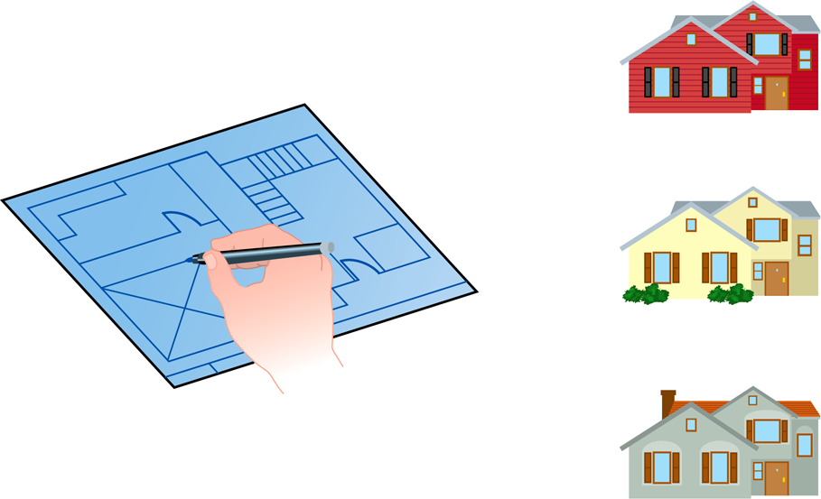
Class = Blueprint
One blueprint to create several similar, but different, houses:

Slide 80
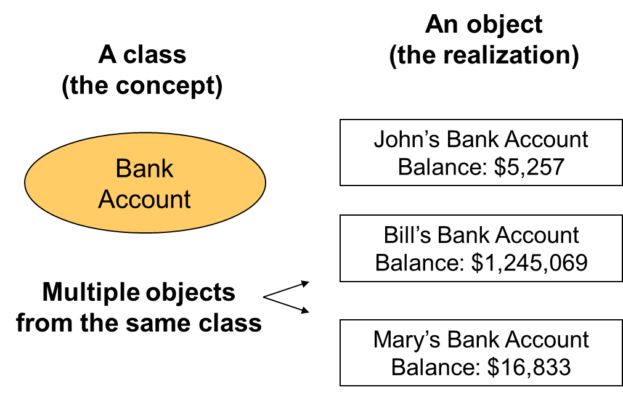
Objects and Classes

Slide 81
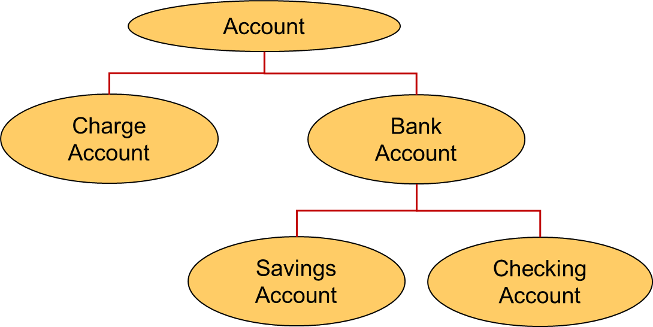
Inheritance
One class can be used to derive another via inheritance
Classes can be organized into hierarchies

Slide 82
Summary
Chapter 1 focused on:
components of a computer
how those components interact
how computers store and manipulate information
computer networks
the Internet and the World Wide Web
programming and programming languages
an introduction to Java
an overview of object-oriented concepts

Slide 83

Copyright
This work is protected by United States copyright laws and is provided solely for the use of instructors in teaching their courses and assessing student learning. Dissemination or sale of any part of this work (including on the World Wide Web) will destroy the integrity of the work and is not permitted. The work and materials from it should never be made available to students except by instructors using the accompanying text in their classes. All recipients of this work are expected to abide by these restrictions and to honor the intended pedagogical purposes and the needs of other instructors who rely on these materials.

